Slide 1

Annual General Meeting
Notes:
---

Slide 2
Agenda
Welcome and Opening Remarks
Apologies
Confirmation of Minutes of the 2025 Annual General Meeting
Matters arising from the previous Minutes not dealt with on the agenda.
Chairperson’s Report - Ms Tebogo Makhambeni
General
Closure

Slide 3
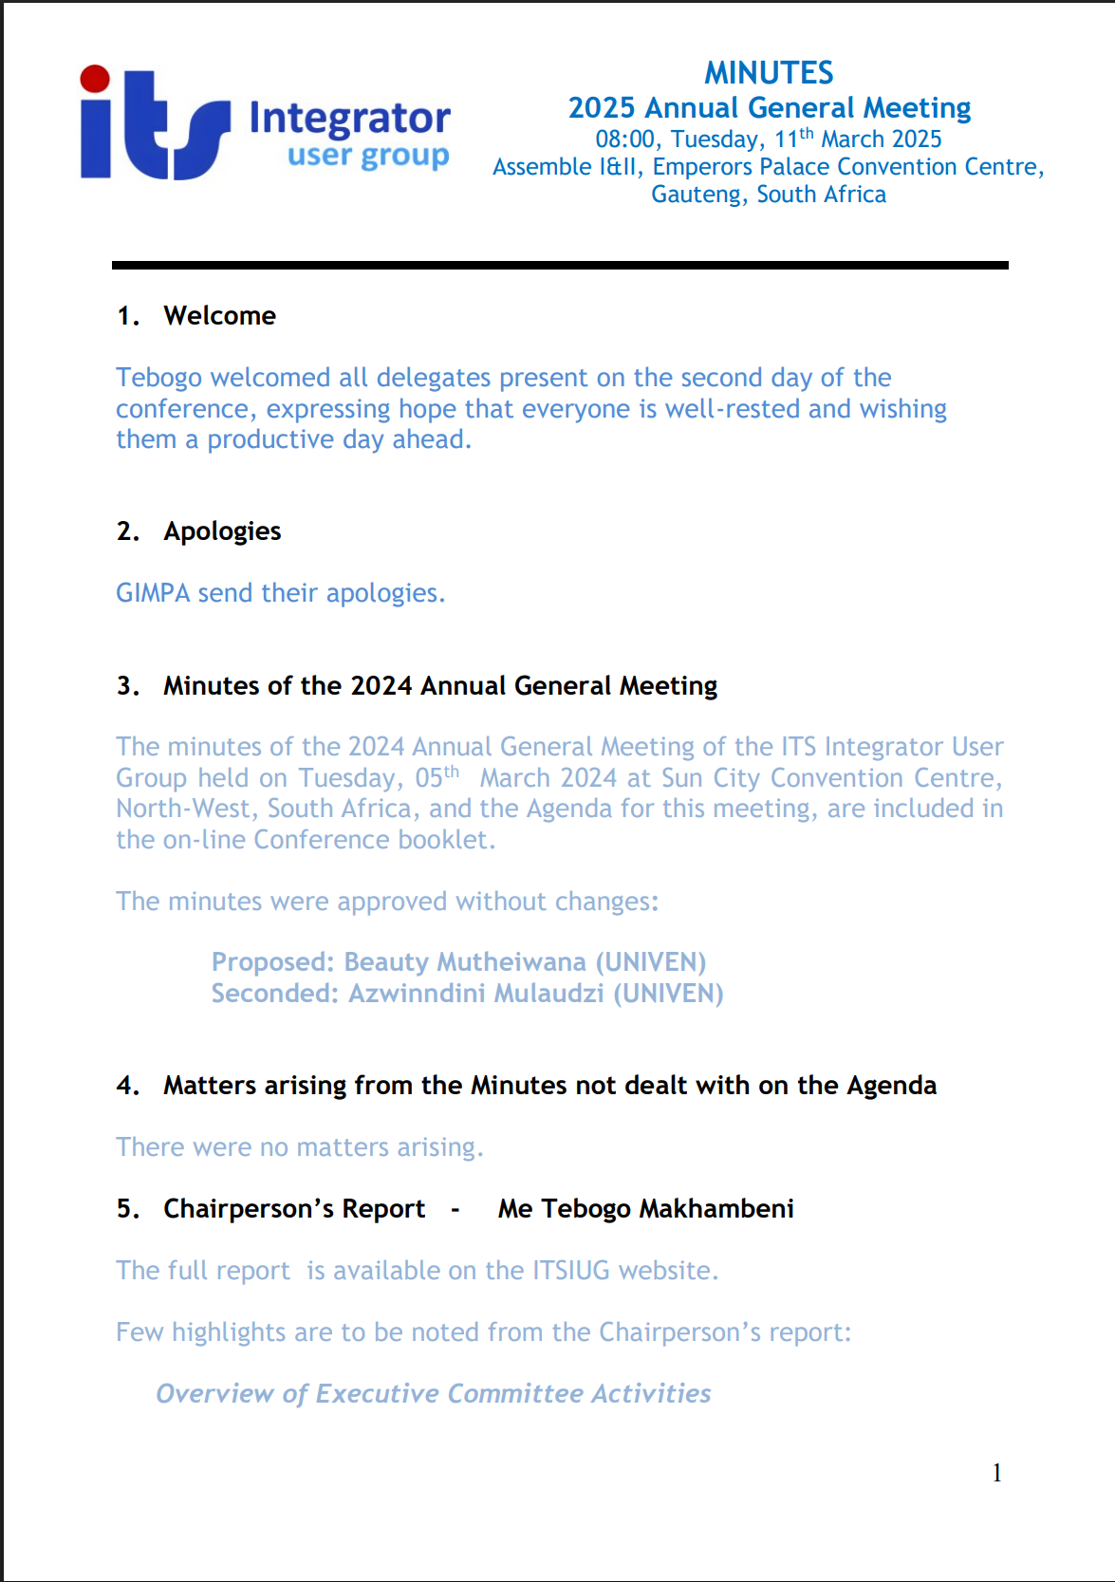

Slide 4
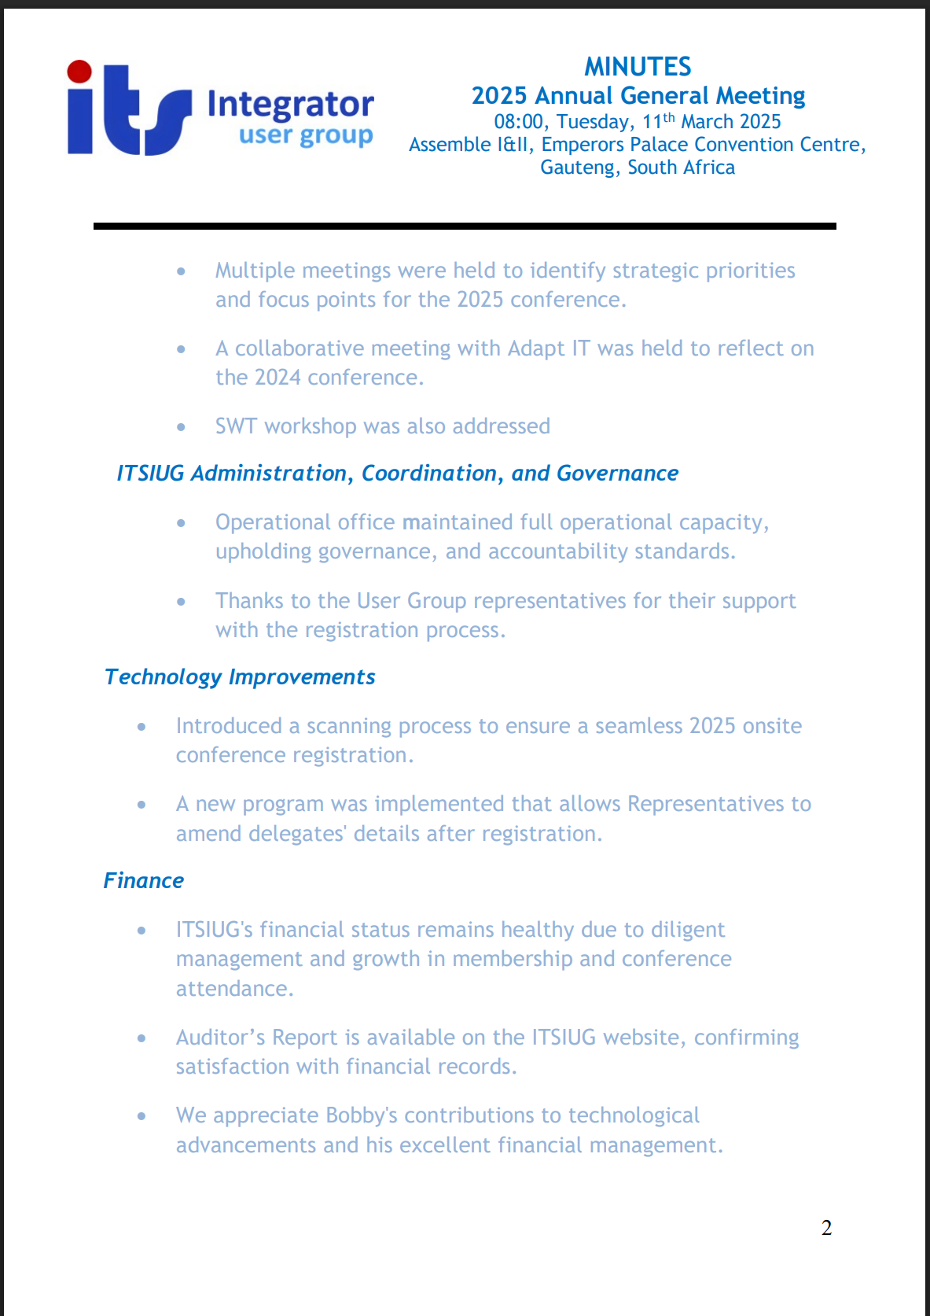

Slide 5
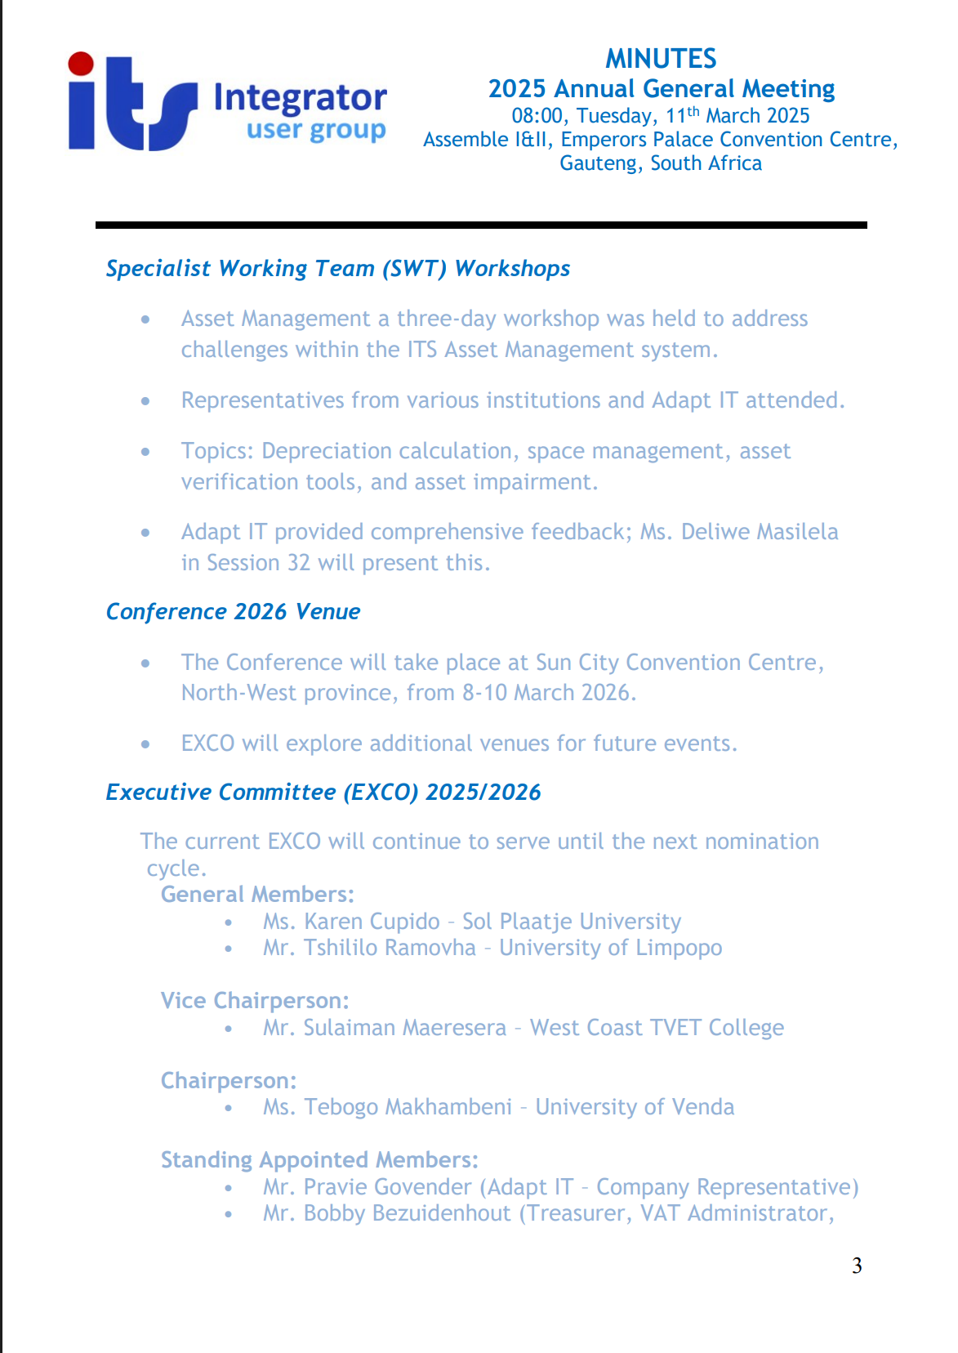

Slide 6
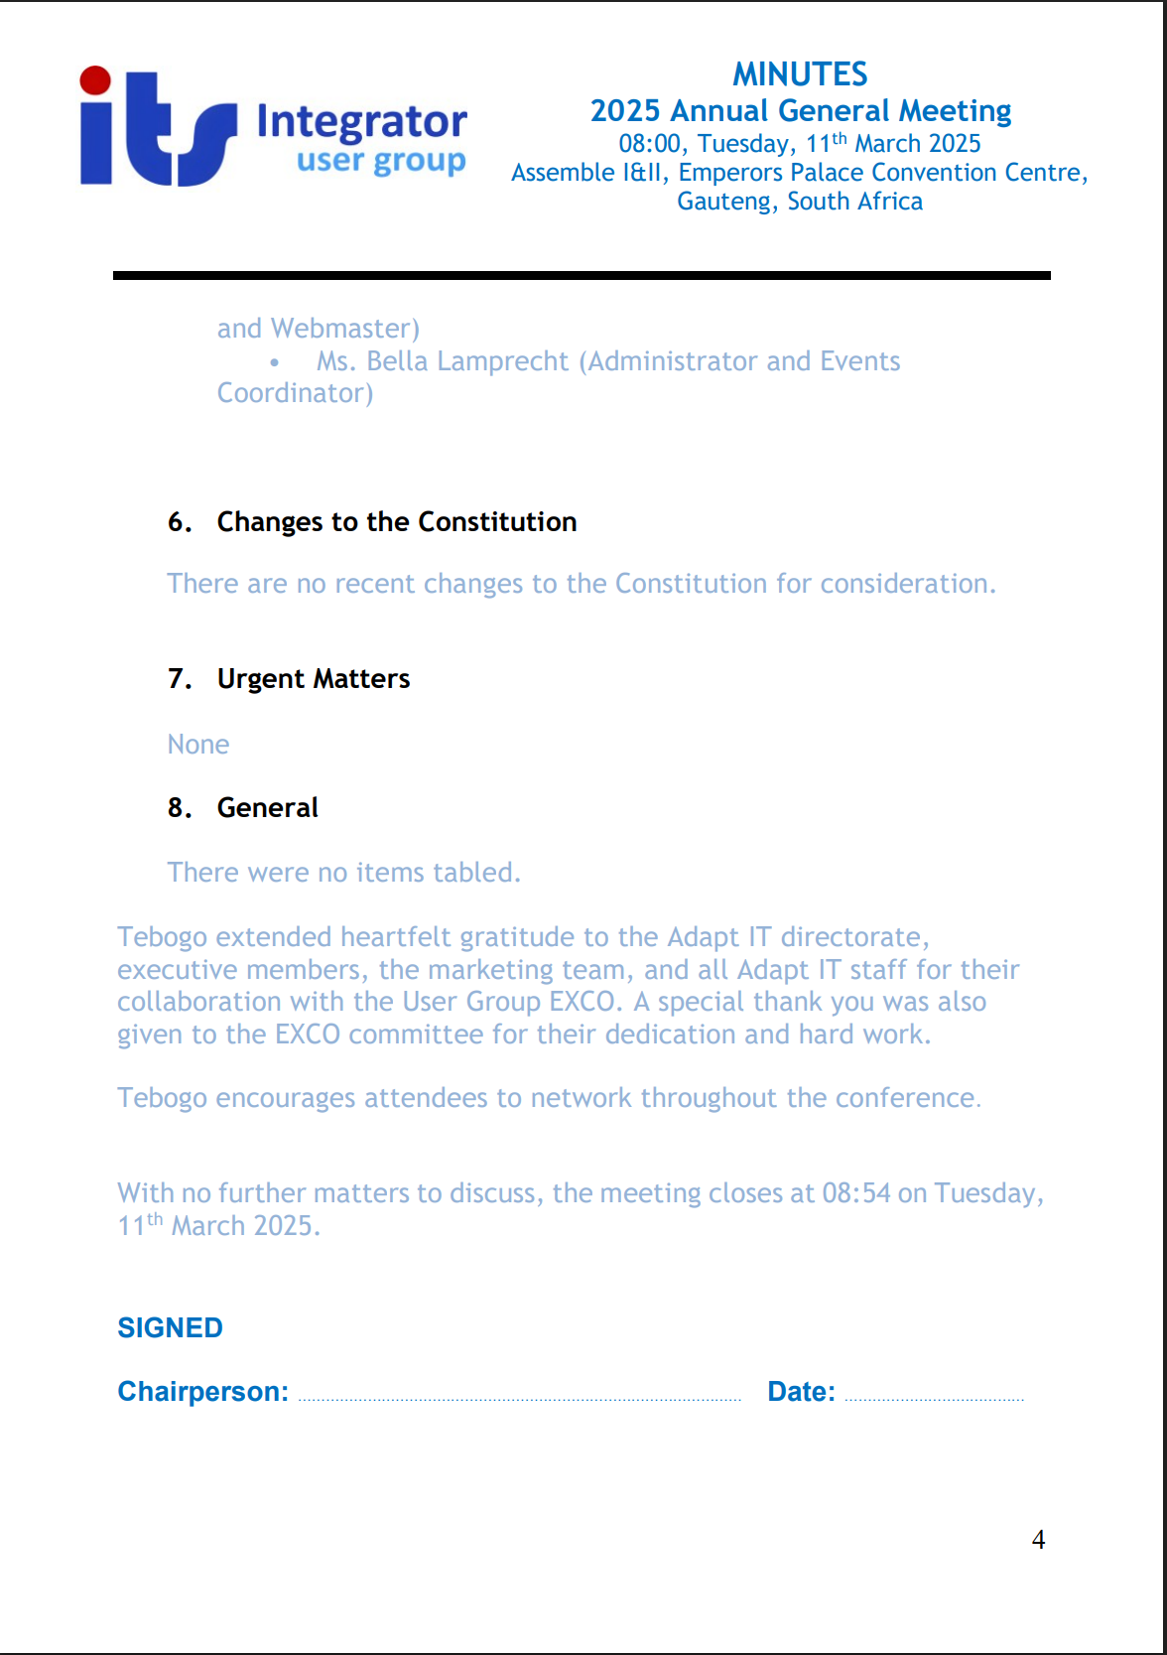

Slide 7
Executive Committee Report
Notes:
---

Slide 8
Executive Snapshot and Governance
Notes:
2025 at a Glance: Progress and Governance

Slide 9

2025 at a Glance: Progress and Governance
Disciplined Governance
  EXCO maintained operational stability with strong governance, ensuring accountability and continuity throughout 2025.
Responsive Conference Planning
  The year featured responsive conference planning guided by a strategic direction focused on measurable member impact.
User-Led Collaboration
  EXCO embraced the motto 'for the users, by the users,' emphasizing user-led collaboration and shared learning.
Sustained Momentum and Leadership
  Strong leadership continuity and financial health positioned ITSIUG to sustain momentum and deepen collaboration.
Notes:
The ITSIUG Executive Committee (EXCO) achieved significant progress in 2025, marked by disciplined governance and operational stability. The year was characterized by responsive conference planning, with a renewed strategic direction focused on measurable impact for member institutions. EXCO’s commitment to strong governance ensured full operational capacity, clear accountability, and administrative continuity. The guiding motto, 'for the users, by the users,' shaped the organization’s focus, reinforcing its dedication to serving member institutions through user-led collaboration and shared learning. Appreciation was extended to all delegates, exhibitors, guest speakers, presenters, facilitators, moderators, panelists, chairpersons, and scribes, whose contributions strengthened both the conference programme and the broader ITSIUG community experience. The EXCO’s efforts resulted in enhanced conference value, healthy financial position, and continuity in leadership, positioning ITSIUG to sustain momentum and deepen sector collaboration into the next term.

Slide 10
Strategic Improvements and Lessons Applied
Notes:
Key 2025 Strategic Improvements

Slide 11

Key 2025 Strategic Improvements
Structured Discussion Forums
  New forums enable deeper exploration of user issues, fostering practical solutions and balanced stakeholder engagement.
Mid-Term Strategic Planning
  EXCO developed a three-year strategy to enhance digital maturity, accountability, and collaborative value sector-wide.
VAT SWT
  Consolidated VAT priorities focus on automation, compliance, reporting standardization, and regulatory readiness.
Notes:
In 2025, the EXCO translated lessons learned and stakeholder feedback into actionable programme enhancements. Structured discussion forums were introduced within the conference programme, creating space for deeper exploration of user-raised issues and practical solution-building. This ensured balanced engagement beyond vendor roadmap presentations, encouraging delegates to contribute their knowledge and experience. The EXCO also formulated a mid-term (three-year) strategy (2026–2028) to reposition the ITSIUG conference as a results-driven platform that advances digital maturity, strengthens institutional accountability, and enables measurable, collaborative value across the sector. Targeted enhancements to the ITS ERP and iEnabler platforms, including AI-enabled self-service capabilities, were prioritized. Additionally, the VAT Specialist Working Team (SWT) process consolidated VAT system enhancement priorities, aligning institutional needs and tax expert guidance into a structured roadmap focused on automation, compliance, reporting standardization, and readiness for future regulatory developments such as e-invoicing.

Slide 12
Strategic Direction and Conference Evolution
Notes:
Three-Year Strategy (2026–2028)

Slide 13
Three-Year Strategy (2026–2028)
Year | Focus | Key Outcomes
2026 | Foundation & Accountability | Leadership alignment, digital maturity baseline, accountability tools
2027 | Transformation & Impact | Collaboration, measurable progress, enhanced ERP & self-service
2028 | Sustainability & Value | Long-term institutional value, scalable innovation, sector-wide collaboration
Notes:
The ITSIUG three-year strategy (2026–2028) positions the conference as an outcomes-driven platform advancing digital maturity, institutional innovation, and sector-wide collaboration across higher education institutions. Anchored in the theme of building smart institutions through digital transformation, the strategy emphasizes institutional accountability, implementation evidence, secure and cost-effective digital ecosystems, scalable collaboration, and progress monitoring through structured tools and measurable outputs. The strategy is designed to progress from foundational accountability and leadership alignment in 2026, to transformation through collaboration and measurable impact in 2027, and finally to sustainability and long-term institutional value in 2028. Key focus areas include enhancement of the ITS ERP environment and iEnabler self-service usability, with AI-enabled capabilities. The strategy was shared with Adapt IT, ensuring alignment and collaborative advancement.

Slide 14
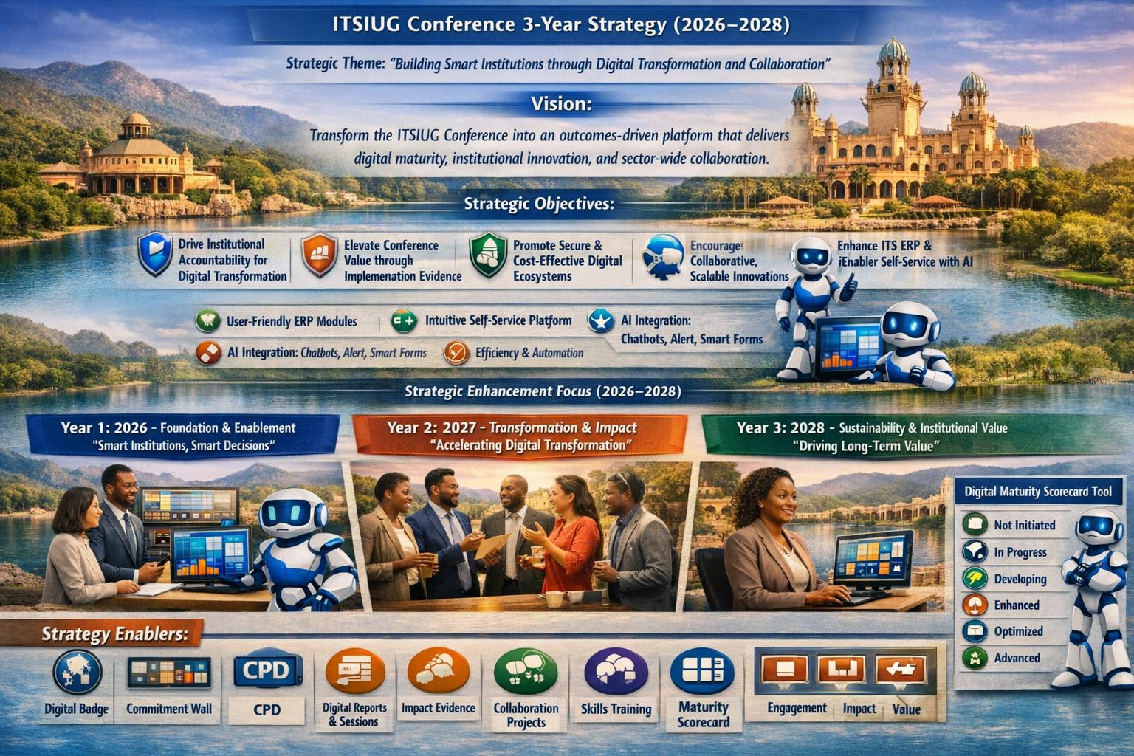
Three-Year Strategy (2026–2028)
Notes:
The ITSIUG three-year strategy (2026–2028) positions the conference as an outcomes-driven platform advancing digital maturity, institutional innovation, and sector-wide collaboration across higher education institutions. Anchored in the theme of building smart institutions through digital transformation, the strategy emphasizes institutional accountability, implementation evidence, secure and cost-effective digital ecosystems, scalable collaboration, and progress monitoring through structured tools and measurable outputs. The strategy is designed to progress from foundational accountability and leadership alignment in 2026, to transformation through collaboration and measurable impact in 2027, and finally to sustainability and long-term institutional value in 2028. Key focus areas include enhancement of the ITS ERP environment and iEnabler self-service usability, with AI-enabled capabilities. The strategy was shared with Adapt IT, ensuring alignment and collaborative advancement.

Slide 15
Financial Management
Notes:
Financial Overview and Audit

Slide 16

Financial Overview and Audit
Strong Financial Position
  ITSIUG maintained a healthy financial status in 2025 through disciplined management and growth in revenue streams.
Revenue Growth Sources
  Membership and conference participation are primary revenue sources supporting ITSIUG's operations and planning.
Audit Confirmation
  The auditor’s report confirmed satisfaction with ITSIUG’s financial records, ensuring transparency and trust.
Treasurer Appreciation
  EXCO acknowledged the Treasurer’s exceptional stewardship and valuable contributions to ITSIUG’s success.
Notes:
ITSIUG maintained a healthy financial position in 2025, supported by disciplined financial management and continued growth in membership and conference participation, which are the primary revenue streams. Members were encouraged to ensure timely registration and payment to support effective planning and operational execution. The auditor’s report for the period ended 31 December 2025, available on the ITSIUG website, confirmed satisfaction with the organization’s financial records. The EXCO expressed sincere appreciation to the Treasurer, Mr Bobby Bezuidenhout, for his consistent excellence, stewardship, and invaluable contribution to ITSIUG. The financial stability reaffirmed confidence in the organization’s operations and enabled sustained momentum for future initiatives.

Slide 17
VAT SWT Workshop Outcomes
Challenge | Improvement Area | Expected Outcome
Manual VAT Processing | Automation & Integration | Reduced compliance risk, improved efficiency
Inconsistent Reporting | Standardization & Training | Enhanced reporting depth, user readiness
Limited Automation | System Enhancement | Preparation for e-invoicing, audit readiness
Notes:
The VAT Specialist Working Team (SWT) workshop, held on 15–16 September 2025 at Adapt IT Education, brought together representatives from multiple institutions, Adapt IT, and tax specialists to identify system constraints and define improvement priorities within the ITS VAT system. The workshop confirmed systemic challenges, including reliance on manual processing, inconsistent VAT reporting, limited automation, and compliance risk across VAT revenue, expenditure, reconciliation, and VAT201 submissions. Key areas identified for improvement included VAT return completeness, supplier and transaction validation, VAT apportionment automation, reporting depth and usability, systems integration, and targeted training for users. The outcomes culminated in a prioritised roadmap of proposed enhancements to strengthen compliance readiness (including e-invoicing), improve standardization, and reduce audit risk. Institutional readiness, data discipline, and consistent system usage were recognized as critical success factors alongside system development.

Slide 18
Conference Venues and EXCO Leadership
Notes:
Upcoming Conferences and EXCO 2027/2028

Slide 19
Upcoming Conferences
Year | Conference Venue
2027 | Emperors Palace, Gauteng
2028 | Sun City, North West
Future | CTICC, Cape Town (exploring)
Notes:
The 2027 conference will take place at Emperors Palace in Gauteng, with the 2028 conference scheduled for Sun City. The EXCO will also explore the possibility of hosting future conferences at CTICC in Cape Town. As the current EXCO term concluded, ITSIUG Representatives elected the following EXCO members for the 2027/2028 term: Chairperson: Mr Sulaiman Maeresera (West Coast TVET College), Vice Chairperson: Dr Queen Ambe (University of Western Cape), General Members: Mr Tshililo Ramovha (University of Limpopo) and Ms Thokozile Vilakazi (Tshwane North College). Standing Appointed Members include Mr Pravie Govender (Adapt IT – Company Representative), Mr Bobby Bezuidenhout (Treasurer, VAT Administrator, and Webmaster), and Ms Bella Lamprecht (Administrator and Events Coordinator). This leadership continuity ensures sustained momentum and deepened sector collaboration.

Slide 20
2027-2028 EXCO
Chairperson: Mr Sulaiman Maeresera – West Coast TVET College
Vice Chairperson: Dr Queen Ambe – University of Western Cape
General EXCO Members:
Mr Tshililo Ramovha – University of Limpopo
Ms Thokozile Vilakazi - Tshwane North College
Standing Members
Mr Pravie Govender (Adapt IT – Company Representative)
Mr Bobby Bezuidenhout (Treasurer, VAT Administrator, and Webmaster)
Ms Bella Lamprecht (Administrator and Events Coordinator)
Notes:
The 2027 conference will take place at Emperors Palace in Gauteng, with the 2028 conference scheduled for Sun City. The EXCO will also explore the possibility of hosting future conferences at CTICC in Cape Town. As the current EXCO term concluded, ITSIUG Representatives elected the following EXCO members for the 2027/2028 term: Chairperson: Mr Sulaiman Maeresera (West Coast TVET College), Vice Chairperson: Dr Queen Ambe (University of Western Cape), General Members: Mr Tshililo Ramovha (University of Limpopo) and Ms Thokozile Vilakazi (Tshwane North College). Standing Appointed Members include Mr Pravie Govender (Adapt IT – Company Representative), Mr Bobby Bezuidenhout (Treasurer, VAT Administrator, and Webmaster), and Ms Bella Lamprecht (Administrator and Events Coordinator). This leadership continuity ensures sustained momentum and deepened sector collaboration.

Slide 21


Appreciation and Forward Outlook
Words of Gratitude
  Acknowledging the support and professionalism of EXCO members, and the continued partnership with Adapt IT.
Strategic Future Vision
  Continued leadership and momentum position ITSIUG to foster deeper collaboration and measurable impact.
Commitment to Innovation
  EXCO commits to advancing digital maturity, accountability, and collaborative innovation across institutions, working closely with Adapt IT.
Encouraging Delegate Engagement
  Delegates are urged to actively participate and strengthen professional networks during the conference.
Notes:
In closing, sincere appreciation is extended to the Adapt IT Directorate, Executive Management, and staff for their continued support and collaboration with the ITSIUG EXCO. The dedication and professionalism of EXCO members have consistently exceeded expectations, contributing to the organization’s sustained progress. Delegates are encouraged to fully engage in the conference and use the opportunity to strengthen professional networks across institutions. The momentum achieved in 2025, combined with the continuity in leadership and strategic direction, positions ITSIUG to deepen sector collaboration and drive measurable impact in the coming years. The EXCO remains committed to advancing digital maturity, institutional accountability, and collaborative innovation for all member institutions.

Slide 22

Notes:
Upcoming Conferences and EXCO 2027/2028

