Slide 1

Modernisation and Agentic AI POC
Session 14
Presenter: Linda Putu

Slide 2

DISCLAIMER
This presentation is only a summary of some of Adapt IT’s products, features and their latest developments. Adapt IT only intends for the information to give you an overview, and not a complete and comprehensive statement that necessarily suits your purposes.
Adapt IT reserves the right to change any information contained in this presentation and is not responsible for any loss that results from inaccuracies in the information. You may not distribute or reproduce the information without Adapt IT’s written permission.

Slide 3
TABLE OF CONTENT
Modernisation
Security Framework
Agentic AI POC

Slide 4
Modernisation

Slide 5
Legacy Tech, Modern Problems
The iEnabler portal is a critical component of ITS Integrator, but its legacy Oracle technology stack — built on WebLogic and OHS — is expensive to maintain, difficult to scale, and fails modern user expectations, especially on mobile.
Strategic Goals
Eliminate costly legacy licensing
Deliver mobile-first student experience
Enable rapid feature deployment
Build a cloud-ready, API-first platform
This proposal advocates replacing the existing front-end with a modern Angular framework and introducing Spring Boot microservices as a streamlined integration layer — eliminating WebLogic entirely and delivering a more agile, cost-effective system.
This initiative aligns with Adapt IT Education's strategic roadmap to deliver modern, API-first, cloud-ready solutions for higher education institutions.

Slide 6
Held Hostage by Legacy
The iEnabler portal is the digital front door for core student services — applications, registration, results, payments, and personal information. Yet its architecture creates serious challenges:
💸 Unsustainable Costs
📱 Poor User Experience
High WebLogic and OHS licensing fees tied to CPU usage create a growing financial burden and a barrier to growth.
The UI is not responsive or mobile-friendly — critical given most student interactions occur on smartphones, driving higher support call volumes.
🐢 Limited Agility
🔒 Technical Debt & Skills Gap
Monolithic architecture means every minor change requires a full system re-deployment — slow, risky, and cumbersome.
Tight coupling creates security risks and technical debt. The market for legacy Oracle web stack developers is shrinking, raising maintenance costs.

Slide 7

Proposed Modernised Architecture
The new architecture will be decoupled and API-first, providing a flexible and scalable foundation built on widely adopted open-source technologies.
Angular Front-End
Responsive, component-based UI served as static files.
Spring Boot APIs
Microservices exposing RESTful endpoints and business logic.
Oracle Database
Existing database retained for persistent storage.
What's Added
Angular — fully responsive, component-based UI delivered as static HTML/CSS/JS, hosted independently
Spring Boot — microservices exposing well-defined RESTful APIs, replacing WebLogic entirely
What's Removed
WebLogic application server — eliminated, reducing infrastructure overhead
Oracle HTTP Server (OHS) — removed, simplifying the technology stack significantly

Slide 8
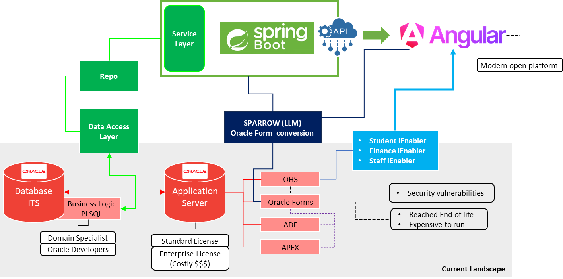
Proposed Modernised Architecture

Slide 9





Benefits of Modernisation
Cost Optimisation
Enhanced UX
Agility & Scalability
Eliminate WebLogic and OHS licensing fees. Lighter infrastructure reduces operational overhead and development cycles.
Mobile-first design, intuitive workflows, and faster API-driven performance reduce support requests.
Independent front-end and back-end deployment enables faster time-to-market and easier onboarding with open-source tools.
Enhanced Security
Future-Proofing
Token-based authentication, reduced attack surface, and improved compliance with data protection regulations.
API-first strategy enables easy third-party integrations. Microservices architecture ensures full cloud readiness.

Slide 10

Implementation Approach
To ensure a seamless transition from the current iEnabler environment, the full suite of student self-service processes must be migrated. A phased approach is adopted to convert all core functions—including AOA (Admission/Application Online), Registration, Study Records, and Graduation processes—before any final transition.
Architecture
Front-End
Define APIs and map iEnabler processes
Develop Angular UI and migrate processes
Microservices
Go-Live
Build Spring Boot services by domain
Parallel run validation and cutover
Go-live will only occur once all student processes are fully converted and validated. This rigorous phased approach ensures zero disruption to clients currently relying on iEnabler, guaranteeing continuity across the entire student service lifecycle.

Slide 11
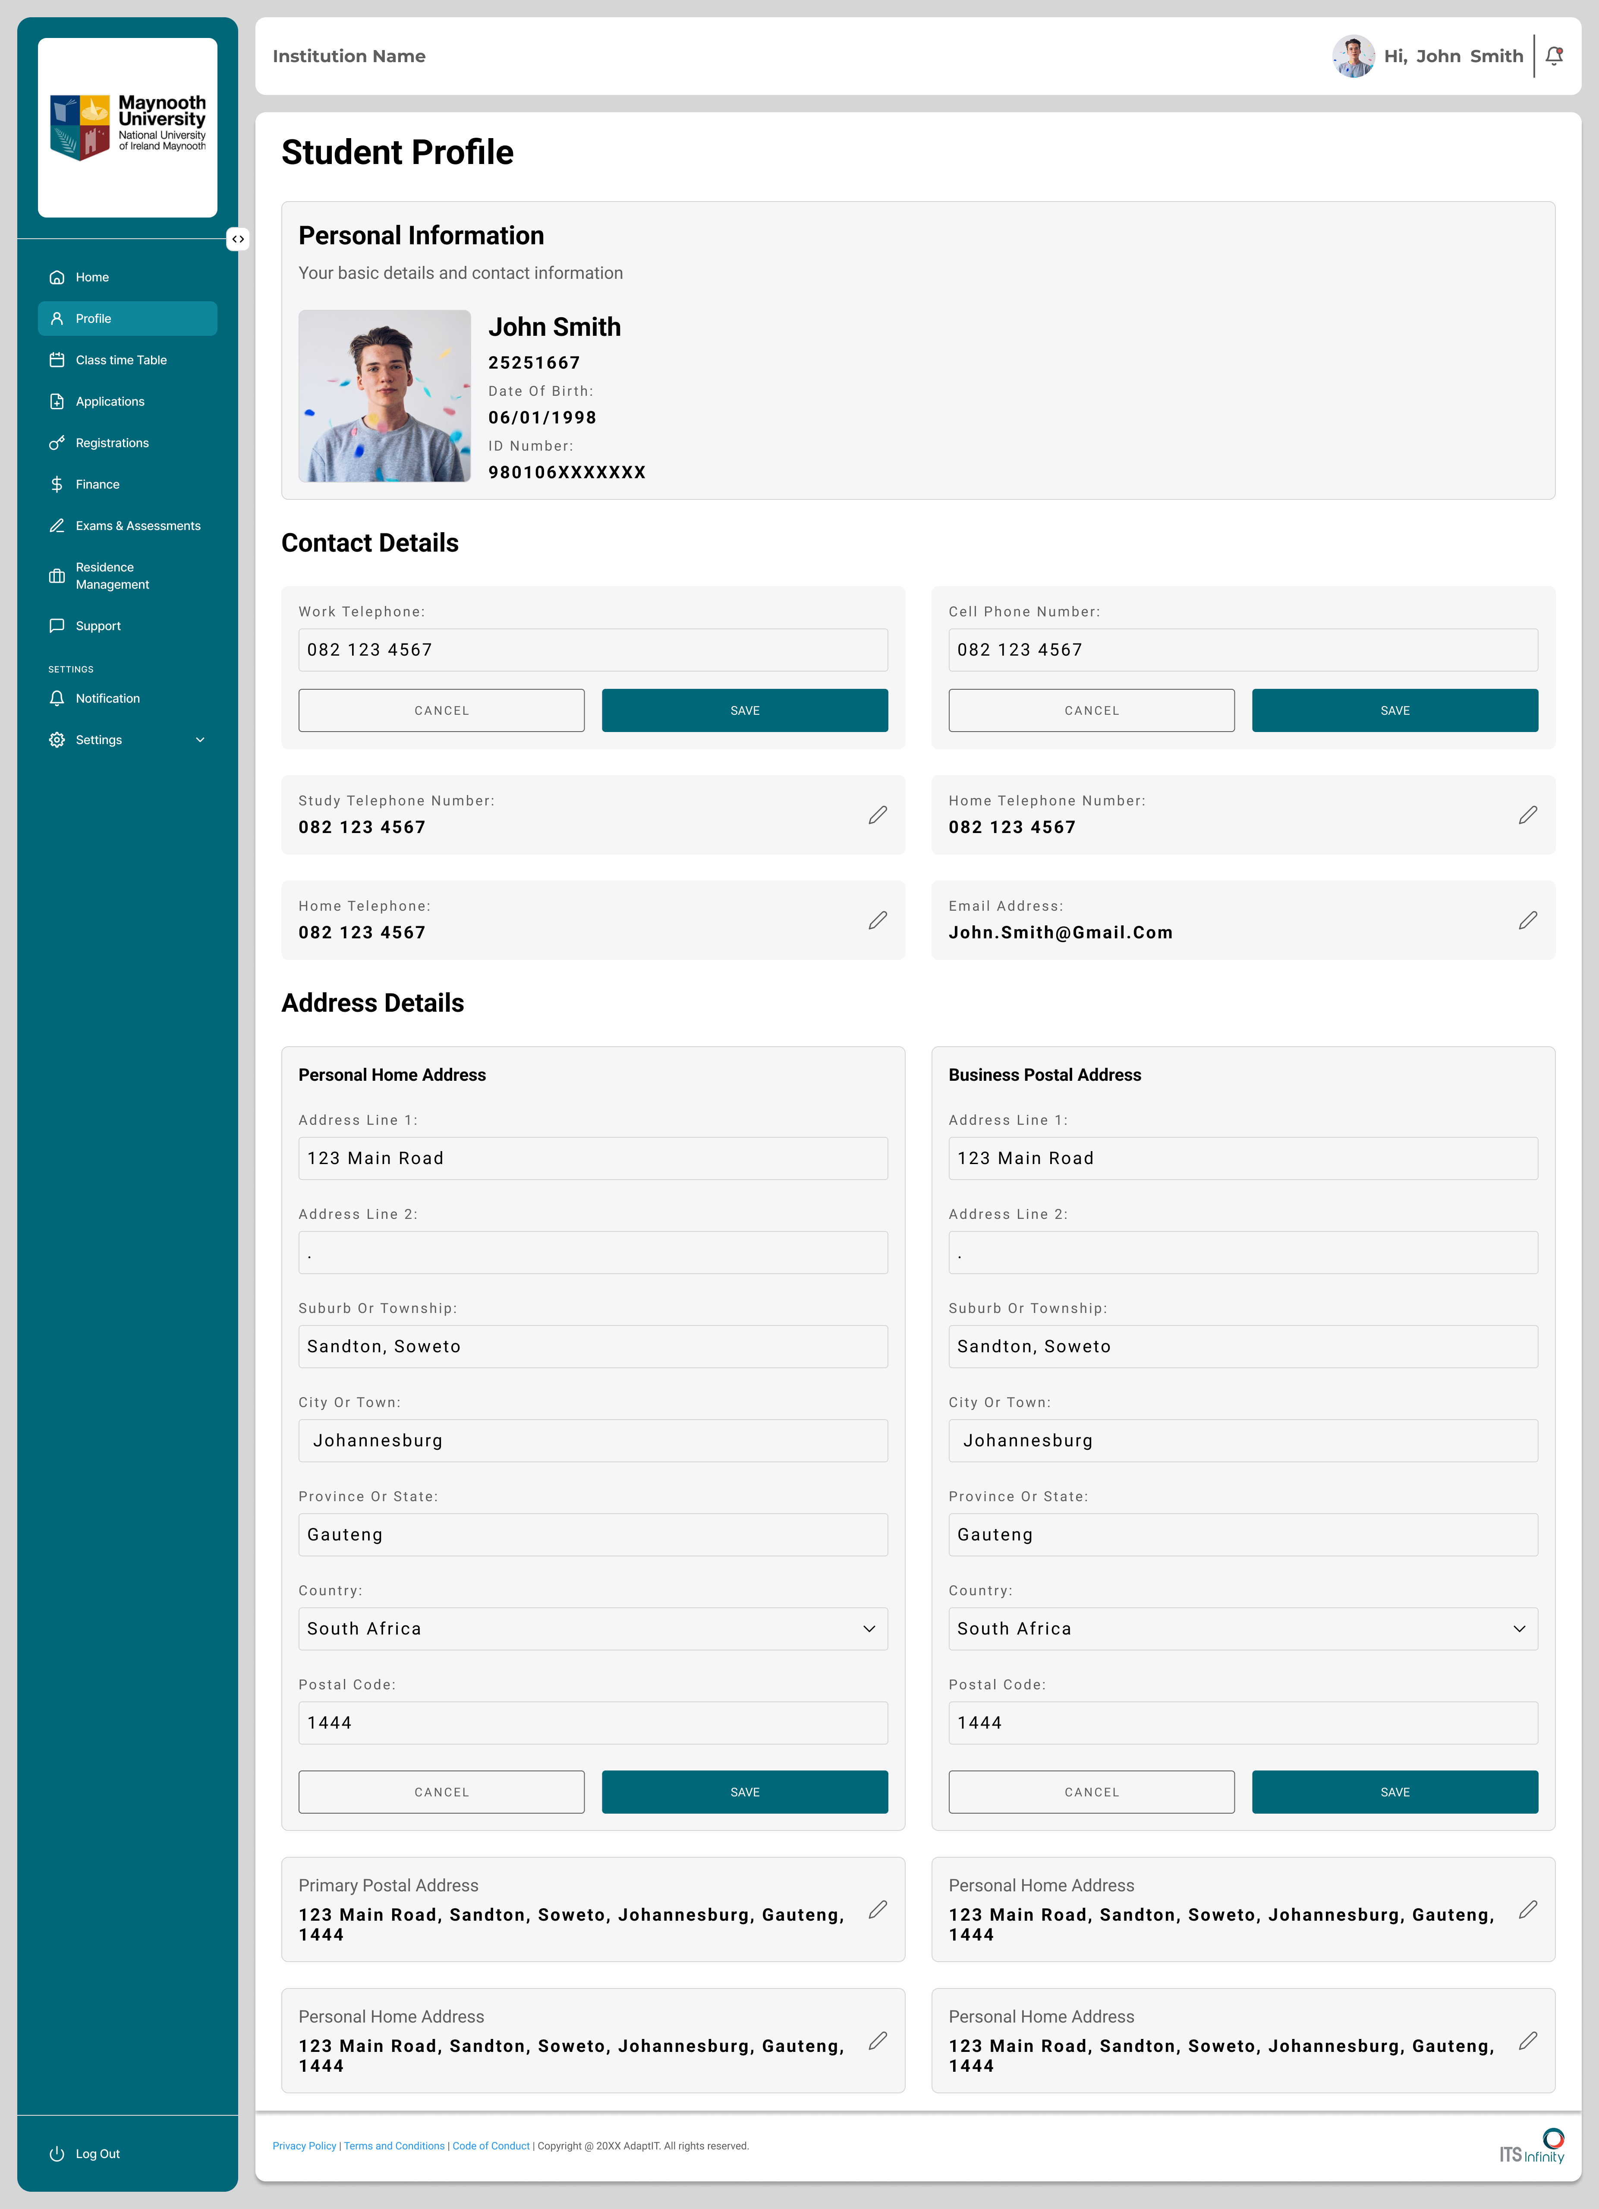
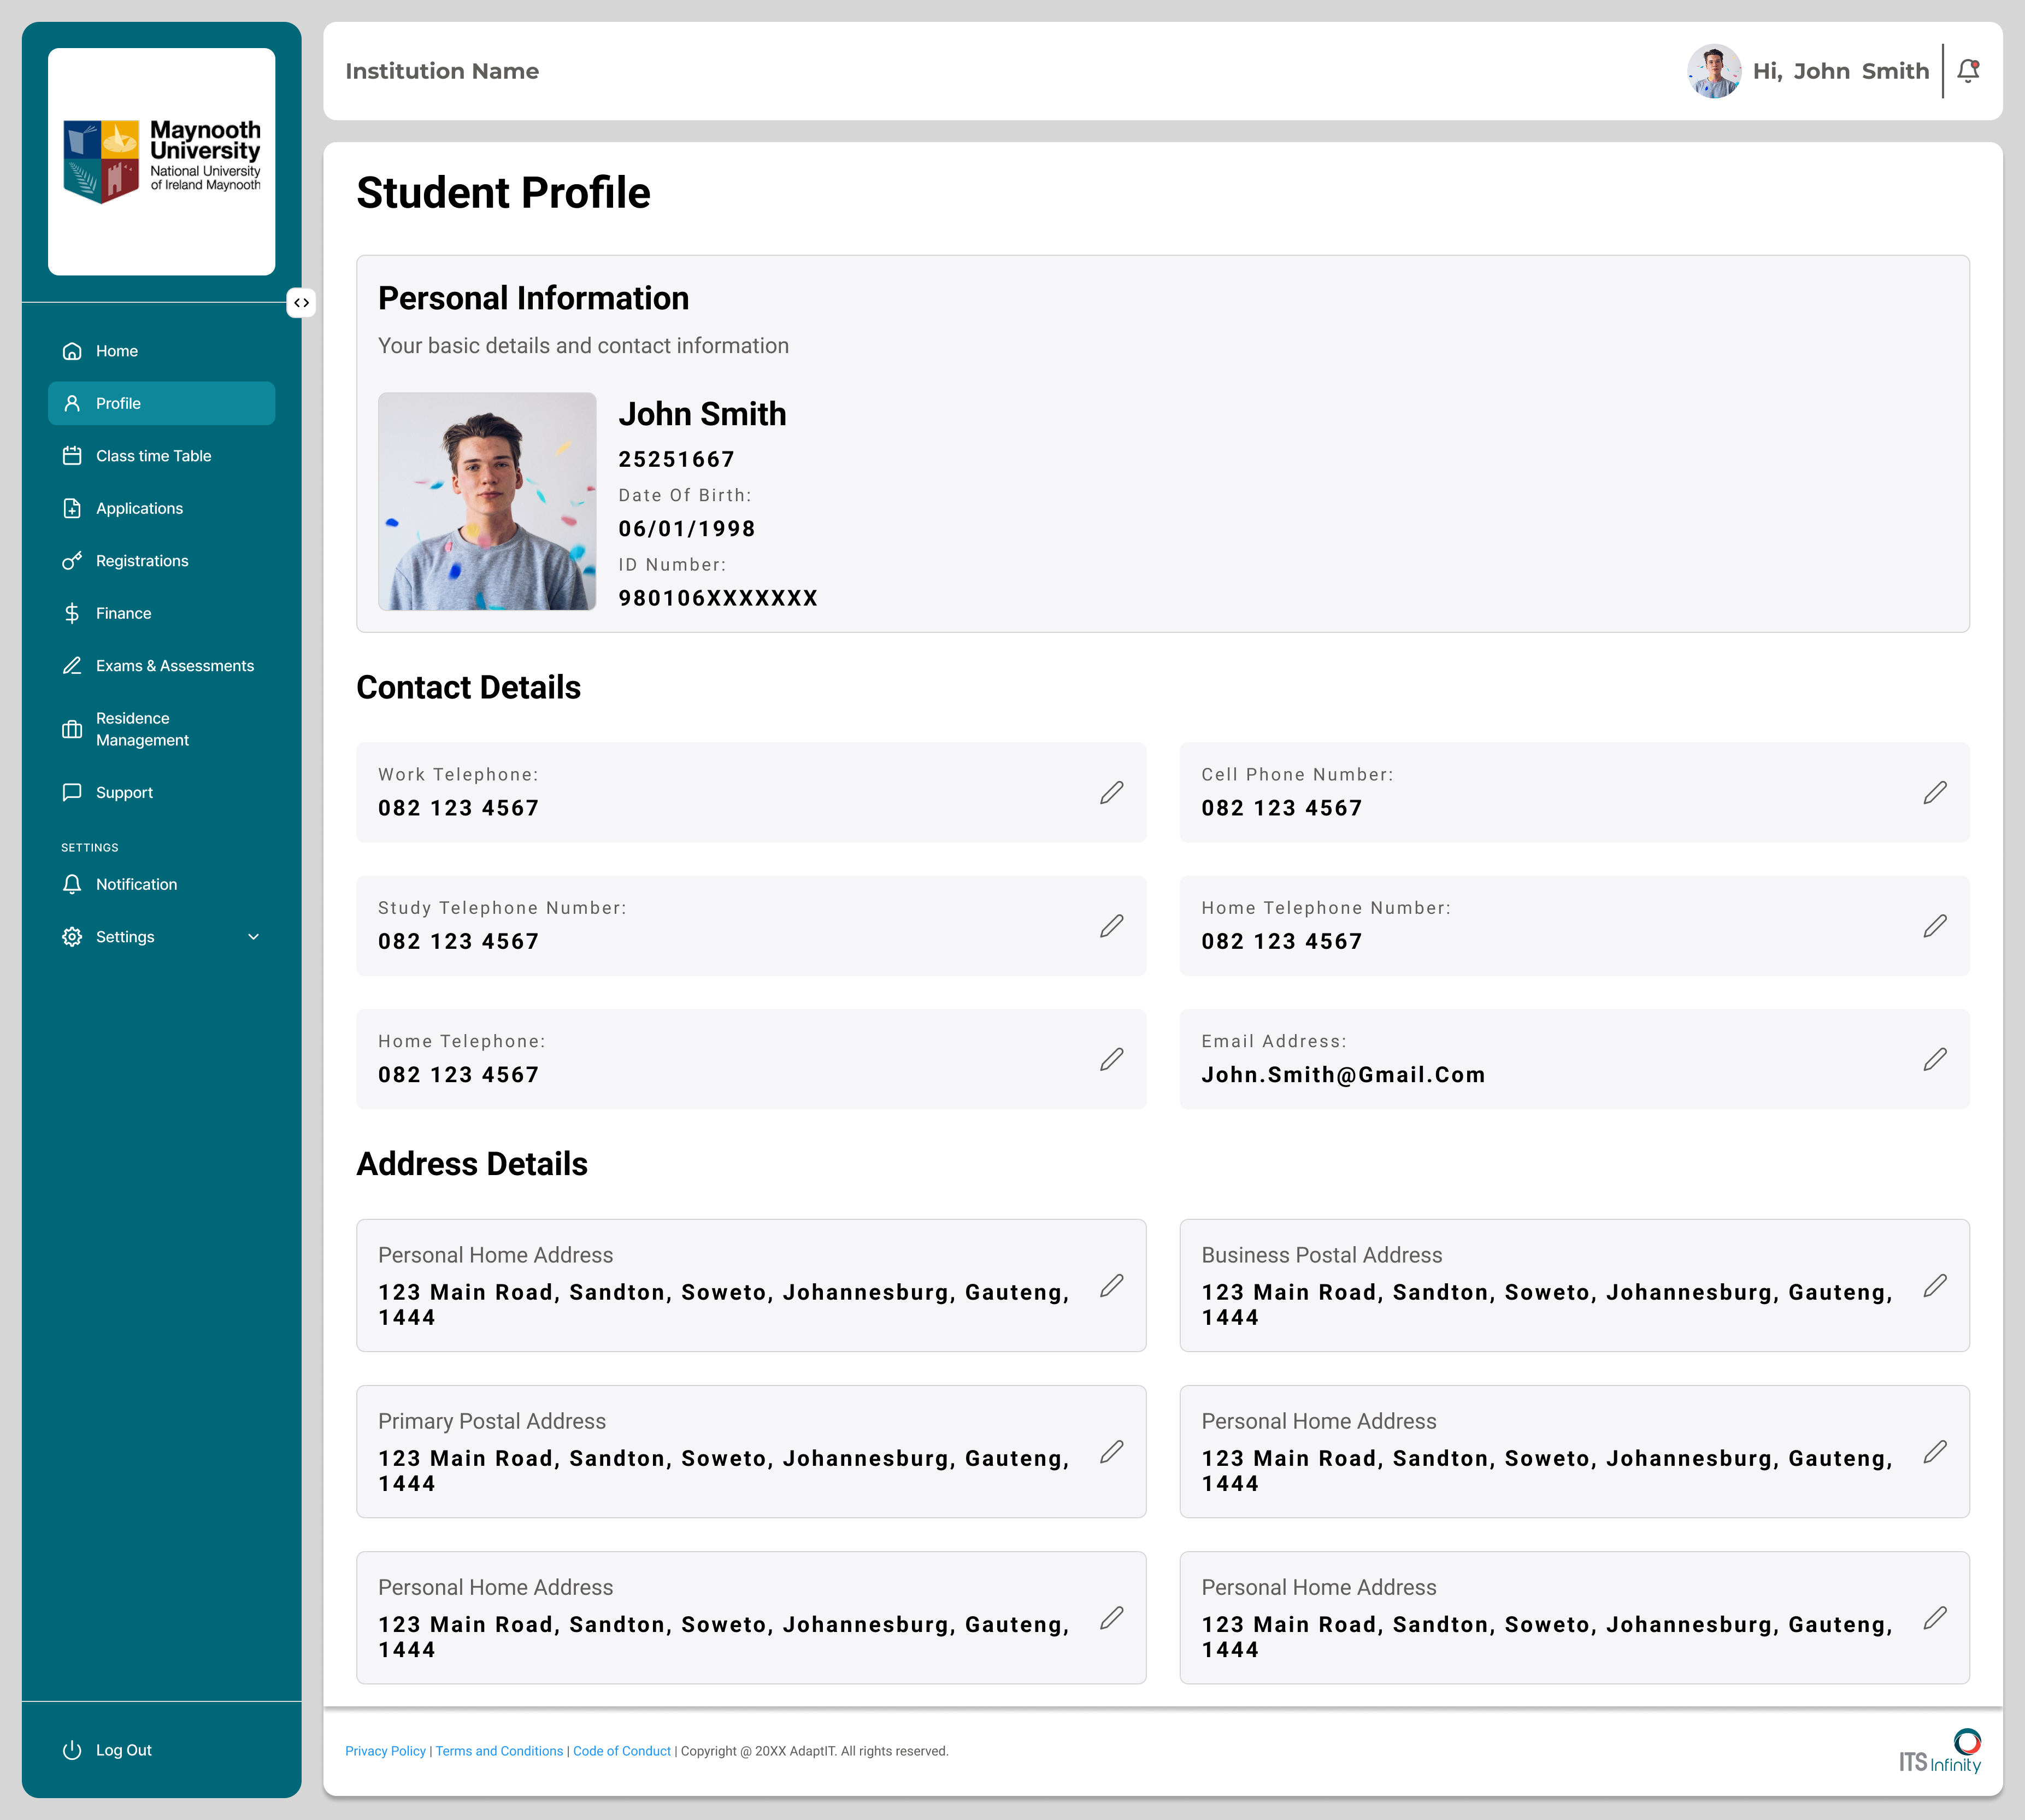
Concept Designs

Slide 12
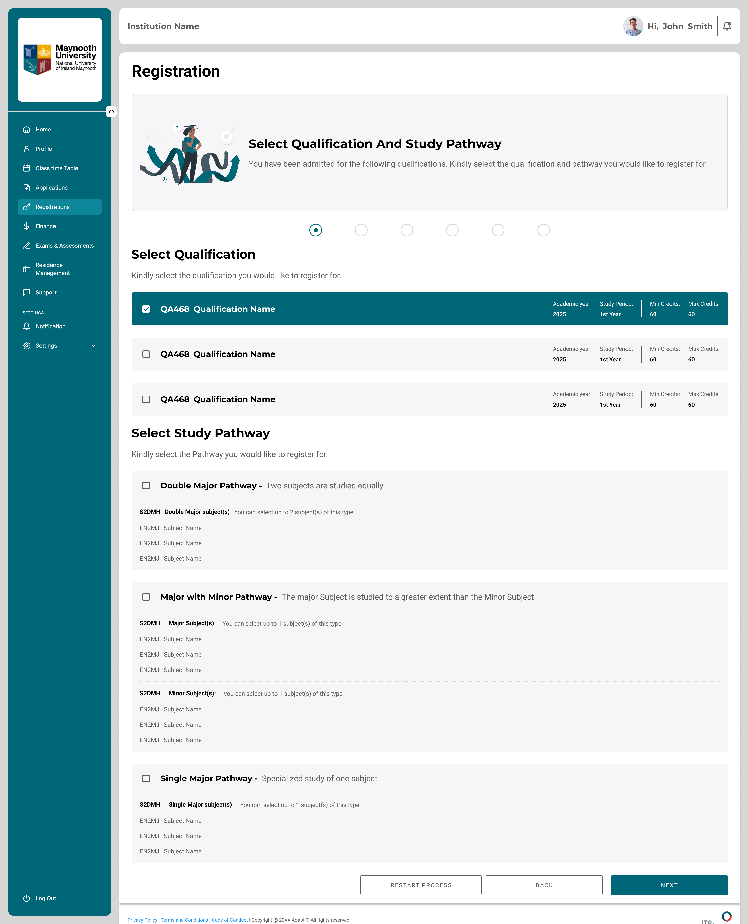
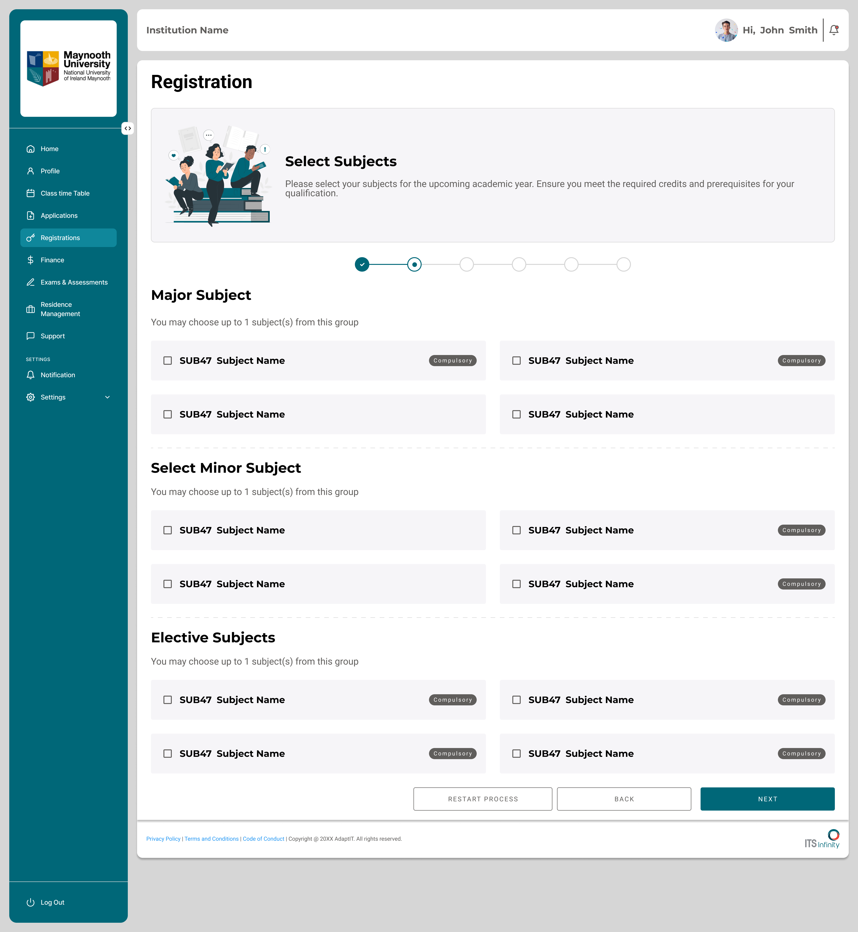
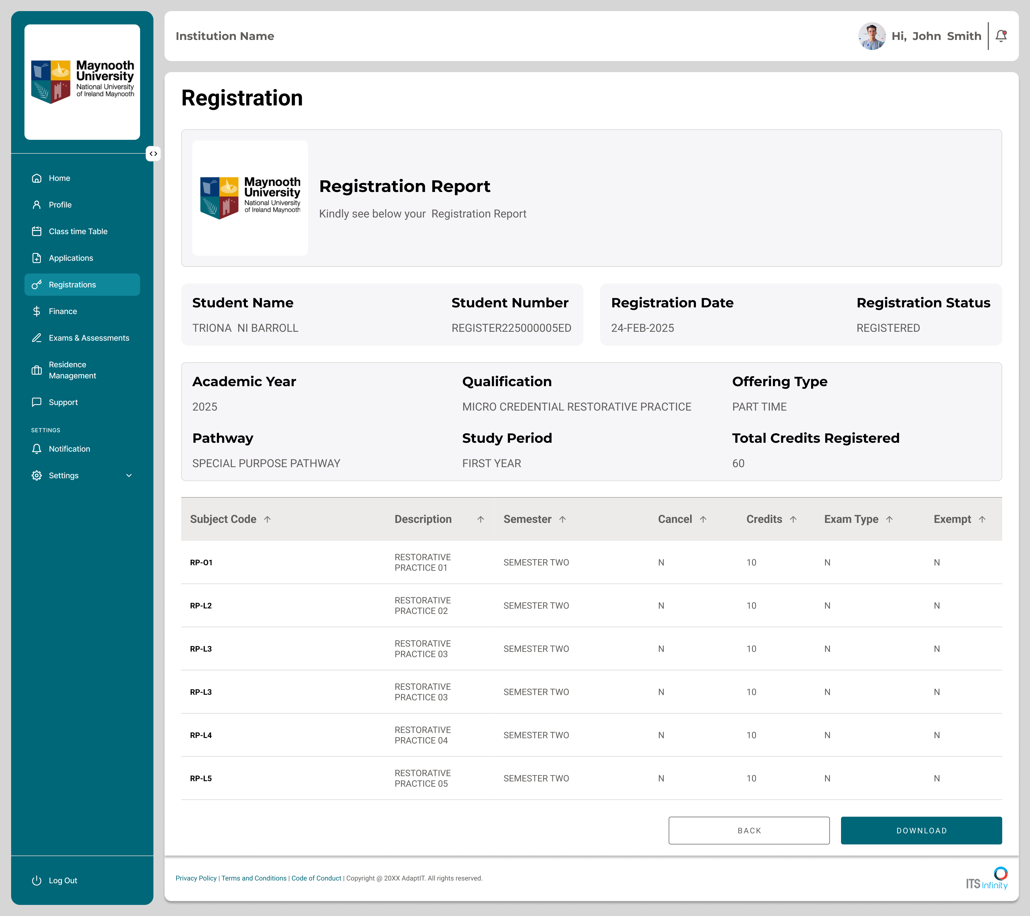
Concept Designs

Slide 13

Why Modernise?
Modernising the iEnabler portal is a strategic imperative — the catalyst to unlock unprecedented operational efficiency and transformative user experiences.
The path forward is clear. By transitioning to a modern, decoupled architecture, we are not just upgrading software; we are future-proofing your institution. Together, we will slash operational complexity, deliver the seamless digital experiences your students demand, and build a high-performance foundation designed to scale with your ambitions.
Maximize Value
Elevate Experience
Eliminate restrictive licensing and infrastructure bloat to free up resources for innovation.
Deploy a mobile-first, intuitive interface that sets the gold standard for your campus community.
Accelerate Growth
Adopt an API-first, cloud-ready platform that empowers you to lead in the evolving education landscape.

Slide 14
SECURITY FRAMEWORK

Slide 15
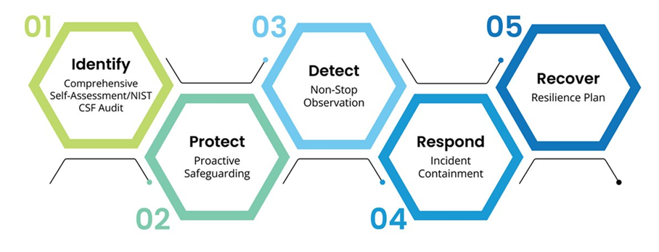
Adopting Security Framework
  Identify
  Protect
  Detect
  Respond
  Recover

Slide 16

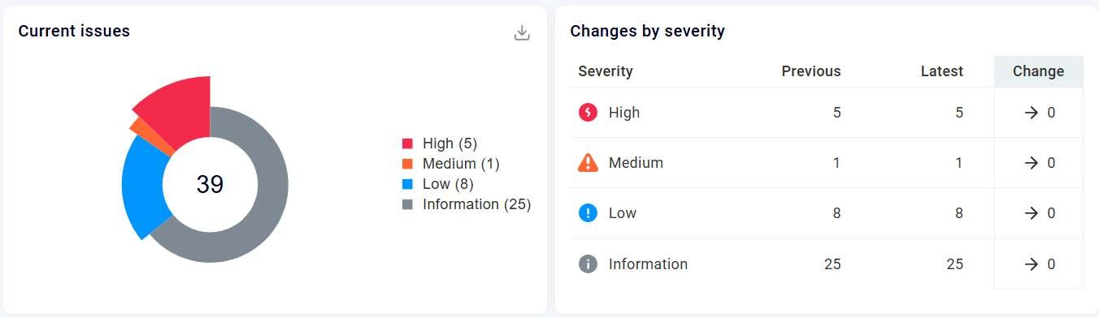


Monitoring
Monitoring Tools

Slide 17
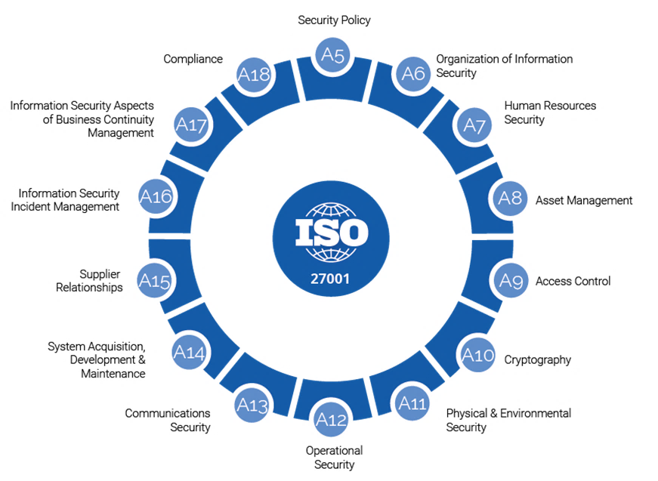
ISO : 27001
  ISO 27001 training – completed
  ISO 9001 – Stage 2 audit planned for next week
  Engaged with WWISE to assist us with the readiness and implementation

Slide 18
Agentic AI POC

Slide 19
Purpose
Why we’re doing this
Why it matters
Move from systems of record to systems of intelligence
Use AI agents to turn SIS & ERP data into early warning, prediction, and decision support
Demonstrate tangible innovation through a focused Student Tracking POC
Elevates our positioning from administration systems to student success enablers
Builds internal AI capability and agent architecture thinking
Establishes a scalable blueprint for intelligent ERP modules
Why Now
Our data maturity enables meaningful AI use cases
AI capabilities are now practical for rapid POC delivery
User Group creates a clear strategic milestone
Market expectation: ERP & SIS platforms must become AI-enabled

Slide 20
EWAI Agent Intelligence
Current State Problem
EWAI Agent Intelligence
Academic risk is identified too late, often only at the exclusion stage. This reactive approach creates cascading institutional challenges: increased appeals, inconsistent rule application across departments, governance risk exposure, lost tuition revenue, and critically, limited documentation of prior structured support efforts.
The Early Warning & Academic Intelligence Agent proactively evaluates student academic progression after each official exam cycle, detecting risk before exclusion thresholds are reached.
The system applies Senate-aligned academic rules using approved hierarchies, manages progressive warning lifecycles from Advisory through Final Warning, routes cases for structured intervention with mandatory human approval, and provides explainable, auditable decision support to governance bodies.
Without early intervention mechanisms, students fall through the cracks until it's too late to provide meaningful support.
Critical principle: The system supports but does not replace human judgment—it enhances institutional capacity for timely, consistent, and defensible academic decision-making.

Slide 21


EWAI Agent Intelligence
Proactive Detection Outputs
Governance & Compliance
Early "At Risk" alerts before formal exclusion thresholds
Progressive academic warning notifications (Advisory → Warning 1 → Warning 2 → Final)
Structured intervention task assignments for Academic Advisors
Escalation workflows requiring human governance approval
Senate-ready dashboards with aggregated risk intelligence
Transparent decision explanations for audit and appeal purposes
Measurable Institutional Value
Student Success
Financial Protection
Risk Mitigation
Governance Confidence
Increased retention and throughput rates through timely, structured intervention
Revenue protection through improved continuation rates and reduced exclusion appeals
Reduced legal and reputational risk through consistent, defensible rule application
Strengthened Senate confidence through transparent, auditable academic decision-making
Strategic Planning
Data-driven academic planning and intervention effectiveness tracking capabilities

Slide 22
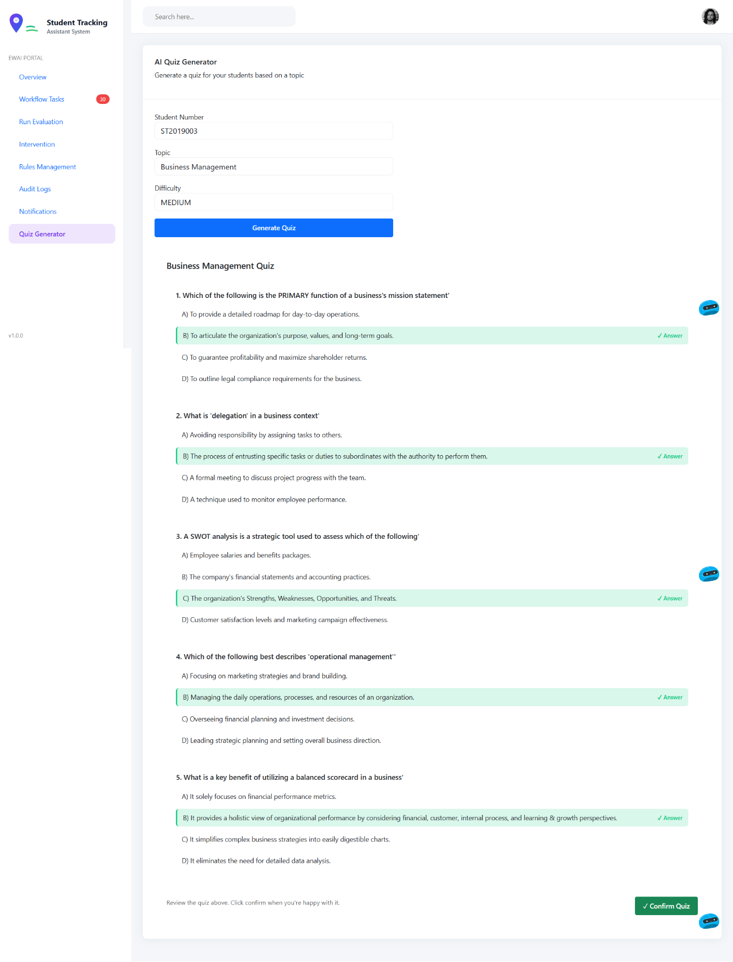
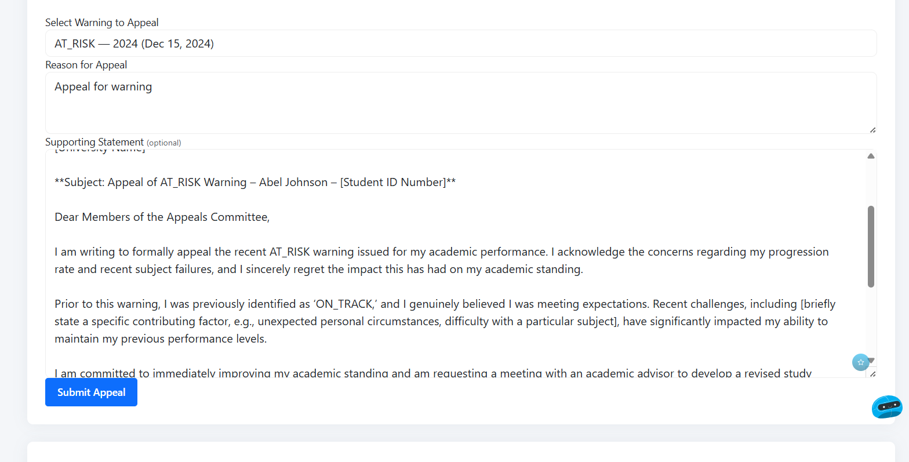
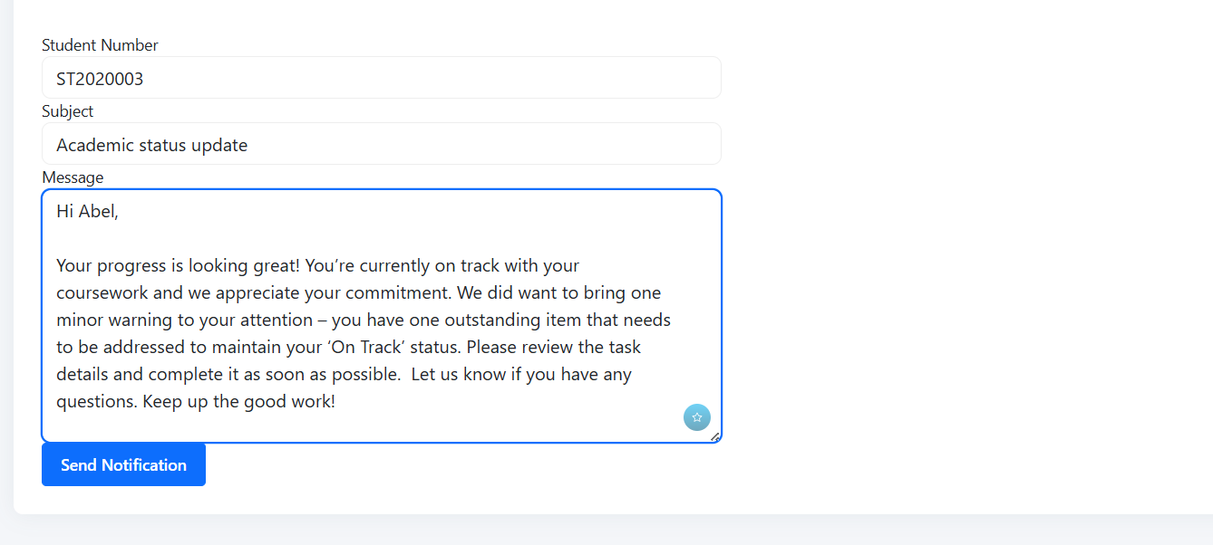
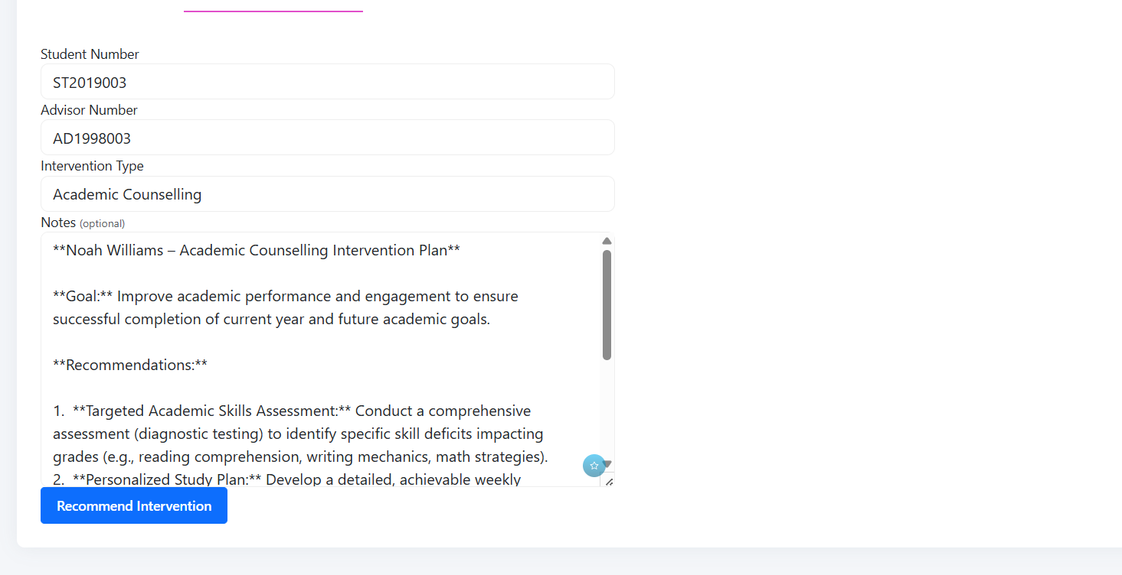
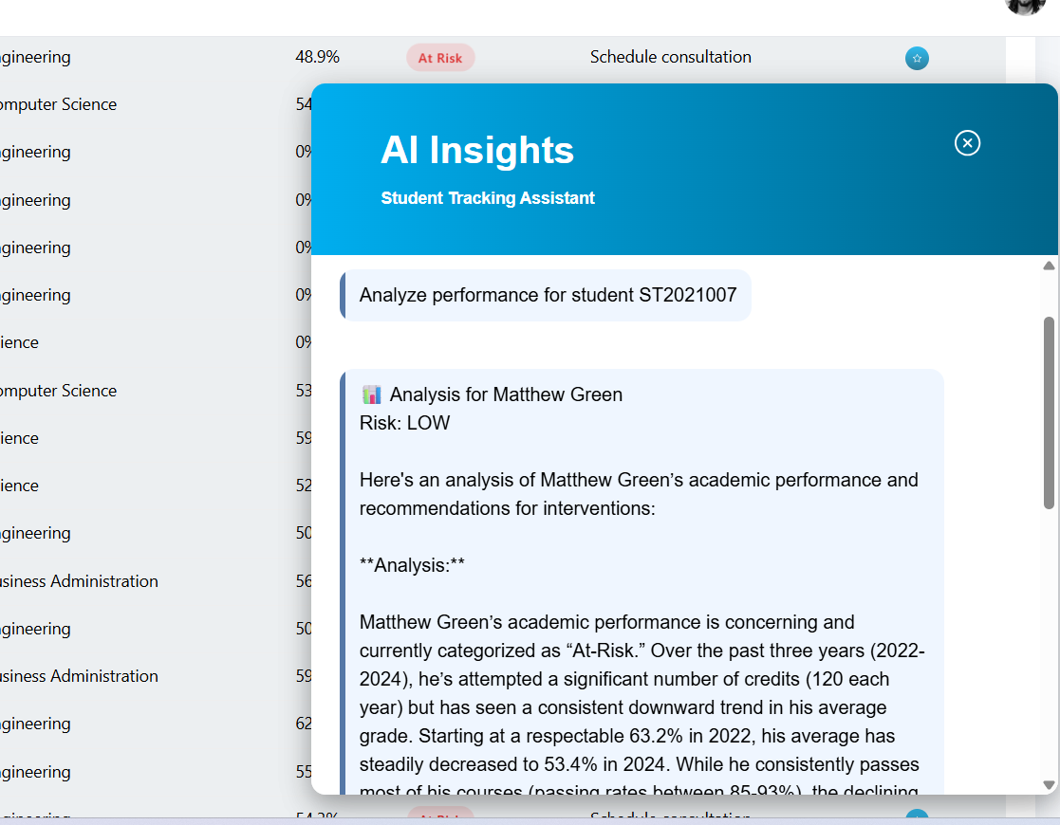
EWAI Agent Intelligence

Slide 23
Navigation Slowing Teams
CHALLENGE
Difficulty locating correct modules quickly, causing critical delays in operations.
Over-reliance on manual training and institutional memory creates bottlenecks when experienced staff are unavailable.
Incorrect screen usage leads to workflow errors.
Fragmented data sources slow down decision-making.
Results in lost productivity, inconsistent service delivery, and increased operational risk.
Valuable time is wasted on navigation instead of serving students, processing applications, or advancing strategic priorities.
Key Pain Points
Delayed critical actions due to navigation friction
Heavy reliance on manual training
Workflow errors from incorrect screen usage
Fragmented access to essential data

Slide 24








How the Navigation Assistant Works
SOLUTION
The Selections Navigation Assistant acts as an intelligent guide, interpreting natural language input to route users directly to relevant system modules. It suggests contextual filters and actions, guides staff through workflows step-by-step, and enables cross-module actions without manual searching. Importantly, the agent augments staff efficiency rather than replacing human judgment.
Interprets Intent
Direct Routing
Smart Filters
Guided Workflows
Understands natural language queries and user context
Takes users straight to the right modules and screens
Recommends contextual filters and next actions
Walks users through multi-step processes seamlessly
Data Sources
Key Outputs
The assistant leverages existing workflow systems, role-based access controls, and application modules—no new data sources required. It simply enhances how staff access and interact with tools they already use.
Guided navigation to relevant screens
Context-aware filter recommendations
Suggested next actions based on user role
Cross-module task shortcuts for complex workflows

Slide 25




Expected Benefits
Productivity Gains
Risk Reduction
Adoption & Experience
Compliance & Governance
Reduced time to complete tasks, faster onboarding of new staff, and lower dependency on manual training sessions
Fewer navigation errors, more consistent workflow execution, and reduced operational mistakes across teams
Improved system usability, higher staff satisfaction, and increased platform adoption rates
Enforcement of role-based permissions, standardized operational pathways, and improved audit traceability

Slide 26
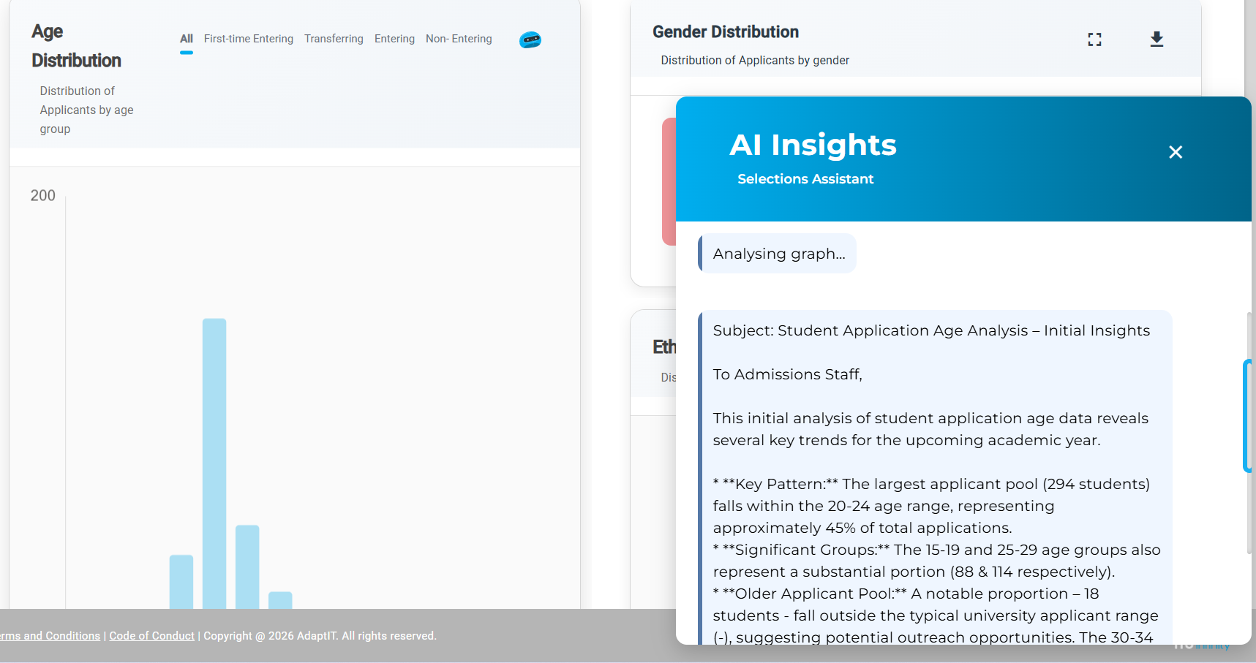
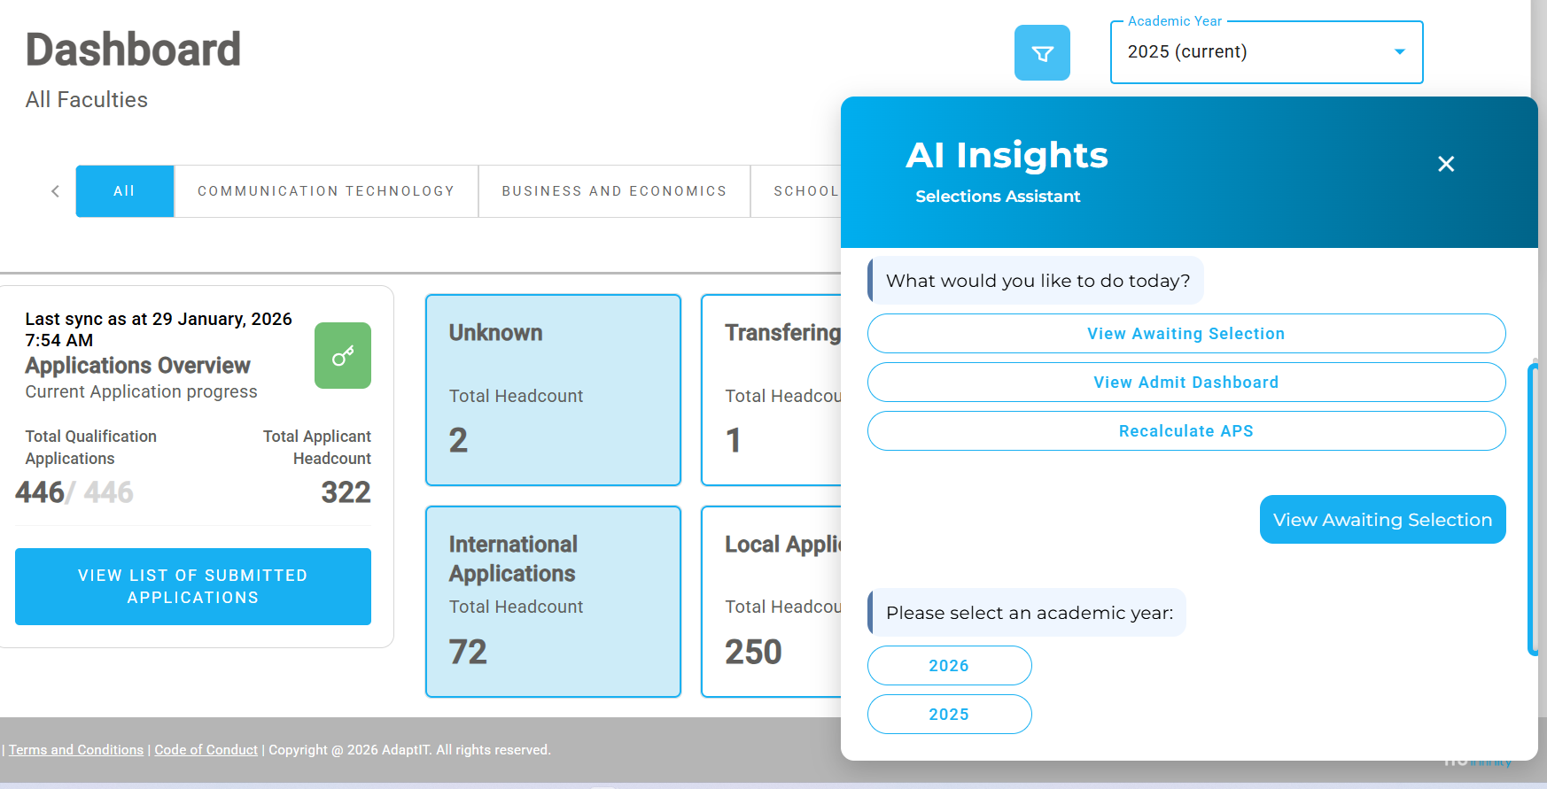
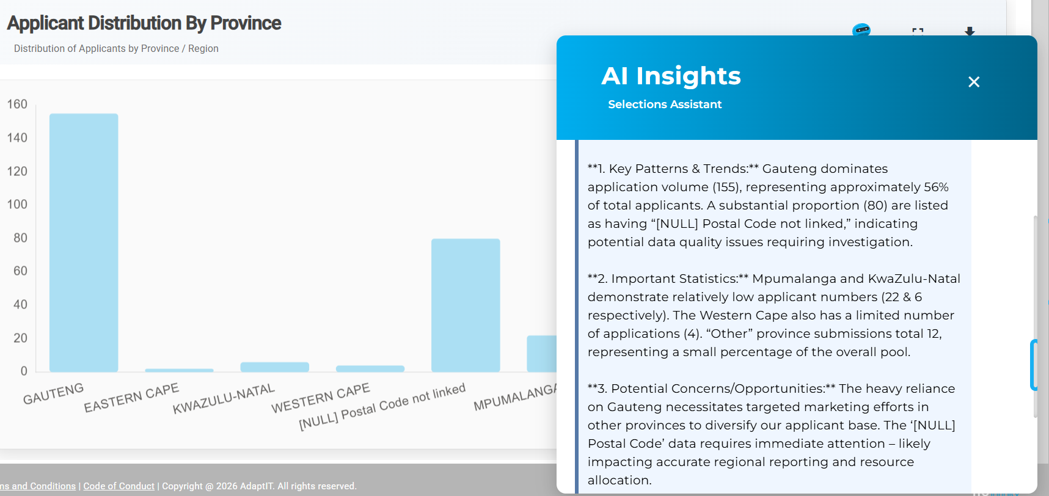
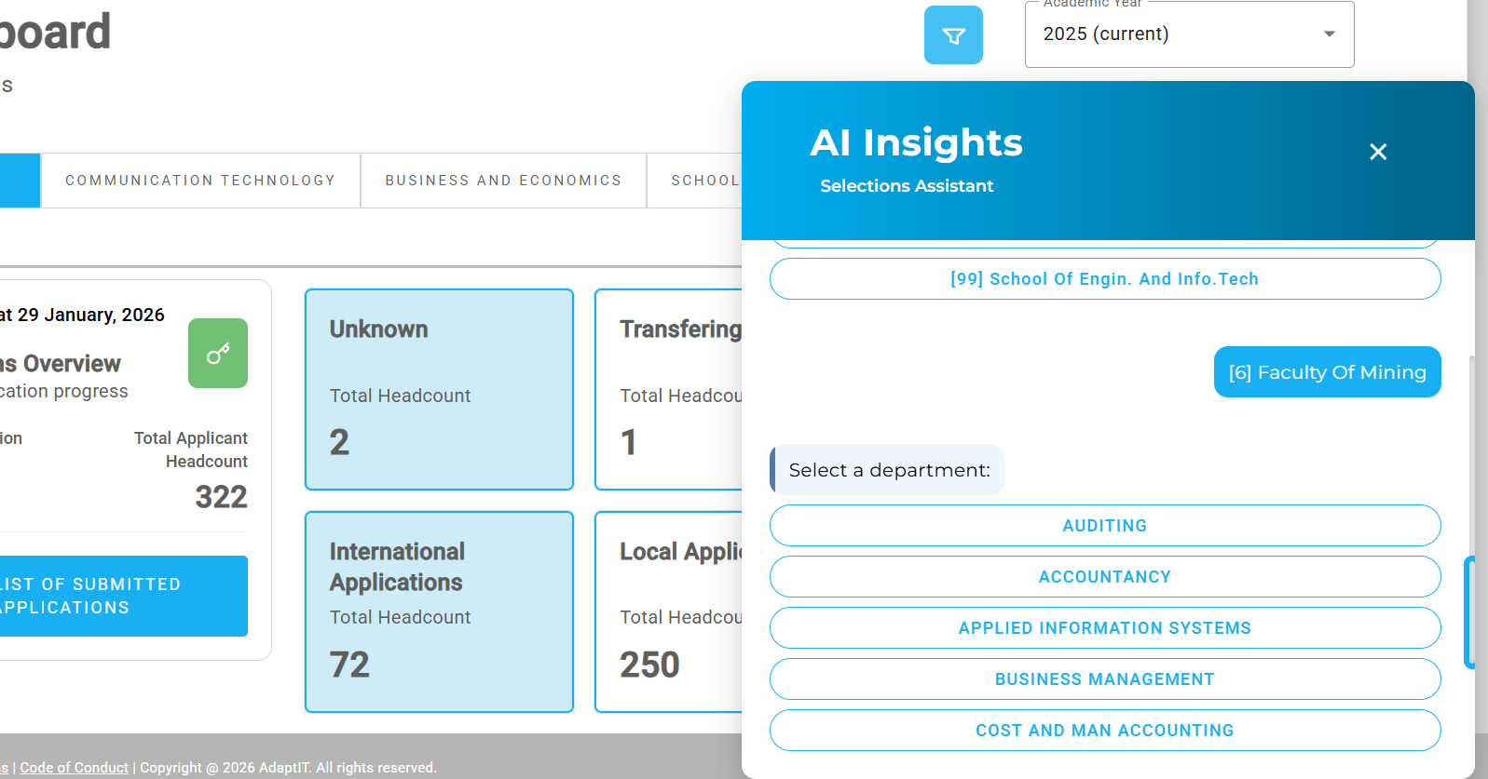
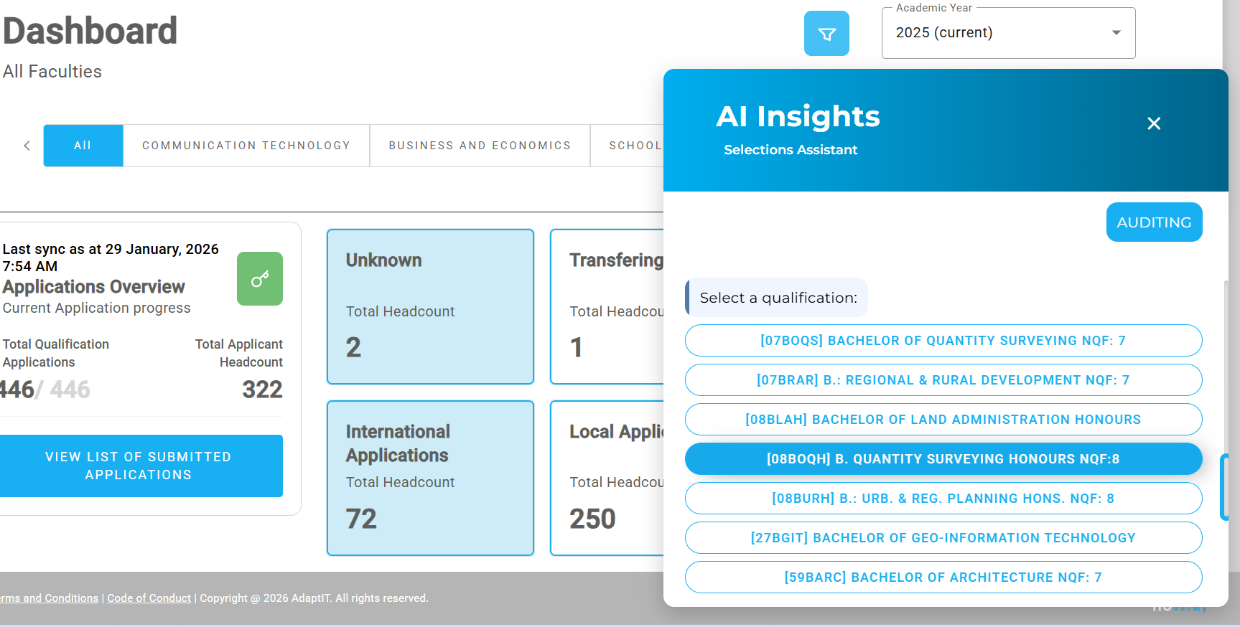
Navigation AI

Slide 27
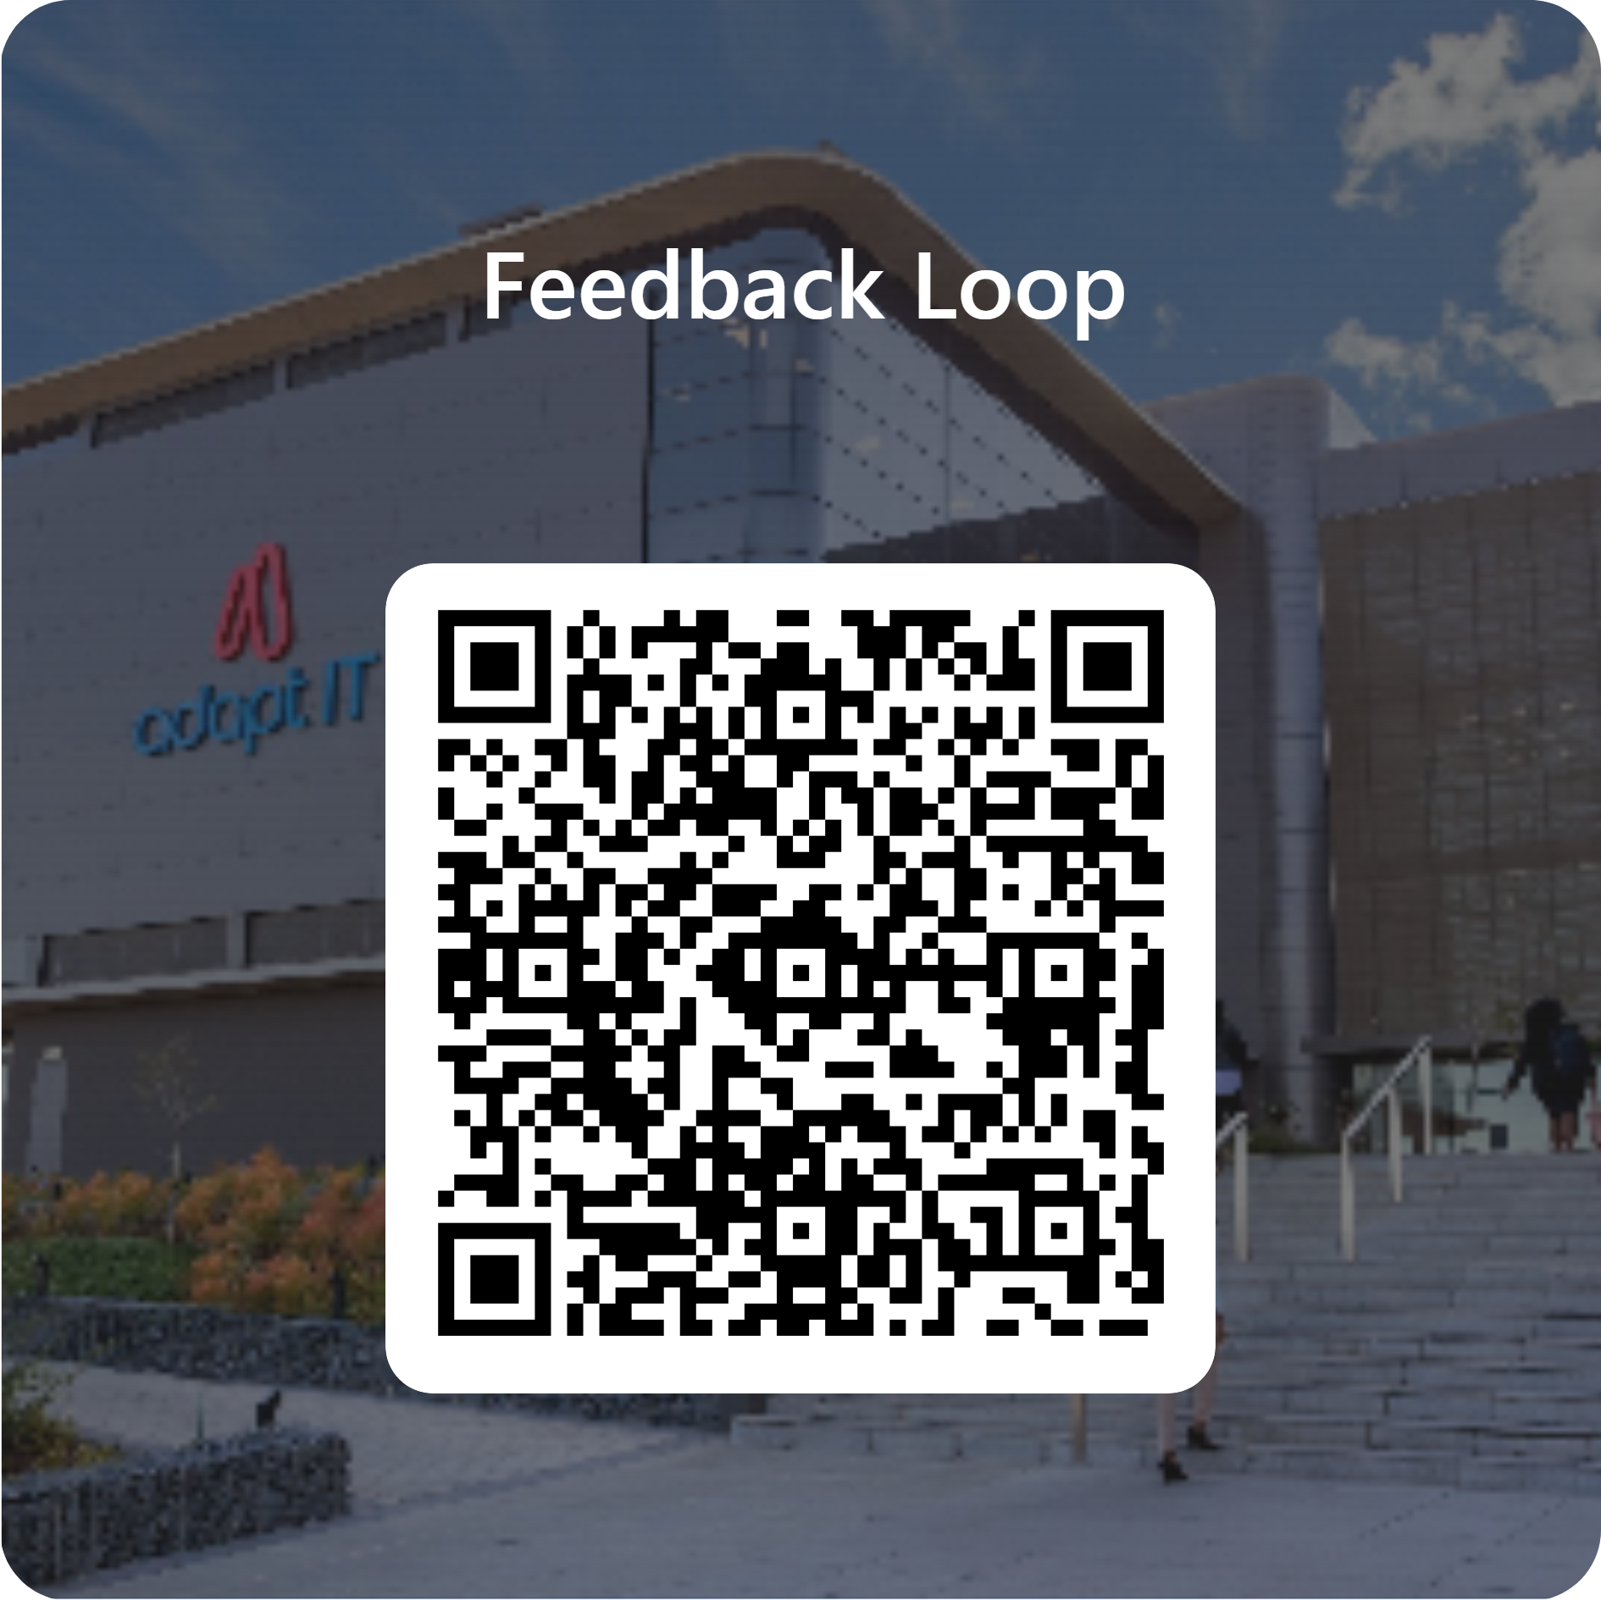
Feedback

