Slide 1


Transition from Legacy to Occupational Qualifications: Building a Capable and Skilled Workforce for South Africa
“What the transition really means for institutions, systems, and the future of skills development.”
ITS Integrator Group Conference
Date: 17 March 2026

Slide 2


Content
01
What the transition means?
02
What changes for institutions?
03
Status of implementation?
04
Challenges and misconceptions
05
What must happen next?

Slide 3
Why the Transition?
Legacy qualifications were
Uniform (same qualifications in 50 TVETs)
Theory-heavy (Chalk & Talk focused) prepared learners for examinations
Poorly aligned with workplaces (Weak employer involvement)
Focus on cognitive domain not competency-based (Ignored multiple intelligences)
Occupational qualifications introduce:
Knowledge Industry aligned
Practical Skills Competency driven
Workplace experience Workplace Integrated
External Integrated Summative Assessment (EISA) / Final Integrated Summative Assessment (FISA)

Slide 4
What does the Transition Actually Mean?
Replacing legacy programmes - NATED (N1-6) and NCV
TVETs and CETs moving from GENFETQA to OQSF
Introducing occupational qualifications on the OQSF
Changing the learning model – Why?
Rapid technological changes
The workplace has changed
The learner has changed – digital natives
Multiple intelligences
Lecturing replaced with facilitation
PSET institutions must apply for accreditation, provide practical or simulated training and real workplace training

Slide 5
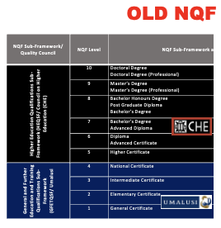
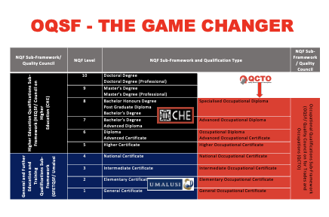
What changes for institutions?

Slide 6


QUALIFICATIONS DEVELOPMENT & PROGRAMME SELECTION
State of Readiness - System Reality (PQM)
Occupational Qualifications &
Part Qualifications Developed and Available to TVETs
01
896
Skills Programmes Developed and
Available to TVETs
341
02
Number of Occupational Qualifications &
Part Qualifications selected by TVETs (PQM)
197 / 896
03
04
Number of Skills Programmes selected
by TVETs (PQM)
51 / 341
Number of TVETs accredited as
Assessment Centres
36 / 50
05
Number of Qualifications covered by
TVET Assessment Centres
⚠️
06
80 @ 113 sites

Slide 7
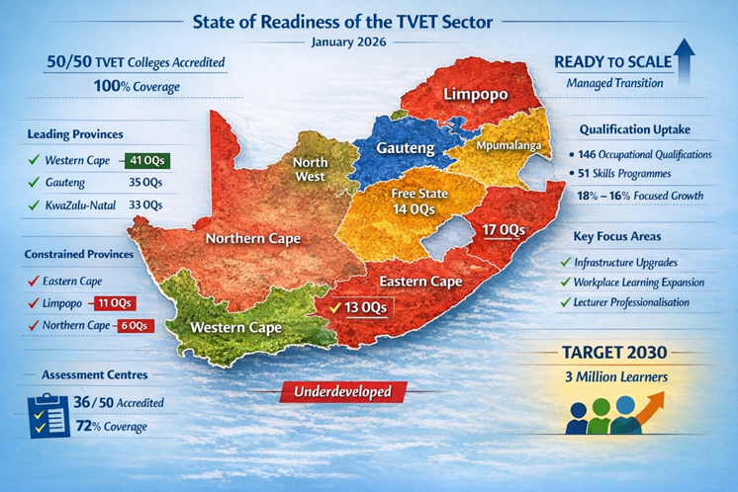


QUALIFICATIONS DEVELOPMENT & PROGRAMME SELECTION
State of Readiness - System Reality
50 out of 50 TVETs are accredited to offer
Occupational, Part, or Skills Programmes
11 OQs
35 OQs
12 OQs
197 Occupational Qualifications
12 OQs
KZN
33 OQs
197 Occupational Qualifications in 147 sites
51 Skills Programmes in 142 sites
36 Assessment Centres for 80 Qualifications
6 OQs
41 OQs
Your paragraph text

Slide 8

TVET READINESS SCORECARD
DIMENSION | STATUS | INTERPRETATION
1. Institutional Participation | 100% (50/50) | Full system inclusion
2. Campus-Level Accreditation | 147 campuses / sites | Expanding, uneven but improving
5. Assessment Centre Coverage | 36 / 50 (72%) | Strong base, needs expansion
6. Leading Province | Western Cape | GDP density, stable governance
7. Constrained Provinces | EC, Limpopo, NC | Structural & historical factors
8. Overall Readiness Status | Ready to Scale | Managed transition phase

Slide 9
What are the opportunities for ITS?
Occupational Qualification Structures
Knowledge Modules
Practical Modules
Workplace Modules (Logbooks)
Funding sources at all level of delivery
EISA admissions
Copy of Digital Certificates from QCTO

Slide 10
What are the opportunities?
Stronger employer participation
Better graduates' employability
Modernisation of TVET and CET System
Alignment with 4IR occupations and skills for the future

Slide 11
What are the Challenges?
Work placement capacity (Industry Partnership Agreements)
Lecturer readiness (unqualified and underqualified lecturers) – Facilitation Skills, Learning Experience Design
OHS
Infrastructure – outdated technologies
Funding models
Institutional systems – must Adapt!

Slide 12
What Must Happen Next?
More partnerships between industry and institutions
Train more lecturers
Upgrade information systems
More accreditation as Assessment Centers

Slide 13
“The transition from legacy qualifications to occupational qualifications is not simply a curriculum change. It represents a fundamental shift in how South Africa prepares its workforce — placing industry, competence and employability at the centre of learning.”

Slide 14


Thank You

