Slide 1

International Student Applications
Kolosa Mbambanisi

Slide 2
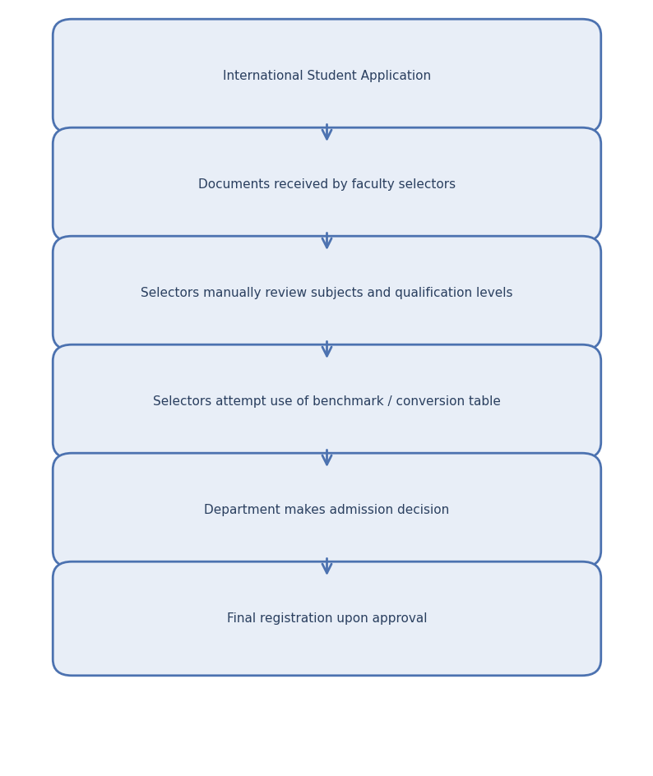
Current Process

Slide 3
1. International Student Application
Students submit:
  School‑leaving certificates (IGCSE, AS, A Levels, etc.)
  Transcripts / statement of results
  Passport and other identity documents
  (Sometimes) Additional documents like Cambridge Statements of Results
Issue noted: Not all students submit complete sets of documents (e.g., IGCSE only, without AS/A Levels).

Slide 4
2. Documents Are Received by Faculty Selectors
Selectors in departments receive the applications and supporting documents.
Current gap:
Selectors are assumed to understand foreign matric systems — but many do not.

Slide 5
3. Selector Reviews Subjects and Results Manually
Selectors try to identify:
  Which subjects the student has (e.g., Maths, English, Physics)
  At which level (IGCSE, AS, A Level)
  Whether marks appear “good enough”
Common challenges:
Some selectors incorrectly treat IGCSE as equivalent to Grade 12.
Limited knowledge of the difference between IGCSE, AS, and A Level.

Slide 6
4. Attempted Use of Benchmark / Conversion Tables
Some selectors refer to a previously distributed benchmark conversion table, intended to map:
  A, B, C grades → SA percentage equivalents
  Different foreign systems → SA symbols
However:
Confidence in the table is low.
Many do not know how or when to use it.
Not applied consistently across faculties.

Slide 7
5. Admission Decision Made
Selectors decide whether:
  The qualification meets programme requirements
  The subject combinations are valid
  The results meet minimum entrance thresholds
Current risk:
Students may be incorrectly accepted or rejected due to:
  Misinterpretation of qualification levels
  Incorrect percentage conversions
  Missing understanding of curricula (IGCSE vs AS vs A Level)

Slide 8
6. Final Registration If All Checks Pass
If:
  The department accepts the student
  The exemption/matric equivalency is approved
  Documents are verified
→ The student is allowed to register.
Risk:
Inconsistencies in early evaluation stages can result in unsuitable admissions reaching registration.

Slide 9
Assessment of International applications
How are foreign matriculants evaluated against SA matric standards?
What conversion tables, benchmarks, or rubrics are used?
How to verify subject‑specific requirements correctly?
  Engineering programmes may require:
  Mathematics at AS or A Level, NOT at IGCSE. Physics at AS/A Level only.

Slide 10
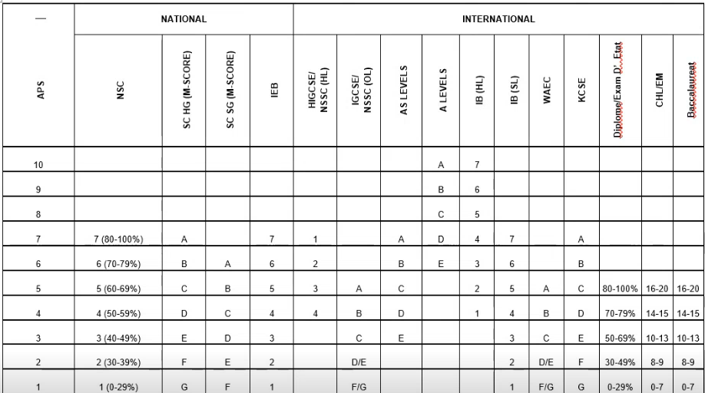
Conversion Table

Slide 11
Challenges Identifies
1. Lack of staff training Selectors do not fully understand: International qualification structures Level equivalencies Which subjects are acceptable for which programmes 2. Inconsistent use of conversion tables No standard tool or required procedure currently exists. | 3. Incomplete or partially submitted documentation Some students present only IGCSE results - often misinterpreted as matric. 4. No standardised institutional workflow Each faculty or selector may be applying their own process. 5. Risk of incorrect admission decisions Potential for: Unqualified students being admitted Qualified students being rejected Audit issues in the future

Slide 12
Discussion
How do other institutions assess students with international or foreign matric qualifications?
What type of rubric/conversion tables institutions use to assess subject-specific requirements?

