Slide 1

HDMS, Student Tracking Modernisation
Session 21
Presenter: Linda Putu

Slide 2

DISCLAIMER
This presentation is only a summary of some of Adapt IT’s products, features and their latest developments. Adapt IT only intends for the information to give you an overview, and not a complete and comprehensive statement that necessarily suits your purposes.
Adapt IT reserves the right to change any information contained in this presentation and is not responsible for any loss that results from inaccuracies in the information. You may not distribute or reproduce the information without Adapt IT’s written permission.

Slide 3
Table of Contents
HDMS
The future of Student Tracking

Slide 4
HDMS SIG – Product Progress Update
Responding to Client Feedback & Delivering the HDMS Process Engine

Slide 5

HDMS SIG – Commitment to Clients
During our HDMS SIG engagements, institutions shared important feedback about how current HDMS workflows operate in practice. Adapt IT listened carefully and committed to meaningful action.
What We Committed To
Today's Session Covers
Listening to institutional feedback
Identifying key workflow challenges
Redesigning HDMS for flexible academic processes
Providing progress updates on the redesign
What we heard from institutions
The action plan we agreed on
Progress towards the new HDMS Process Engine

Slide 6


SIG Engagement Summary
HDMS SIG MEETING OVERVIEW
Participating Institutions
Key Discussion Areas
HDMS workflows and approvals
Supervisor vs. administrator responsibilities
Document handling processes
Reporting and visibility
Institutional workflow differences
SMU
VUT
UNISWATINI
CUT
Outcome: Institutions confirmed the need for a more flexible and transparent workflow model for postgraduate processes.

Slide 7
Key Client Feedback
Institutions highlighted several consistent challenges with the current HDMS implementation — challenges that span workflow rigidity, role clarity, and process visibility.
Rigid Processes
Approval Bottlenecks
Institutional Differences
A single fixed workflow route is applied to all institutions, leaving no room for institutional customization or exceptions.
Processes stall when a single role-holder is unavailable, causing delays that cascade through the entire postgraduate pipeline.
Each university follows slightly different postgraduate processes, yet the system forces them into one standardized path.
Supervisor Workload
Limited Visibility
Supervisors are frequently required to perform administrative actions that should be handled by dedicated admin roles.
It is difficult to track where a request sits in the process at any given time, frustrating both staff and students.

Slide 8

Action Plan Agreed with SIG
HDMS REDESIGN COMMITMENT
Following the SIG engagement, Adapt IT committed to redesigning HDMS with clear objectives tied to each institutional concern raised.
Commitment
Outcome
Flexible workflow model
Institutions can configure their own process routes
Reduced supervisor burden
Automation and role-based routing
Improved transparency
Real-time tracking of all processes
Modern user experience
Simplified Angular interface
Future-ready architecture
API-driven service model
Delivery Commitment: First working HDMS Process Engine by the end of Q1 — a tangible milestone to demonstrate progress to participating institutions.

Slide 9
Progress Since the SIG
DEVELOPMENT PROGRESS
Since the SIG engagement, the team has moved swiftly from feedback to action. Significant groundwork has been completed across architecture, design, and strategic alignment.
01
02
03
HDMS Architecture Redesign
Service Request Workflow Model Defined
Centralised Process Engine Designed
Core system architecture has been rethought to support flexible, API-driven workflows.
The engine that orchestrates all approval stages has been architected and scoped.
Every postgraduate action will be captured as a structured service request with full traceability.
04
05
Initial UX Concept Designs Prepared
Alignment with Infinity Modernisation Strategy
Visual prototypes of the new HDMS experience have been developed for review today.
HDMS development is fully aligned with the broader Infinity platform modernisation roadmap.
Today we will show concept designs of the future HDMS experience — a first look at what institutions can expect.

Slide 10




Introducing the HDMS Process Engine
FUTURE HDMS ARCHITECTURE
The redesigned HDMS introduces a centralised process engine — the core innovation that enables flexible, transparent, and configurable postgraduate workflows across institutions.
Centralised Workflow Management
Service Request Model
The engine orchestrates all approval stages from a single point of control, eliminating fragmented ad-hoc processes.
Every postgraduate action is captured as a structured service request, creating a clear and auditable record of each step.
Dynamic Routing
Process Transparency
Processes adapt and route automatically based on institutional rules, reducing manual intervention and bottlenecks.
Full tracking of every request at every stage ensures institutions, supervisors, and students always know where things stand.

Slide 11
Service Request Workflow Model
Every postgraduate action in the new HDMS becomes a service request — a structured, trackable unit that moves through the process engine with full visibility and institutional configurability.
Each Request Contains
Possible Actions on a Request
Current status
Assigned role responsible for action
Outcome (approved, rejected, re-routed)
Full process history and audit trail
Submit
Approve
Reject
Re-route
Auto-complete
This model allows institutions to configure their own workflows rather than relying on fixed system routes.

Slide 12





User Experience Improvements
MODERN HDMS INTERFACE
The redesigned HDMS interface is built with the daily user in mind — students, academics, and administrators all benefit from a dramatically simplified experience.
Clean Angular Screens
Simplified, role-specific screens reduce cognitive load and make common tasks fast and intuitive.
Real-Time Tracking
Users can see exactly where their requests sit in the workflow at any moment, eliminating the need to follow up manually.
Automated Notifications
Proactive reminders and alerts for pending actions keep processes moving without manual chasing.
Reduced Administrative Work
Automated routing and status updates free up administrators and supervisors to focus on higher-value tasks.

Slide 13
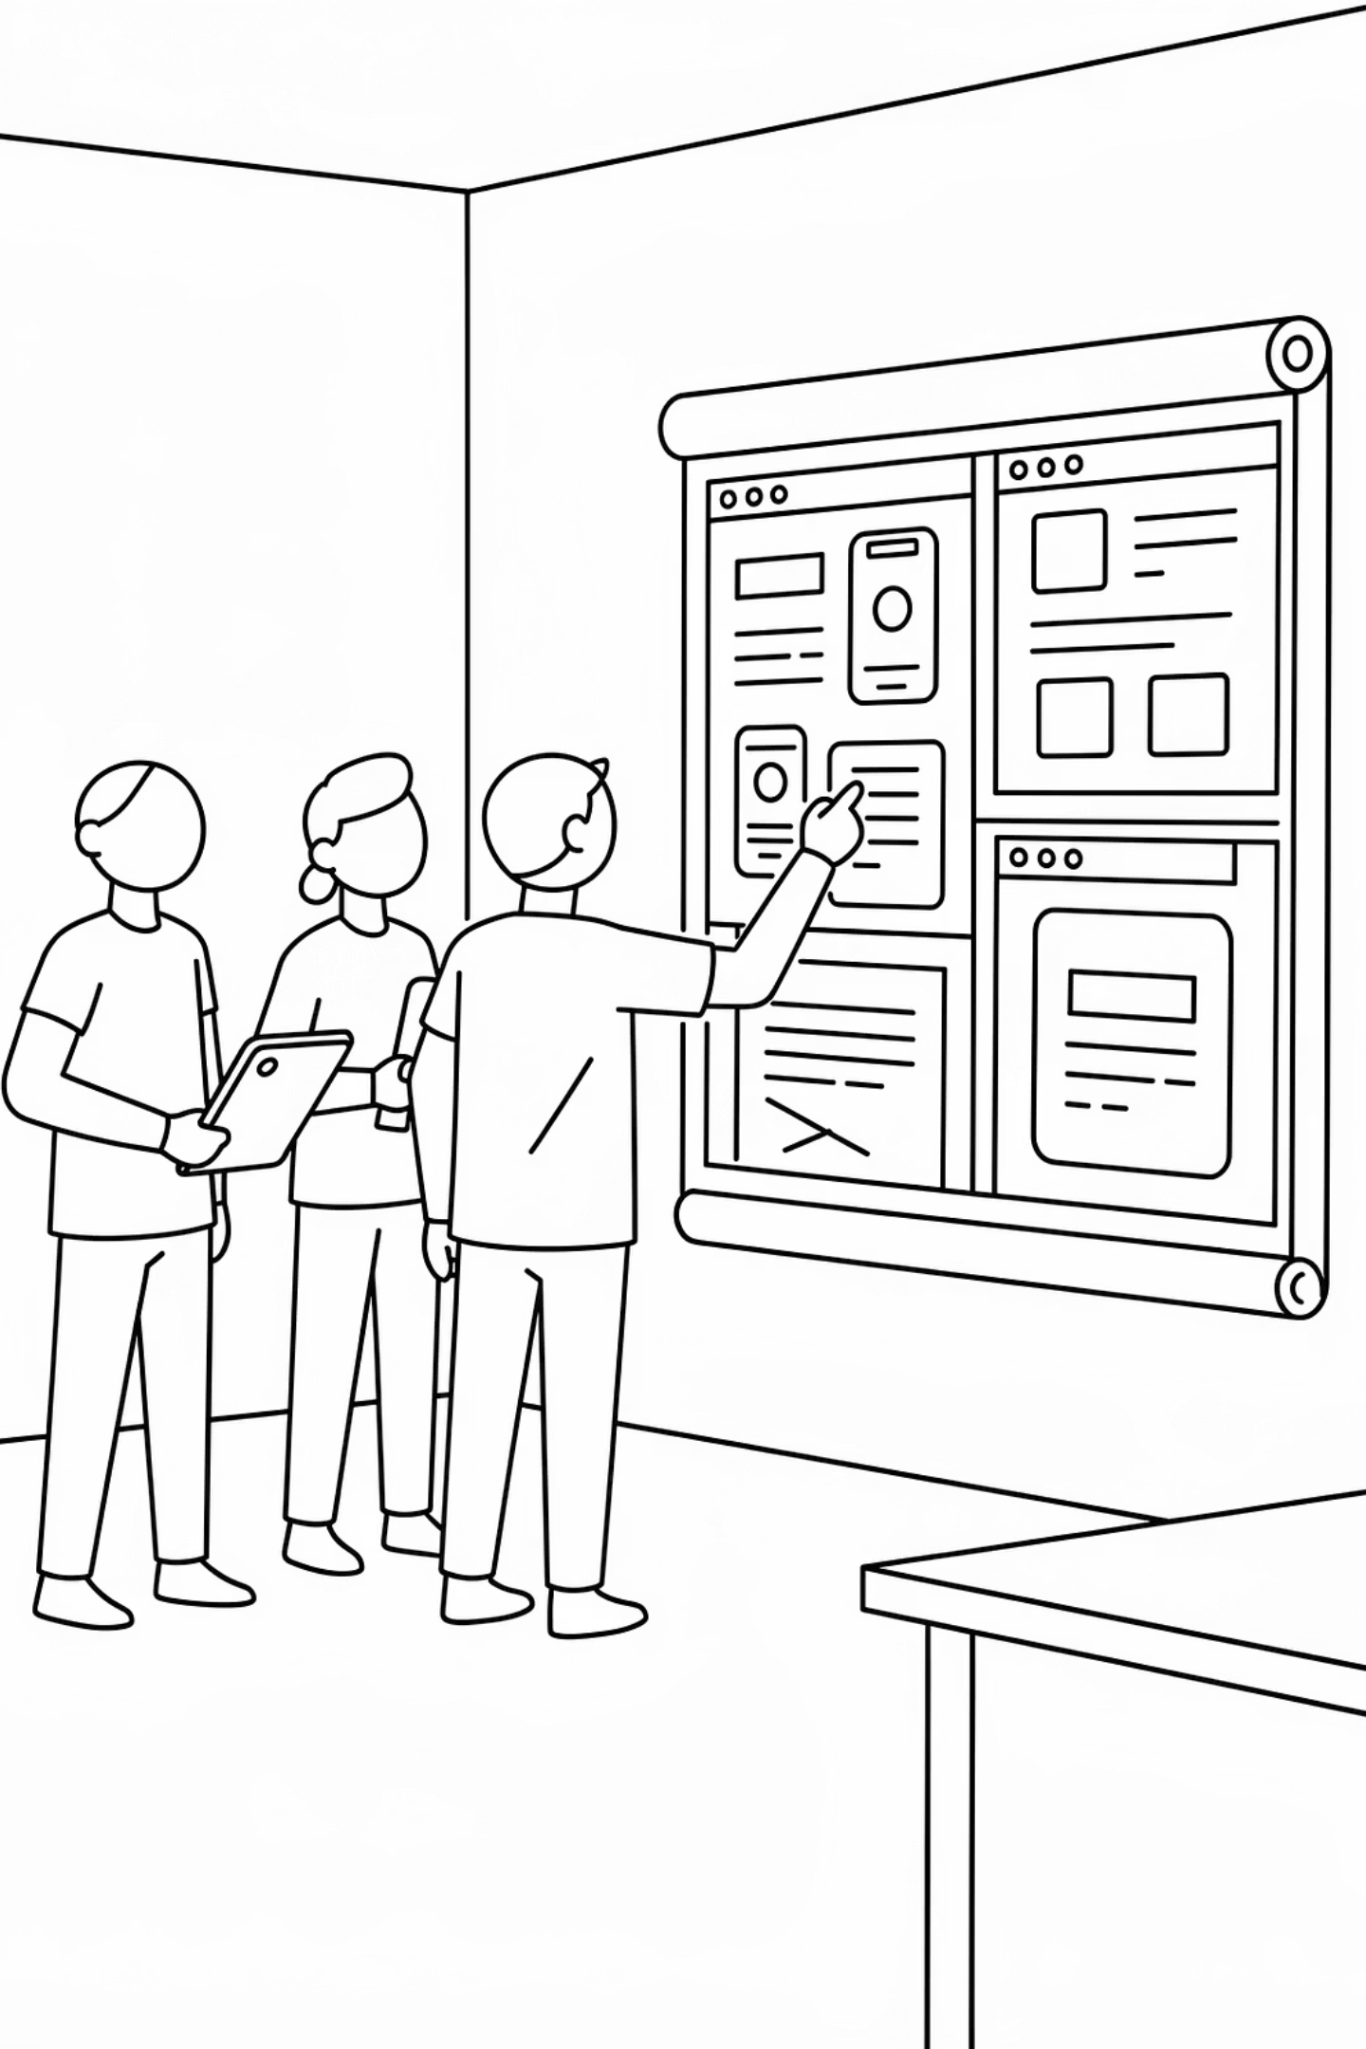
Concept Design Preview
COMING UP NEXT
Designs to come.
The UX concept designs developed for the new HDMS experience will be presented in this section. These previews represent the first visual articulation of the redesigned interface — built directly in response to the feedback shared by participating SIG institutions.

Slide 14
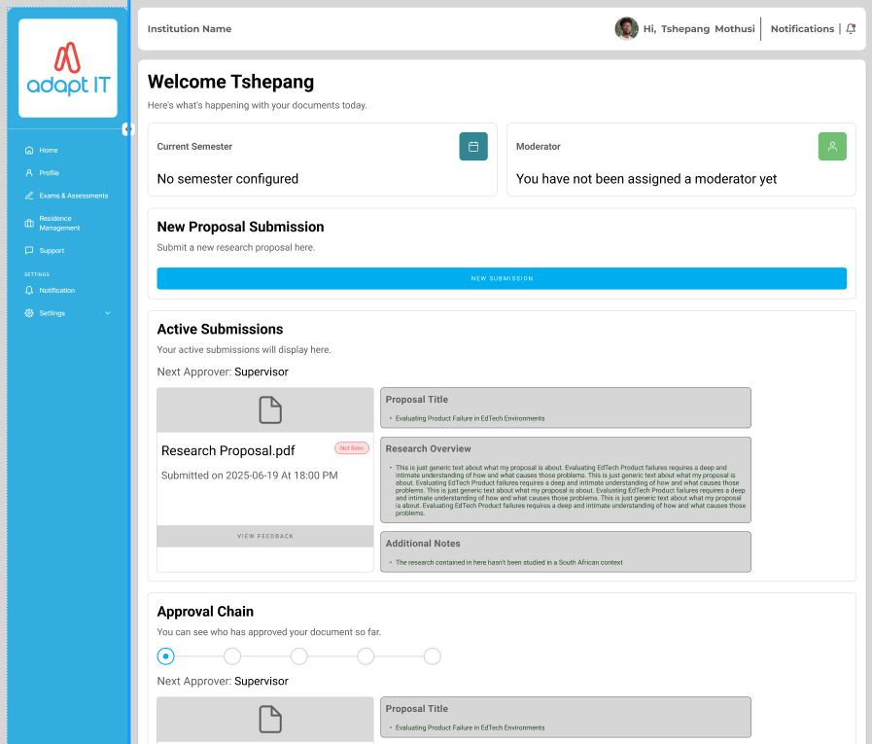
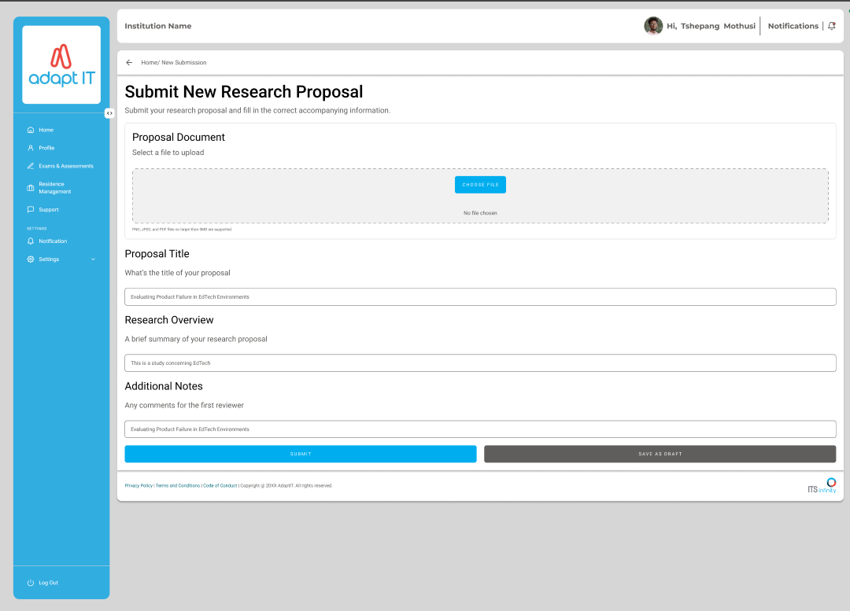
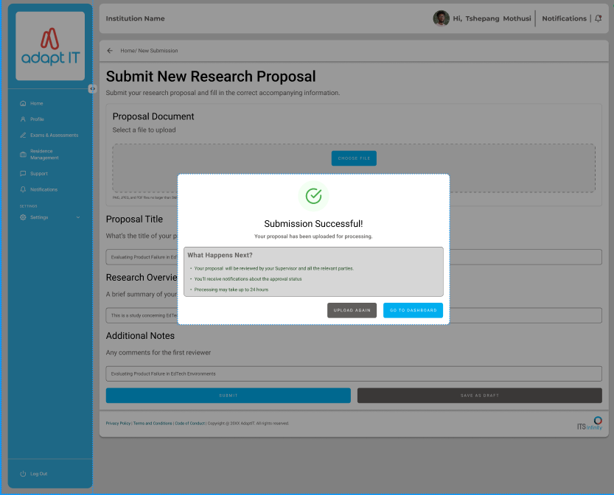
Concept Design Preview

Slide 15
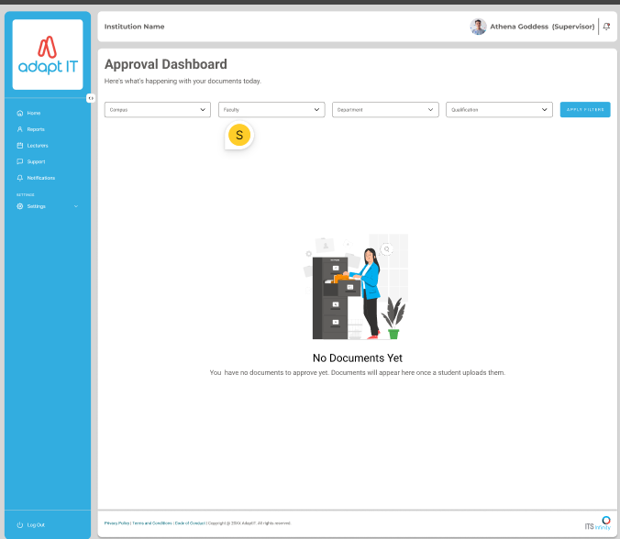
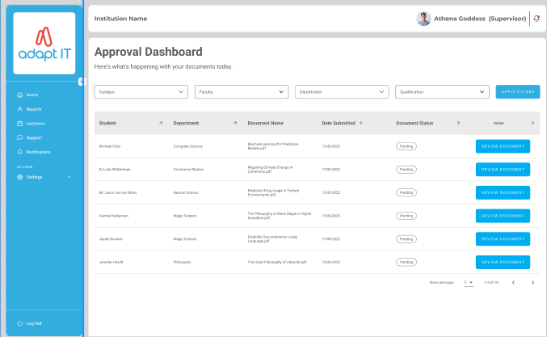
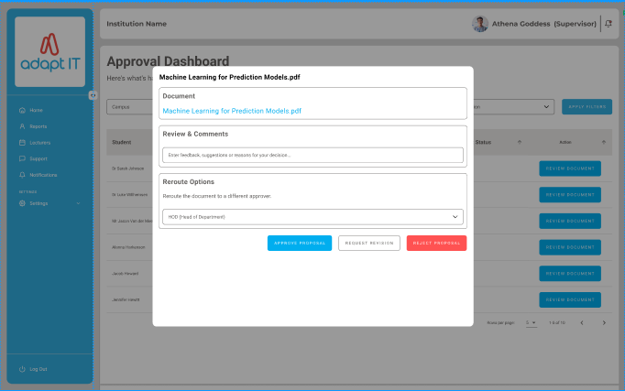
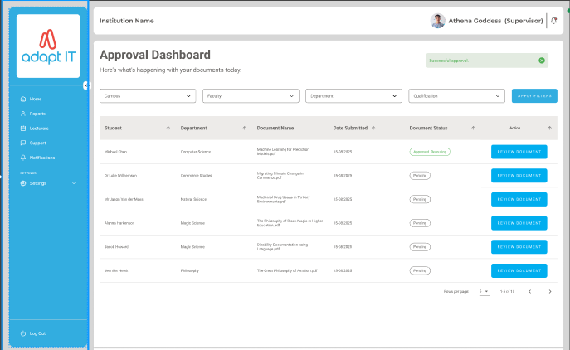

Slide 16
Roadmap Progress
HDMS DELIVERY ROADMAP
Development is progressing on schedule. The table below reflects the current status of each phase in the HDMS redesign journey.
Phase
Status
SIG feedback engagement
✅ Complete
Architecture and workflow design
🔄 In Progress
Process Engine development
🔄 In Progress
UX concept designs
✅ Completed
Pilot institutions
📅 Planned
Target: First HDMS Process Engine release by the end of Q1 — delivering on the commitment made to SIG institutions.

Slide 17






2027 – Automation & AI Validation
FUTURE INNOVATION
Objective: Introduce AI agents to monitor and validate research workflows — moving HDMS from a process management tool to an intelligent research oversight platform.
Proposal & Ethics Validation
AI validates proposal completeness and checks ethics documentation compliance before human review — reducing rework and processing delays.
Stall & Bottleneck Detection
Automated detection of stalled research processes and missing documents — enabling proactive intervention before delays escalate.
Supervisor Workload Monitoring
Tracks supervisor caseloads and flags overloaded supervisors, supporting more equitable distribution of academic oversight responsibilities.
Research Pipeline Analytics
Institutional-level dashboards reveal patterns across the entire research pipeline, enabling data-driven academic planning.

Slide 18



Strategic Impact
The HDMS roadmap delivers compounding strategic value across three horizons — from operational digitisation today to predictive intelligence by 2028.
By End of 2028
Predictive research intelligence · Institutional benchmarking · Fully modernised commercial HDMS platform
By End of 2027
AI validation embedded in research workflows · Automated monitoring of research progress and stall detection
By End of 2026
Full postgraduate lifecycle digitised · Modern HDMS workflow engine operational · API-enabled research management platform

Slide 19
Student Tracking

Slide 20

Enhancing Student Success Through Early Intervention
STRATEGIC DIRECTION
Objective: Transform the current exclusion-based monitoring approach into a proactive student tracking and intervention framework — catching risk before it becomes crisis.
Current Institutional Challenge
Our Direction
Most institutions identify struggling students too late — often only when they reach exclusion thresholds. This results in:
Introduce structured student tracking, early warning mechanisms, and intervention processes — all triggered well before exclusion criteria are met.
Increased academic appeals
Reduced student retention rates
Limited opportunity for meaningful academic support
Governance pressure on faculties and Senate
This shifts the institution's posture from reactive to proactive, enabling academic support teams to engage students at the point of risk, not the point of failure.

Slide 21
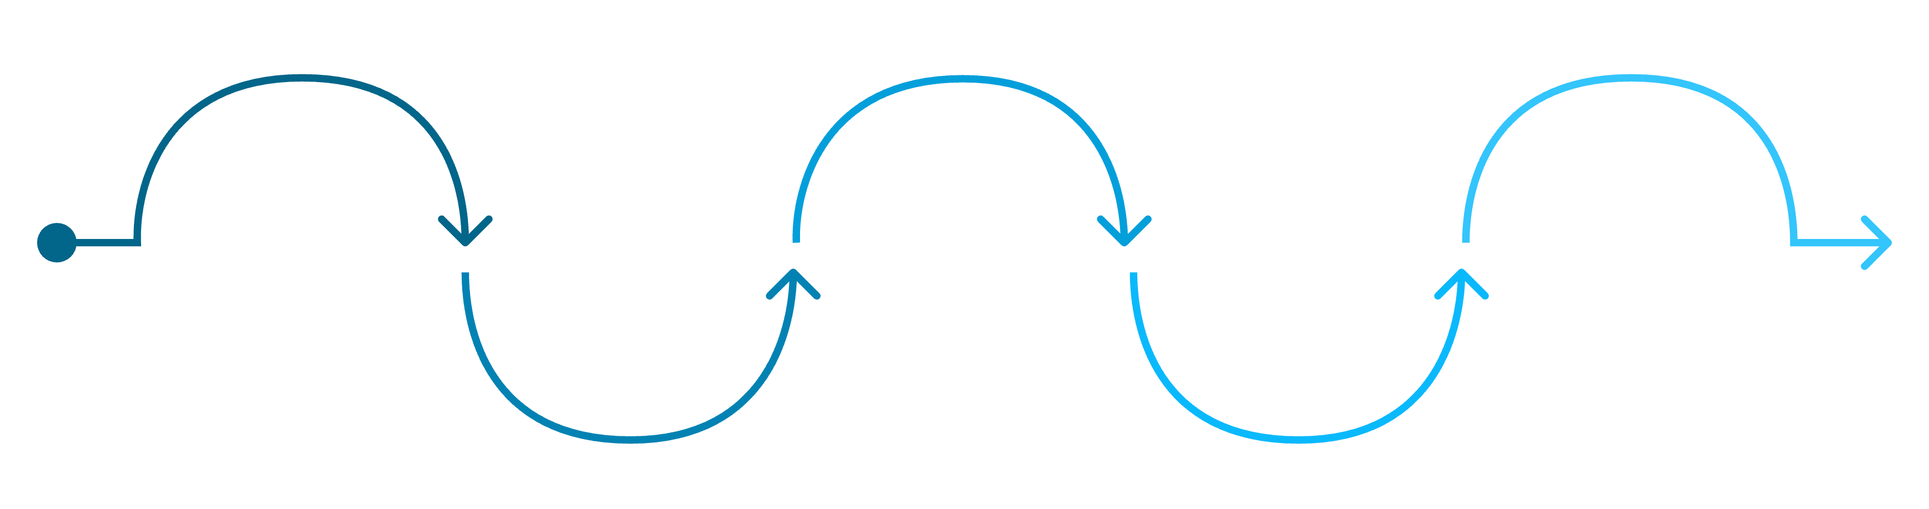
Current Process (Today)
CURRENT STATE ASSESSMENT
Today's exclusion lifecycle follows a strictly linear path that leaves no structured room for early detection or intervention. The system responds to failure — it does not prevent it.
Exclusion Criteria Reached
Student Progresses
Student Registers
Academic Rules Evaluated
Exclusion Program Runs
Academic activity and attendance
Thresholds met for risk
Enrollment recorded in system
Final removal or sanction applied
Automated checks against standards
Key Limitation
The Consequences
The system acts only when the problem has already occurred — at the point of exclusion, not before it.
Students are identified too late for meaningful support
Faculties have limited time to intervene effectively
Institutions rely heavily on appeals processes as a fallback

Slide 22

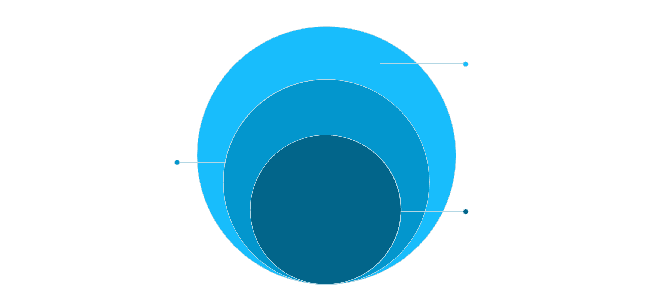

The Opportunity
STRATEGIC OPPORTUNITY
Instead of waiting for exclusions to occur, institutions can track risk earlier — inserting a structured intervention layer before the exclusion programs ever execute.
Exclusion should be the final step — not the first signal of a problem.
Exclusion Programs
Final step only if all supports fail
Intervention & Support
Activate targeted academic and social supports
Early Risk Tracking
Identify students trending toward exclusion
This requires adding a student tracking layer before the exclusion programs execute — a foundational shift in how institutions use HDMS to manage student outcomes. This is the next frontier of HDMS development.

Slide 23






Proposed Future Process
STUDENT SUCCESS FRAMEWORK
We are moving from a reactive exclusion system to a proactive student success framework — one that monitors academic activity, detects risk early, and intervenes before exclusion becomes necessary.
Monitor
Student academic activity tracked continuously
Detect
At-risk students identified early
Warn
Structured warning notifications issued
Intervene
Targeted intervention processes initiated
Reassess
Academic progress re-evaluated
Exclude
Applied only if required, as a last resort
Result: A proactive student success framework rather than a reactive exclusion system — placing student outcomes at the centre of academic governance.

Slide 24




New Capabilities Being Introduced
The new framework introduces two transformative capabilities that fundamentally shift how institutions identify and respond to academic risk — giving faculties and advisors the tools to act before exclusion occurs.
Early Risk Identification
Progressive Warning Mechanisms
The system proactively identifies students approaching exclusion thresholds, enabling timely intervention across a range of risk signals:
Students receive a structured, escalating series of warnings, creating clear accountability at every stage:
Overstay risk
Unsatisfactory academic progress
Repeated module failures
Qualification progression delays
Warning 1
Advisory Warning
Final Warning
Warning 2

Slide 25




Structured Intervention Framework
Students identified as at risk are not simply flagged — they are guided into a structured, trackable intervention process designed to support their academic recovery and protect institutional integrity.
Possible Interventions
Institutional Benefit
Academic Advising
Progress Review Meetings
By formalising the intervention process, institutions gain a significant governance advantage. Every intervention is:
One-to-one guidance to address individual academic challenges
Formal reviews to assess and document student progress
Structured — consistent processes applied across all cases
Trackable — full audit trail of actions taken
Auditable — defensible records for appeals or reviews
Academic Support Programmes
Faculty Monitoring
This strengthens compliance, reduces institutional risk, and demonstrates duty of care to students.
Ongoing oversight to ensure students remain on track
Targeted learning support to address skill or knowledge gaps

Slide 26
Role of the Exclusion Programmes
The exclusion programmes remain an essential part of the system. However, their position and purpose fundamentally change within the new framework — from the primary response mechanism to the final stage of a fair, structured process.
Current Role
New Role
Identify and exclude students who violate academic rules.
Act as the final stage in a structured academic governance process, reached only after:
Exclusion acts as the primary — and often only — institutional response, with limited opportunity for intervention beforehand.
Early risk warnings have been issued
Intervention opportunities have been provided
Academic progress has been monitored and reviewed
Outcome: Exclusions become more defensible and transparent — demonstrating that every reasonable step was taken before a final decision was made. This reduces appeals and strengthens institutional confidence.

Slide 27
Integrating Our AI Agent Initiative
INNOVATION ROADMAP
As part of our innovation roadmap, we are introducing AI-powered academic intelligence agents — designed to complement, not replace, the Student Tracking Framework. Both solutions are built to operate independently, ensuring institutions can move forward at their own pace.
Two Independent Solutions
AI Agent Capabilities
The Early Warning & Academic Intelligence Agent can:
Student Tracking Framework
AI Academic Intelligence Agents
Detect at-risk students earlier using pattern analysis
Manage progressive warning lifecycles automatically
Route cases for advisor intervention at the right moment
Provide explainable decision support to governance teams
Available immediately. Implement structured risk monitoring, warnings, and intervention processes today.
Enhances the framework with advanced analytics and proactive intelligence when institutions are ready.
The AI does not replace human decision-making — it supports and strengthens institutional governance structures.

Slide 28

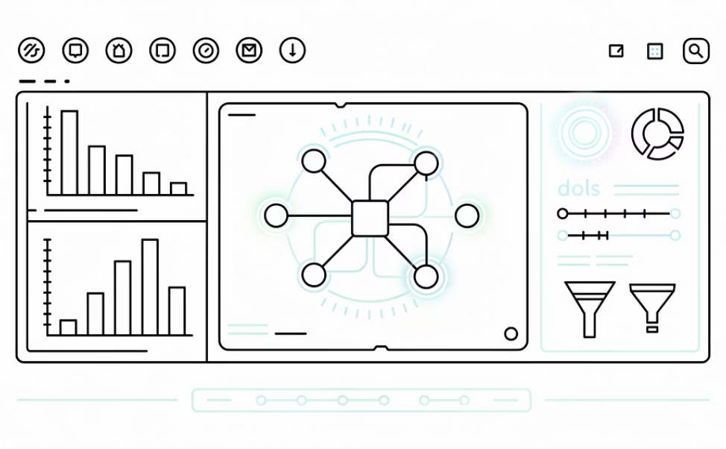
The Strategic Direction
Our strategy is clear: strengthen academic processes first, then enhance them with intelligence over time. This phased approach ensures immediate value while building towards a more intelligent, proactive institution.
Immediate Value
Future Enhancement
Implement the Student Tracking Framework today to improve student retention, strengthen academic governance, and reduce exclusion appeals — with no dependency on AI readiness.
When institutions are ready, AI Agents augment these processes with advanced analytics, earlier risk detection, and intelligent decision support — seamlessly layered on top of the existing framework.
We are not replacing institutional processes with AI. We are strengthening academic processes first, then enhancing them with intelligence over time.

