Slide 1




GELEZA NAMI TIMETABLING SOLUTION
Smart Academic Scheduling for Higher Institutions

Slide 2


THE TIMETABLING CHALLENGE IN HIGHER EDUCATION
Timetabling remains one of the most complex administrative challenges in higher education institutions.
KEY CHALLENGES:
ACADEMIC Timetables are often created manually using spreadsheets and fragmented systems
Frequent clashes between lecturers, venues, and course modules
Limited coordination across faculties and departments
Students and lecturers lack real-time visibility of schedules
Any timetable change requires multiple manual updates across systems
INSTITUTIONAL IMPACT
HIGH ADMINISTRATIVE WORKLOAD FOR ACADEMIC LECTURERS
Delays in academic planning and semester readiness
Frustration for both students and lecturers
Poor utilization of lecture halls and campus facilities

Slide 3
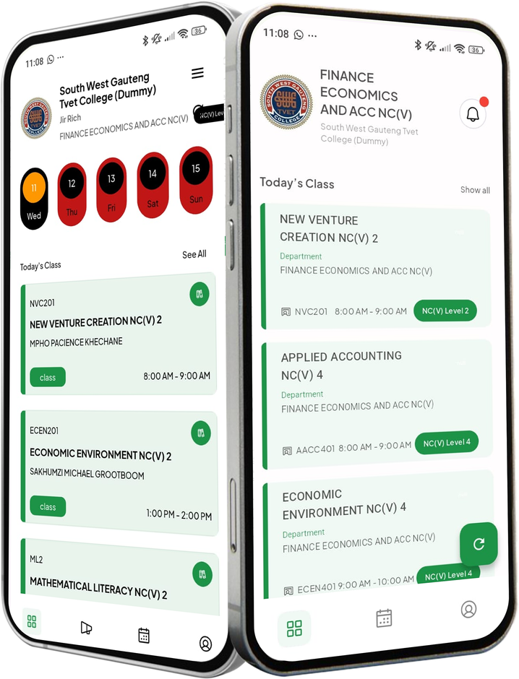

THE SOLUTION
Geleza is a smart timetabling platform designed to simplify and automate academic scheduling for higher education institutions.
WHAT GELEZA ENABLES INSTITUTIONS TO DO:
Plan and generate academic timetables efficiently
Coordinate lecturers, modules, and venue allocation seamlessly
Automatically detect and resolve timetable conflicts
Maintain a centralized and structured timetable database
Provide students and lecturers with easy access to their schedules
Geleza transforms timetabling from a manual administrative burden into an automated institution-wide system.

Slide 4

CORE CAPABILITIES OF GELEZA NAMI
Geleza provides a range of features that support the complete timetabling cycles.
Key features include:
1.
2.
AUTOMATED TIMETABLE CREATION:
Structured scheduling process across faculties and departments.
CONFLICT DETECTION:
Automatically identifies lecturer, classroom, and module clashes.
3.
4.
TIMETABLE VISIBILITY:
Students and lecturers access accurate schedules
CENTRALIZED TIMETABLE MANAGEMENT:
Single source of truth for all scheduling data.
5.
6.
Venue Optimization:
Efficient allocation of classrooms and learning spaces.
SEAMLESS INTEGRATION WITH INSTITUTIONAL SYSTEMS

Slide 5


IMPLEMENTING GELEZA DELIVERS BOTH OPERATIONAL AND STRATEGIC ADVANTAGES.
Operational Benefits
Improved timetable planning and management
Reduced scheduling conflicts
Improved venue utilization
Reduced administrative workload
Strategic Benefits
Better coordination across faculties
Improved student experience
Greater timetable transparency
Scalable scheduling for multi-campus institutions

Slide 6

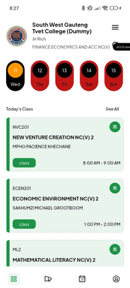
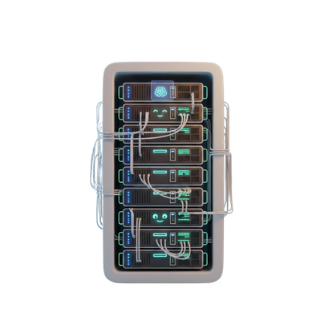
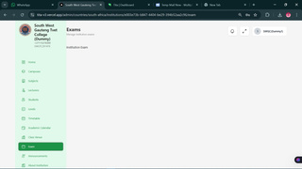
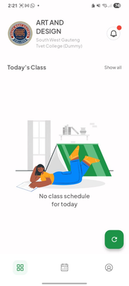
HOW GELEZA NAMI WORKS (WORKFLOW)
ITS Integrator
INFORMATION REQUIRED
GELEZANAMI
(Student facing)
Subject Information (Subject code, Subject distribution, Campus, Faculty, department)
Lecturer Allocation (personnel ID, Subject Assigned)
Class Schedule Meta data (Date, Time, Venue Duration)
Student Enrollment Data (Student number, Campus, Department , Faculty)
Academic Calender Data (Seminar Dates, Holidays, Exams Periods)
CSV
GELEZA NAMI
(Lecturer facing)
BACKEND/ HOST SERVER
Admin
Panel

Slide 7





Geleza Workflow
1.
2.
3.
Academic data imported from institutional systems
Modules, lecturers, and venues assigned
System detects scheduling conflicts
5.
4.
Timetable published to students and staff
Timetable reviewed and finalized
This ensures a structured and efficient timetabling process.

Slide 8
