Slide 1

Discover Finance Features That Unlock the Power of Your Operations
Session 31 & 32
Presenter: Bernard Mostert

Slide 2

DISCLAIMER
This presentation is only a summary of some of Adapt IT’s products, features and their latest developments. Adapt IT only intends for the information to give you an overview, and not a complete and comprehensive statement that necessarily suits your purposes.
Adapt IT reserves the right to change any information contained in this presentation and is not responsible for any loss that results from inaccuracies in the information. You may not distribute or reproduce the information without Adapt IT’s written permission.

Slide 3
TABLE OF CONTENT
Bursaries and Loans (Financial Aid)
Counter & Cash Book
Student Debtors
Procurement Management
Expense Budgeting
General Ledger

Slide 4
Bursaries and Loans – Financial Aid
Notes:
https://www.kiplinger.com/article/college/t042-c000-s001-master-the-financial-aid-process.html

Slide 5
Is it still available?
Are there other clients using it?
Is it working?
No, it doesn’t have an integration to NSFAS
Is it not difficult to use?
Notes:
Have you ever heard this after been asked, are you using the bursary system – also known as financial aid

Slide 6
Bursaries and Loans – Benefits using the module
Better administration
Improved reporting – historic vs. current
Segregation of duties
Improved accuracy
Notes:
These are some advantages or benefits when using the module. Important that you compare this with the existing practise where you are processing SD journals.

Slide 7
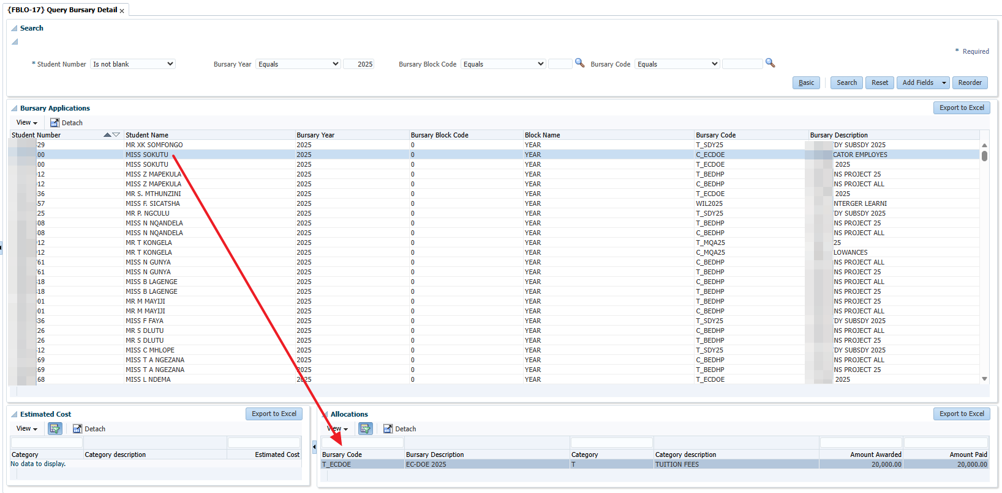
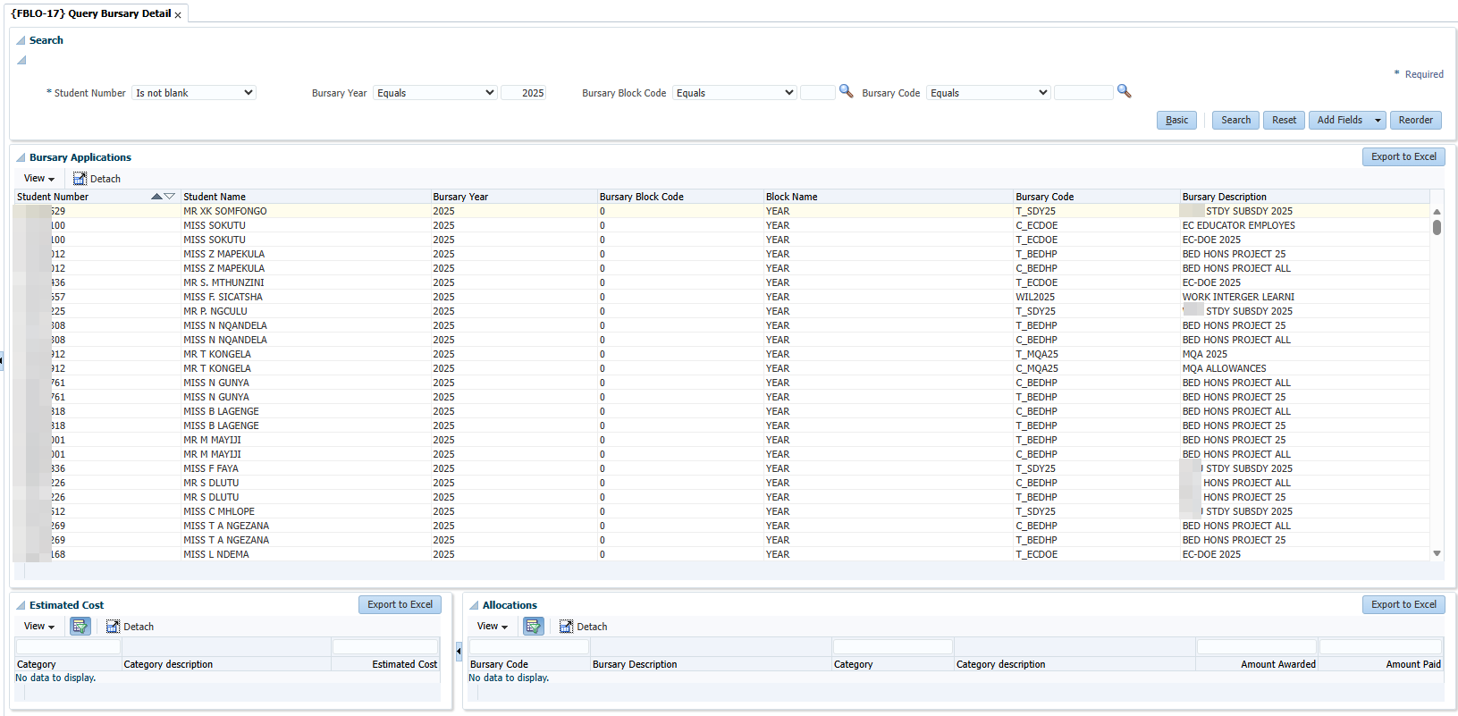
Highlights of some functionality – {FBLO-17} Query Bursary Detail
Notes:
You will see at the top of the screen you can insert specific query criteria. In my example I selected bursaries for 2025. The moment that you select a specific student, you can see the details appearing at the bottom. Then for those who are Excel jockeys, you can export to excel.

Slide 8
Highlights of some functionality – Batch update functionality
Estimated costs – {FBLO28/30}
Applications – {FBLO-35}
Allocations – {FBLO-36}
Bank details – {FBLA-8}
Notes:
I am lazy, if there is a chance to do things in batch, I am using this. Here is a list of the things we can load in batch, with the relevant menu option. Just a reminder that the remittance advice can be used to get the applications and allocation in the system.

Slide 9
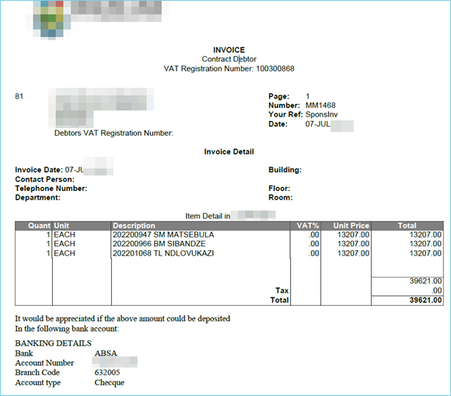
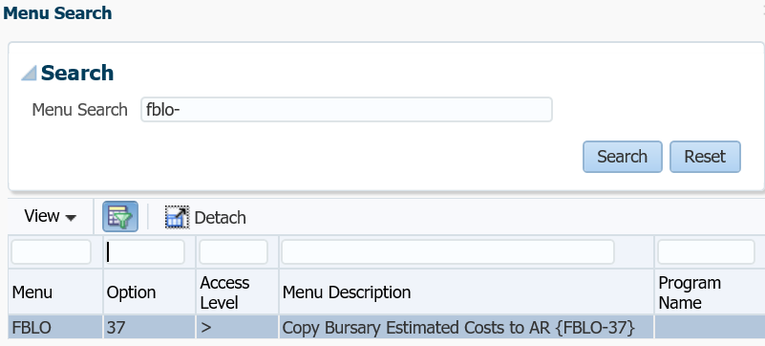
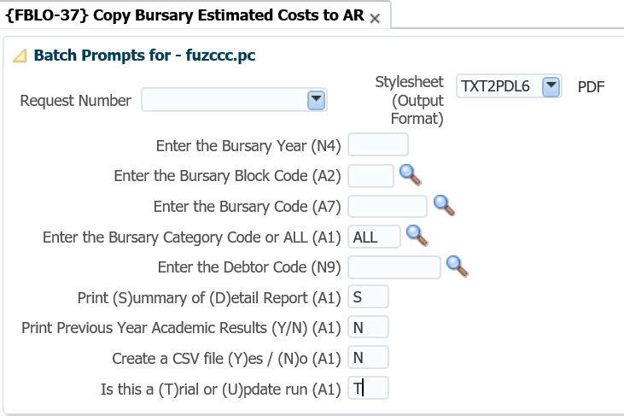
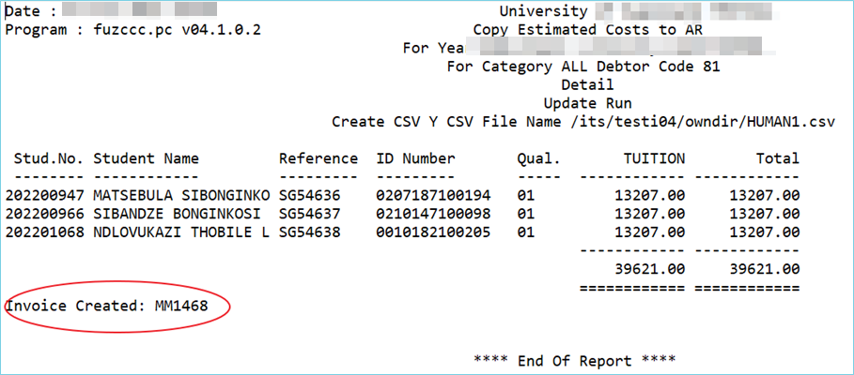
Highlights of some functionality – Create invoice from bursaries
How can we Improve Student success? A Bigger Picture
Other bursaries, not NSFAS money.
Notes:
Do you have bursaries that are administered, but where the sponsor is expecting an invoice? NOT NSFAS money.
We have the functionality for the contracts, but do you know about the bursaries and the AR system? Have a look at this option.
Just note that it is looking at THE ESTIMATED costs.
What the option does it will create the invoice for the specific debtor.

Slide 10
Counter and Cash book
Notes:
https://bankingbiz.co.za/news/general-banking-news/south-african-banking-weathering-change,-seizing-opportunity.html

Slide 11
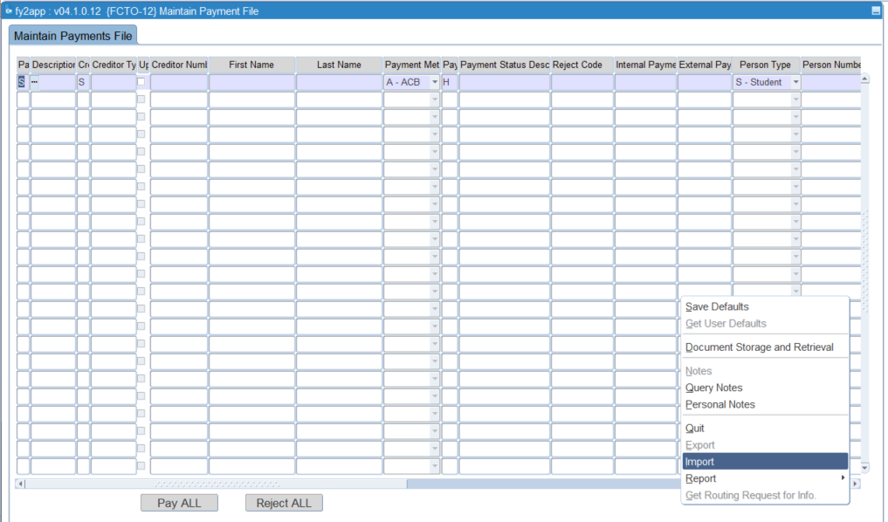
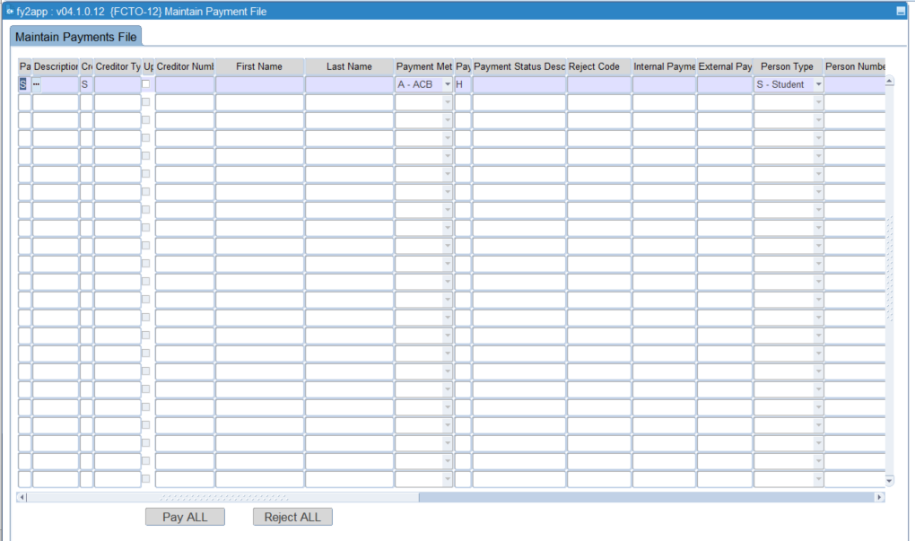
Highlights of some functionality – {FCTO-12} Maintain Payment File
Right click
Notes:
The option allows you to not only pay refunds to student, but also to make payments, like stipends to students.
The functionality to import high volumes of data also exists.
Reminder that we also have segregation of duties, where you have a user loading the payment, while another one can approve the payments, before generating the payments in FCTO-20.
Also remember the functionality that exists to upload bank details in batch. Alternatively you can load them individually where approvals of the bank details can also be done.

Slide 12
Highlights of functionality – Generate ACB (EFT) payments {FACM}
Payments are not just for creditors, also refunds to debtors.
Challenge is where the payments are done “outside” of the system. Payments are not in the cash book.
Notes:
There are situations where clients are not using the functionality to pay their creditors (or other payments).

Slide 13
Student Debtors
Notes:
https://www.wealthprofessional.ca/news/industry-news/when-the-most-affordable-plan-vanishes-us-student-debtors-brace-for-impact/391103

Slide 14
Highlights of some functionality – {FSAOR2-9} Student statement
Functionality to email statements to students
Statement with notes, ageing and summary of balance
Notes:
How many of you are still sending statements to students? Yes I know the students can view their own statements, but who emails them?

Slide 15
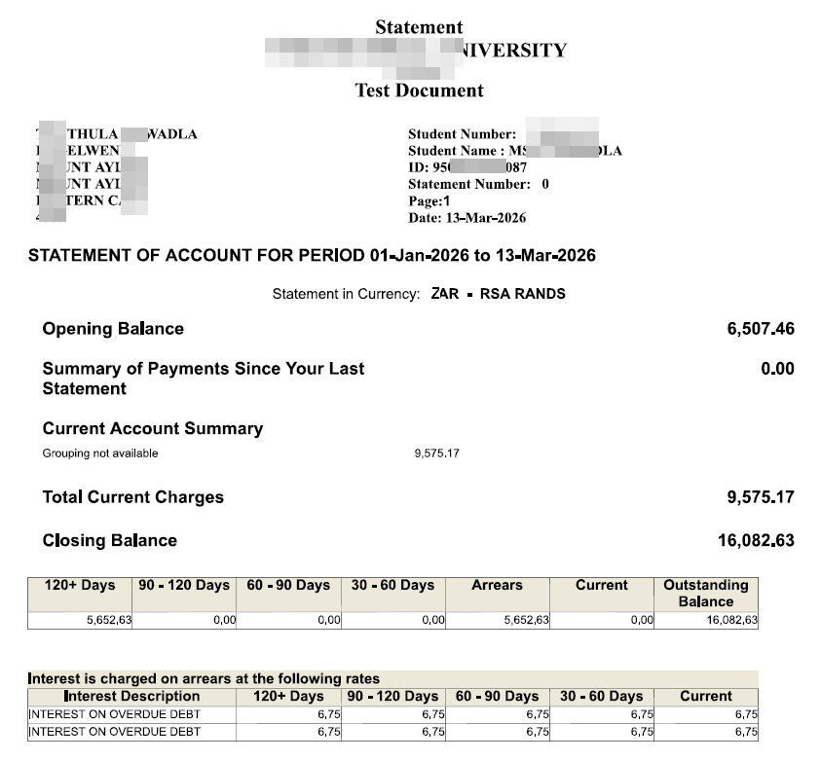
Highlights of some functionality – {FSAOR2-9} Student statement
Notes:
An example of the first page of a statement from FSAOR2-9

Slide 16
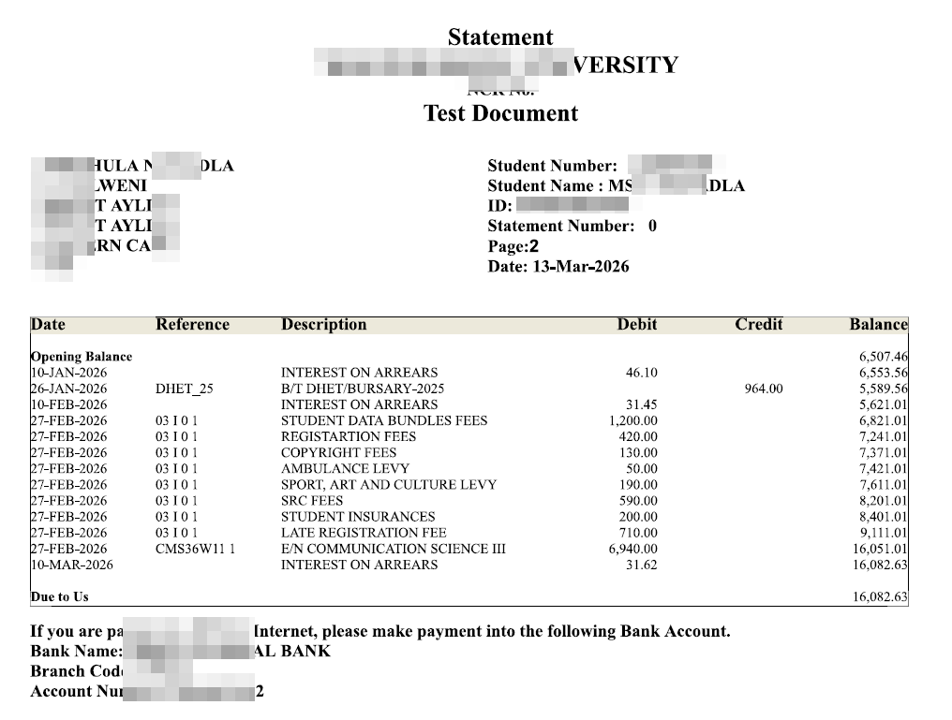
Highlights of some functionality – {FSAOR2-9} Student statement

Slide 17
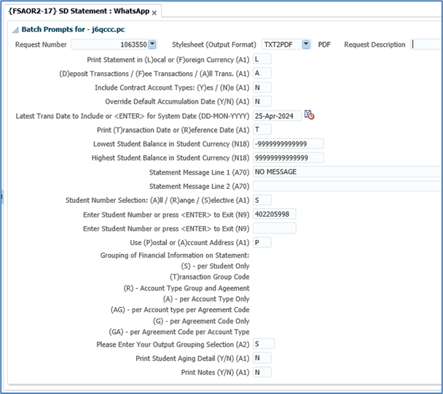
Highlights of functionality – WhatsApp
Highlights of some functionality – {FSAOR2-9} Student statement
Notes:
Now I mentioned getting the statements to students by means of email. How about WhatsApp?

Slide 18
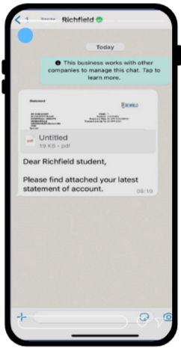
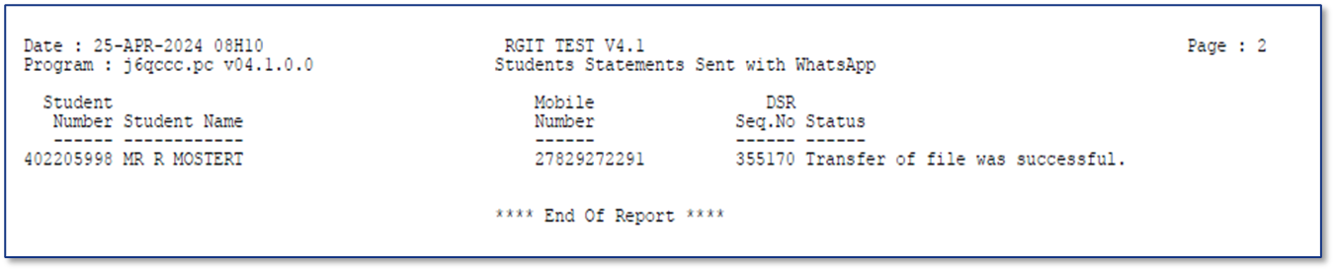
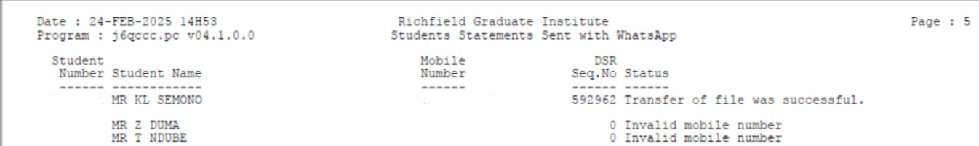
Seamless Statement Automation with WhatsApp

Slide 19
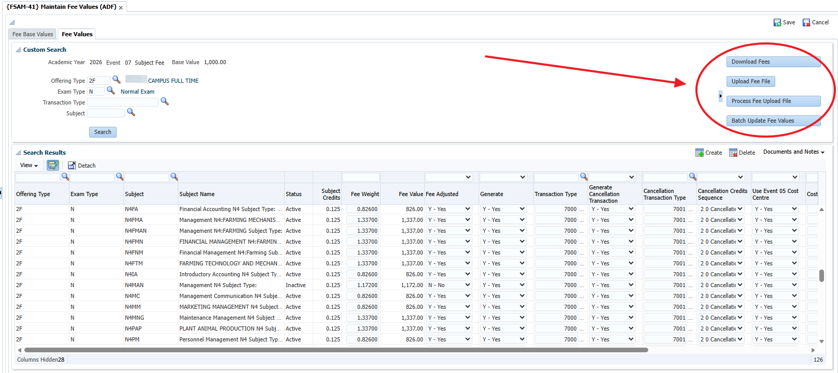
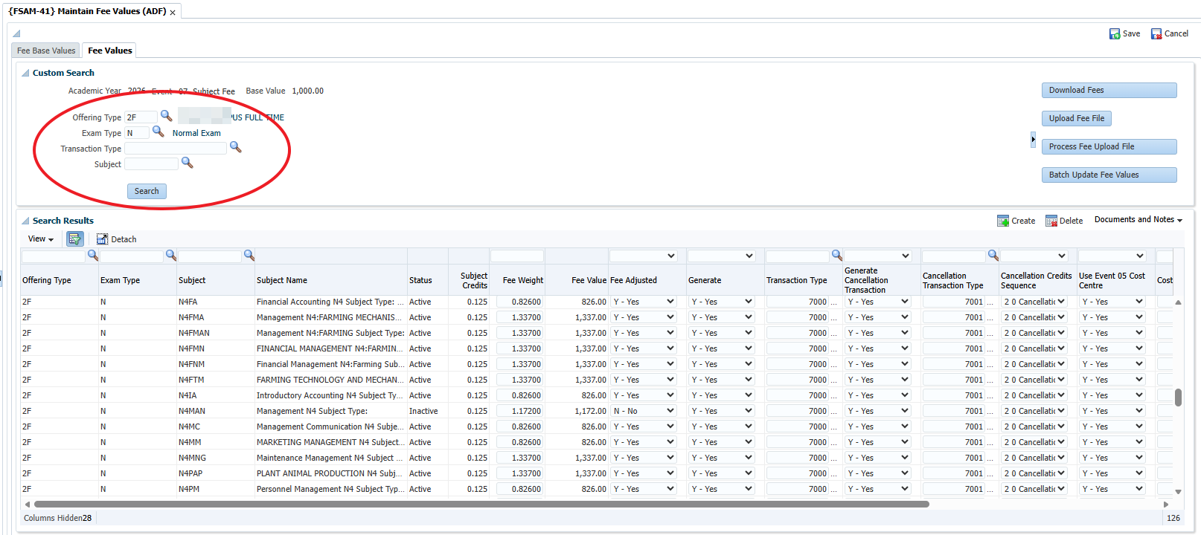
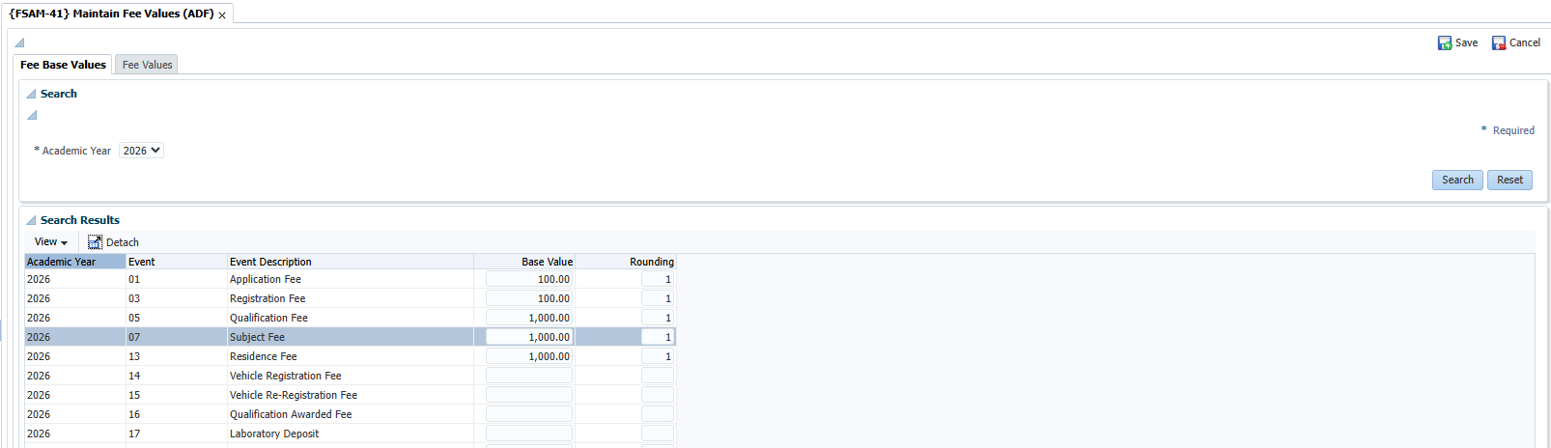
Highlights of some functionality – {FSAM-41}
Notes:
They say you can’t teach an old dog new tricks…
I am also guilty, still using FSAM-29 and FSAM-1
How many of you are actually using FSAM-40 and 41?

Slide 20
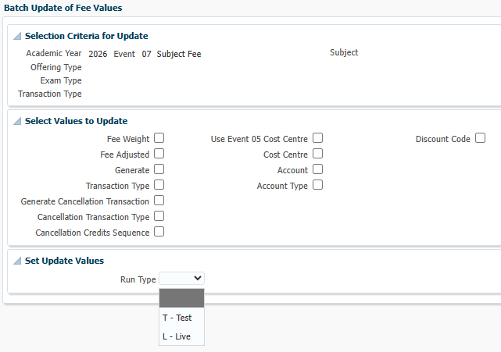
Highlights of some functionality – {FSAM-41} Fees (continue)
Functionality to download fees
Upload fees (then process file)
Batch update of fee values:
Notes:
Just some of the functionality I also forget about that exists on the option.
Here you can see the fields that you can update in batch or bulk. Specific fields for the records you searched in the previous screen.

Slide 21
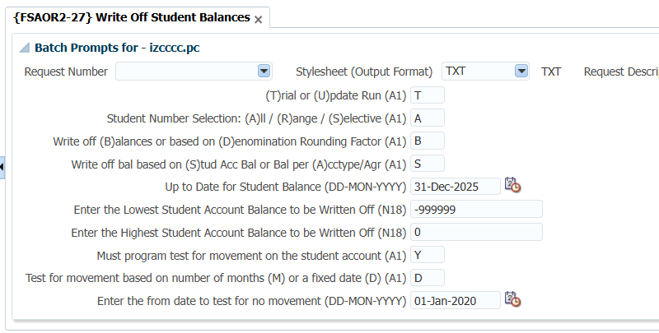
Highlights of some functionality – {FSAOR2-27} Write off student balances
Notes:
This option works with 4 events.
A debit/credit for the denomination
A debit/credit for balances. Very useful option as you can also look at no movement on a student.

Slide 22
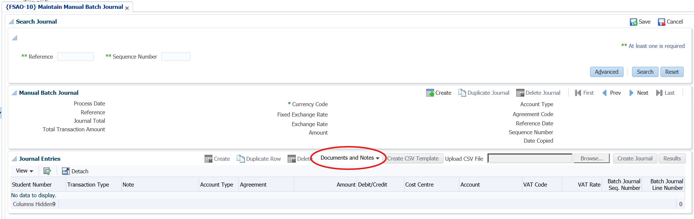
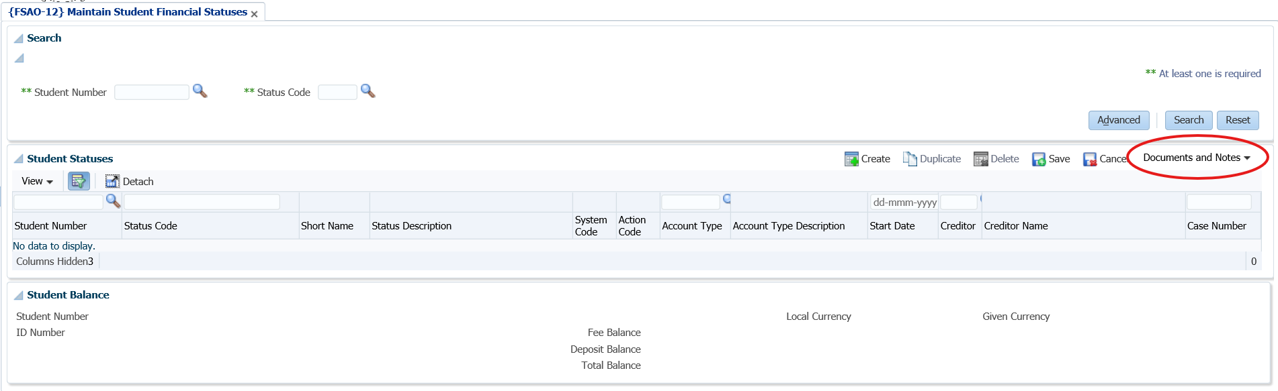
Highlights of some functionality – {FSAO} Documents and Notes
Notes:
Have you ever used supporting documents when you are processing journals, or linking statuses to students?
Remember you can also view these documents when you view the records later.

Slide 23
Highlights of some functionality – iEnabler (student debt)
Acknowledgement of debt
Functionality where student can indicate how they will pay back their debt.
Staff member will approve/reject application.
Refunds
Student submits a request for refund.
Staff member approves/rejects application.
Refund paid to bank account.
Notes:
There are some functionality that exists in the iEnabler that is not always used.

Slide 24
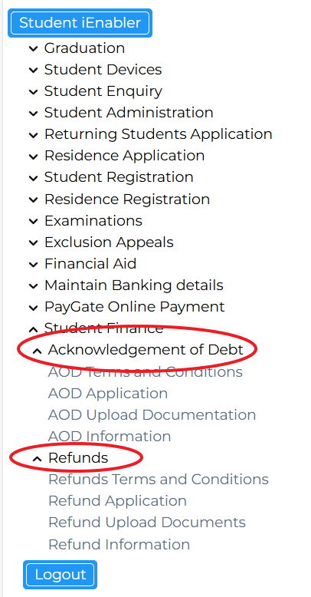

Slide 25
Procurement Management

Slide 26
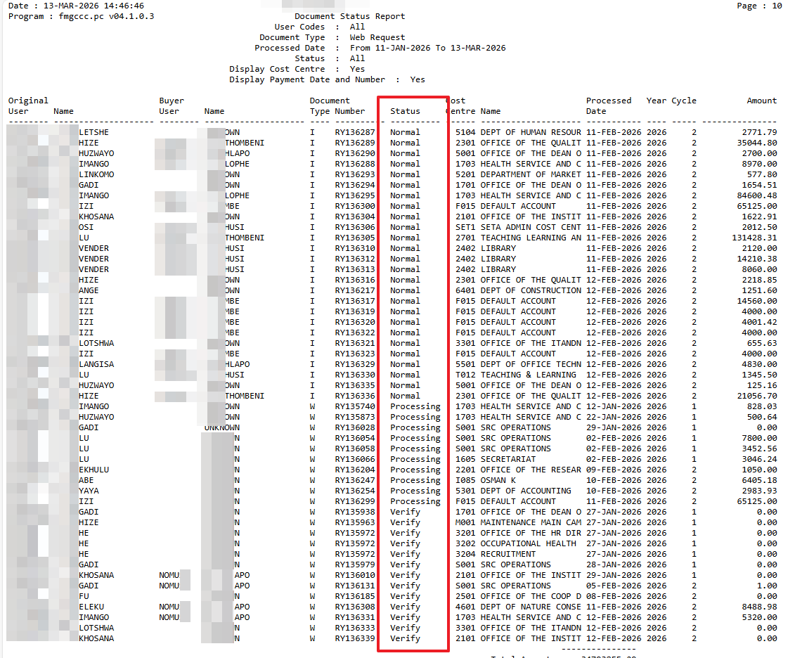
Highlights of some functionality – {FPMOR2-4}
When executing the report, the report will provide details of documents that are in:
“Approval” – impacts budget
“Normal” – impacts budget
“Processing”
“Verify” – impacts budget
Notes:
I mentioned this last year – for those who may have missed this,
The status of a document is making a difference – yes, it impacts your budgets.

Slide 27
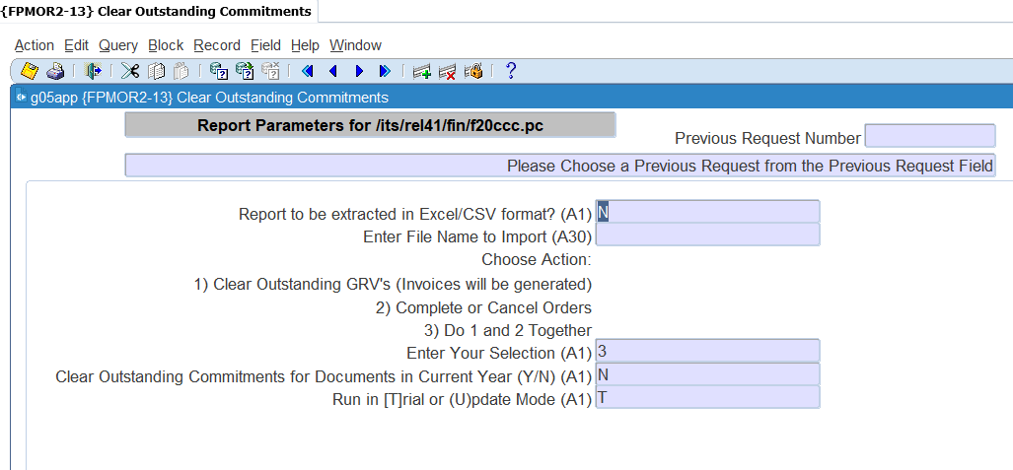
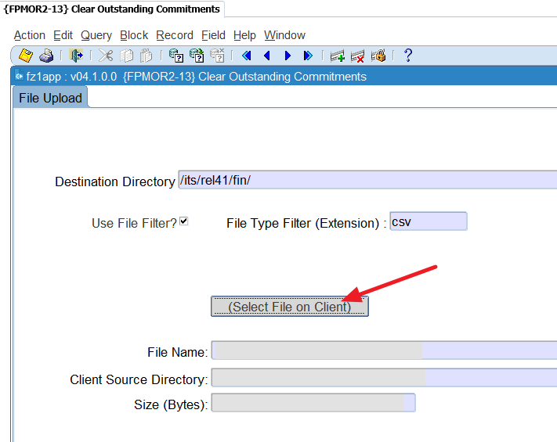
Highlights of some functionality – {FPMOR2-13} Clear outstanding commitments
How do I get rid of outstanding commitments? {FPMOR2-13}
You will have three options BUT execute in trial first.
1. Clear outstanding GRVs (invoices will be generated) – Commitments are cleared by generating the invoices and cancelling them.
2. Complete or cancel orders – Commitments are cleared by completing or cancelling the orders.
3. Do 1 and 2 Together: this option will apply both option 1 and 2
Notes:
FPMOR2-13 removing commitments
First run the outstanding commitments report in {FPMOR2-6. The input parameters are critical as these are the commitments you want to delete.
You will use that report to compile a report that will be used in the report {FPMOR2-13} to remove the commitments.
Make sure the file path is completed in {BATCH-7} against the function ‘OUTCOM’
When you access the option, it will first allow you to upload the file you compiled…
Then after you upload the file and click exit it will look like a report. Click enter and it will display the parameters.

Slide 28
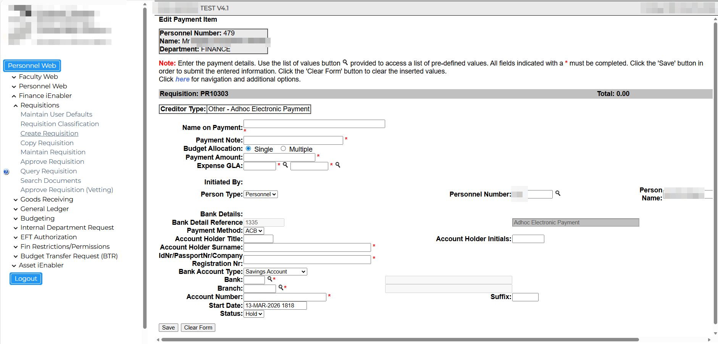
Highlights of functionality – Ad hoc Payments
Notes:
How many ad hoc payments do you have… I am talking about other payment, where you are not paying creditors, or payroll or refunds. All the other things.
This functionality allows you to submit a payments request. This is done via the iEnabler.

Slide 29
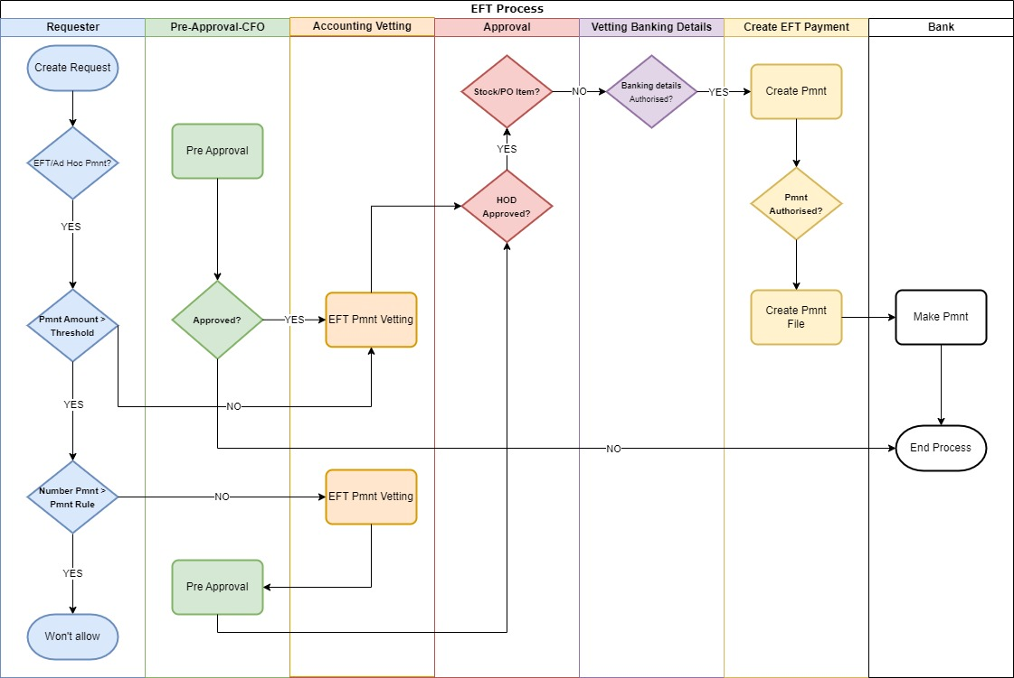
Notes:
Here is a process flow that just shows the functionality that is actually available when it comes to ad hoc payments.
It could be simplified, but this is what the system is catering for.

Slide 30
Highlights of some functionality – Creditors, audit reports
Standard Jasper views and reports to assist with audits
W_FIN_01SpendingPerSupplierPerYear
VW_FIN_01SpendingPerSupplierDetails
RP_FIN_PM03_Creditor_Details_Banking_Address_Transactions Report
VW_CREDITOR_BANKING_DETAILS
VW_FIN_01CreditorDetailsAndPayments
Notes:
Here is a list of Jasper reports that we often have to repeat to the users. This is usually during the audit time when you need to provide info to the auditors. Have a look at the list.

Slide 31
Expense budgeting
Notes:
https://www.gep.com/blog/strategy/budget-management-software-solutions-pain-points-benefits

Slide 32
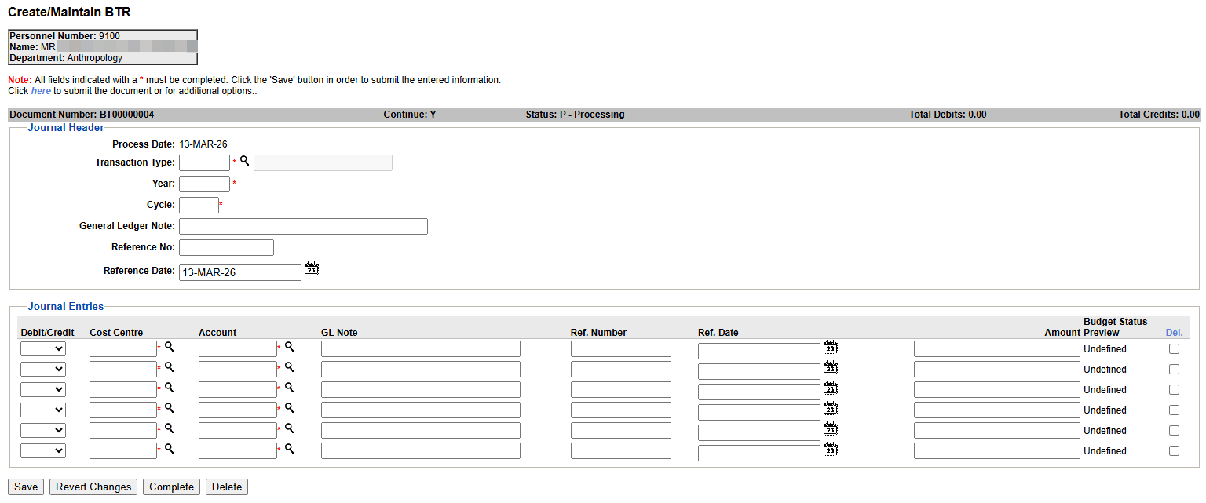
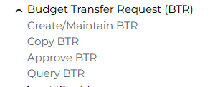
Highlights of some functionality – iEnabler budget
This allows you to request the transfer of budget amounts.
Approval functionality included.
Notes:
This is just to give you a brief look of the BTR.

Slide 33
General Ledger
Notes:
https://www.accountsportal.com/guides/small-business-guide/what-is-a-general-ledger

Slide 34
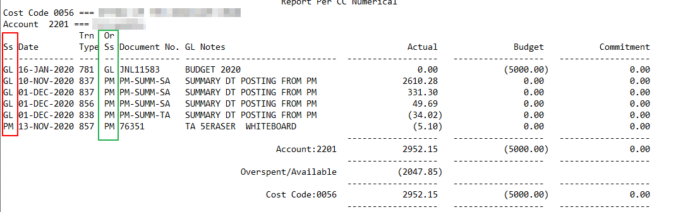
Highlights of some functionality – {FGLOR1-8/28}
What do all the columns mean when looking at some reports?
Notes:
When you are executing TT reports, account summary reports or CC reports, there may be differences – although there should NOT be…
Do you know what these columns mean?
The green one is the originating sub system – where was this processed?
The green one shows where is it now – pay attention to the last record. It says PM – so means that transaction is not posted yet.
What does it mean? Some GL reports may not include that transaction. Be careful.
Validation of CC structure

Slide 35
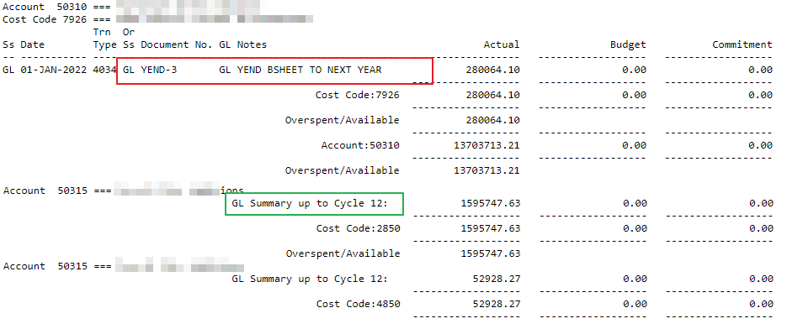
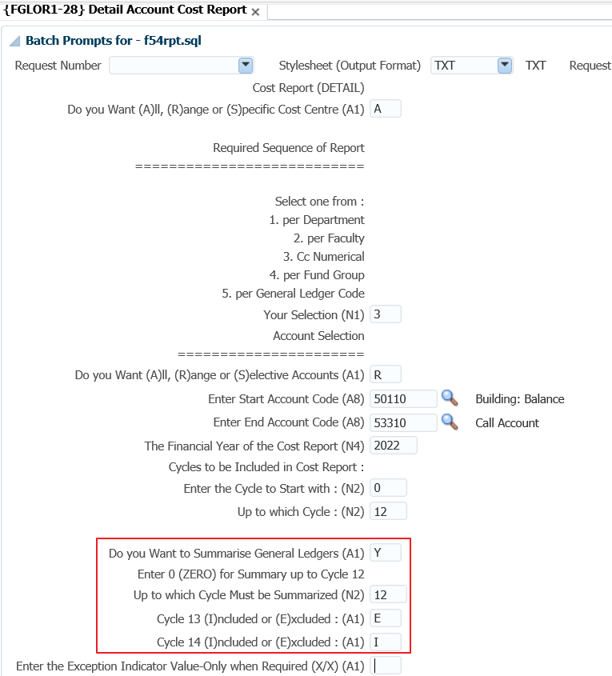
How can we Improve Student success? A Bigger Picture
How do you get only the opening balance of a specific account?
Notes:
When you look at the detail report CC or account – {FGLOR1-8/28} you need to pay attention to the parameters:
The section I have blocked…
Those parameters can be explained as follow – summary the important one, while you also need to pay attention to cycle 13 and 14.
The output will have the opening balance and the summary – if there were entries in that financial year will shows summary up to the selected cycle.
Validation of CC structure

Slide 36
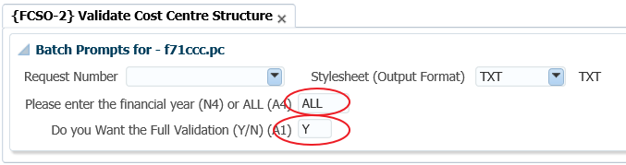
Imbalance on your TB?
Notes:
You execute the TB and have an imbalance, yes it sounds like an easy problem, but I want to recap how you should use the reports that are available.
You all start with the transactions on invalid GLA’s report – {FGLPR1-3}.
Then you run the account structure validation – {FCSO-3} and then the
Validation on the CC structure – in {FCSO-2}. This is where you could miss some valuable information.
You will probably complete the following values – all financial years and complete validation.
Rather insert the financial year where you have the imbalance AND the consolidation CC code that you used for the TB.
Just a last reminder – what you can also look at before doing the validations, is to run the account summary report in {FGLOR1-26}. If that report is in balance, you know it is a consolidation structure that is wrong. If this report has an imbalance, then run the TT report in {FGLOR1-21} for the specific year, BUT in summary, for all cycles – 0 to 14 and all TT’s.

Slide 37


Slide 38
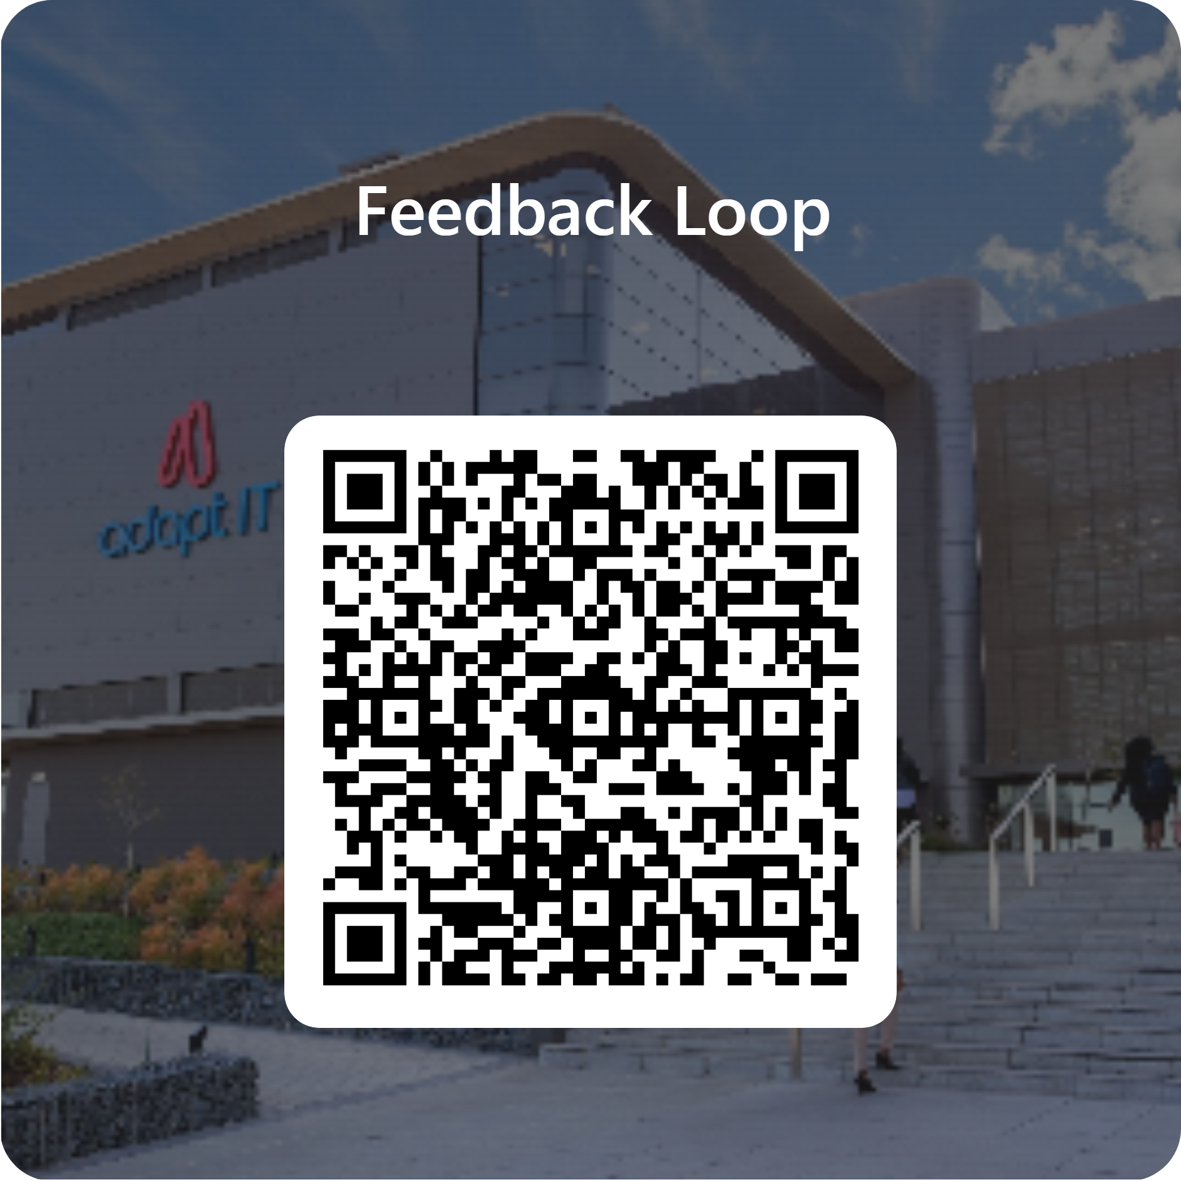
Feedback

