Slide 1

4.1 Finance System Enhancements
Transform Your Finance Operations to Maximize Returns!!!
Presenter: Brilliant Tleane & Zama Mkhize

Slide 2

DISCLAIMER
This presentation is only a summary of some of Adapt IT’s products, features and their latest developments. Adapt IT only intends for the information to give you an overview, and not a complete and comprehensive statement that necessarily suits your purposes.
Adapt IT reserves the right to change any information contained in this presentation and is not responsible for any loss that results from inaccuracies in the information. You may not distribute or reproduce the information without Adapt IT’s written permission.

Slide 3
TABLE OF CONTENT
Finance Team
Strategic Technology Plan
Student Finance Enhancements
Core Finance Enhancements
Finance Roadmap

Slide 4
Strategy

Slide 5
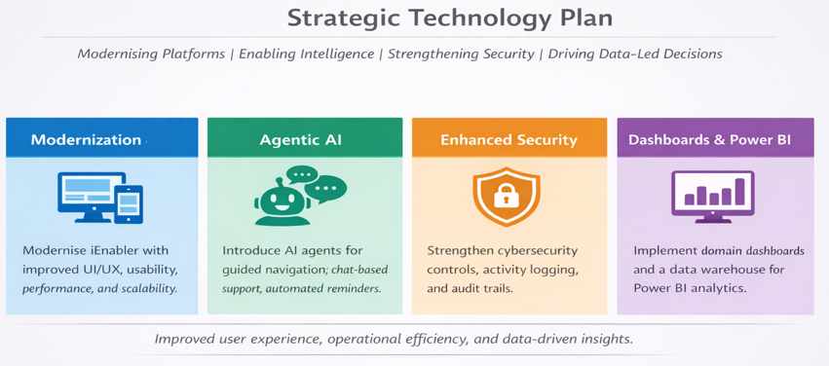
Strategic Technology Plan

Slide 6
Special Interest Group

Slide 7

Special Interest Group (SIG)
About SIG:
A structured pathway for higher-education institutions to co-design the future of digital technology — before it reaches the broader market.
What Makes a SIG Different
Direct Influence : Institutions actively shape features, design, and priorities from the ground up.
Equal Voice : Every participating institution has equal input, regardless of size or resources
Early Access : SIG members gain access to new capabilities well before general availability.

Slide 8
Student Finance
Enhancements

Slide 9

Finance Enhancements
Provisional statement (Student Deposits)
Nedbank Host to Host
DPO Payment Gateway
Paygate : Infinity
Fee Estimation (Quotation)
OTP Before Updating Banking Details
RealPay Mandate

Slide 10
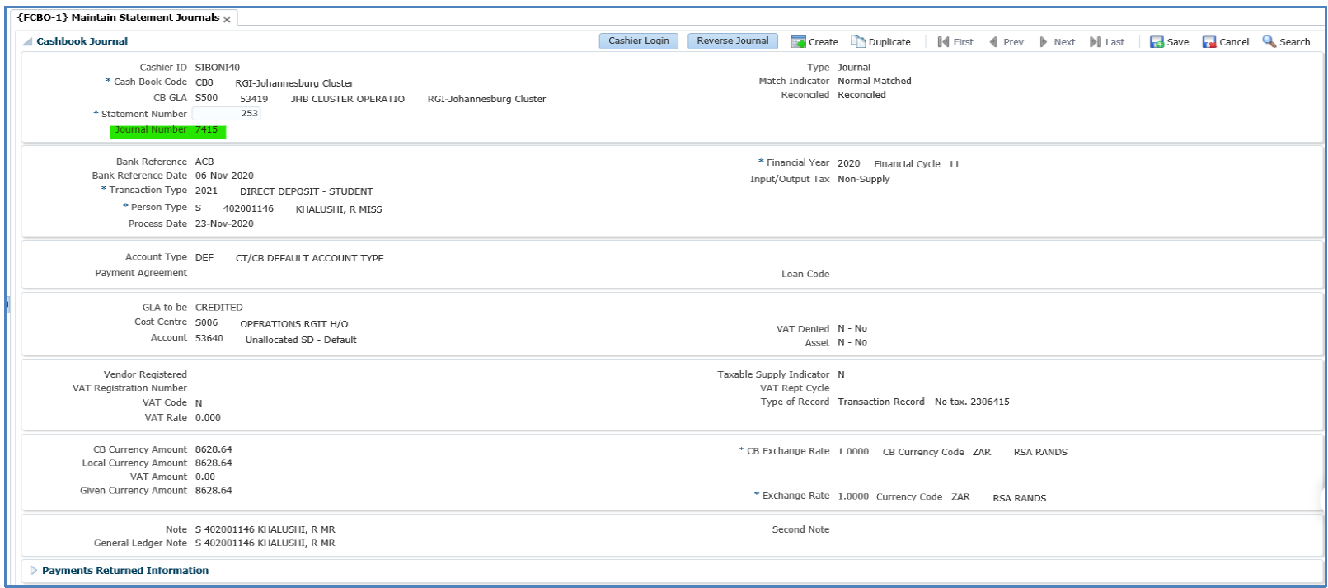
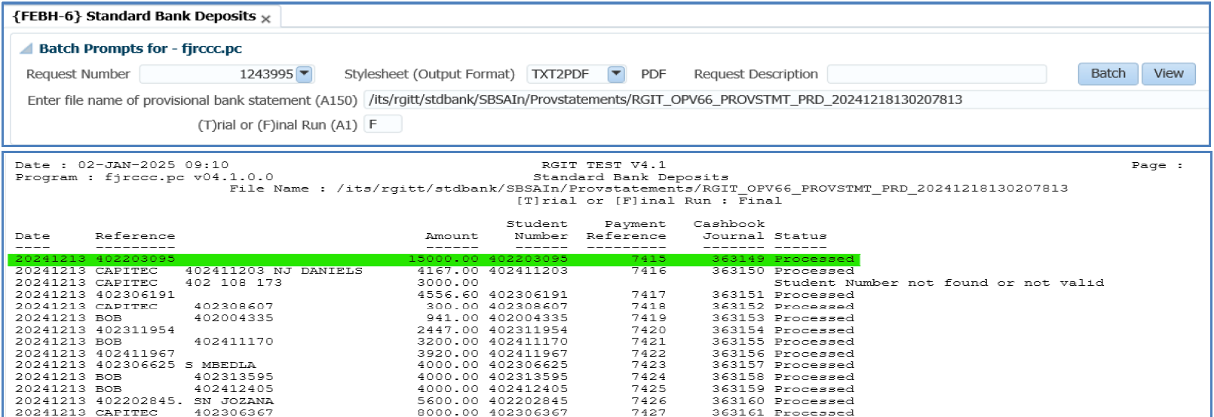
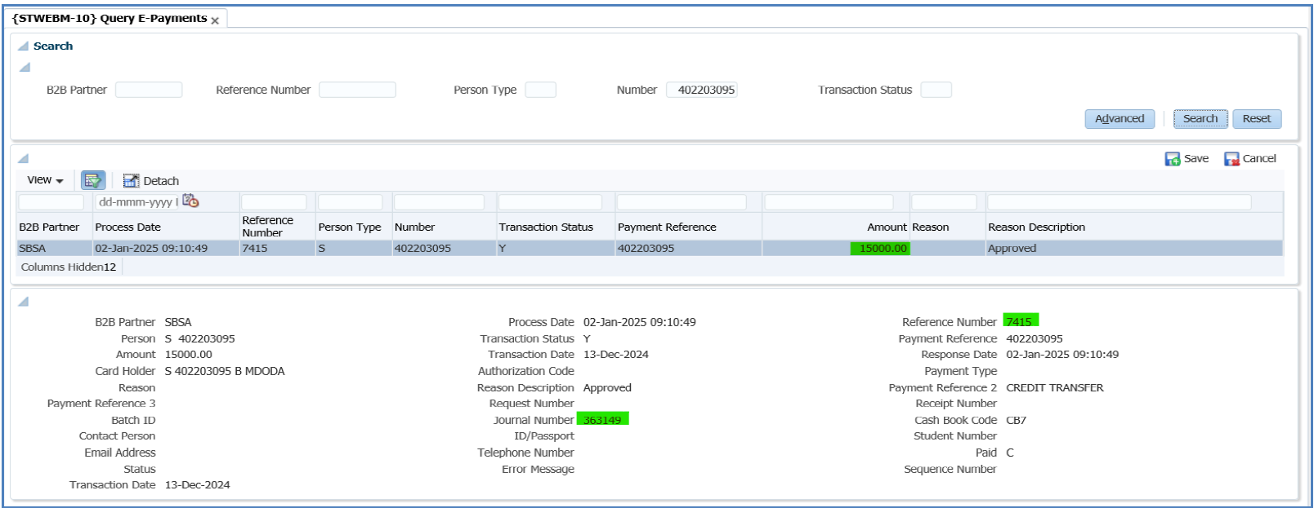
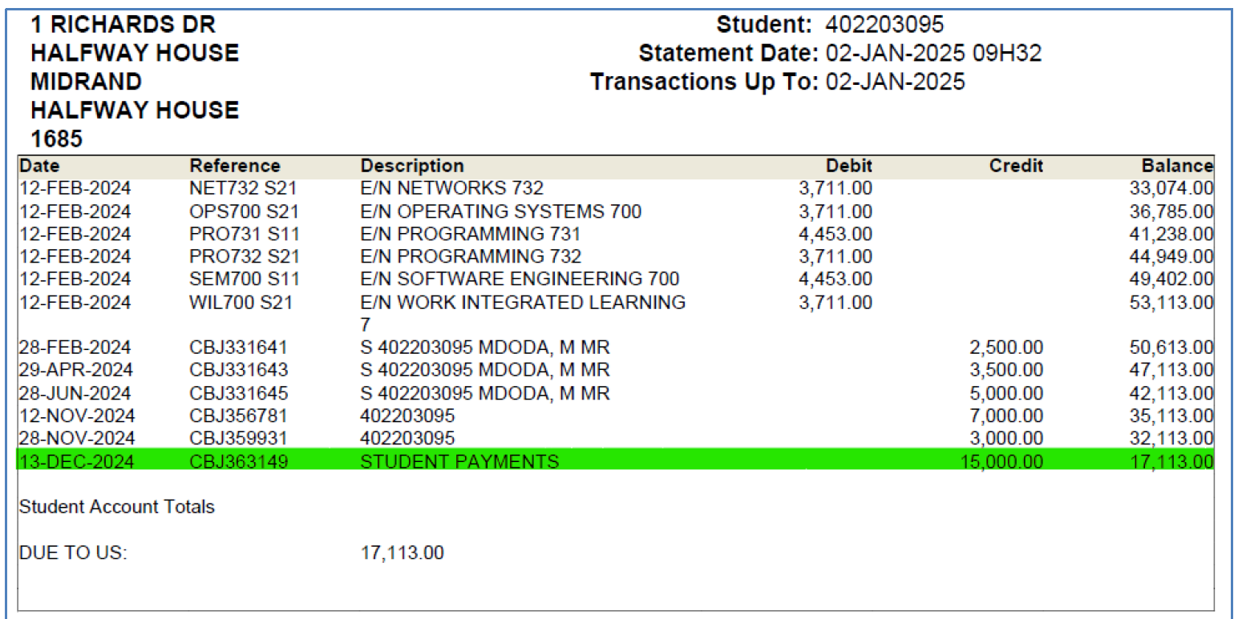
Provisional Statements (Student Deposits)

Slide 11
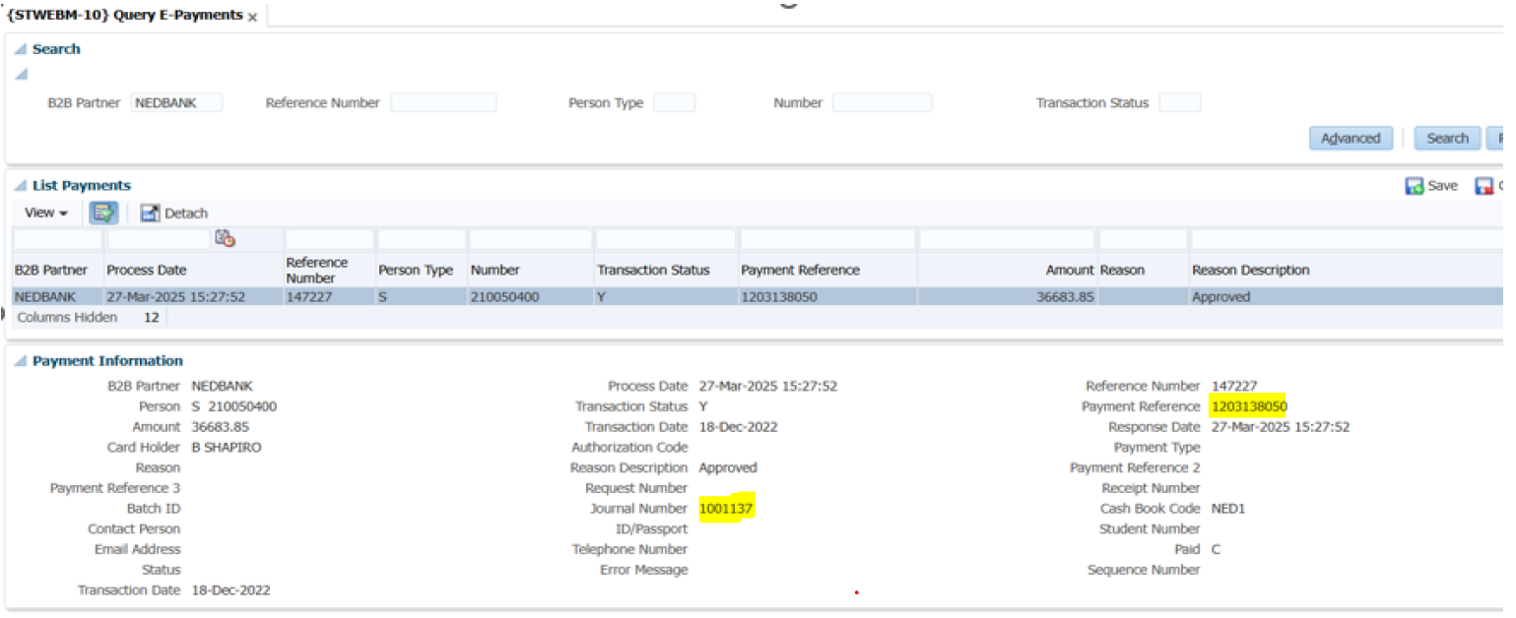
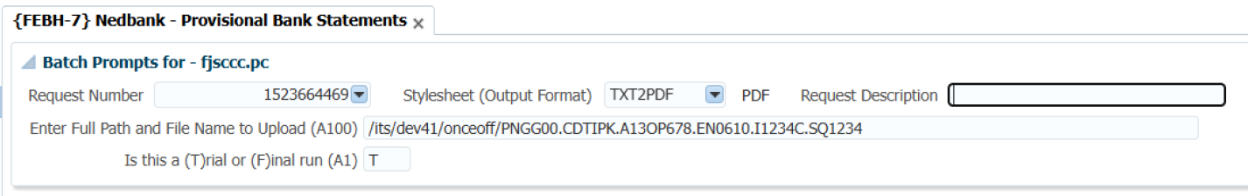
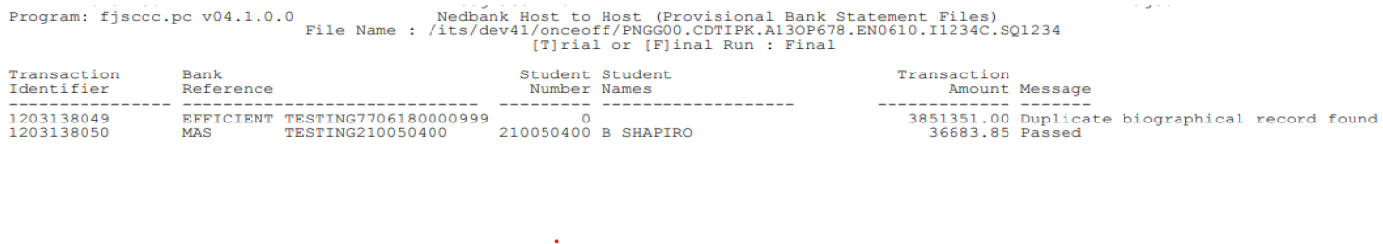
Nedbank H2H (Student Deposits)

Slide 12
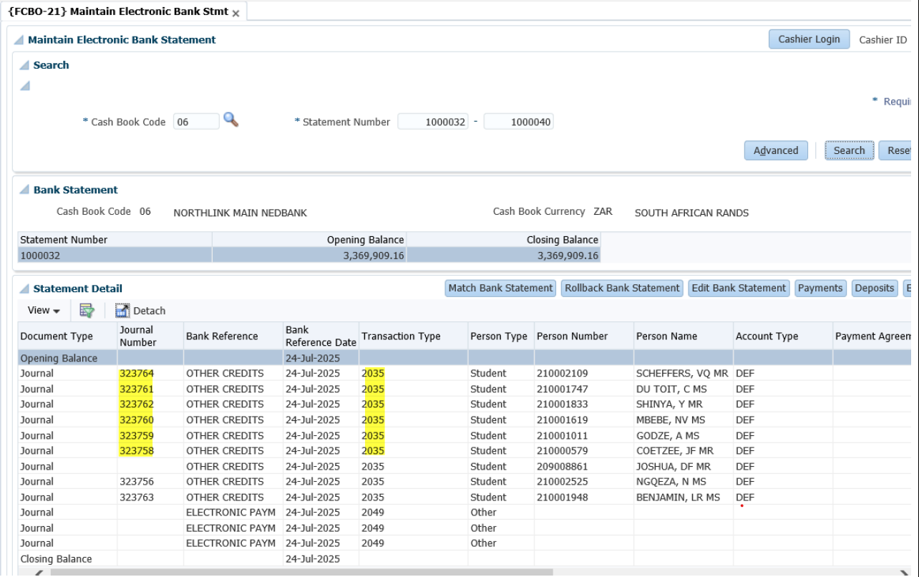
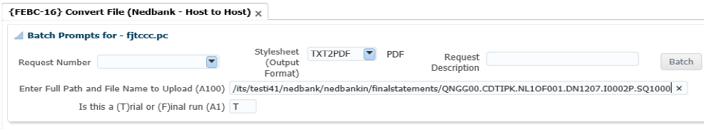
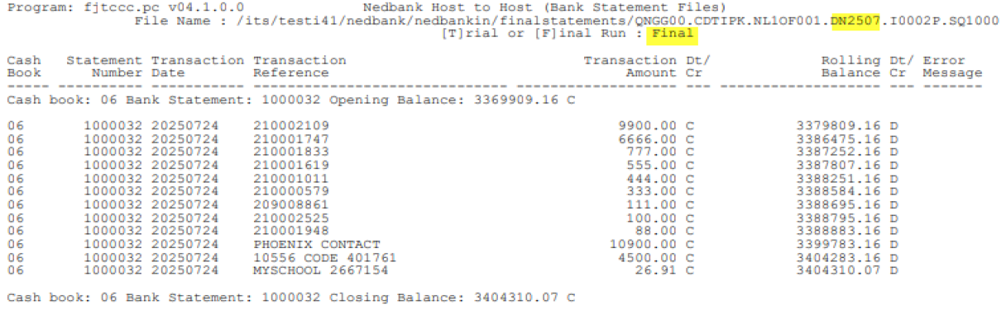
Nedbank H2H (Bank Statement)

Slide 13
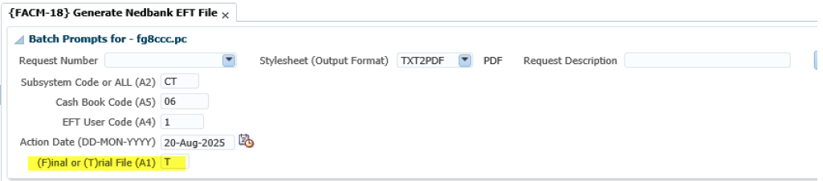
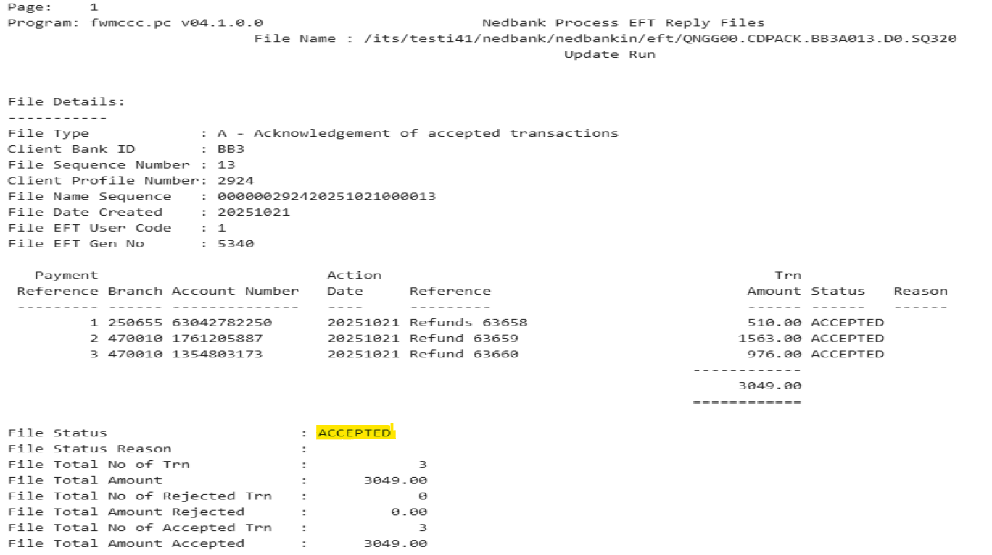
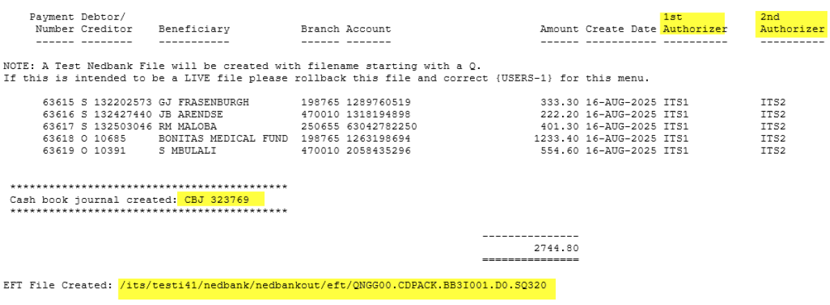
Nedbank H2H (EFT Payments)

Slide 14
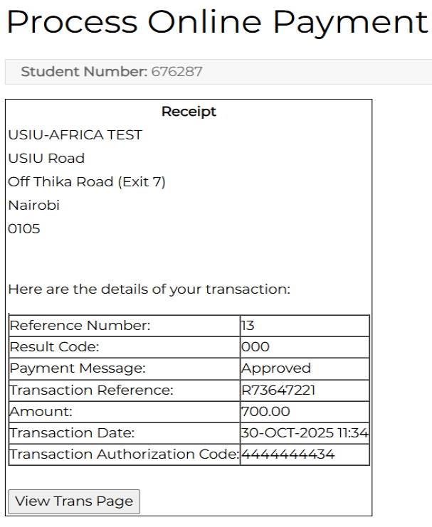
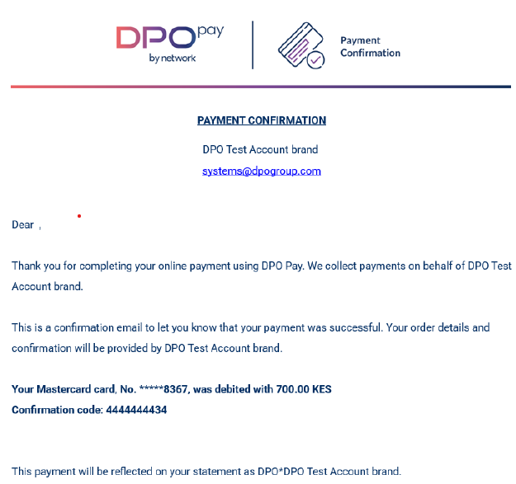
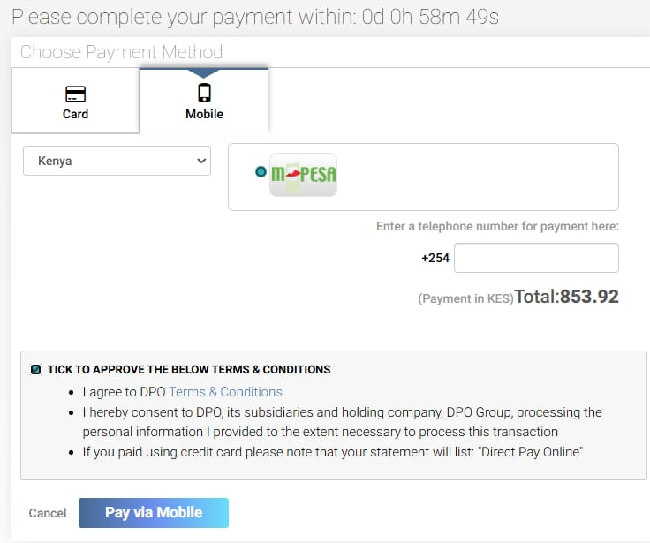
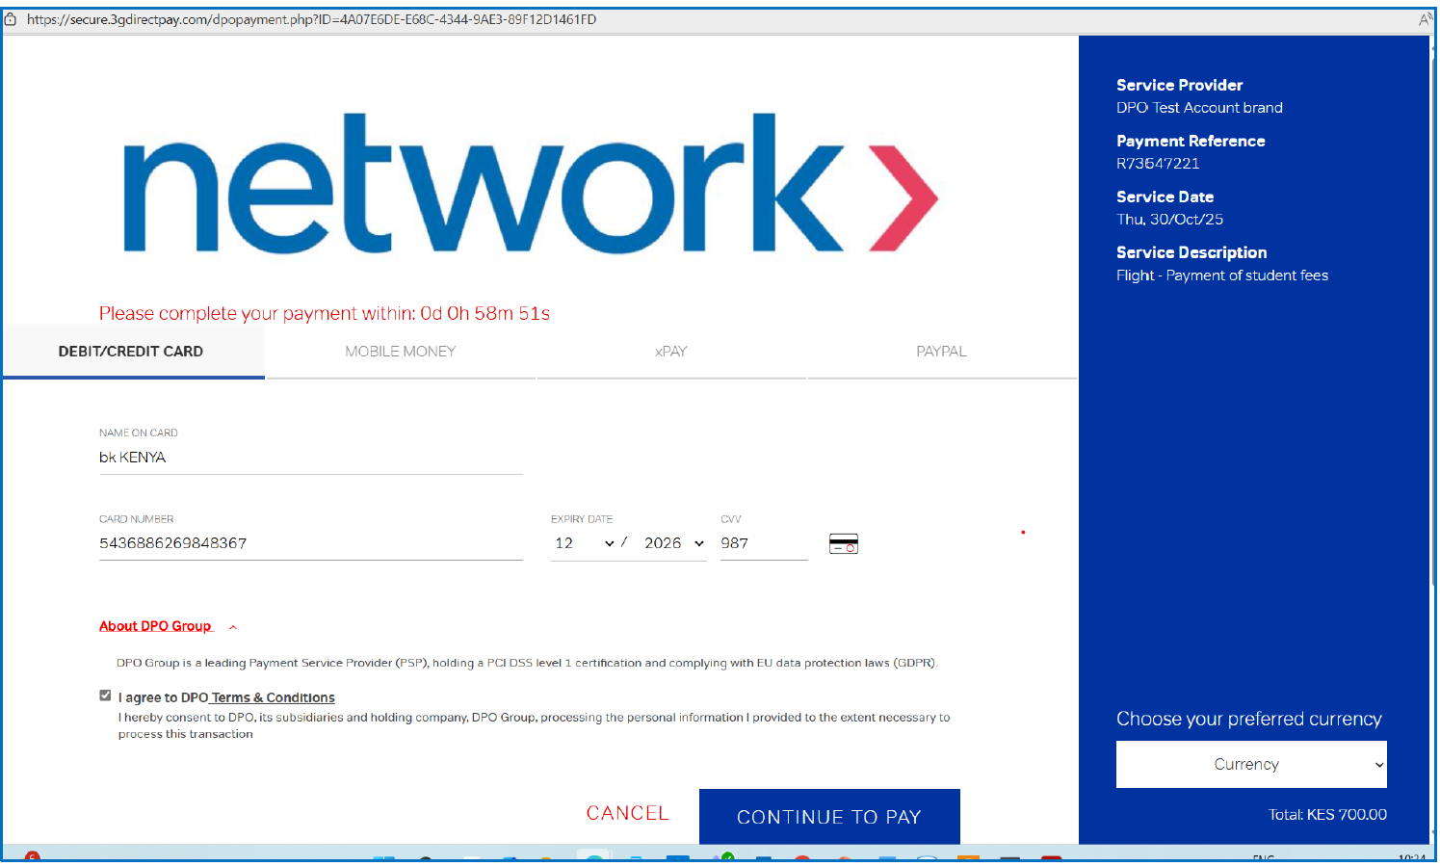
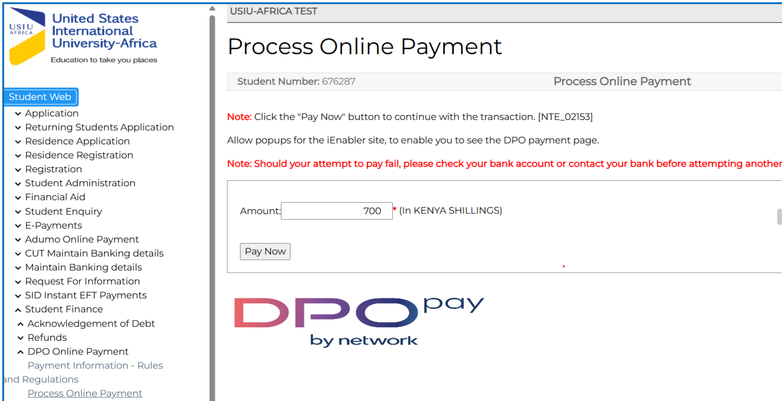
DPO Payment Gateway

Slide 15
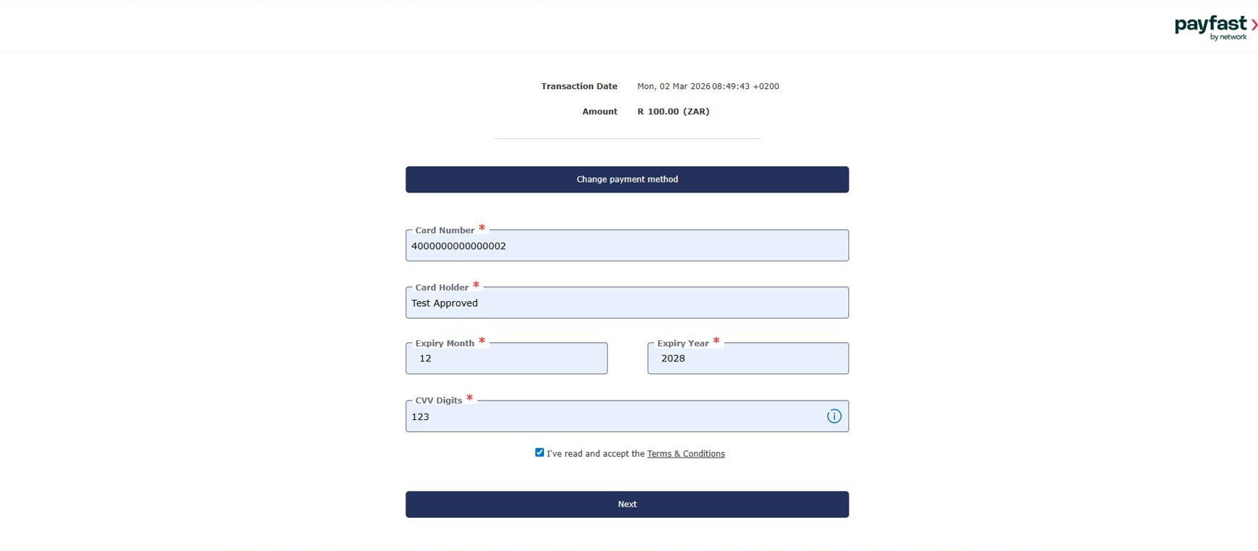
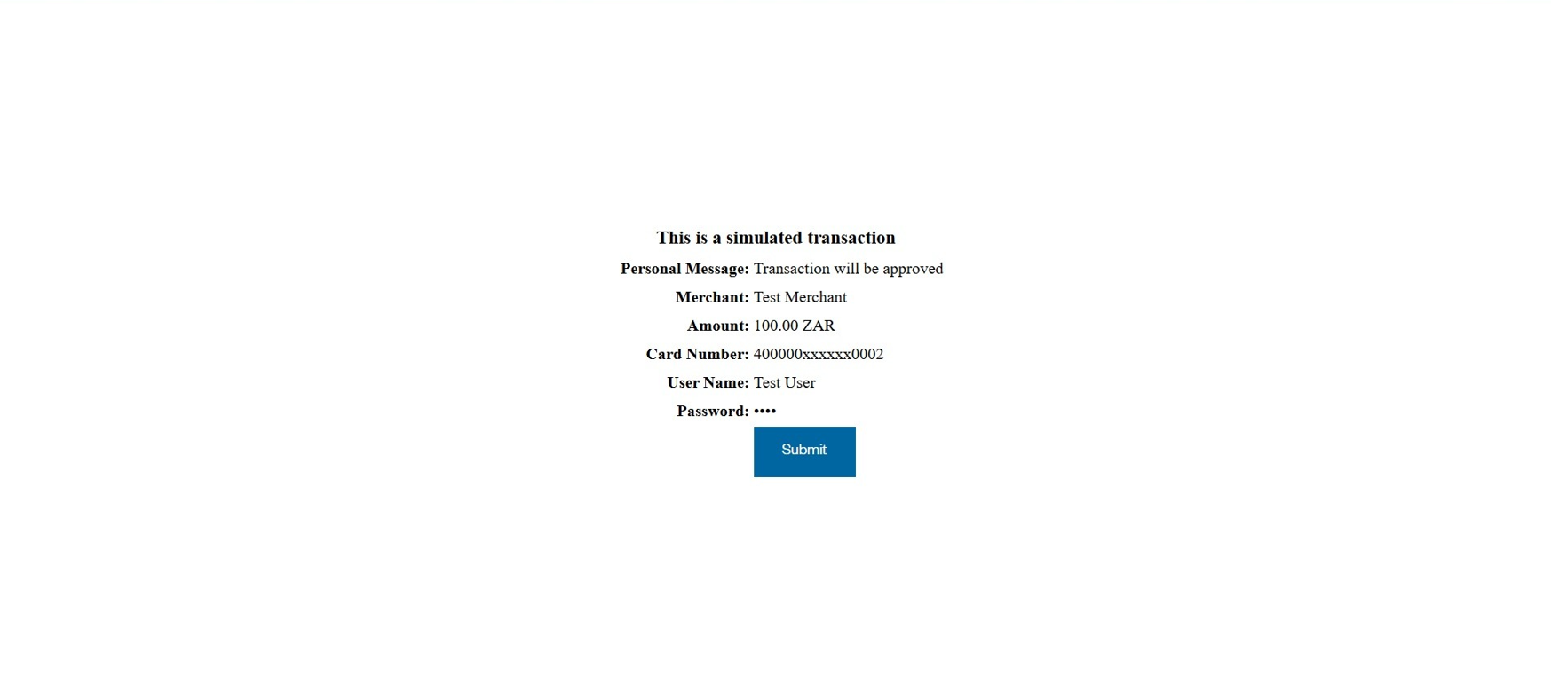
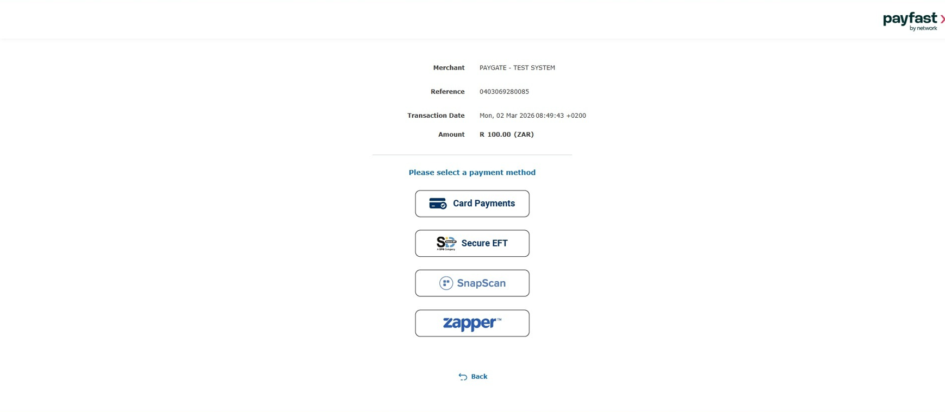
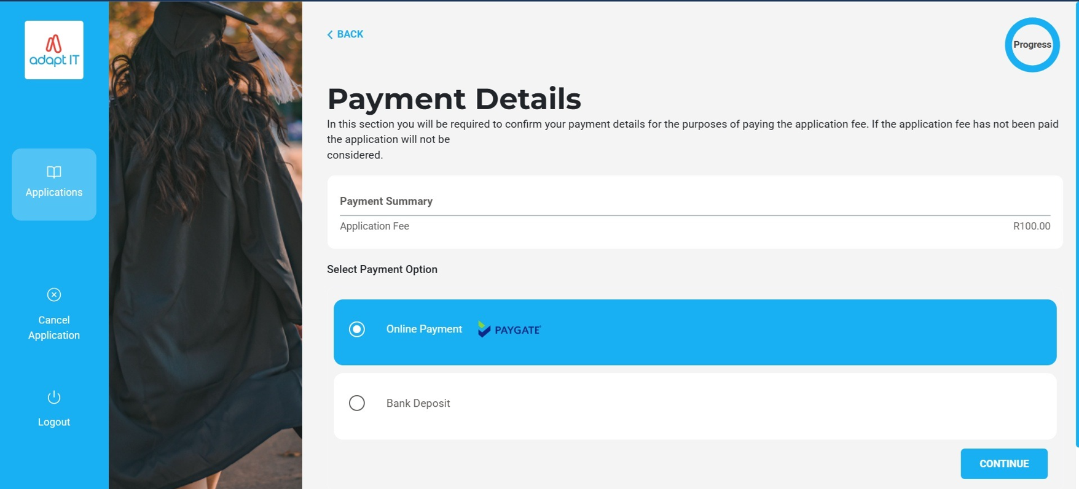
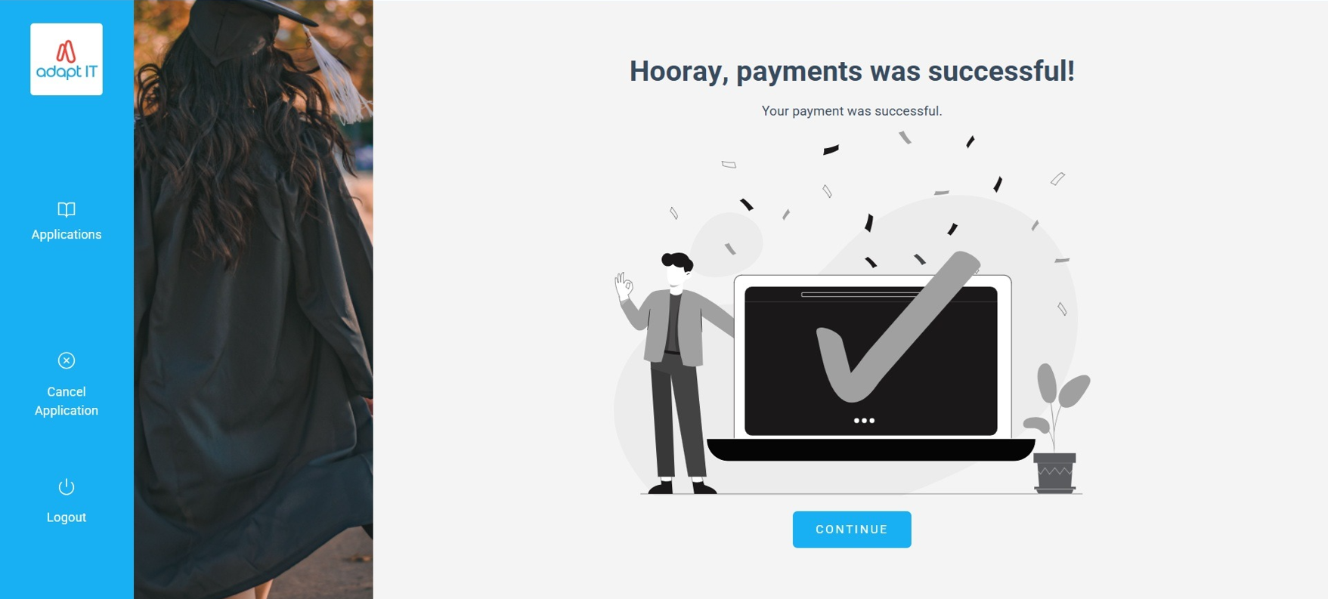
Paygate: Infinity

Slide 16
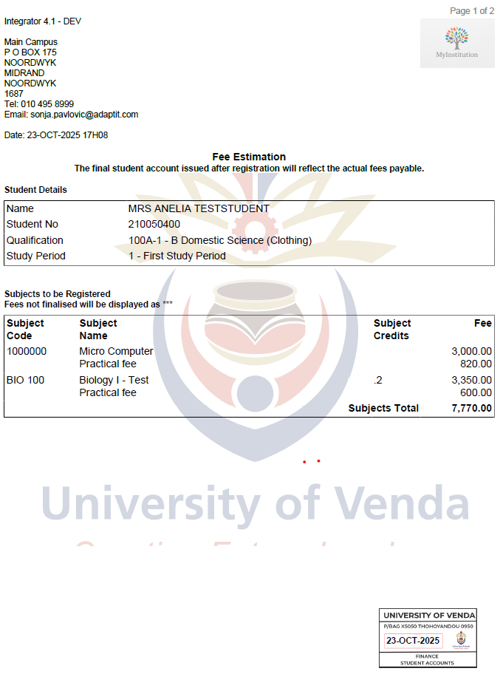
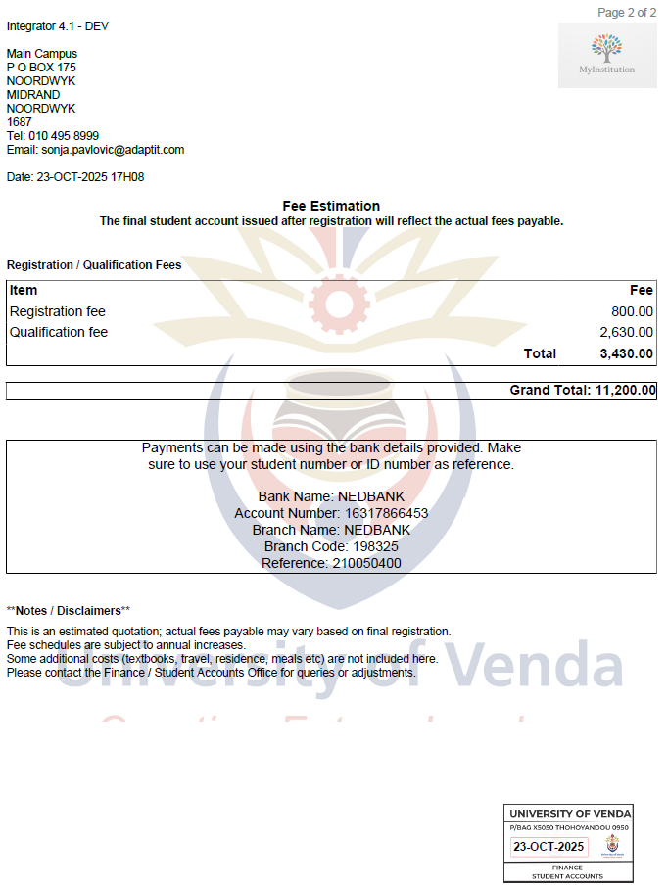
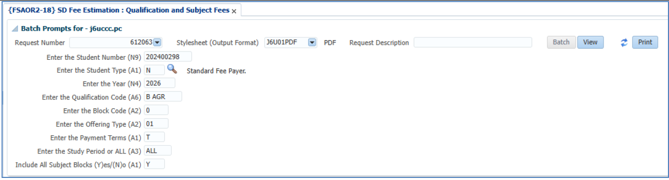
Fee Estimation: Quotation

Slide 17
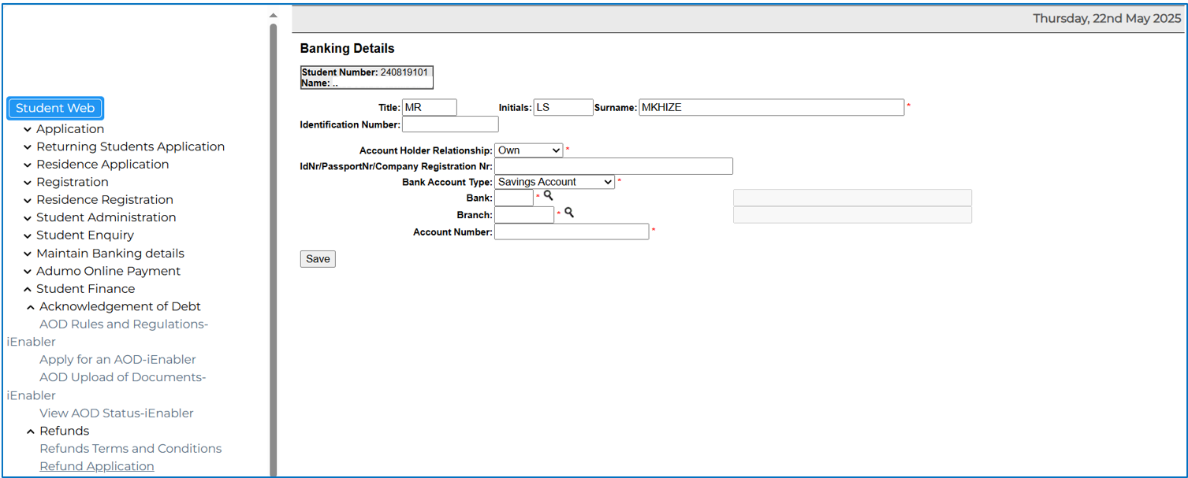
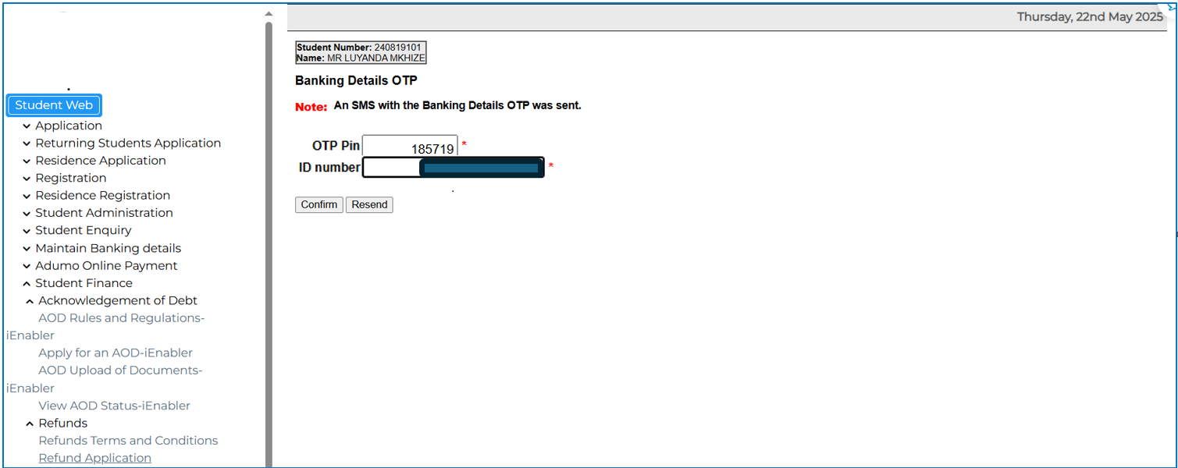
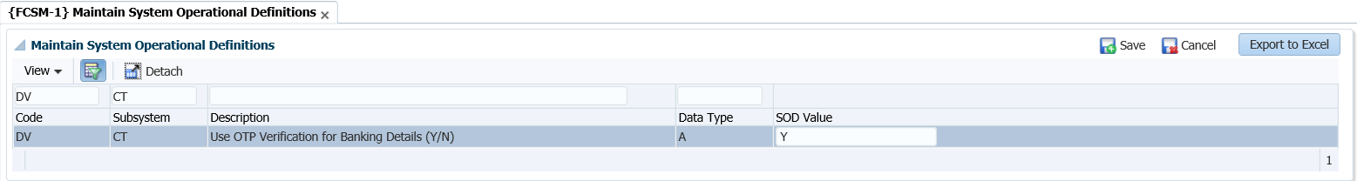
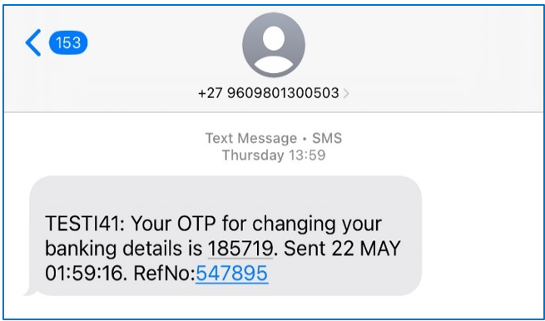
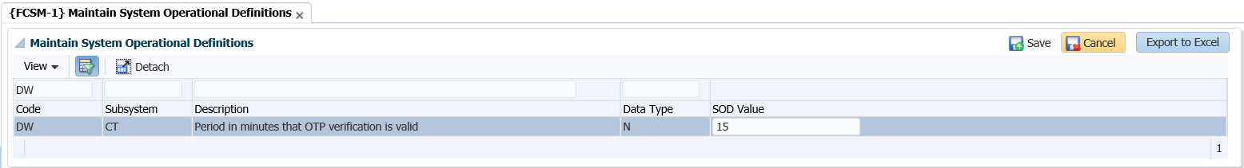
OTP Before Updating Banking Details

Slide 18
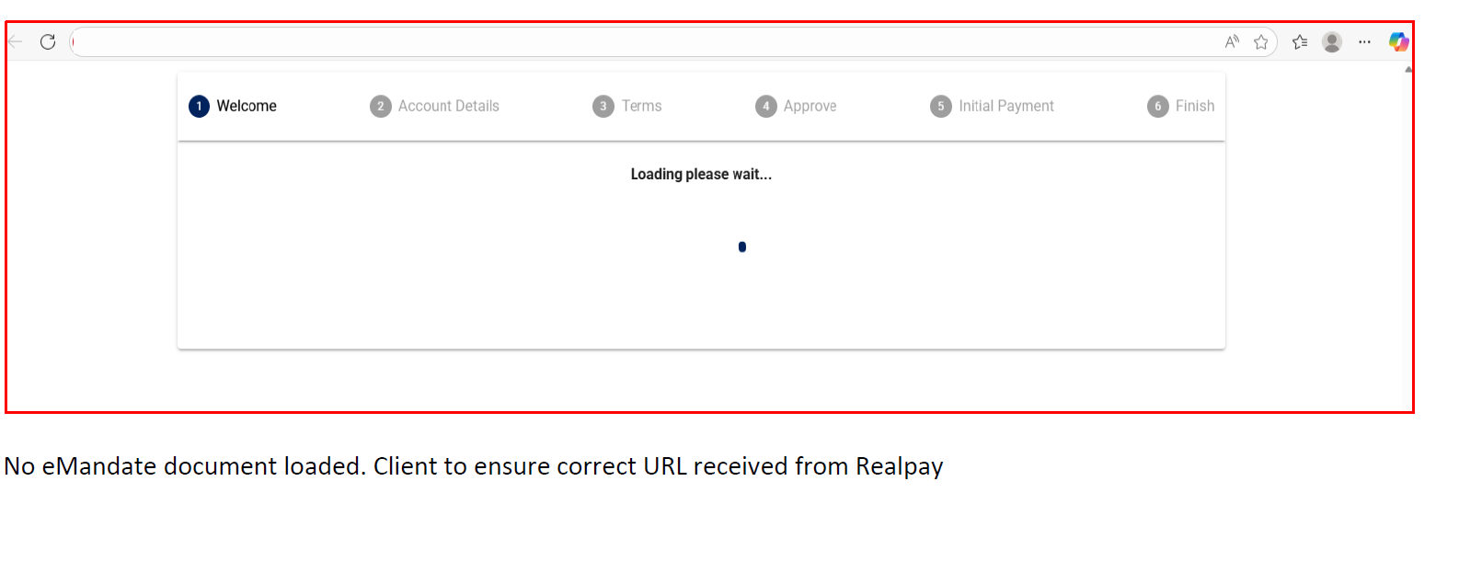
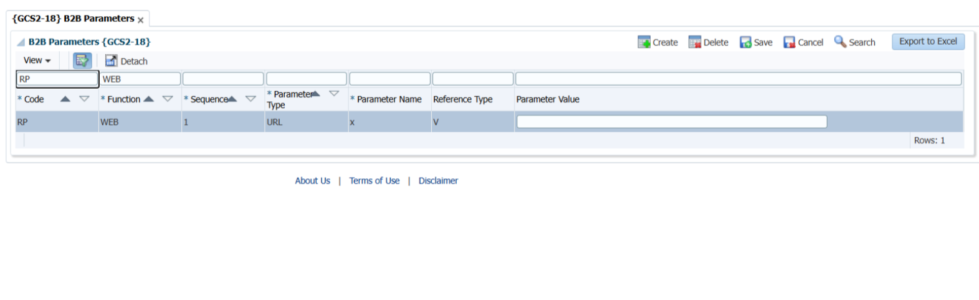
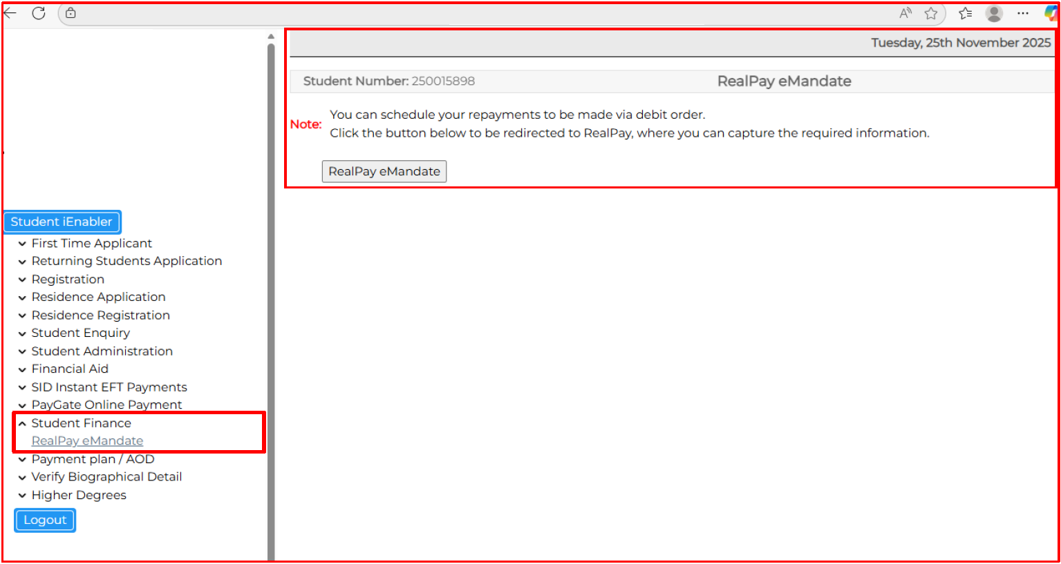
RealPay emandate

Slide 19
Roadmap

Slide 20
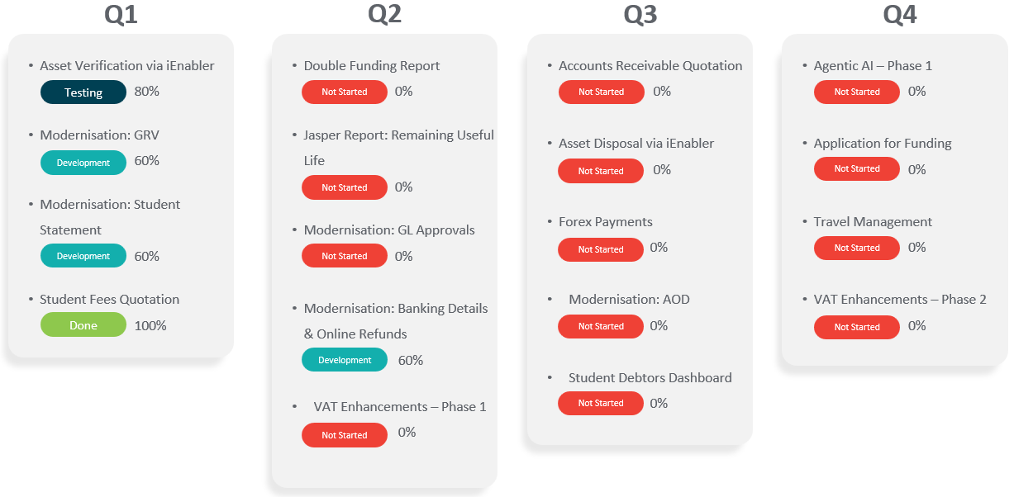

Slide 21
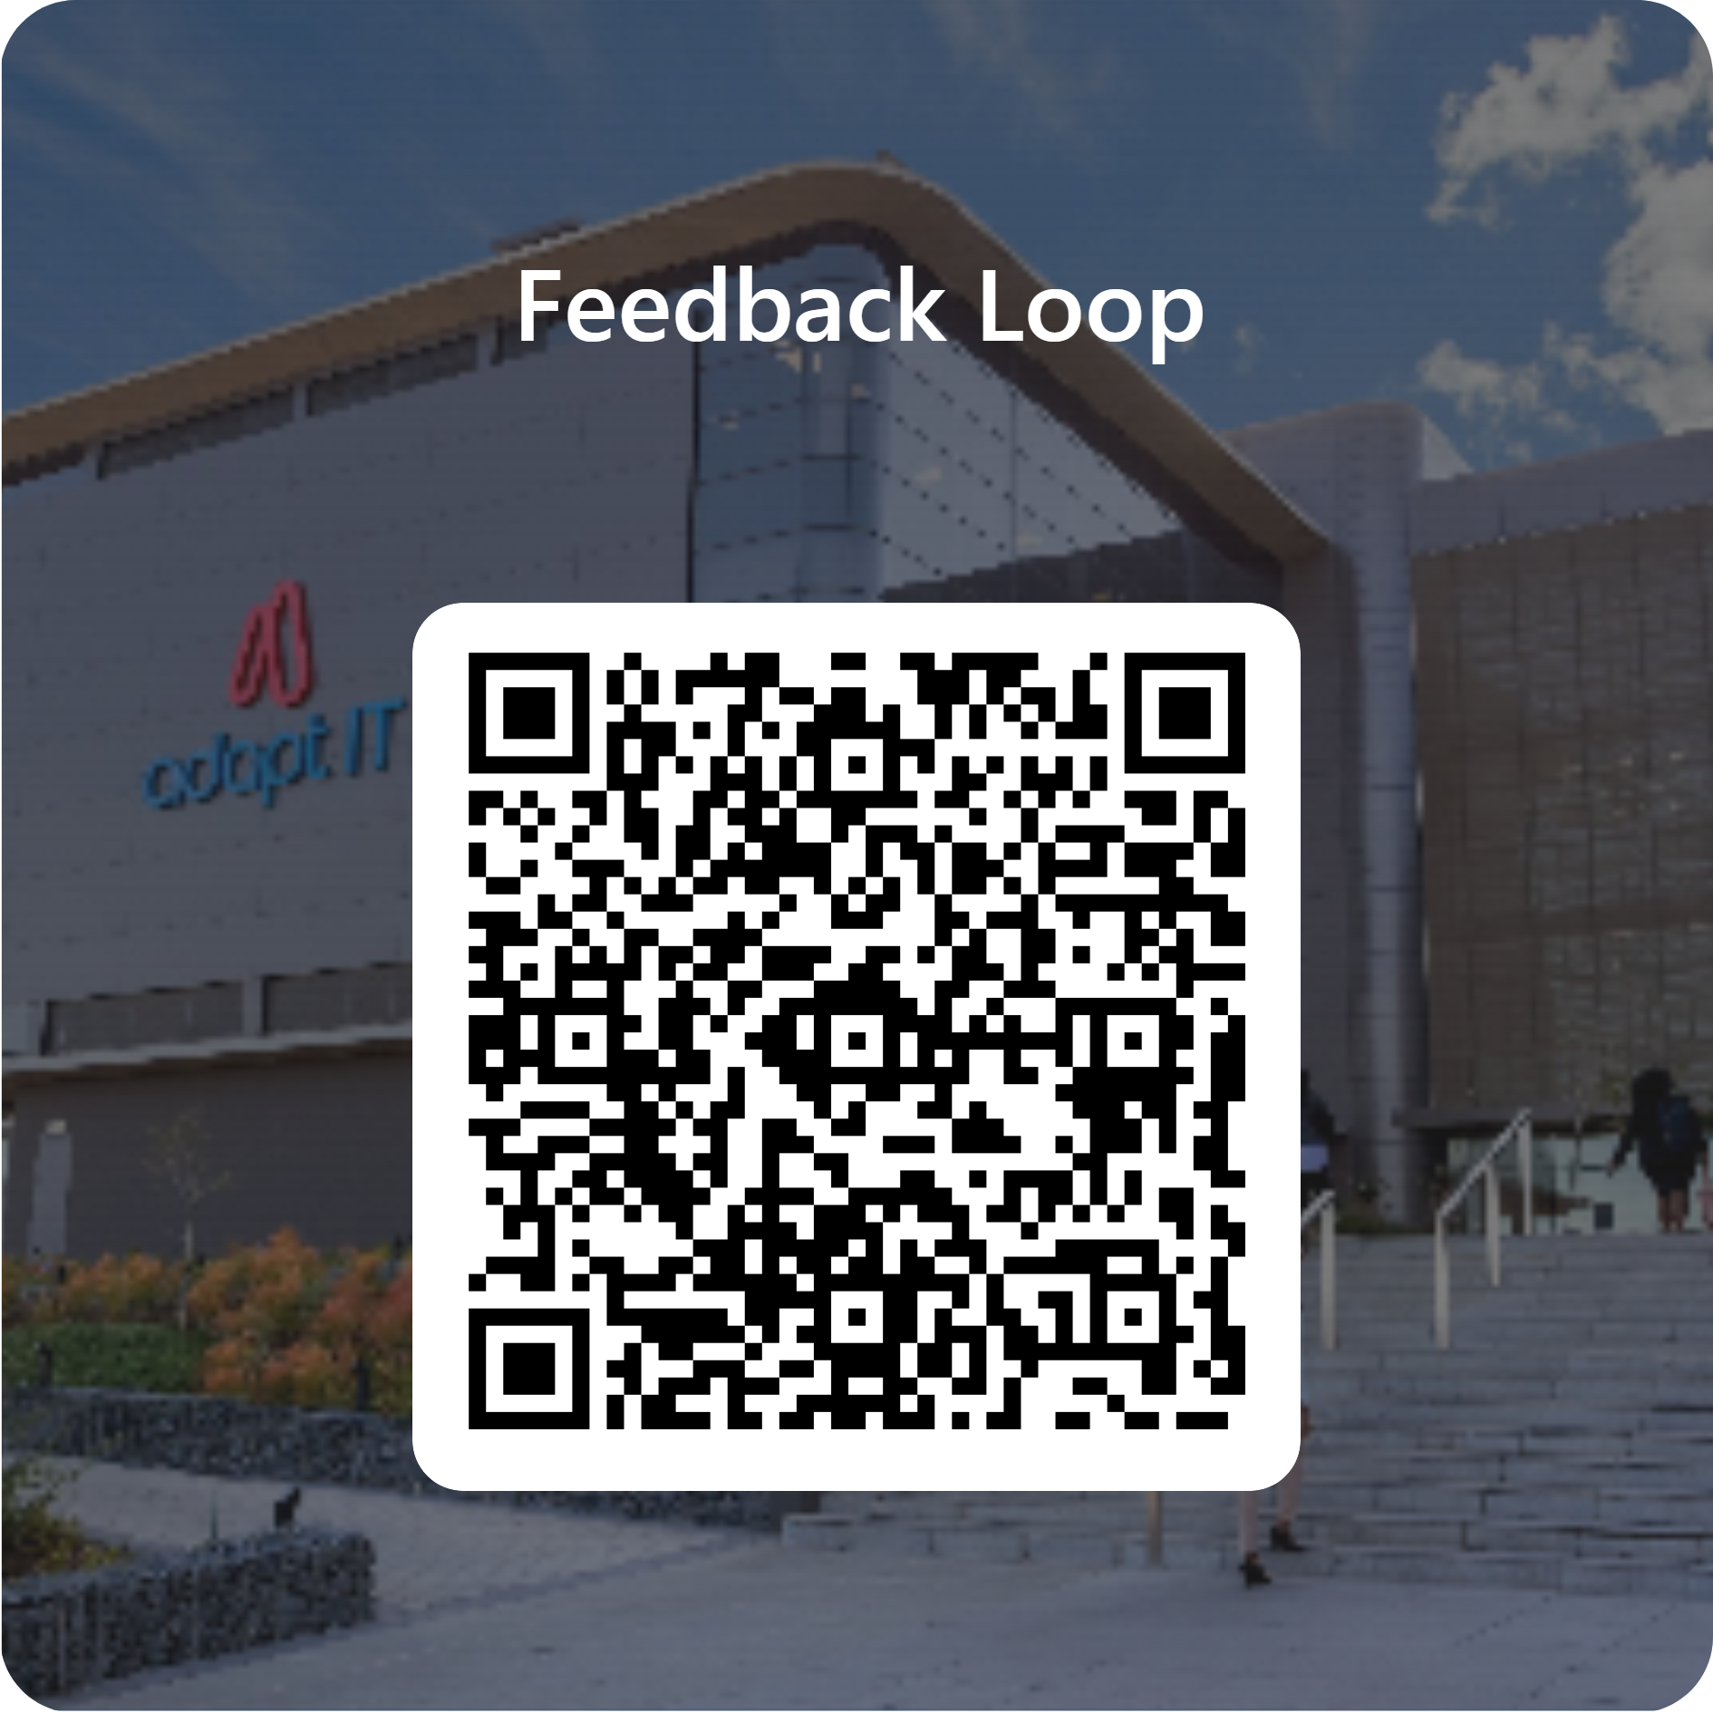
Feedback

