Slide 1

ITSIUG 2026 SESSION 36
VAT COMPLIANCE BEST PRACTICE:
TIPS AND TRICKS

Slide 2
VAT – GENERAL COMMENTS
If the VATable income of an organisation exceeds R2.3m for a 12 month period it has to be registered for VAT and submit monthly VAT returns.
VAT compliance is essential. Tax Clearance status is mandatory those who want to trade with government departments, amongst others.
The ITS system has functionality embedded in its subsystems. Use this to configure your system to such an extent that your VAT information is readily available. Make sure that you link transactions to the correct VAT Boxes.
Remember to declare VAT Outputs on imported services. The system does not do this for you, you have to analyse your foreign trade transactions.
See the following slides to see where configuration can be done.

Slide 3
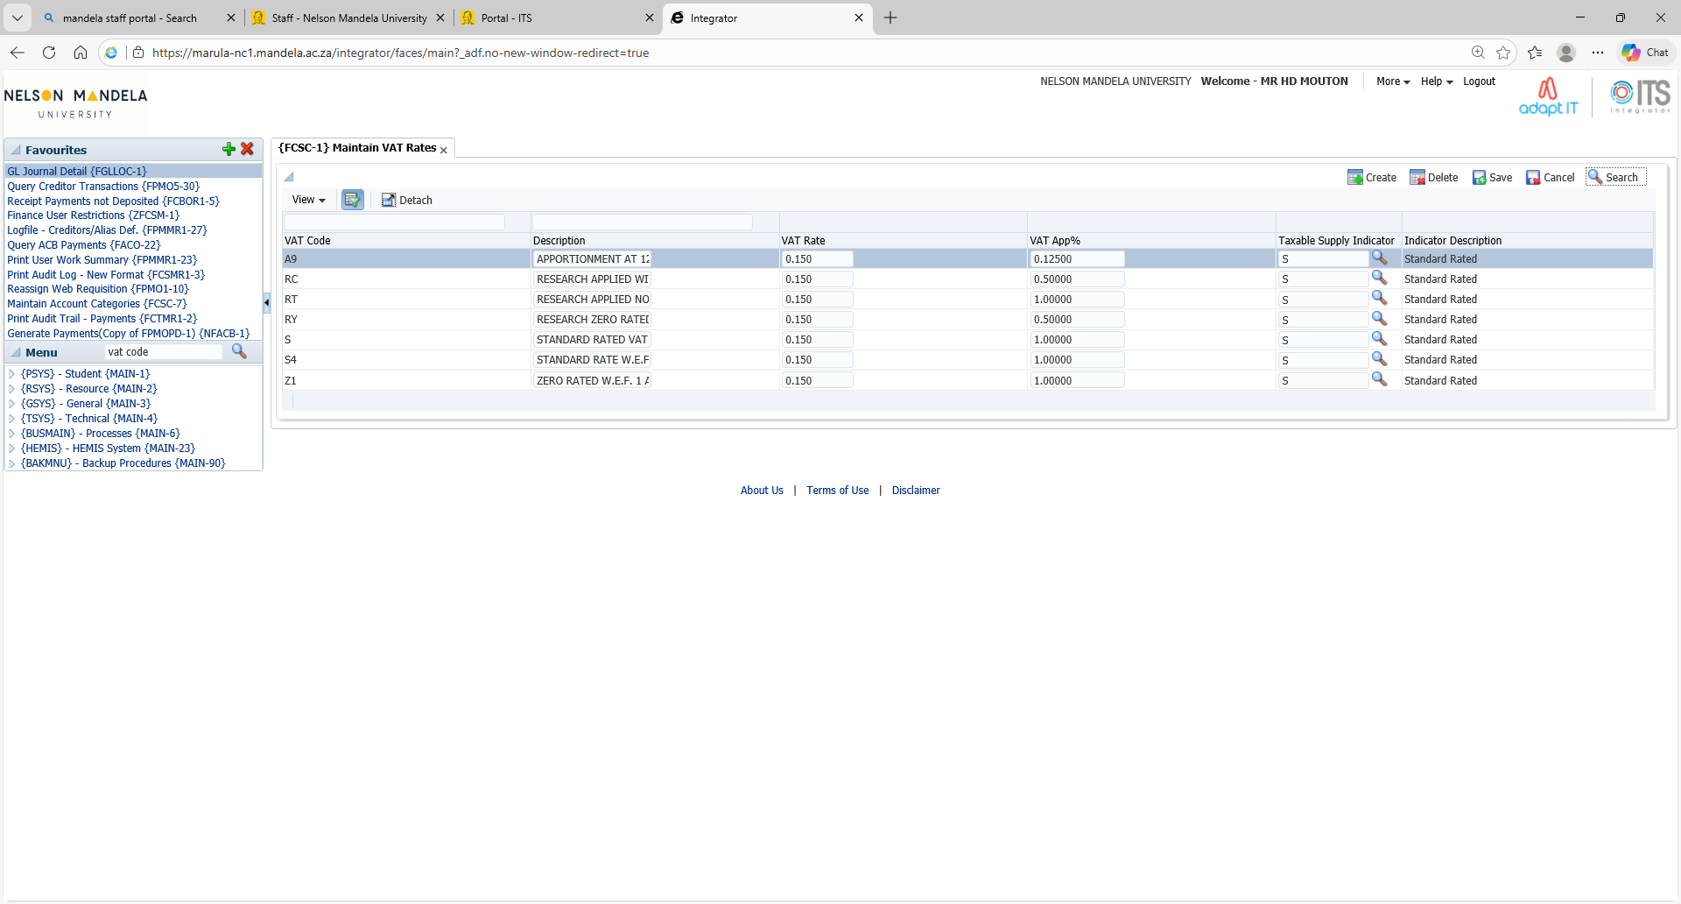
Set up VAT codes – FCSC-1

Slide 4
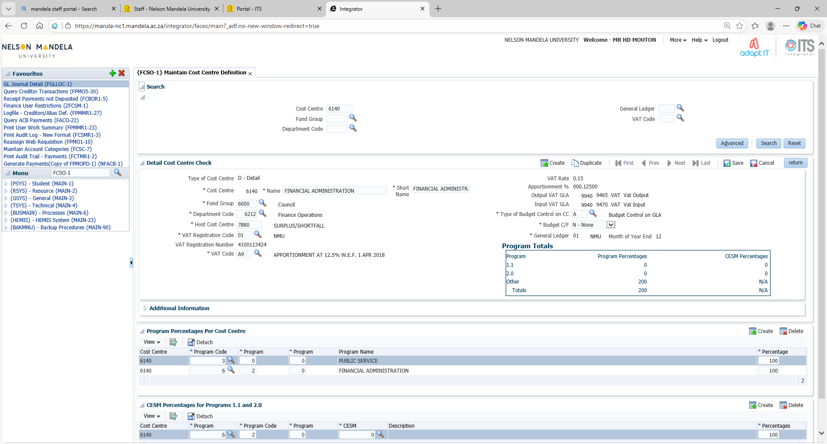

FCSO-1

Slide 5
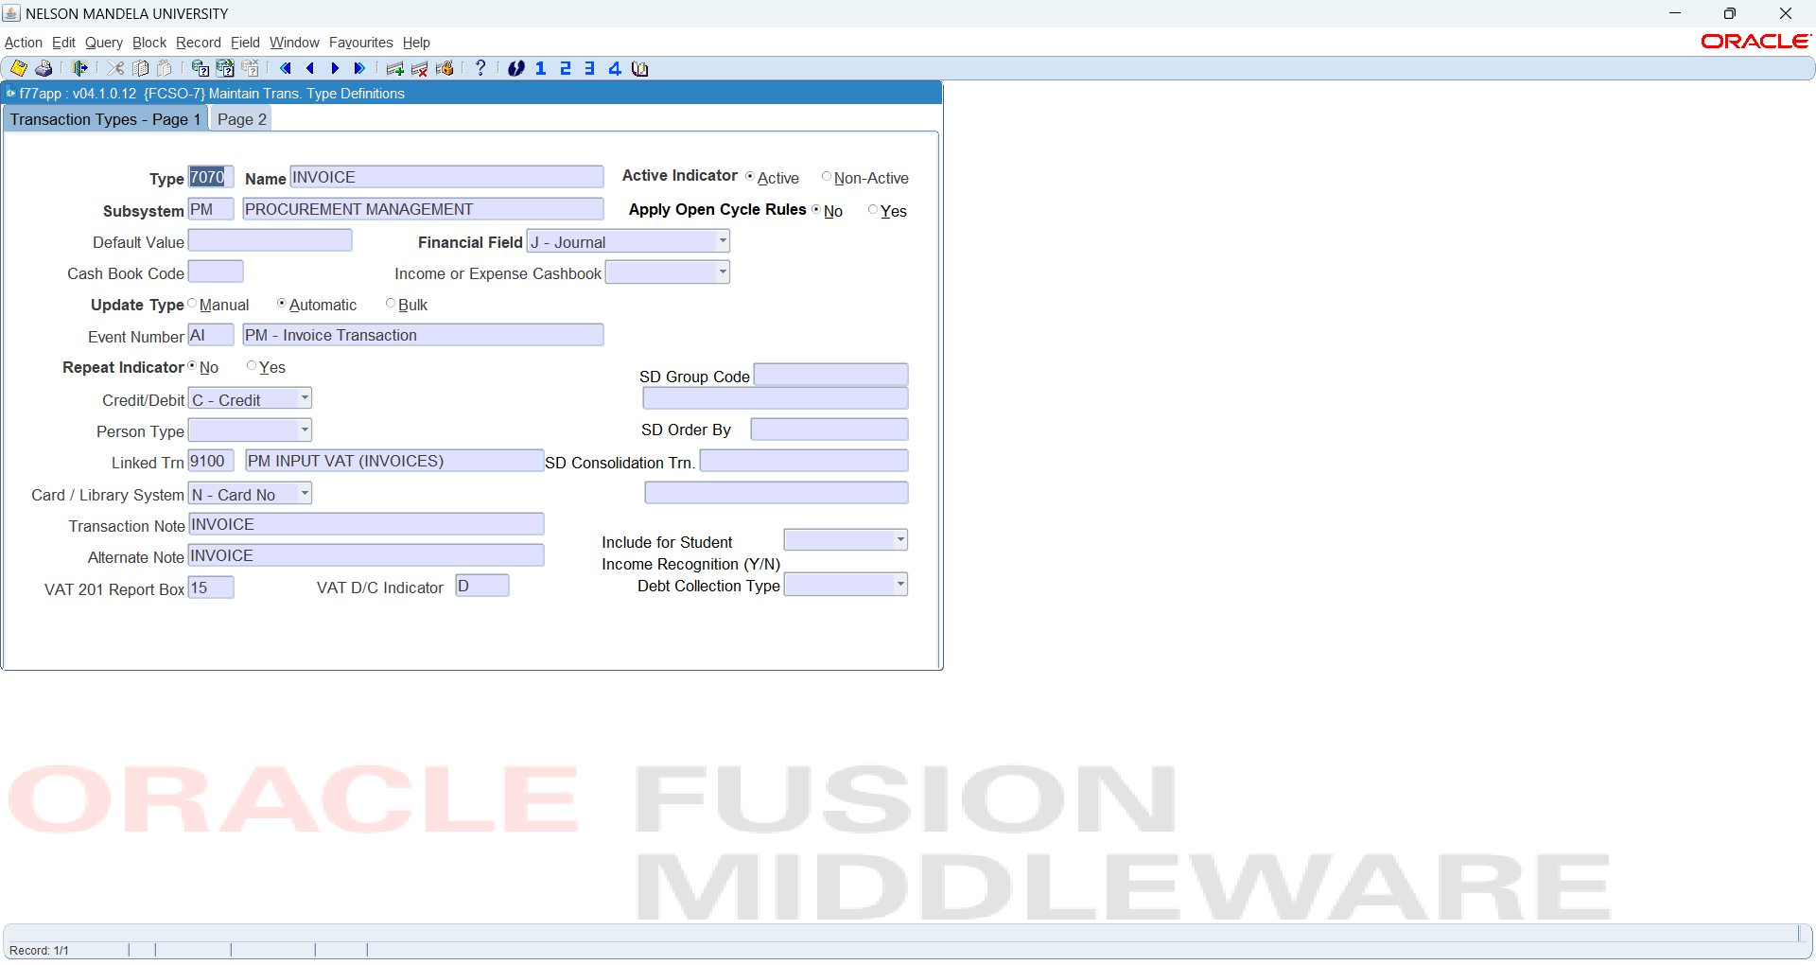

FCSO-7

Slide 6
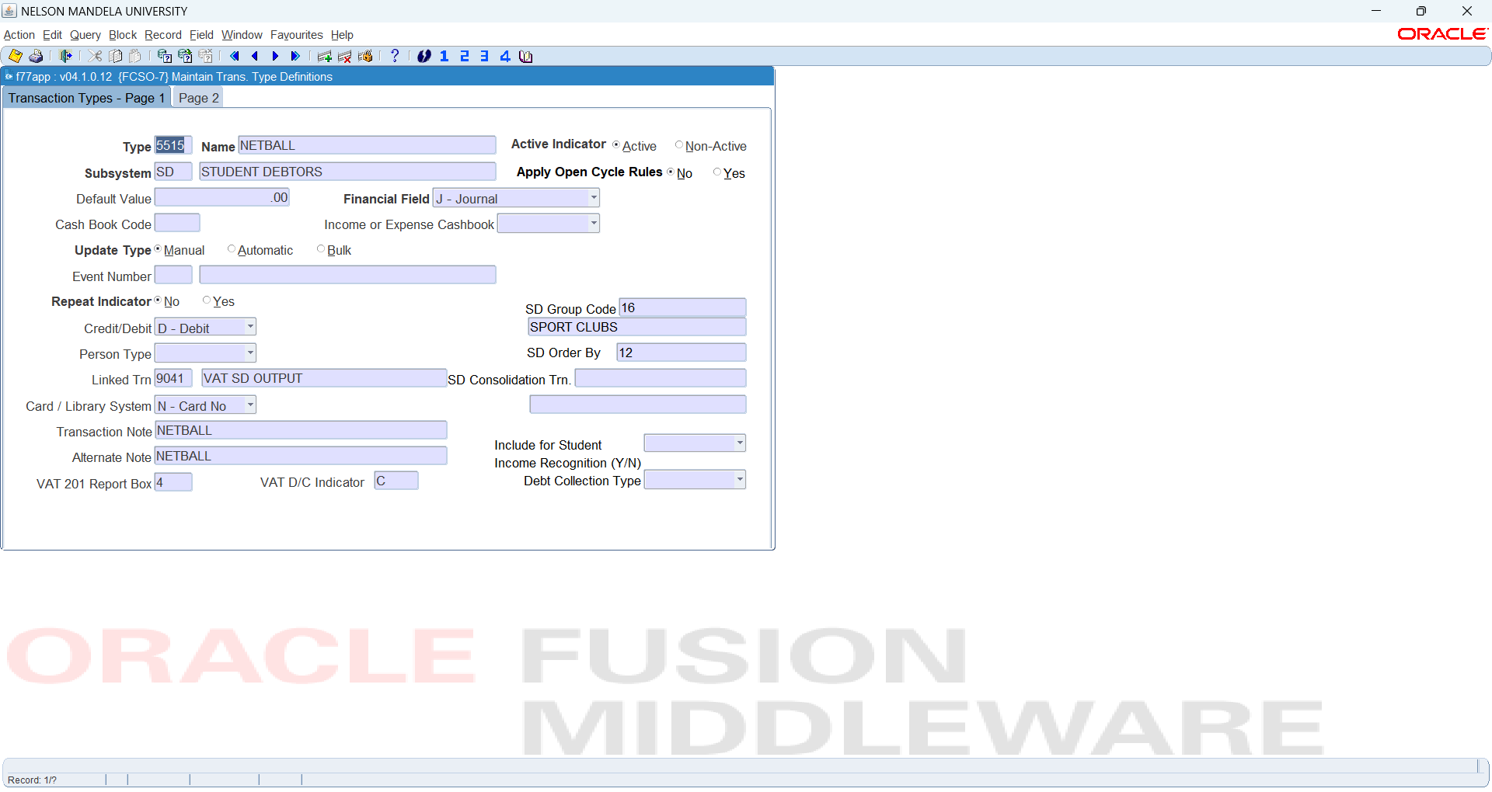


FCSO-7

Slide 7
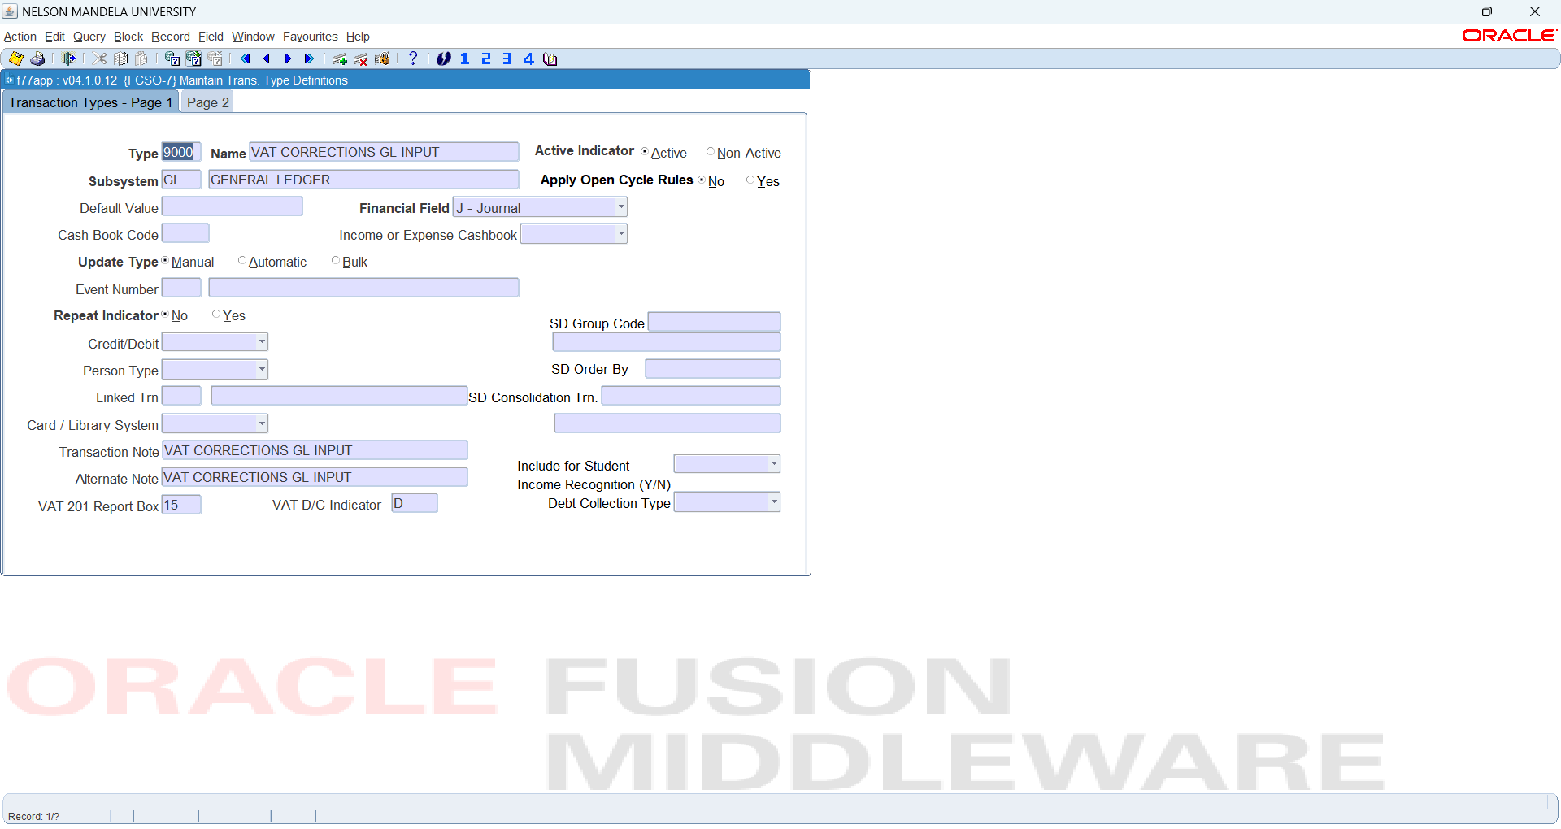
FCSO-7 GL VAT ADJUSTMENTS

Slide 8
Finally, ensure that you retain all supporting documents. If your account is selected for verification or an audit you will have to be able to supply SARS with the required information.

