Slide 1

Finance Modernisation and Agentic AI POC
Presenter : Zama Mkhize and Brilliant Tleane

Slide 2

DISCLAIMER
This presentation is only a summary of some of Adapt IT’s products, features and their latest developments. Adapt IT only intends for the information to give you an overview, and not a complete and comprehensive statement that necessarily suits your purposes.
Adapt IT reserves the right to change any information contained in this presentation and is not responsible for any loss that results from inaccuracies in the information. You may not distribute or reproduce the information without Adapt IT’s written permission.

Slide 3
TABLE OF CONTENT
Modernisation
Agentic AI

Slide 4
Modernisation

Slide 5

Why Modernisation?
The current iEnabler platform:
Visually outdated and not user-friendly
Aging technology with potential security vulnerabilities
Not mobile responsive or scalable
Fragmented user experience
Strategic Goal: Secure, Mobile, Intelligent Finance Platform

Slide 6
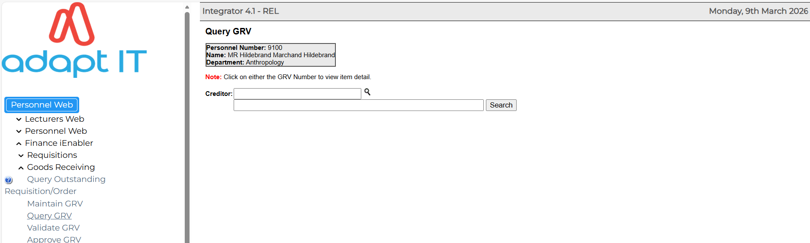
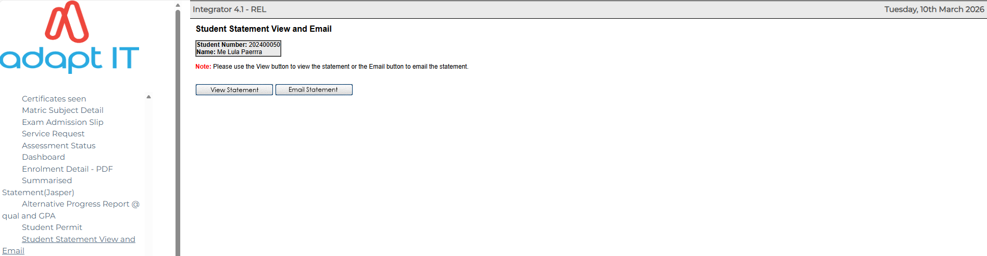
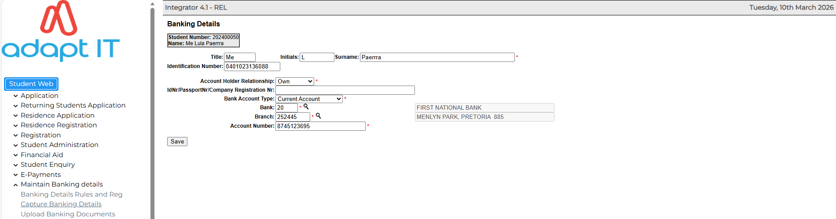
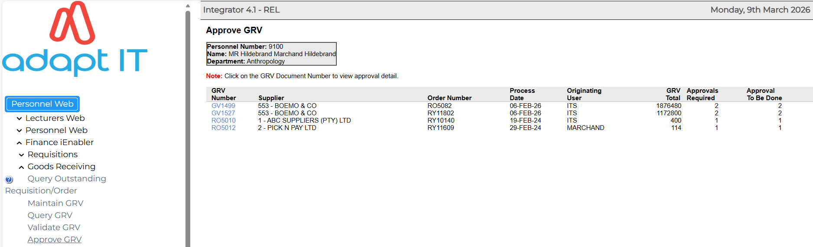
Current 4.1 iEnabler

Slide 7
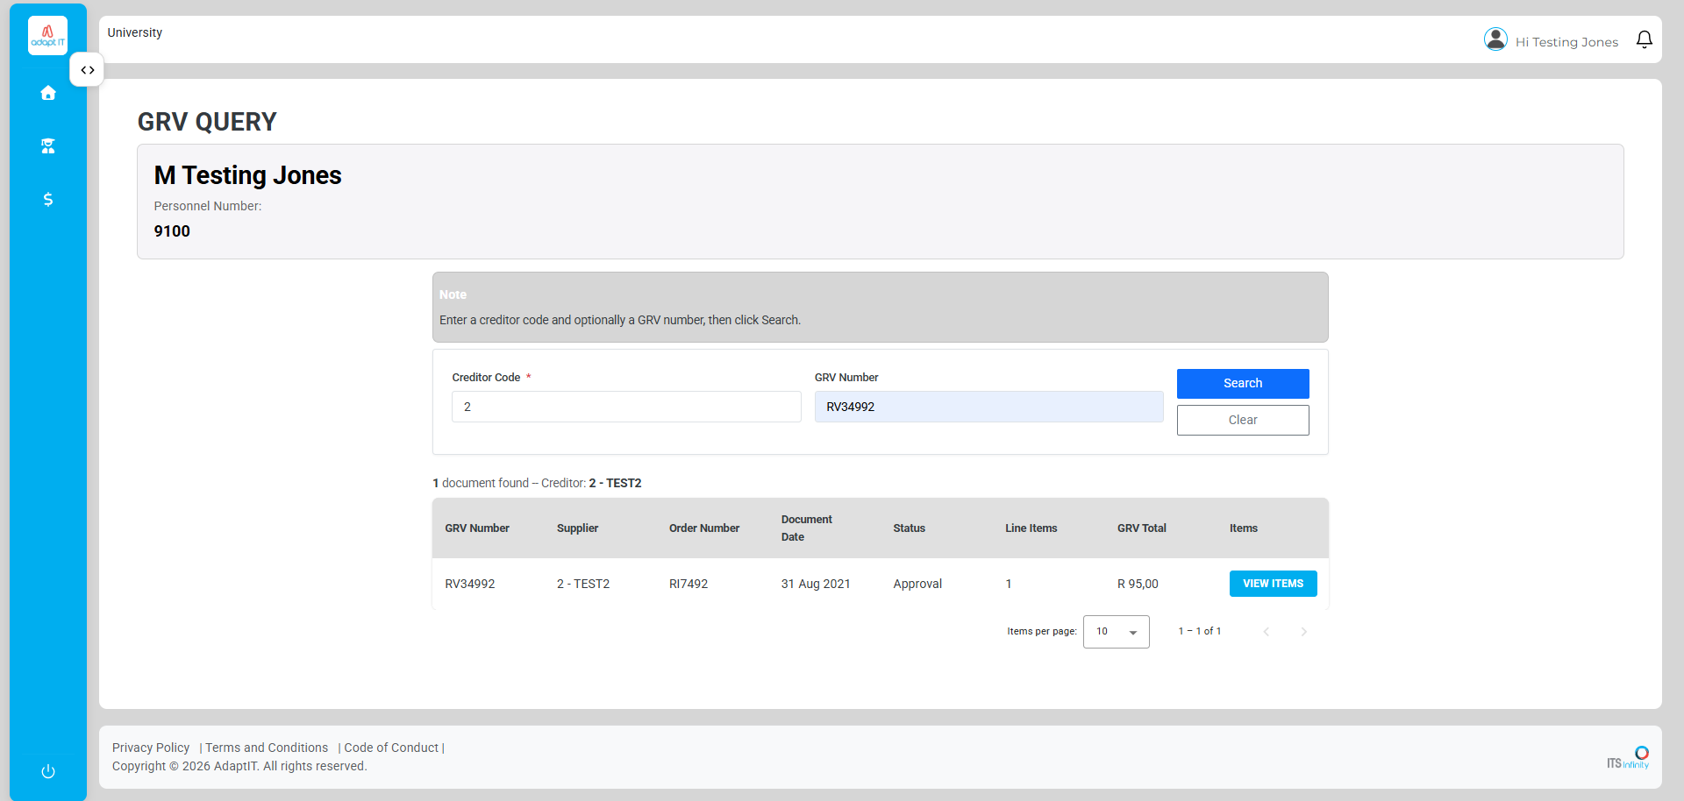
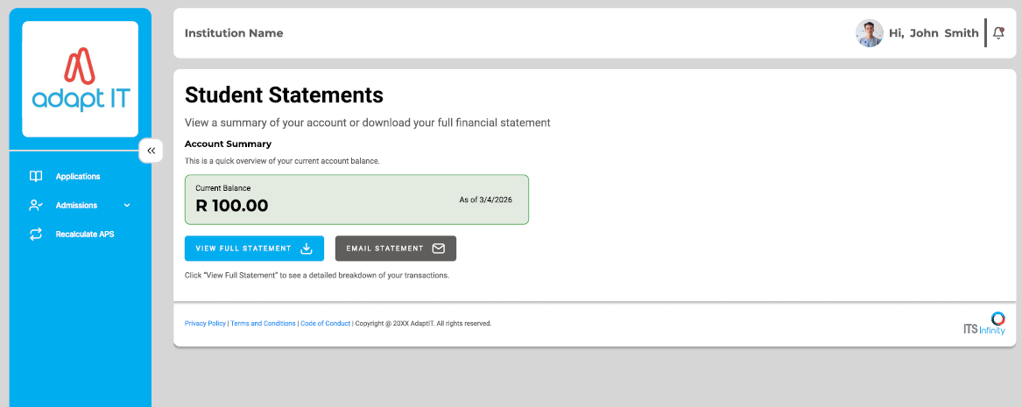
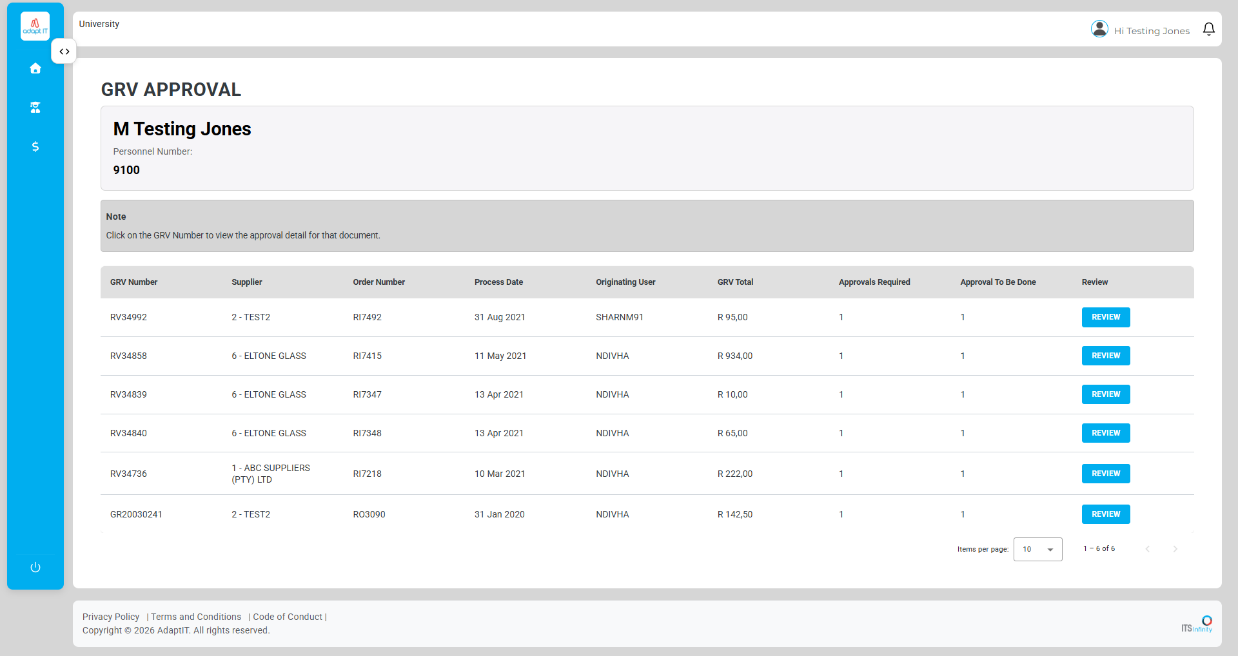
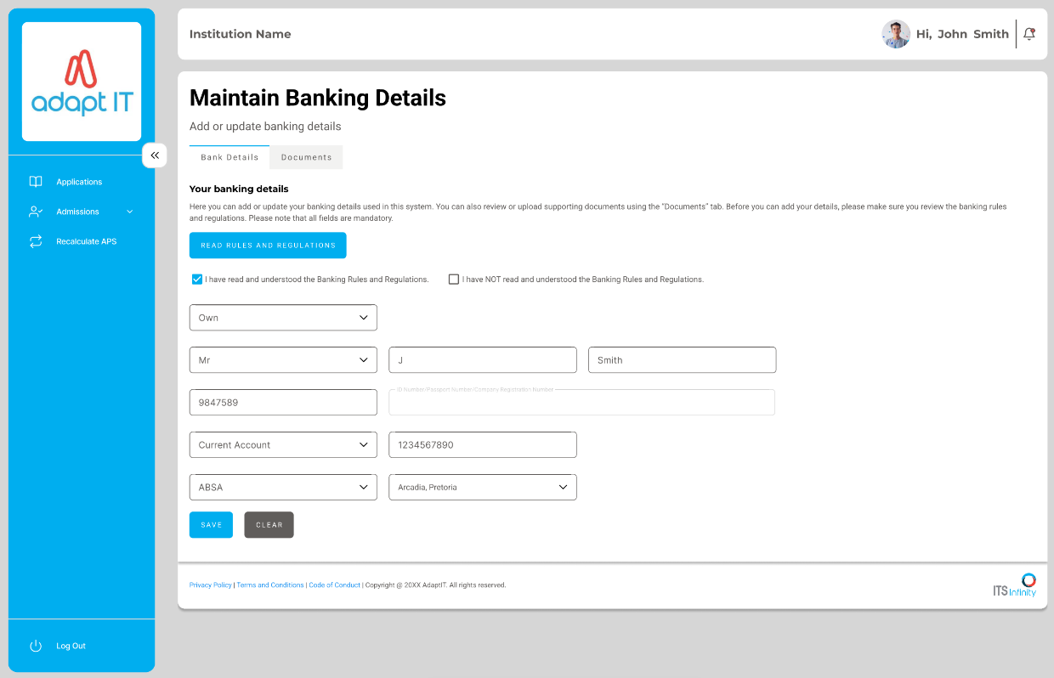
Modernisation (POC)

Slide 8




Modernisation Roadmap
AOD’s
GL Approvals
Maintain Banking Details and Refunds
GRV’s
Student Statement

Slide 9
Benefits
Adapt IT
Reduced support calls and manual queries from clients.
Easier system maintenance and faster rollout of new Finance features .
Platform ready for AI, automation, and future enhancements.
Institutions
Improved workflow (Refunds, GRV’s and others).
Better compliance, audit trails, and data security.
More efficient Finance processes with reduced administrative workload.
Users (Staff)
Modern, mobile-friendly self-service platform.
Faster access to Finance services (Refunds, GRV’s and others).
Improved Student and Staff satisfaction

Slide 10
Agentic AI

Slide 11
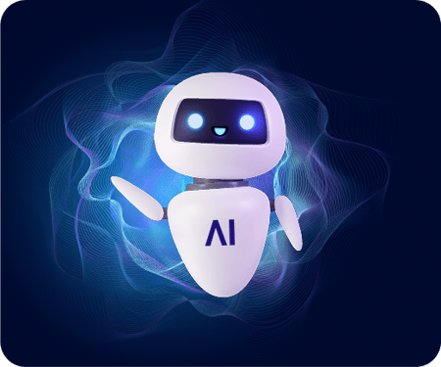
About Agentic AI
DEFINITION
AI systems that can plan, execute multi-step tasks, reason over goals, and take autonomous actions under constraints.
Key Capabilities:
Autonomous Decision Making
Understand Natural Language
Task Automation
Proactive Assistance
Agentic AI adapts and optimizes towards goals.

Slide 12

Why Add Agentic AI?
With AI:
Conversational self-service
Reduced support dependency
Improved user experience
Performs proactive interventions
Reduce Higher training costs

Slide 13
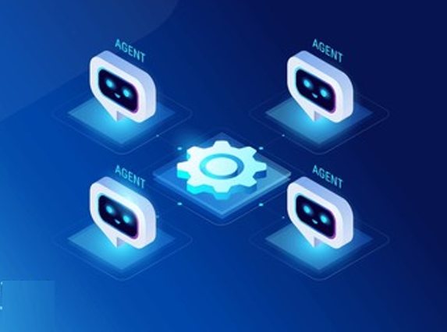
AI Use Cases
Student Finance :
Intelligent Navigation
View Outstanding Balance
Proactive Payment Reminder
Outstanding Balance Report (Finance Administrator)
Multiple Funding Detection (Bursary Officer)
Core Finance :
Assets recon with the GL
Search for a Document (Requisition, Order)

Slide 14
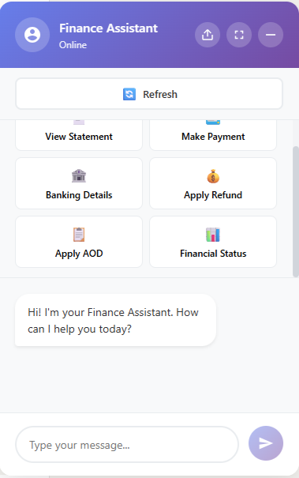
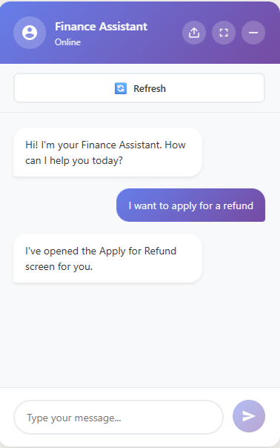
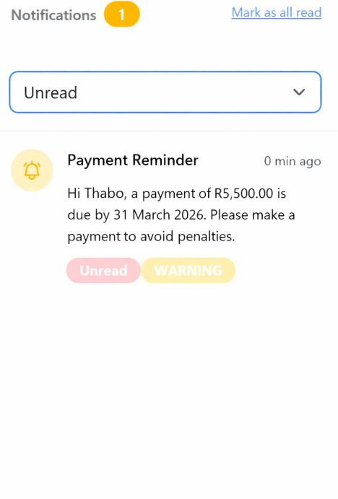
Student Finance (Students) : POC

Slide 15
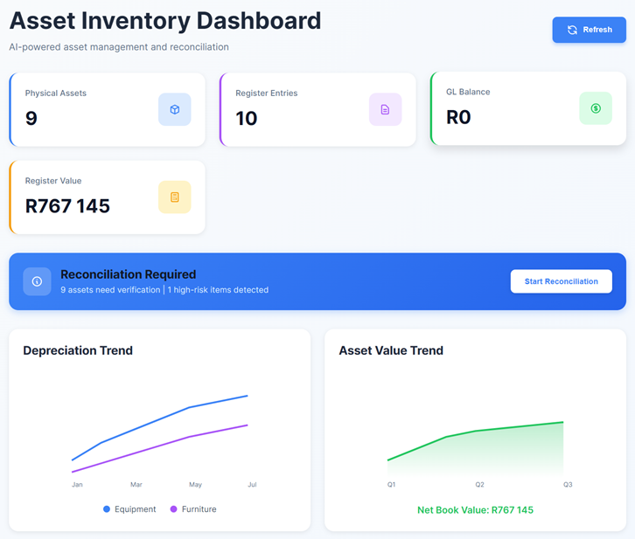
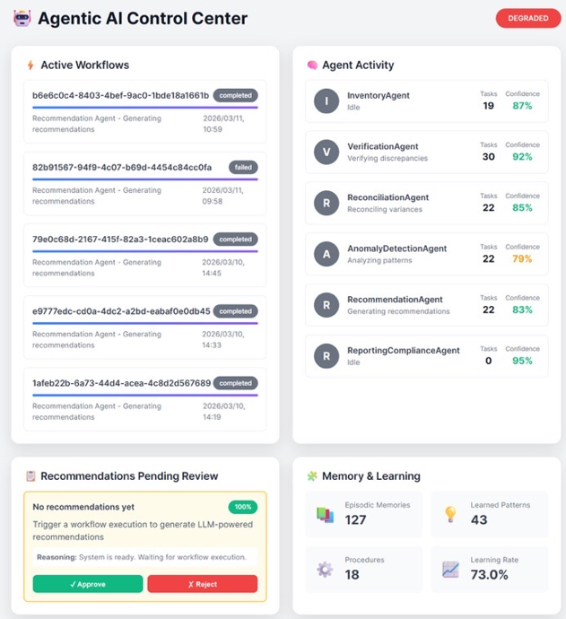
Core Finance : Assets POC

Slide 16
Benefits of AI
Adapt IT
Enables intelligent platform capabilities.
Reduces support tickets and operational costs through automated assistance.
Provides scalable AI solutions that can be deployed across multiple institutions.
Institution
Reduces administrative workload through automated responses
Improves operational efficiency and service delivery.
Enhances decision-making with AI-driven insights and alerts.
Users
Provides 24/7 conversational assistance for queries
Simplifies navigation of complex systems and services.
Enables faster access to info and Improves overall digital experience and satisfaction.

Slide 17
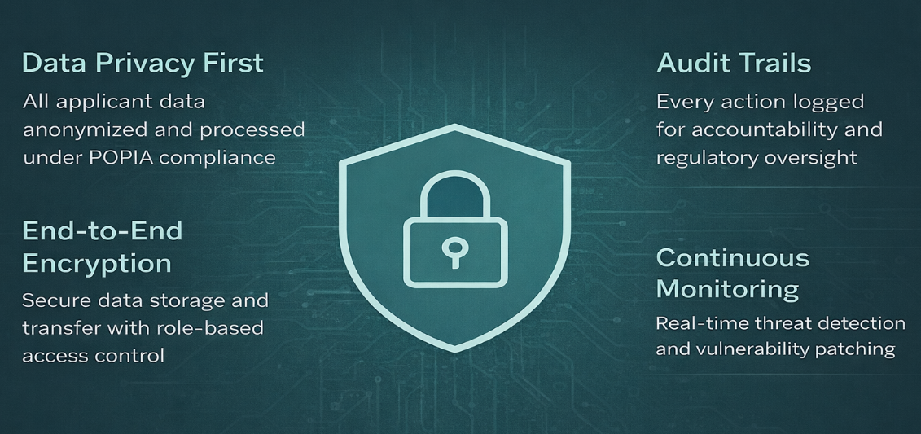
Security and Data Protection

Slide 18
Key Takeaways
Modernization is strategic and necessary
Legacy platform is outdated and inefficient
Modern Finance improves experience and control
Agentic AI enhances intelligence and automation
From Legacy System to Intelligent Finance Experience !!!

Slide 19
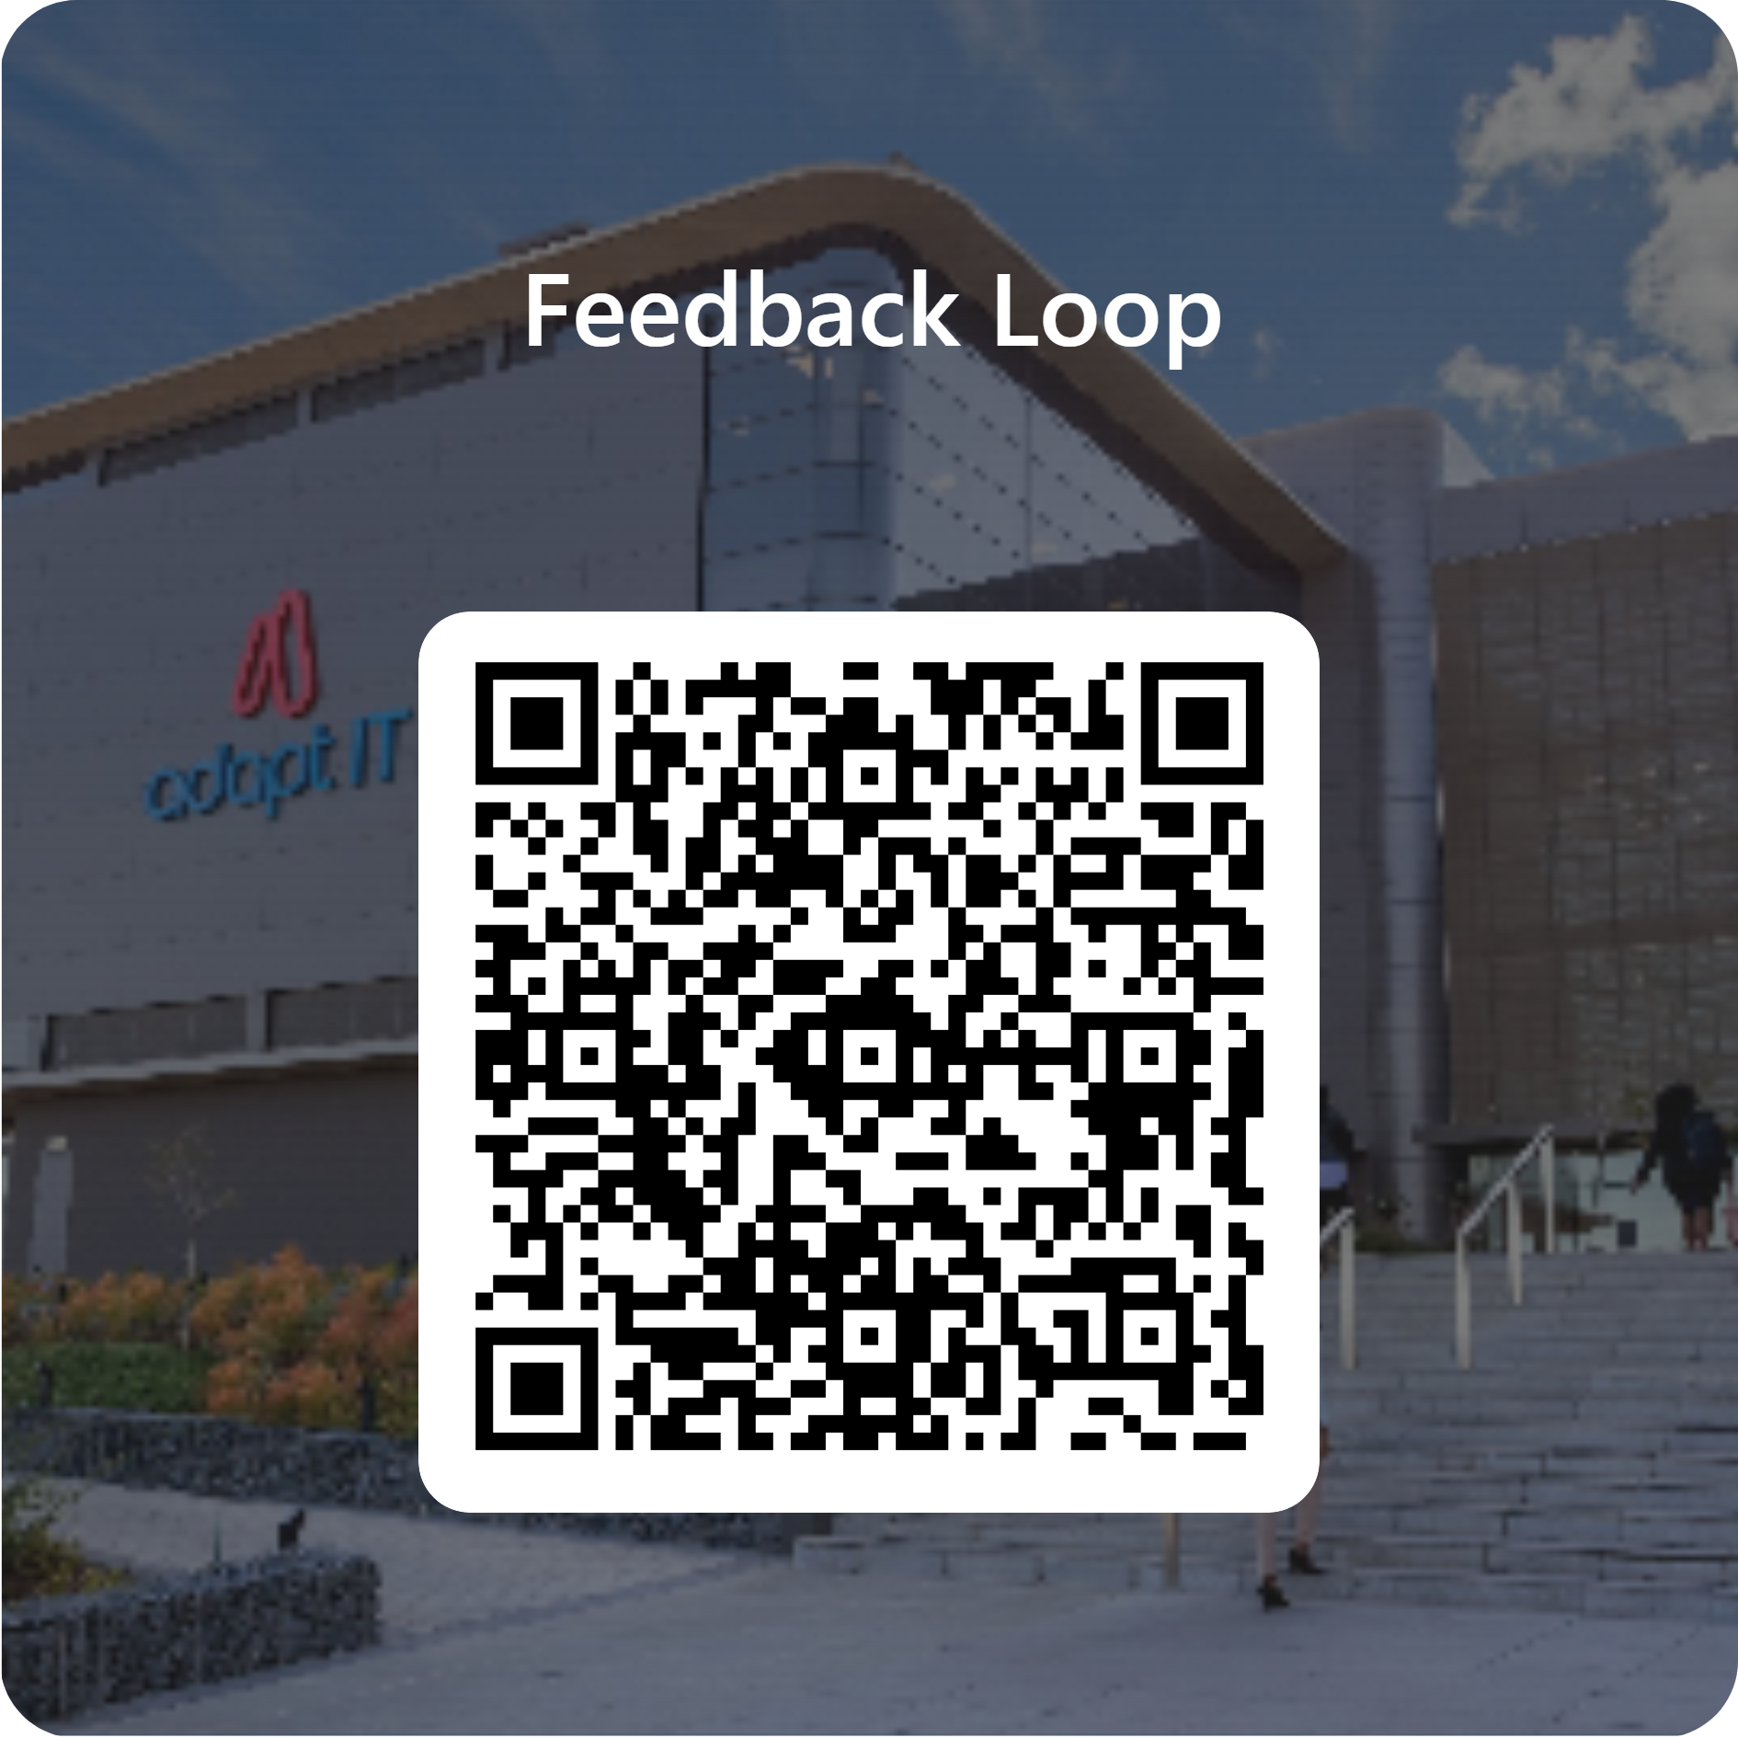
Feedback

