Slide 1

ITS 4.1: Student System Enhancements:
Redefining Student Administration Excellence!!!
Session 4
Presenter: Linda Putu

Slide 2

DISCLAIMER
This presentation is only a summary of some of Adapt IT’s products, features and their latest developments. Adapt IT only intends for the information to give you an overview, and not a complete and comprehensive statement that necessarily suits your purposes.
Adapt IT reserves the right to change any information contained in this presentation and is not responsible for any loss that results from inaccuracies in the information. You may not distribute or reproduce the information without Adapt IT’s written permission.

Slide 3
Table of Contents
Digital Transformation Roadmap 2026-2028
Infinity Roadmap
Special Interest Groups (SIGs)

Slide 4
Digital Transformation Roadmap 2026-2028

Slide 5

Digital Transformation Roadmap 2026-2028
Three-year strategy (2026-2028)
Modernize university IT systems
Leverage API-first architecture, intelligent automation, and AI-powered insights
Transform legacy infrastructure into a configurable, service-driven platform
Enhance student success, operational efficiency, and regulatory compliance

Slide 6
Strategic Vision: Three-Year Transformation Journey
Transformation spans three critical phases.
Each phase builds on the previous year.
2026: Modernization execution, core digital services, API infrastructure.
2027: Automation and intelligent configuration.
2028: Predictive analytics and commercial packaging.
Phased approach minimizes disruption, maximizes value.
By end of 2028: Fully modernized, AI-enhanced platform.
Positions institution as a leader in higher education technology.
Three-Phase Strategy
2026: Modernization execution and API foundation
2027: Automation and configurable rules engine
2028: Intelligence, analytics, and commercialization

Slide 7

Year One: Modernization Execution
2026
Establishes foundation for transformation
Delivers three major modernized platforms
Introduces API-first services for documents and marks
Digitizes complete higher degree management lifecycle
Provides tangible quarterly improvements
Q1 2026
1
Alumni iEnabler modernization launches (refreshed interfaces)
HDMS Phase 1 goes live (application, registration, ethical clearance, research proposal)
Jasper stabilization (reliable reporting infrastructure)
2
Q2 2026
Marks API exposes assessment data
Digital Transcript API pilots (UJ, document generation)
Generic Excel upload fixes improve iEnabler usability
HDMS expands (amendment registration, progress reports)
East Africa transcript redesign (regional requirements)
Q3 2026
3
HDMS progresses (intention-to-submit, first submission workflows)
Assessment policy stabilization (decimal handling, subminimum
Cycle review Finalisation (Continuous assessment)
4
Q4 2026
TVET iEnabler launches
HDMS completes (final submission capability)
Special exam and other workflow design
Graduation domain cleanup (data quality, process efficiency)

Slide 8

Year Two: Automation and Configuration
2027
Transforms rigid systems into flexible, configurable platforms.
Rules Engine enables customization of academic policies without code changes.
AI agents monitor processes for real-time validation and compliance.
Shifts from reactive maintenance to proactive intelligence.
Q1 Special Exam Automation
Q3 Reporting Architecture
Automatic eligibility determination.
Online application streamlines student requests.
Notification automation informs stakeholders, reduces manual coordination.
New data layer decouples analytics from transactional systems.
Dashboard optimization improves performance and user experience.
Heavy Jasper logic migrates to efficient service layers.
Q2 Rules Engine v1
Q4 Digital Documents Scale
Configurable subminimums, promotion logic, and final result calculations.
Institutions gain control over academic rules.
Eliminates technical dependency for policy changes.
Live stamp and signature automation eliminates manual processes.
NQF credits appear on official records.
HDMS AI validates proposal completeness and ethics compliance.

Slide 9






AI Agent Framework: Six Intelligent Assistants
Throughout 2027, we deploy six specialized AI agents that continuously monitor, validate, and optimize critical processes. These agents work 24/7, catching errors before they impact students, ensuring regulatory compliance, and providing early warning of potential issues.
Attendance Monitoring Agent
Results Validation Agent
Reporting Integrity Agent
Compliance Monitoring Agent
Tracks student attendance patterns
Identifies at-risk students early
Triggers interventions to prevent academic difficulties
Validates assessment results against academic policies
Catches calculation errors
Ensures grade submissions meet institutional standards
Monitors data quality in reporting systems
Identifies inconsistencies across sources
Alerts administrators to data issues
Continuously checks regulatory requirements
Validates submissions against DHET standards
Provides compliance status dashboards
Special Exam Agent
Notification Trigger Agent
Processes special exam applications automatically
Validates eligibility criteria
Manages workflow approval chains efficiently
Determines when to send notifications
Personalizes communication by recipient role
Optimizes timing for maximum engagement

Slide 10

Year Three: Intelligence and Commercialization
2028
Culmination of transformation journey.
Shift from operational automation to predictive intelligence.
Deliver analytics to forecast compliance issues, identify at-risk students, and benchmark institutional performance.
Package innovations into commercial products.
Create new revenue streams.
Share success with other institutions.
01
02
Q1: Compliance Intelligence
Q2: Integration Standards
DHET Compliance Intelligence Dashboard launched with predictive forecasting.
Graduation throughput analytics identify bottlenecks.
Compliance Forecast Agent predicts potential regulatory issues months in advance.
Standardized integration templates for Blackboard and Moodle simplify LMS connections.
SMS standard layer provides unified messaging.
Integration Monitoring Agent ensures service health and performance.
03
04
Q3: Student Success Intelligence
Q4: Commercial Packaging
Student Risk Intelligence bridges to early warning systems.
Intervention tracking measures support program effectiveness.
AI agents recommend personalized interventions based on risk profiles and historical success patterns.
Six commercial packages launched: Alumni Pack, TVET Pack, HDMS Pack, Rules Engine Pack, Compliance Dashboard Pack, and Student Risk AI Pack.
Institutional Benchmark Agent enables cross-institution comparisons.

Slide 11



Continuous Transformation: Cross-Cutting Initiatives
Three strategic layers evolve continuously across all three years.
Foundational initiatives ensure alignment with architectural vision and modernization principles.
API-First Architecture
Modernization Layer
AI Evolution
Modules expose services via standardized APIs.
No new hard-coded business logic introduced.
Service Request Engine ensures consistent integration patterns.
Legacy dependencies systematically removed/replaced.
Configurable policy frameworks replace hard-coded rules.
Document rendering abstracts specific technologies.
2026: Establishes AI foundation & infrastructure.
2027: Deploys operational guardrails & validation agents.
2028: Delivers predictive intelligence & proactive recommendations.

Slide 12
Strategic Impact: Transformation Outcomes by 2028
By the end of 2028, our institution will have completed a comprehensive digital transformation that touches every aspect of academic operations. These seven major outcomes represent more than technology upgrades—they fundamentally change how we serve students, support faculty, and manage institutional performance.
1
2
3
Modernized Front-End Ecosystem
Service-Driven Architecture
Configurable Policy Engine
Contemporary interfaces
Mobile responsiveness
Intuitive workflows
Meet modern user expectations
API-first design for seamless integration
Supports external systems and mobile apps
Enables rapid development of new capabilities
Academic rules, assessment policies, and regulations configured without code changes
Enables rapid response to policy updates
4
5
6
AI-Validated Compliance
Research Lifecycle Intelligence
Predictive Success Framework
Continuous monitoring for regulatory adherence
Catches errors before submission
Provides audit-ready documentation automatically
Complete HDMS digitization
Streamlines higher degree management from application to submission
AI-powered validation
Student risk intelligence identifies at-risk students early
Recommends targeted interventions
Tracks support program effectiveness
7
Commercial Platform
Packaged solutions create revenue opportunities
Shares innovations with peer institutions
Establishes thought leadership in higher education technology

Slide 13
Implementation Success Factors
Critical Success Factors
Disciplined execution and stakeholder alignment
Excellence in change management
Phased approach minimizes risk and maintains momentum
Quarterly deliveries build confidence and demonstrate value
Positive feedback loops sustain organizational commitment
Architectural discipline is critical for new features
Features must align with API-first, configuration-driven, and AI-enhanced principles
Prioritize user training and communication for adoption
Regular steering committee reviews ensure leadership engagement
Address obstacles quickly through review process
Resource planning covers new development and ongoing support
Balance internal team capacity with strategic vendor partnerships
Continuous testing and quality assurance prevent technical debt
Achieve fundamental operational transformation by 2028
Executive sponsorship and sustained funding
Architectural governance and standards adherence
User-centered design and change management
Iterative delivery with regular stakeholder feedback
Quality assurance and technical debt prevention
Strategic vendor partnerships and knowledge transfer

Slide 14




Next Steps: Making the Vision Reality
Executive approval needed
Resource allocation for Q1 2026 initiatives
Form program governance structures
Transformation team ready for delivery
Secure Approval
Present roadmap for formal approval
Secure budget authorization
Mobilize Teams
Assemble program management office
Mobilize technical teams
Gather change management resources
Launch Q1 2026
Start Alumni iEnabler development
Initiate HDMS Phase 1
Ensure full stakeholder engagement
Contact the transformation team
Schedule detailed planning sessions
Begin journey toward a modernized, intelligent, and commercially successful IT platform

Slide 15
Infinity Roadmap

Slide 16
Infinity Roadmap: Key Capabilities
Our roadmap defines four critical capability areas designed to enhance the institutional experience.
Foundation
Digital Academic Experience
Curriculum Management: Setup qualification and subject structures for registration cycles, define offerings.
Student Debtors & Fee Setup: Configure all fees, enable automatic charging, invoice generation, and payment allocation.
Student Self-Service Portal: Convert existing functionality to the Infinity platform.
Lecturer Self-Service Portal: Enable remote academic access and marks capture.
Marks Capture & Setup: Configure assessment criteria and facilitate academic marks capture.
Academic Lifecycle Automation
Student & Institutional Services
Progression: Automate student progression based on marks and defined rules.
Graduation: Automatically identify students eligible for graduation.
Residence Management: Setup hostels, rooms, fees, and bulk student allocation.
Alumni Management: Manage institutional alumni records effectively.
Reporting: Generate statutory and institutional reports.

Slide 17
Special Interest Groups (SIGs)

Slide 18

Special Interest Groups (SIGs)
A structured pathway for higher-education institutions to co-design the future of digital technology — before it reaches the broader market.
INNOVATION PARTNERSHIP

Slide 19

What Is a Special Interest Group?
The Core Idea
What Makes a SIG Different
A SIG is a structured collaboration between a select group of higher-education institutions and the product team. Together, they co-design and shape a future solution before it is released to the broader market.
Direct Influence
Institutions actively shape features, design, and priorities from the ground up.
Rather than building products in isolation, the SIG model ensures that solutions are designed around real institutional needs, real workflows, and real challenges — not assumptions.
Equal Voice
Every participating institution has equal input, regardless of size or resources.
Early Access
SIG members gain access to new capabilities well before general availability.

Slide 20
The SIG Lifecycle
Every SIG follows a structured, end-to-end process — taking a concept from initial idea all the way through to a market-ready product release. SIG members are active participants at every stage.
Idea
Concept identified
Enrollment
Institutions join
Kickoff
Workshop launch
Discovery
Research & needs analysis
Prioritization
Requirements aligned
Design Review
Mockups validated
Development
Solution built
Alpha & Beta
Testing with SIG members
General Release
Available to all
SIG programs typically run 9–18 months, with 8–10 participating institutions, a dedicated Product Owner, and a full development team committed to the collaboration.

Slide 21





Key Principles of a SIG
Collaborative Design
Equal Voice
Real-World Validation
Institutions are active partners — not passive observers — in shaping the solution from day one.
Every institution contributes equally. Size or budget does not determine influence within the SIG.
Solutions are tested against actual institutional processes and challenges, not hypothetical scenarios.
Structured Innovation
Early Access
A defined lifecycle guides the SIG from concept through to product release — with clear milestones and accountability.
SIG members gain access to new capabilities before the wider market — staying ahead of digital transformation trends.

Slide 22
Benefits for Participating Institutions
What You Gain
Beyond the Product
SIG members gain recognition as reference institutions and thought leaders in the adoption of emerging digital capabilities for higher education.
Shape the Product Roadmap
Solve Real Challenges
Directly influence design decisions, feature priorities, and solution direction.
Ensure the final product addresses your institution's actual operational needs.
Participation positions your institution at the forefront of:
Digital transformation in higher education
Innovation discussions shaping future platforms
Industry-wide conversations on student experience
Get Ahead of the Market
Peer Learning & Best Practices
Access emerging capabilities months before they become widely available.
Collaborate and exchange insights with peer institutions navigating similar challenges.

Slide 23




Who Should Participate?
SIG participation is most valuable for institutions that are ready to engage, collaborate, and commit to shaping the future of higher education technology.
Influence Seekers
Collaborative Mindset
Institutions that want a direct voice in the direction of future product capabilities — not just feedback after the fact.
Teams open to working alongside peer institutions, sharing experiences, and co-creating solutions in a structured environment.
Digital Transformation Focus
Committed Participation
Institutions actively pursuing digital transformation and interested in gaining early access to next-generation capabilities.
Willing to dedicate time to workshops, discovery sessions, design reviews, and prototype demonstrations across a 9–18 month program.

Slide 24
Join a SIG: Six Themes Shaping the Future of Higher Education
INNOVATION THEMES
Institutions are invited to participate in six Special Interest Groups, each focused on a critical area of digital innovation. Select the theme — or themes — that best align with your institution's strategic priorities.
📡 Digital Communication & Student Engagement
🎓 Employability, Industry & WIL
📊 Student Success & Institutional Analytics
🗂️ Digital Records & Document Management
🏛️ Smart Campus & Digital Ecosystem
🤖 AI & Digital Experience

Slide 25

Digital Communication & Student Engagement
SIG THEME 1
Focus Areas
Objective
Omni-channel communication: Email, SMS, WhatsApp, and push notifications
Student engagement tracking and behavioral insights
Communication campaigns and notification management
Student communities and discussion forums
Mobile-first student communication design
To design a unified student communication and engagement platform that transforms how institutions interact with students across all digital channels — meeting students where they are, in the formats they prefer.

Slide 26

Employability, Industry & Work Integrated Learning
SIG THEME 2
Focus Areas
Objective
Employer portals and industry relationship management
Work Integrated Learning (WIL) placement management
Internship tracking and supervision workflows
Graduate employment outcomes and reporting
Alumni and industry engagement platforms
To create an employability and industry engagement platform that strengthens the connection between institutions, employers, and graduates — bridging the gap between academic achievement and career-ready outcomes.

Slide 27
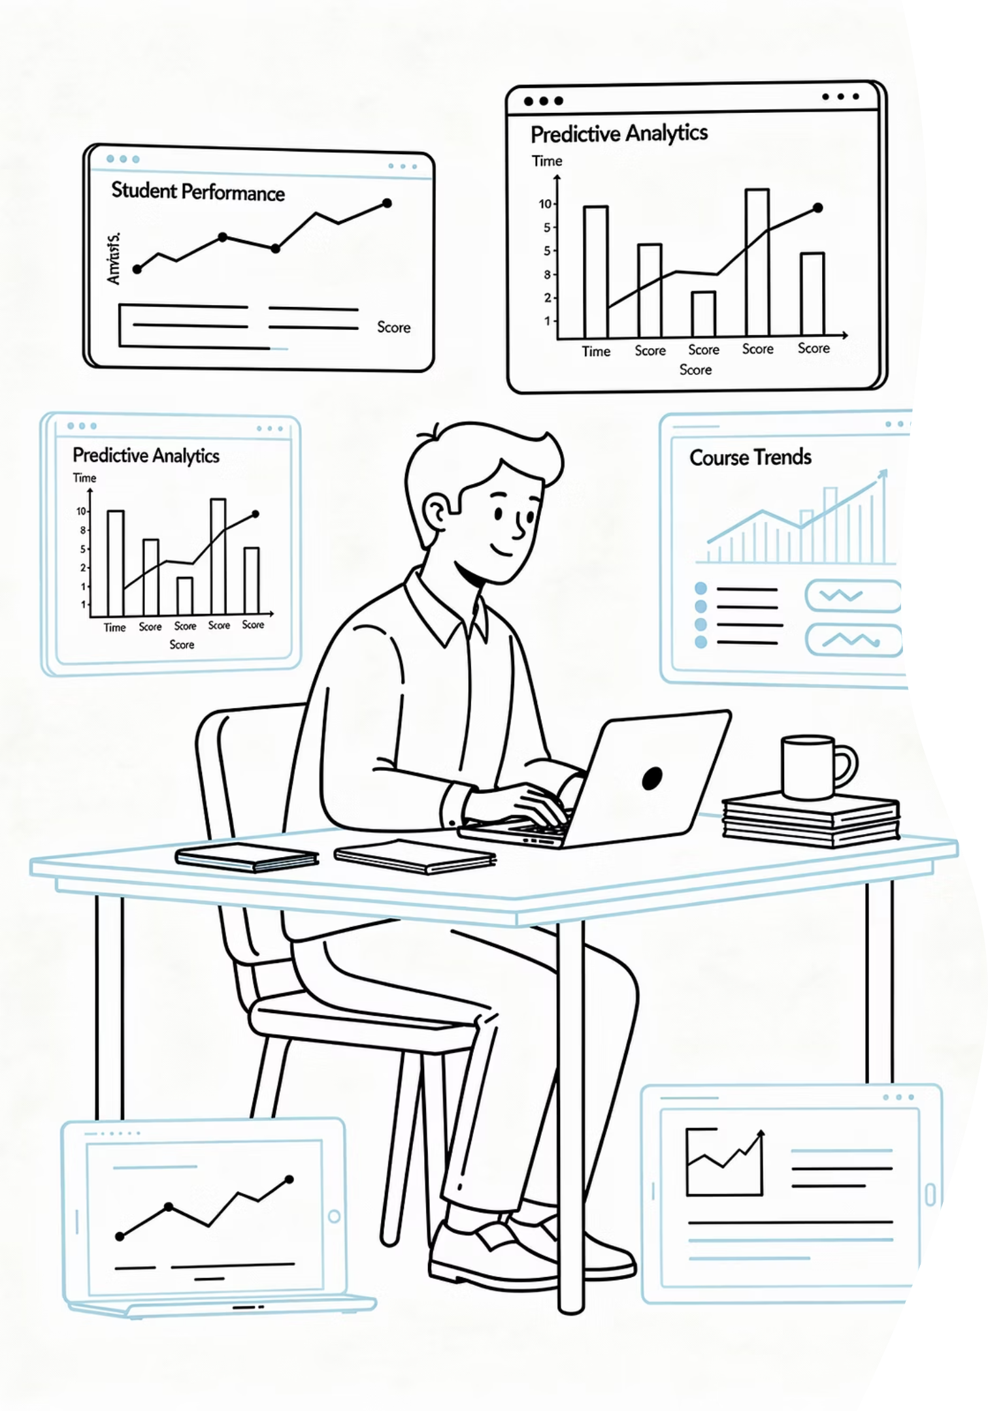
Student Success & Institutional Analytics
SIG THEME 3
Focus Areas
Objective
Student success monitoring and intervention tracking
Early warning systems for at-risk identification
Predictive analytics and machine learning models
Institutional performance dashboards
Data-driven decision support for academic staff
To develop a student success intelligence platform that empowers institutions to proactively identify at-risk students, intervene at the right time, and drive measurable improvements in academic outcomes and retention.

Slide 28
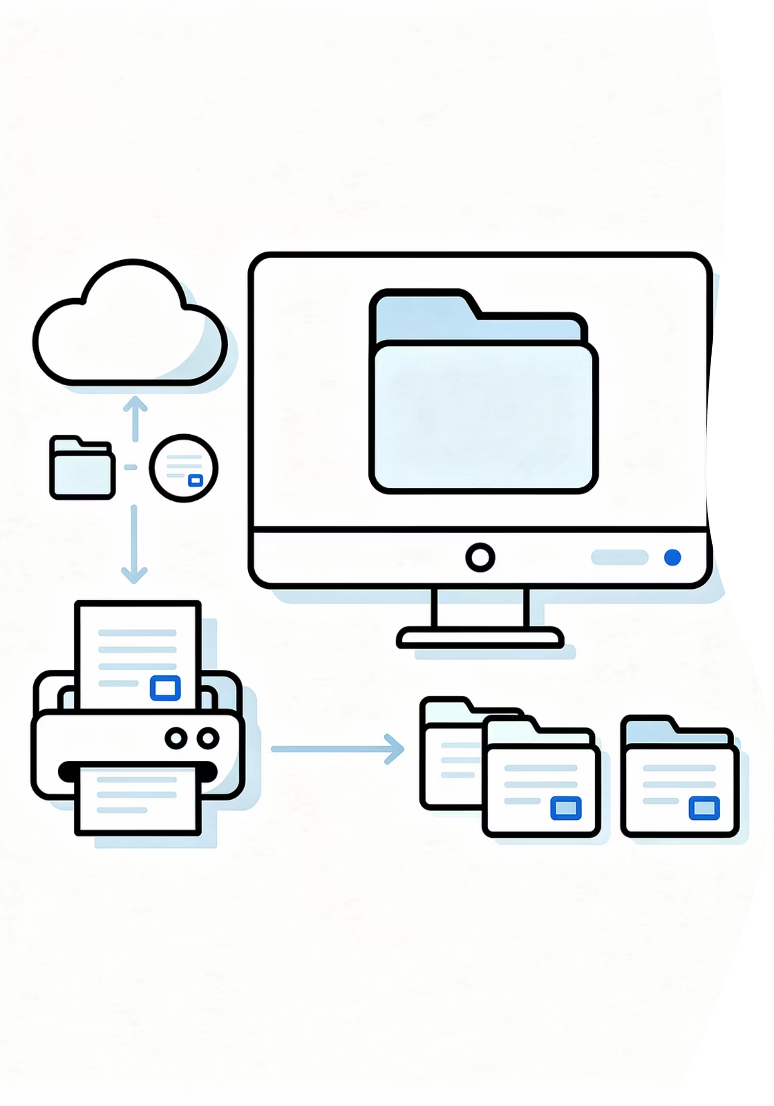
Digital Records & Document Management
SIG THEME 4
Focus Areas
Objective
Digital document management and secure storage
Student file digitization and legacy record scanning
Document workflows, routing, and approvals
Certificate and qualification verification
Compliance, accessibility, and long-term archiving
To establish a modern digital records platform that improves institutional compliance, enhances accessibility of student records, and ensures secure, scalable long-term archiving of critical documentation.

Slide 29
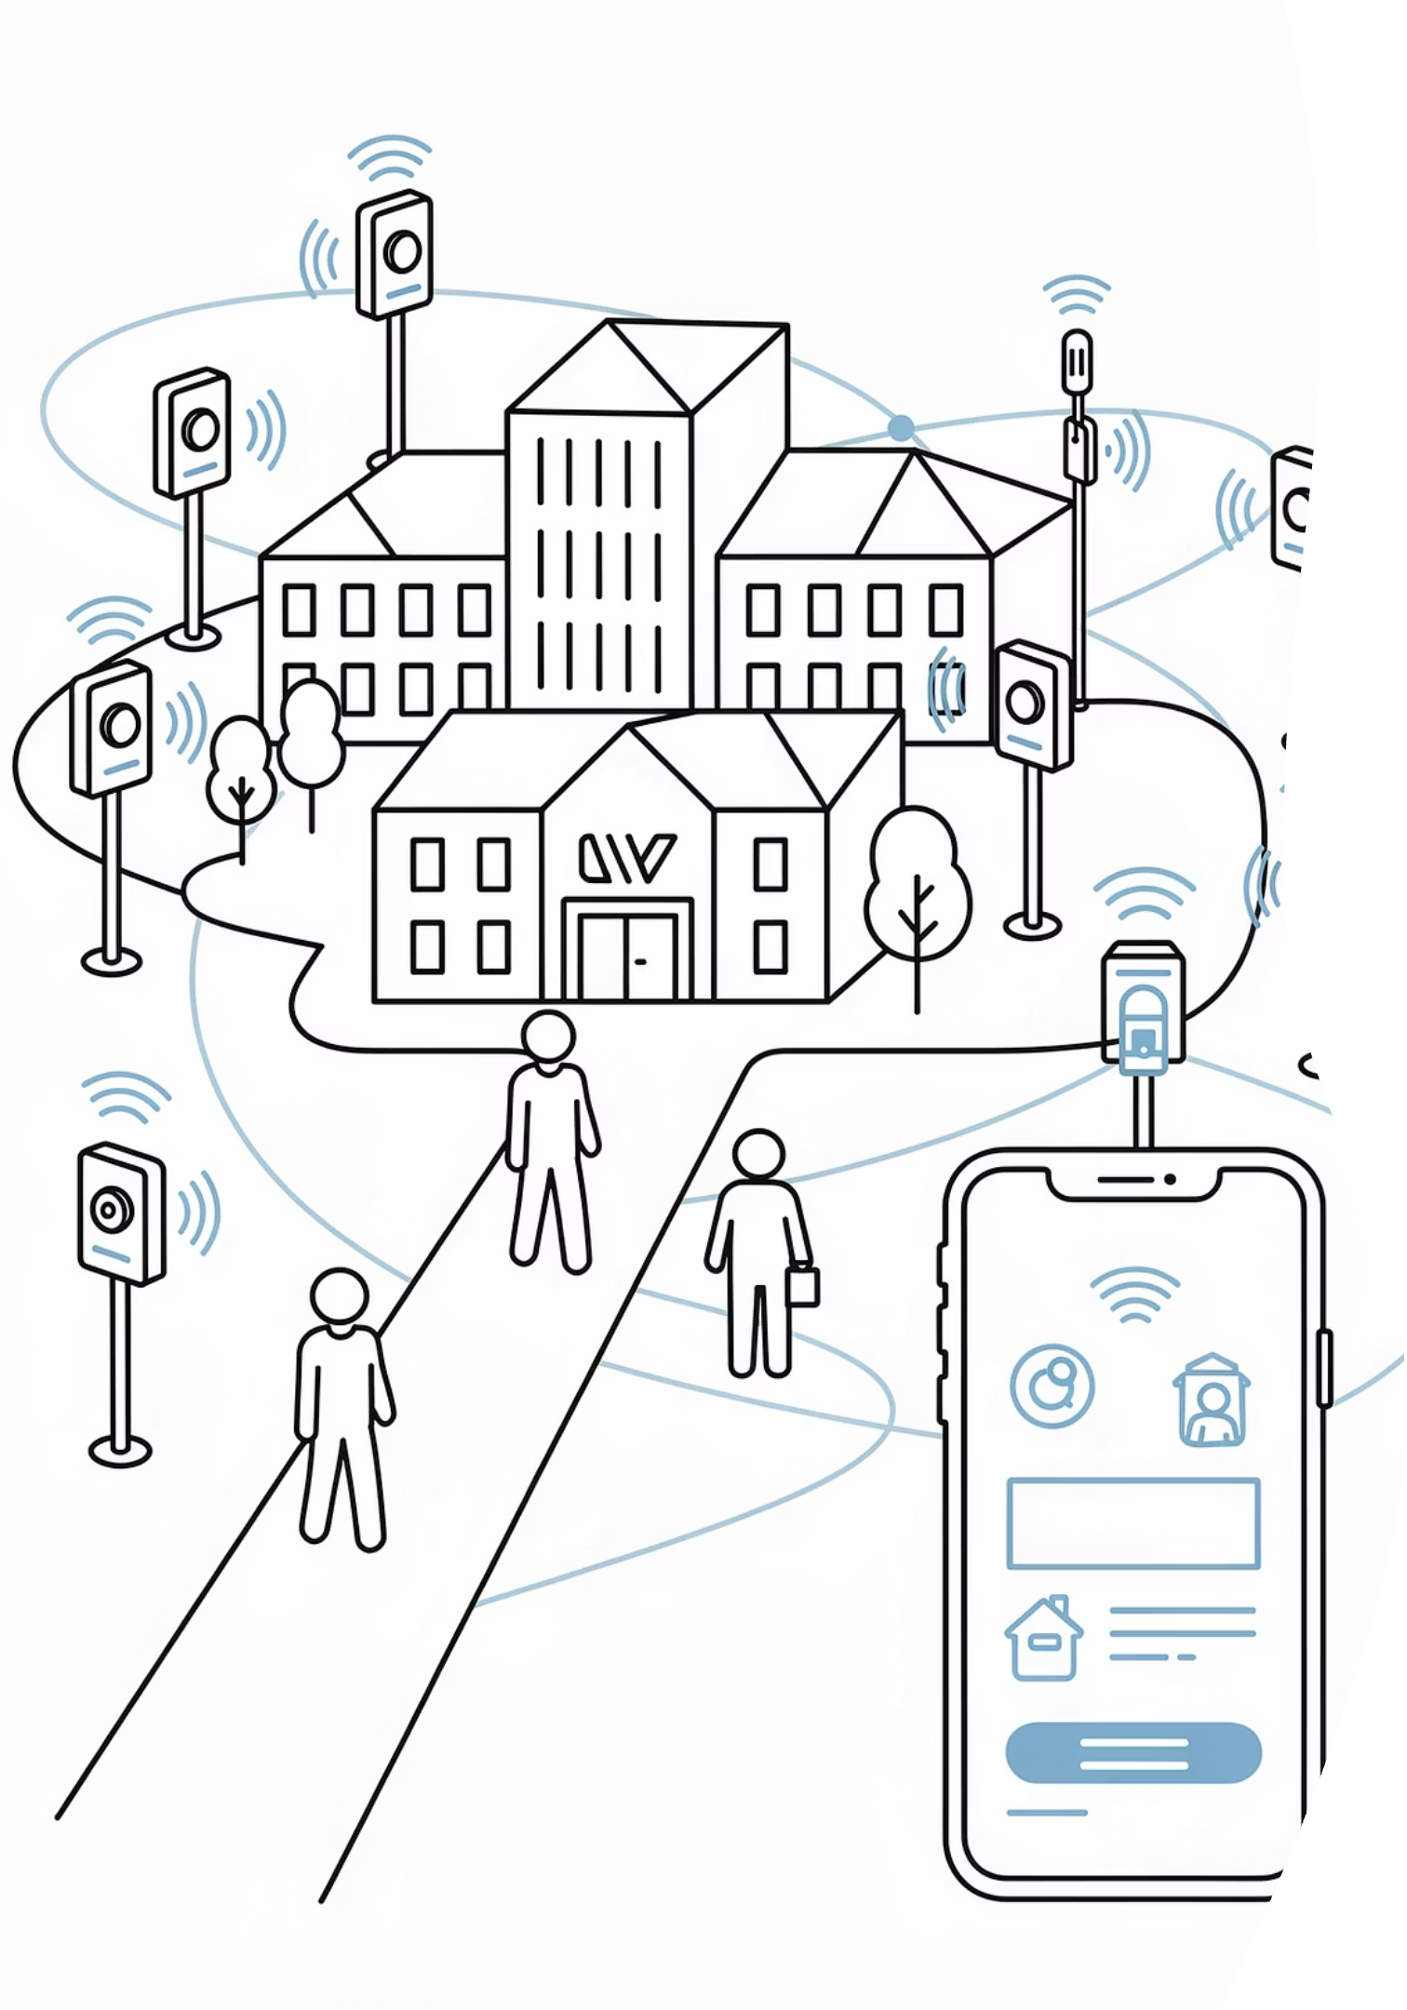
Smart Campus & Digital Ecosystem
SIG THEME 5
Focus Areas
Objective
Smart campus services and IoT integration
Digital identity management and campus access control
Integration with existing campus technologies
Digital marketplaces for student services
Integration with external service providers and partners
To define the next-generation digital campus ecosystem — connecting institutional services, technology partners, and students within a seamlessly integrated, mobile-enabled campus environment.

Slide 30

AI & Digital Experience
SIG THEME 6
Focus Areas
Objective
AI-powered student assistants and virtual advisors
Conversational chatbots for student services
AI-driven service automation and workflow intelligence
AI academic advisory and personalized support
Mobile-first digital experiences for students and staff
To explore and define the role of Artificial Intelligence in improving student and staff experiences across the digital university platform — enabling smarter, faster, and more personalized interactions at scale.

Slide 31





How to Join a SIG
Getting started is straightforward. Institutions can self-select the SIG themes that align best with their strategic goals and nominate the right internal champions to participate.
Nominate Representatives
Review the SIG Themes
Identify and nominate staff from relevant departments — product managers, academic leaders, IT, or operations — to represent your institution.
Explore the six innovation themes and identify the areas most aligned to your institution's digital priorities and strategic roadmap.
Co-Design the Future
Attend Kickoff & Discovery
Work alongside other institutions and the product team to define, validate, and shape next-generation capabilities throughout the full SIG lifecycle.
Participate in SIG kickoff workshops and structured discovery sessions to begin co-designing the solution with your peer institutions.
Each SIG is limited to a small group of participating institutions to ensure effective collaboration, meaningful input, and genuine influence over design decisions.

Slide 32


Why Participate? The Case for Joining a SIG
6
8–10
18mo
Innovation Themes
Institutions Per SIG
Max Program Length
Covering the most critical areas of digital transformation in higher education today.
A small, focused cohort ensures every voice is heard and every contribution matters.
A structured 9–18 month journey from concept to market-ready product release.
Direct Influence
Early Visibility
Shape future product capabilities from the earliest stages of design.
Gain insight into upcoming innovations well ahead of the wider market.
Peer Collaboration
Thought Leadership
Connect with and learn from institutions navigating the same challenges.
Become a recognized reference institution in digital higher education innovation.

Slide 33

The Outcome: Products Built With You, Not Just For You
The result of every SIG is a market-ready product capability — co-designed with direct input from participating institutions, ensuring it meets real operational needs, aligns with industry trends, and delivers meaningful value from day one of release.
SIG participation transforms institutions from passive technology adopters into active architects of the digital future — shaping solutions that serve the entire higher education sector.
🎯 Designed Around Real Needs
🚀 Released to the Broader Market
🏆 Your Institution as a Pioneer

Slide 34
Enhancements

Slide 35
Build 103 – Key Improvements
RELEASE NOTES
Focus: Data Integrity, Registration Stability & Academic Controls — Build 103 delivers foundational improvements across student data management, registration security, academic tooling, and system performance. These enhancements reduce duplication risks, strengthen data governance, and improve the day-to-day experience for students and lecturers alike.
Student Data Integrity
Registration & Security
Prevents duplicate student numbers for the same ID or Passport
Student numbers now reserved per application year for improved tracking
Proof of Registration document links are now encrypted for enhanced security
Faster qualification searches via optimized database queries
Academic Enhancements
Timetable & Group Management
New Maintain MT Criteria functionality enables lecturers to manage assessment criteria directly
Added support for new group types: Virtual, Lab, and Adhoc

Slide 36
Build 106 – Key Improvements
RELEASE NOTES
Focus: Automation, Communication & Application Quality — Build 106 strengthens the application lifecycle through automated payment monitoring, smarter notifications, improved data quality controls, and tighter portal security. These changes reduce manual intervention and keep applicants better informed throughout the process.
Application Payment Monitoring
Application Data Quality
A fully automated process now monitors application payments end-to-end. Students receive real-time notifications when payment is received or still outstanding, and application status updates automatically — eliminating manual follow-up.
Prevents duplicate previous study entries from being submitted
Enhanced postal code search simplifies accurate address capture
Student Communication
Graduation Governance
Improved email notifications for missing and rejected uploaded documents
A new validation rule ensures all qualifications and compulsory subjects are completed before a student can proceed to graduation, enforcing academic compliance at the system level.
CAS Integration
Improved school result processing and subject mapping
Better automation of school result downloads
Security Improvements
Academic transcripts and record PDFs restricted from editing
Improved session security in the student portal

Slide 37
Build 112 – Key Improvements
RELEASE NOTES
Focus: Integration, Document Management & Graduation Processes — Build 112 advances system integration with HDMS, introduces full end-to-end graduation event management, and strengthens portal authentication and access controls. These improvements streamline administrative workflows and raise the bar for document handling and security.
HDMS Integration
Graduation Event Management
Application Processing
Documents from iEnabler, Wizard, and Infinity are now automatically merged and correctly categorised within HDMS, eliminating manual document reconciliation and reducing the risk of misclassified records.
New capabilities allow administrators to link students to graduation ceremonies, generate graduate and guest tickets, and print ceremony tickets — supporting a fully managed end-to-end graduation workflow.
Enhanced matric result processing and validation improves accuracy during application review. A better audit trail with date and time stamping ensures full traceability of application changes.
Registration Stability
Portal Security Enhancements
Improved handling of registration data between back-office and web registration reduces sync errors and ensures consistency across systems during peak registration periods.
Improved login handling with SAML/AAD authentication, guest login prevention, and embargo controls for matric-related processes strengthen access governance across the student portal.

