Slide 1

Asset Verification via iEnabler
Bukelwa Mxamli
    ITSIUG2026
Notes:
Overview of asset verification via iEnabler and session context.

Slide 2

Table of Contents
Table of Contents
  Introduction
  Requirement Definition
  Process Flow
  Prerequisites
  SODs (FCSM-1)
  Allocated Person – Actions
  Allocated Person – Actions (continued)
  Email to Responsible Person
  Responsible Person Actions
  Approval Email
  Rejection Email
  Proposed Future Enhancements
Notes:
High‑level agenda and what will be covered.

Slide 3
Introduction
The SWT Asset Management workshop, held from 29 to 31 July 2024, was convened with the express intent of critically evaluating the ITS Asset Management System and identifying systemic inefficiencies, compliance constraints, and functional limitations. The workshop constituted a multi-institutional stakeholder forum, inclusive of Adapt IT representatives and end-user delegations, wherein consensus was sought on both immediate priorities and medium-term system refinements required for operational optimisation.
Notes:
Summary of workshop outcomes and purpose of system evaluation.

Slide 4
Requirement Definition
iEnabler self-service verification
  The allocated user will log in to iEnabler, and the list of assets allocated to them will be displayed.
  The user can tick to confirm the verification of each asset.
  A comment field should be added if the allocated user wants to comment per asset.
  Allow for attachments per asset (documents/photos).
  This must be under strict timelines and can be introduced via cycles.
  Allow for approvals to be flexible according to the institution's needs.
  Allow the institution to add terms and conditions that the user can accept.
  Almost designed like the disposal
Notes:
Requirements for the iEnabler self‑service asset verification process.

Slide 5
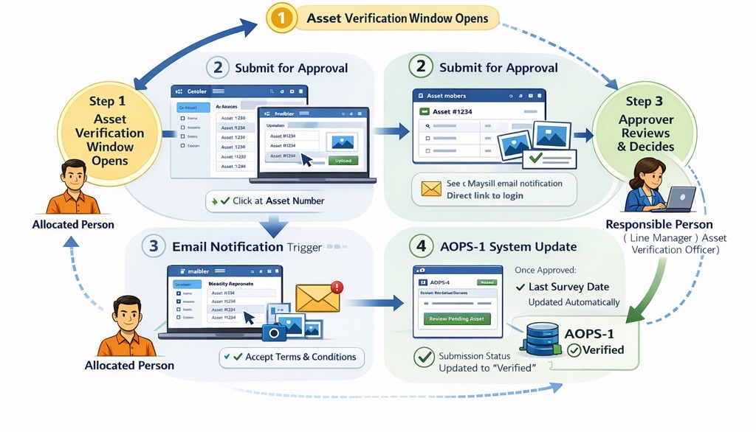
Process Flow
Notes:
Explanation of process flow and user interactions.

Slide 6
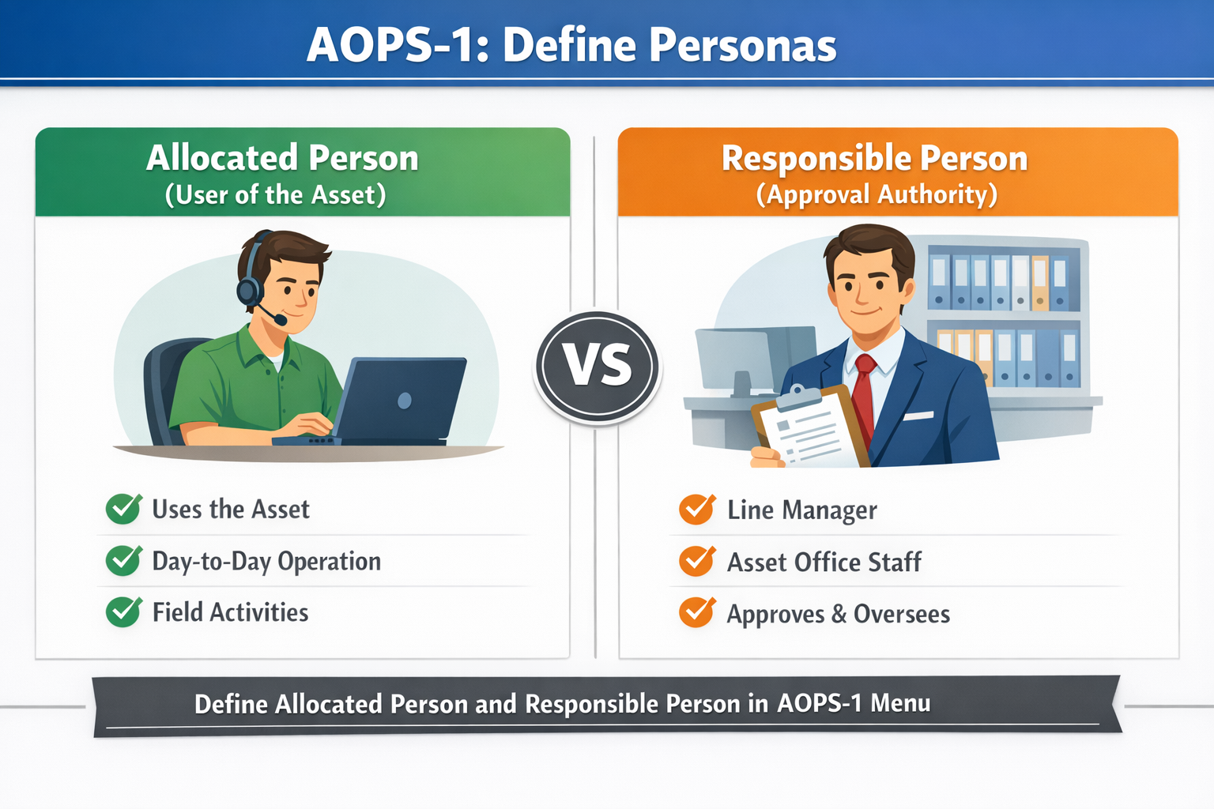
Prerequisite
Notes:
Prerequisites required before the process can be implemented.

Slide 7
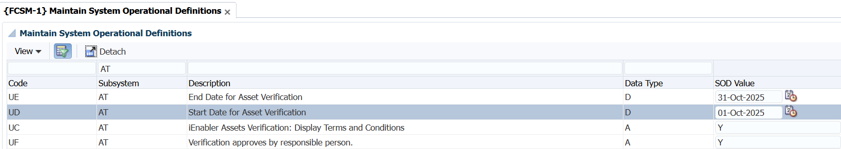
SODs {FCSM-1}
Notes:
Overview of SODs related to FCSM‑1.

Slide 8
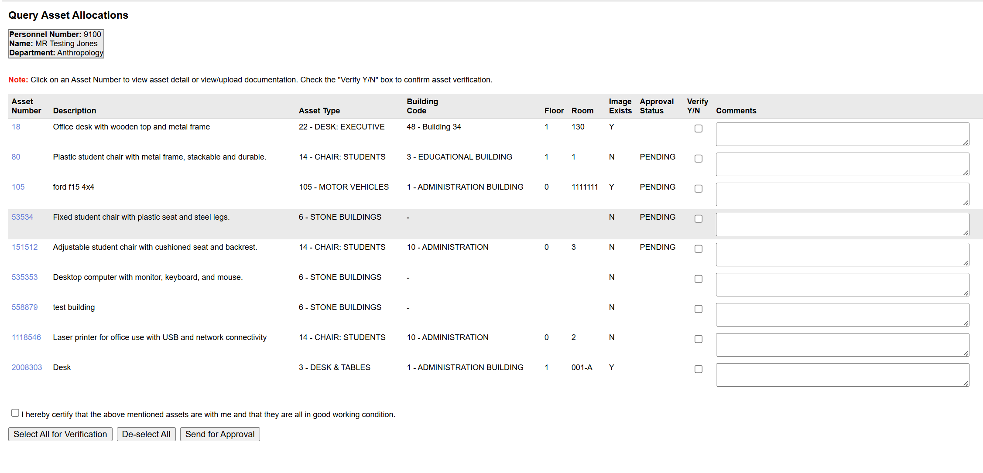
Allocated Person – actions
Notes:
Actions available to the allocated person in the system.

Slide 9
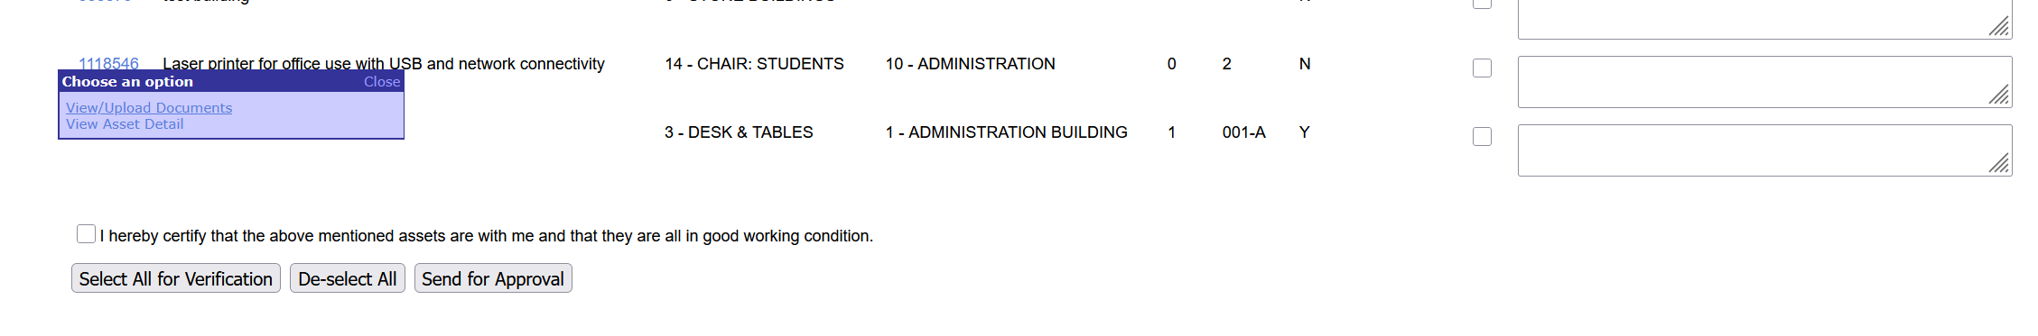
Allocated Person – actions
Notes:
Continuation of allocated person actions.

Slide 10
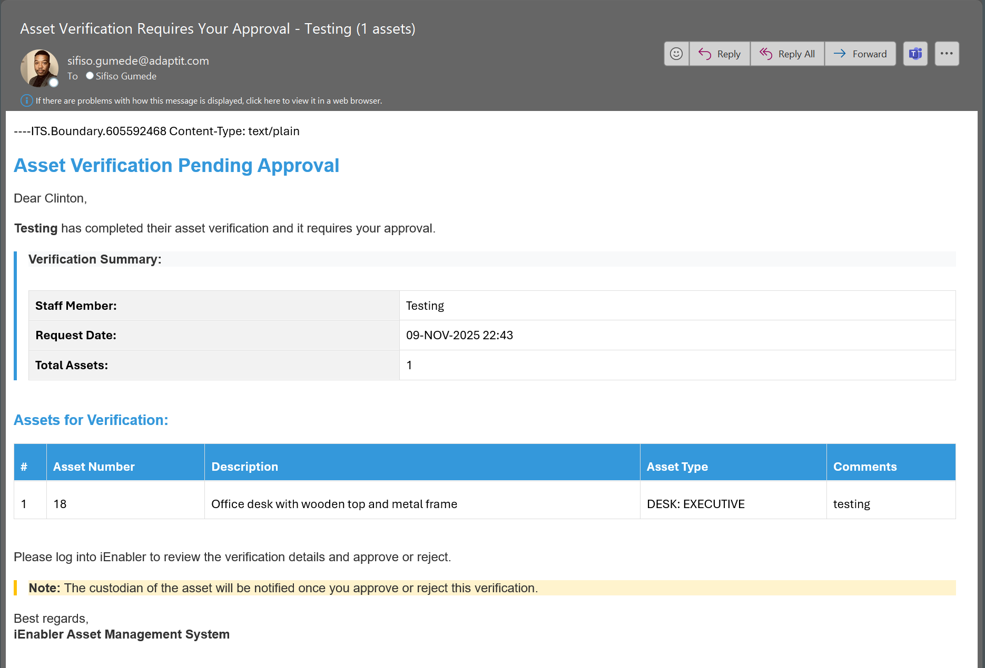
Email sent to Responsible Person to Approve
Notes:
Description of email notifications sent for approval.

Slide 11
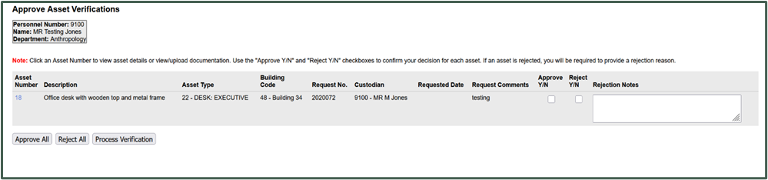
Responsible Person
Notes:
Actions required from the responsible person.

Slide 12
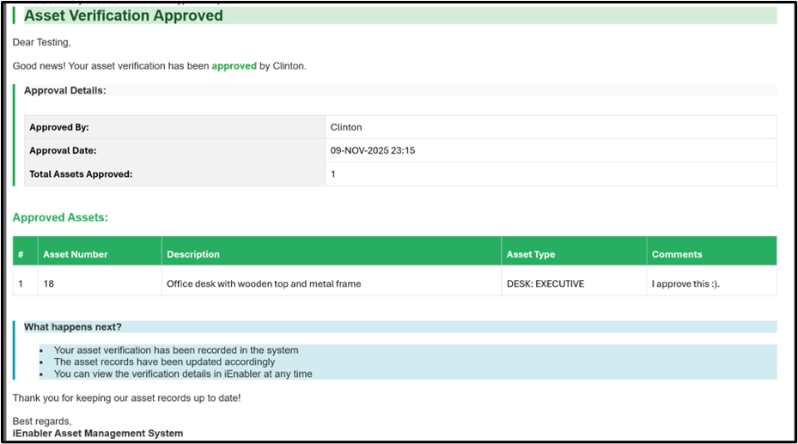
Approval Email sent to Allocated Person
Notes:
Email sent confirming approval back to allocated person.

Slide 13
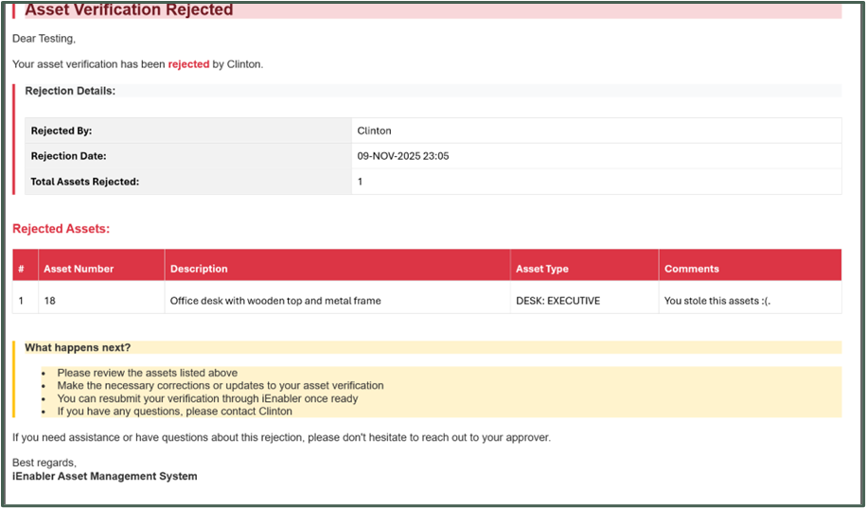
Rejection Email sent to Responsible Person
Notes:
Email sent when verification is rejected.

Slide 14

Proposed Future enhancements
Notes:
Planned future system enhancements.

Slide 15

THANK YOU!!

