Slide 1

4.1 HR & Payroll System Enhancements Building compliant workplaces where people thrive!!!
Presenter: Brilliant Tleane

Slide 2

DISCLAIMER
This presentation is only a summary of some of Adapt IT’s products, features and their latest developments. Adapt IT only intends for the information to give you an overview, and not a complete and comprehensive statement that necessarily suits your purposes.
Adapt IT reserves the right to change any information contained in this presentation and is not responsible for any loss that results from inaccuracies in the information. You may not distribute or reproduce the information without Adapt IT’s written permission.

Slide 3
TABLE OF CONTENT
Strategic Technology Plan
Special Interest Group (SIG)
Enhancements
Roadmap

Slide 4
Strategy Technology Plan

Slide 5
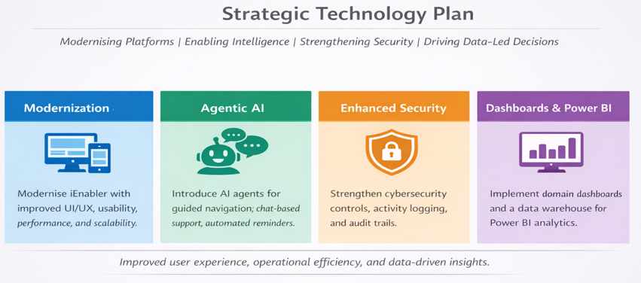
Strategic Technology Plan

Slide 6
Special Interest Group

Slide 7

Special Interest Group (SIG)
About SIG:
A structured pathway for higher-education institutions to co-design the future of digital technology — before it reaches the broader market.
What Makes a SIG Different
Direct Influence : Institutions actively shape features, design, and priorities from the ground up.
Equal Voice : Every participating institution has equal input, regardless of size or resources
Early Access : SIG members gain access to new capabilities well before general availability.

Slide 8
HR & Payroll Enhancements

Slide 9

HR and Payroll Enhancements
Enhanced Leave Liability
Enhanced Training and Skills Development
Preliminary Payslip
e-Recruitment Enhancements
Nedbank Host to Host
Statutory Equity Reporting

Slide 10
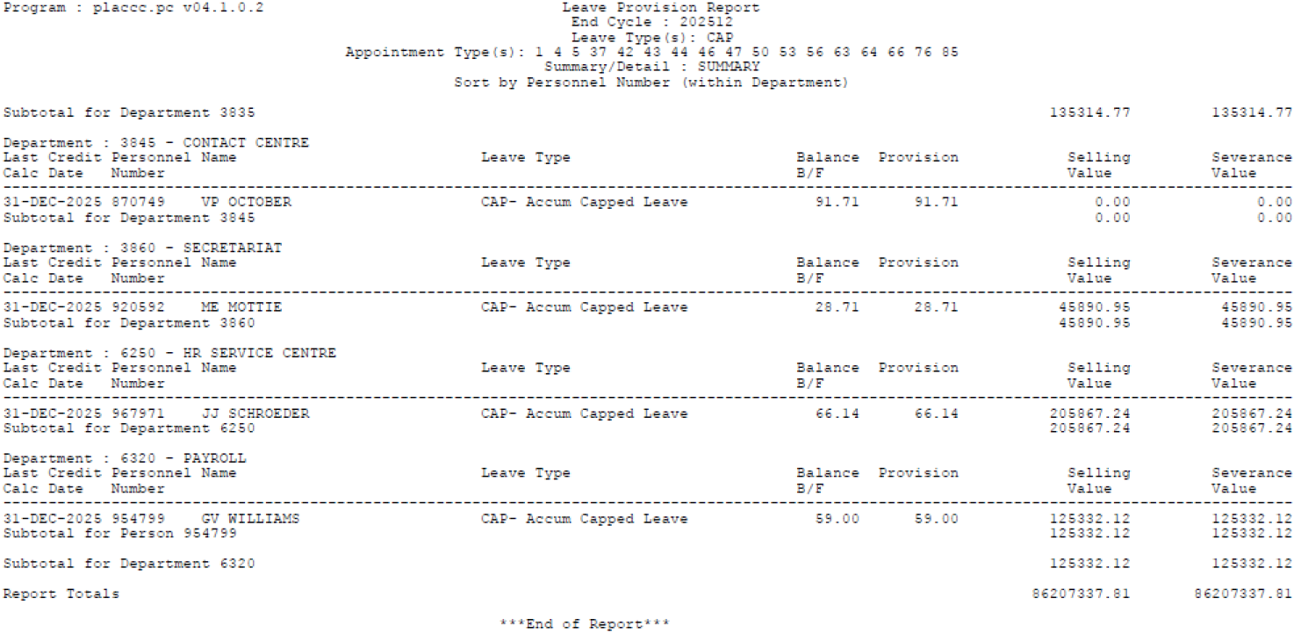
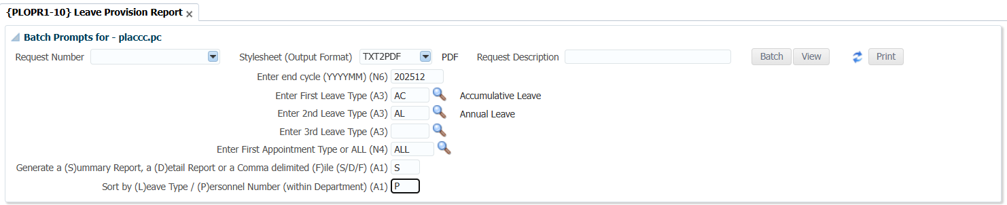
Leave Liability
Notes:
Leave Liability/leave provision report calculated the leave balance as at the end of a specific cycle and then based on the leave balance calculate the leave selling and leave severance value for the leave type and the person. These values are used to calculate the leave liability amount for the university.

Slide 11
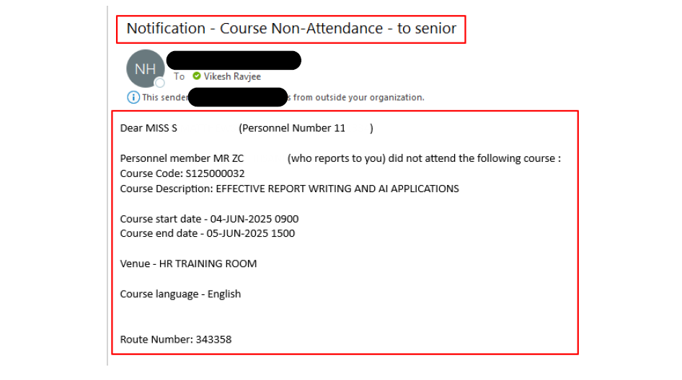
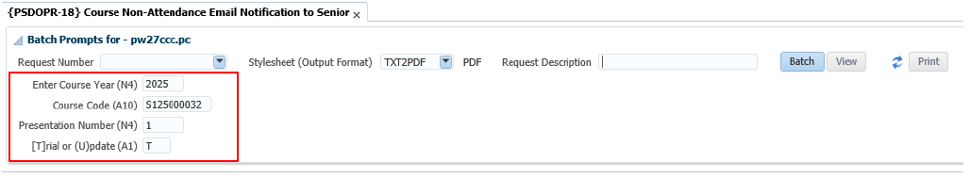
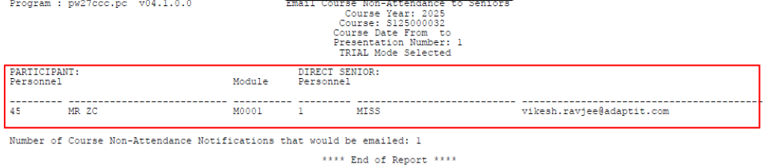
Training & Development Enhancements : {PSDOPR-18} Non-Attendance Mail to Senior

Slide 12
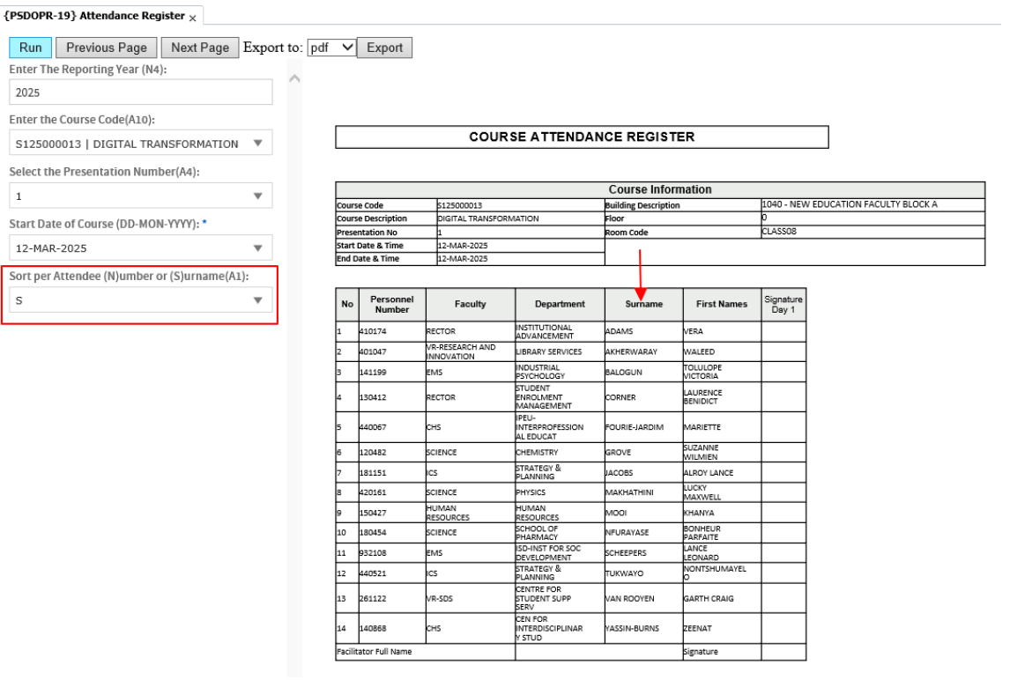
Training & Development Enhancements : {PSDOPR-19} Attendance Register

Slide 13
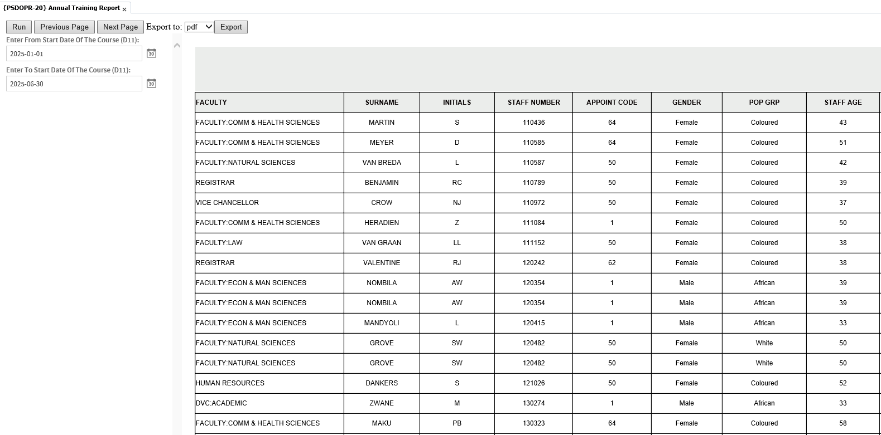
Training & Development Enhancements : {PSDOPR-20} Annual Training Report

Slide 14
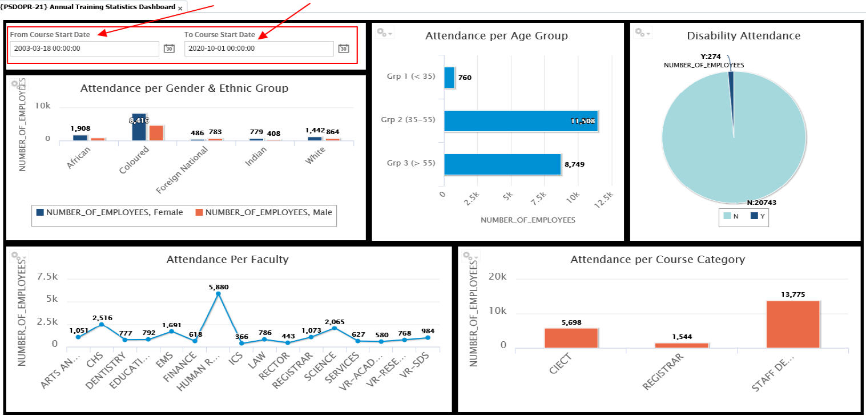
Training & Development Enhancements : {PSDOPR-21} Annual Training Statistics

Slide 15
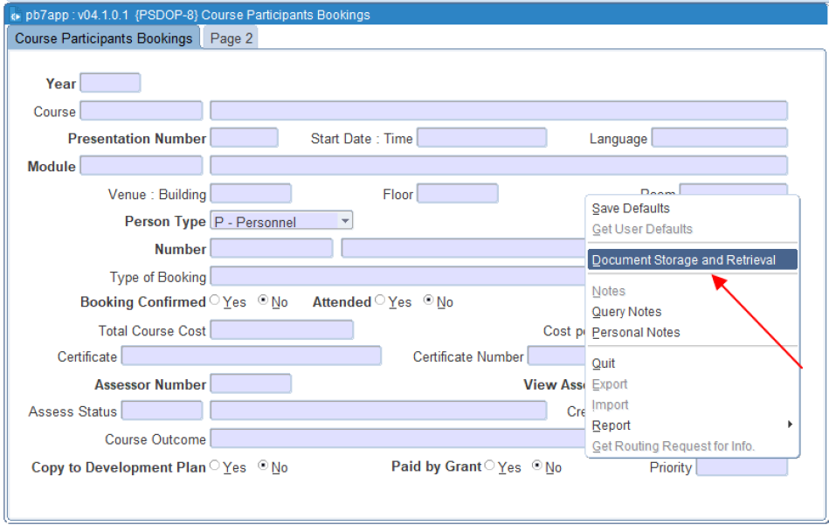
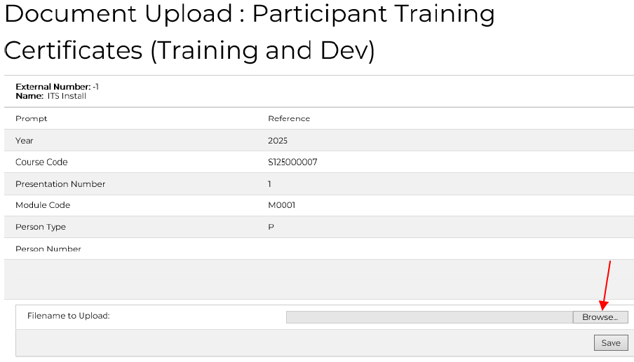
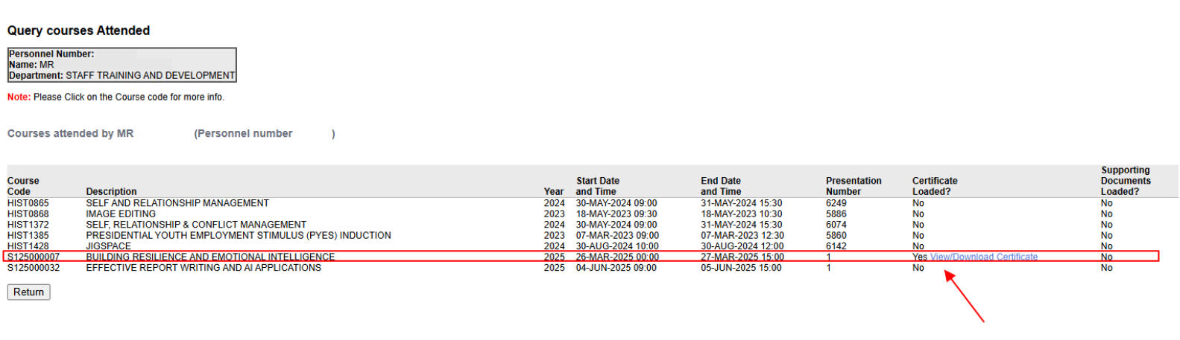
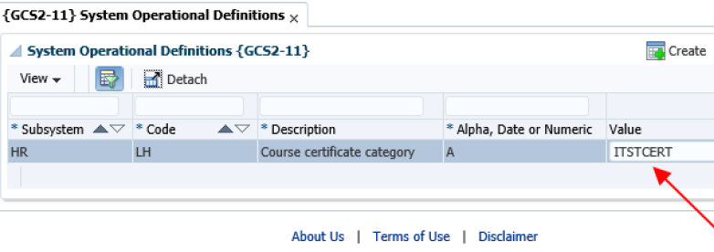
Training & Development Enhancements : {PSDOP-8} Upload Certificate for Attendance

Slide 16
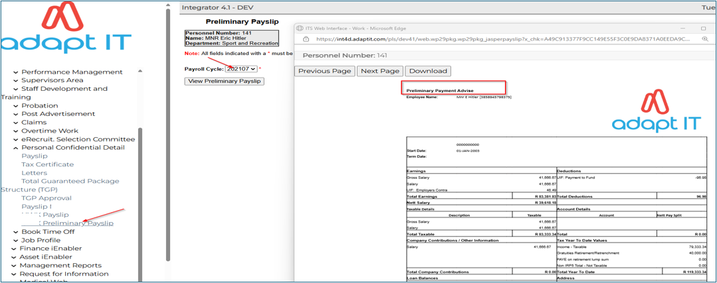
Preliminary Payslip

Slide 17
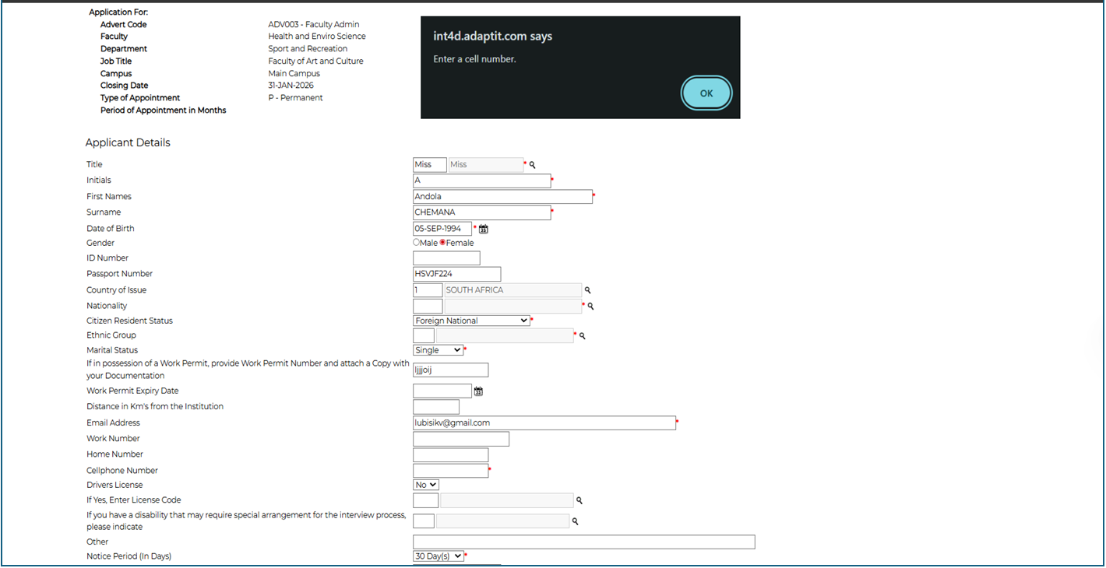
E-Recruitment Enhancements
Notes:
Validation error “Enter Cell Number” Must be display when you try to submit an application

Slide 18
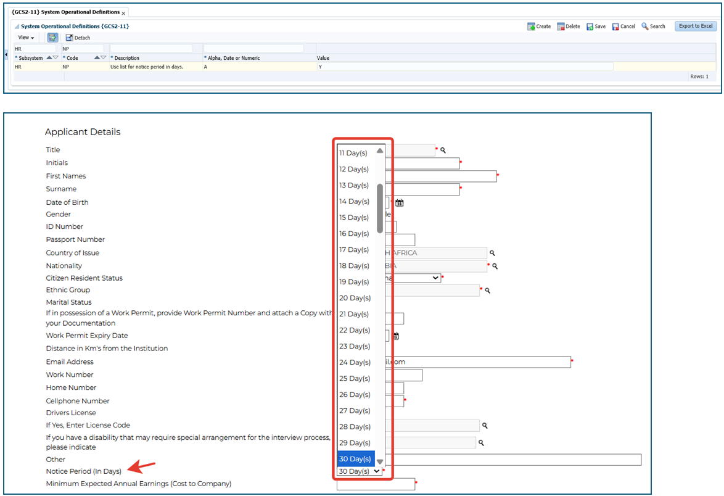
E-Recruitment Enhancements
Notes:
The Field Notice Period must use a dropdown and list all the available notice periods.

Slide 19
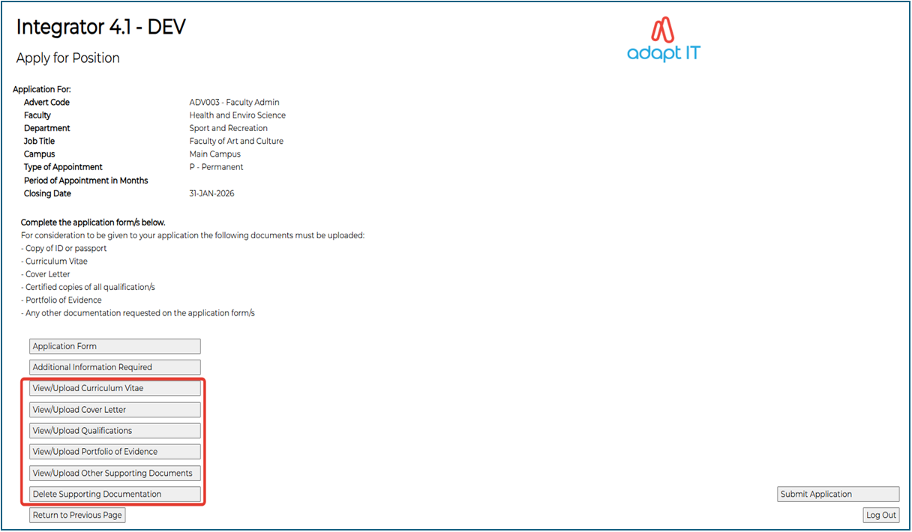
E-Recruitment Enhancements
Notes:
The Upload of the Supporting Documents has been split into different categories of the documents required, i.e. CV, Qualifications, Portfolio of Evidence and also Other.

Slide 20
E-Recruitment Enhancements
Notes:
The Upload of the Supporting Documents has been split into different categories of the documents required, i.e. CV, Qualifications, Portfolio of Evidence and also Other.

Slide 21
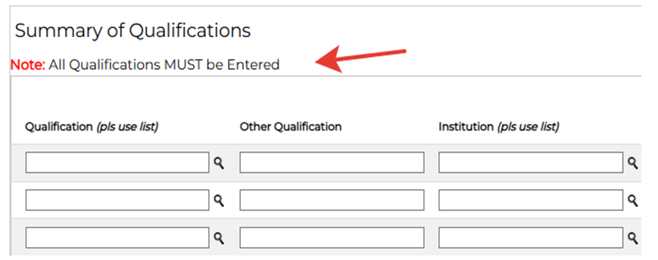
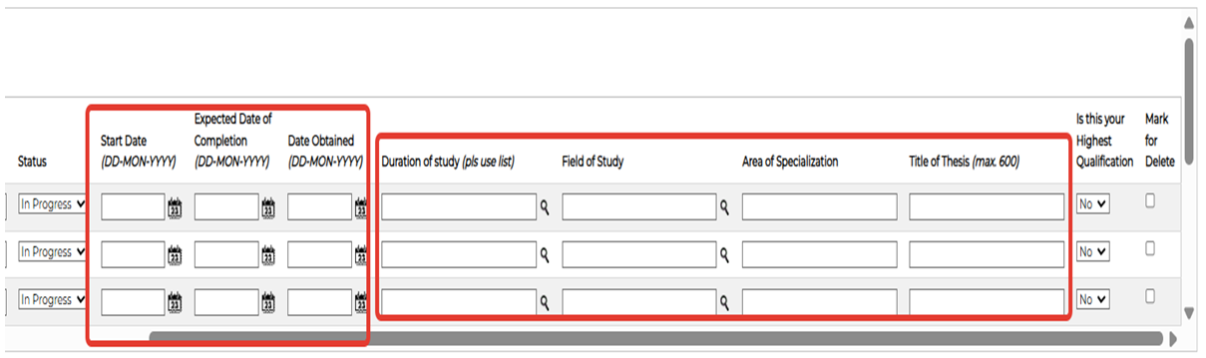
E-Recruitment Enhancements : Phase 1
Notes:
Check the newly added fields on the Summary of Qualifications. Note must be displayed in the description.

Slide 22
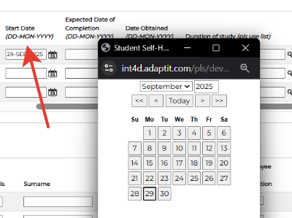
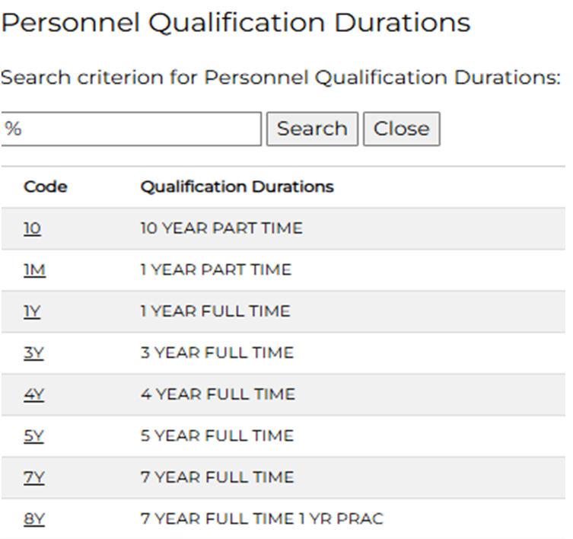
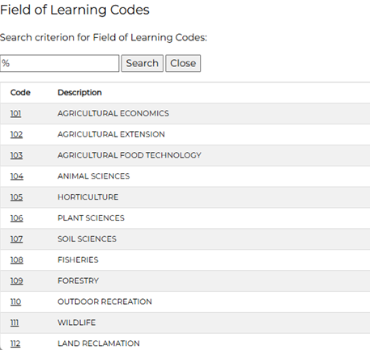
E-Recruitment Enhancements : Phase 1
Notes:
Should allow the applicant to manually type the date or use the calendar. Display a list of Durations for the applicant to select the relevant. Display a list of Fields of study for the user to select the relevant.

Slide 23
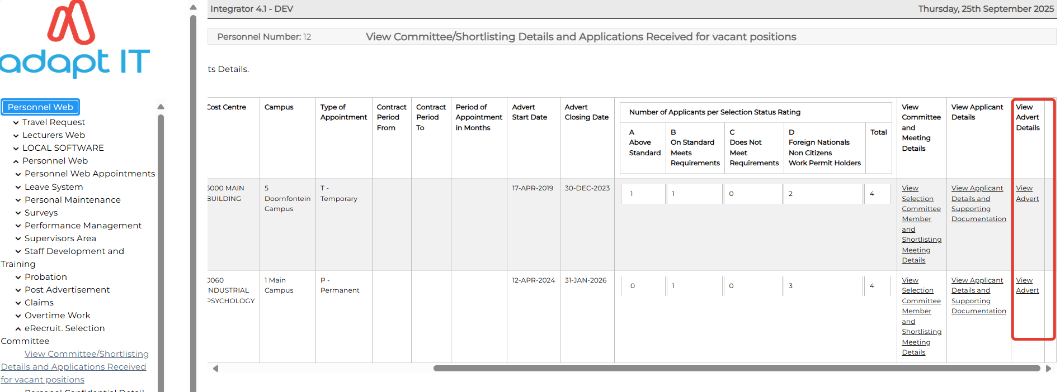
E-Recruitment Enhancements : Phase 1
Notes:
Committee member to access the newly added column View Advert details

Slide 24
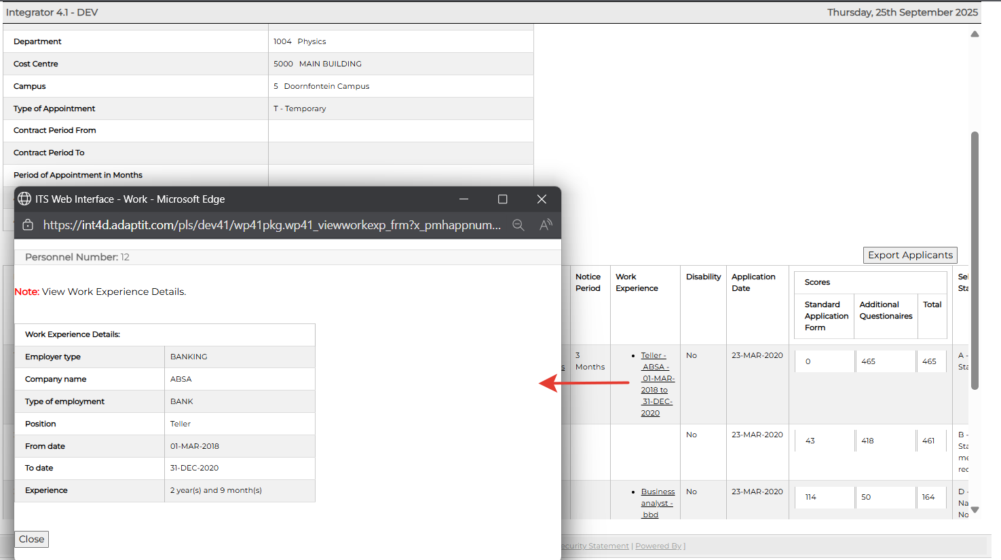
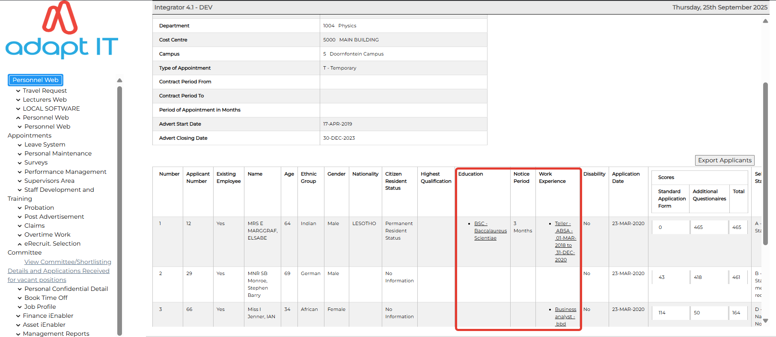
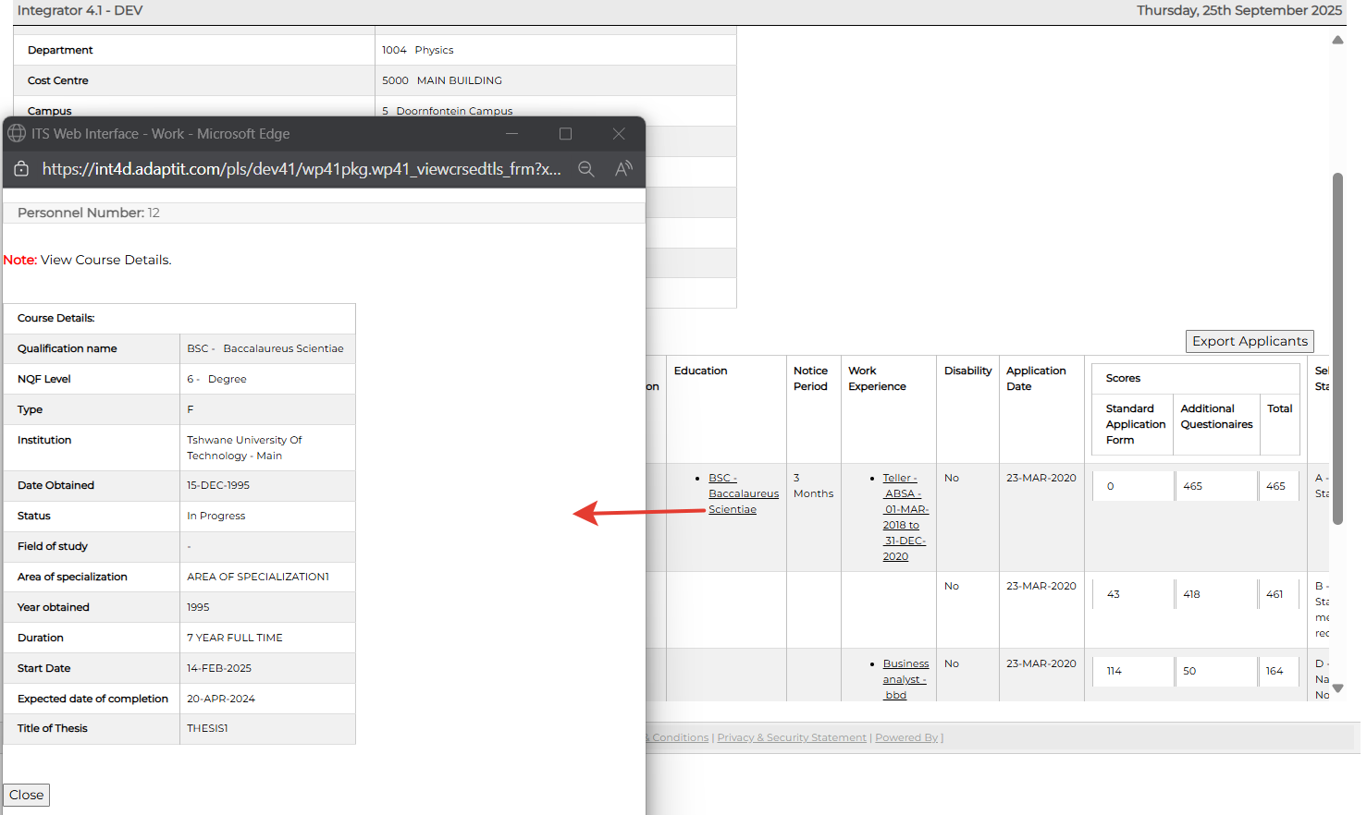
E-Recruitment Enhancements : Phase 1
Notes:
A committee member will be able to view new columns for Education, Notice Period and Work experience.

Slide 25
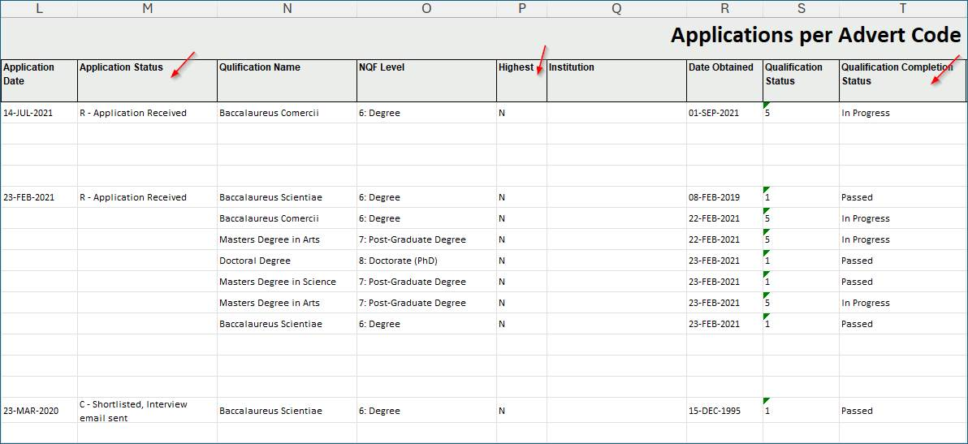
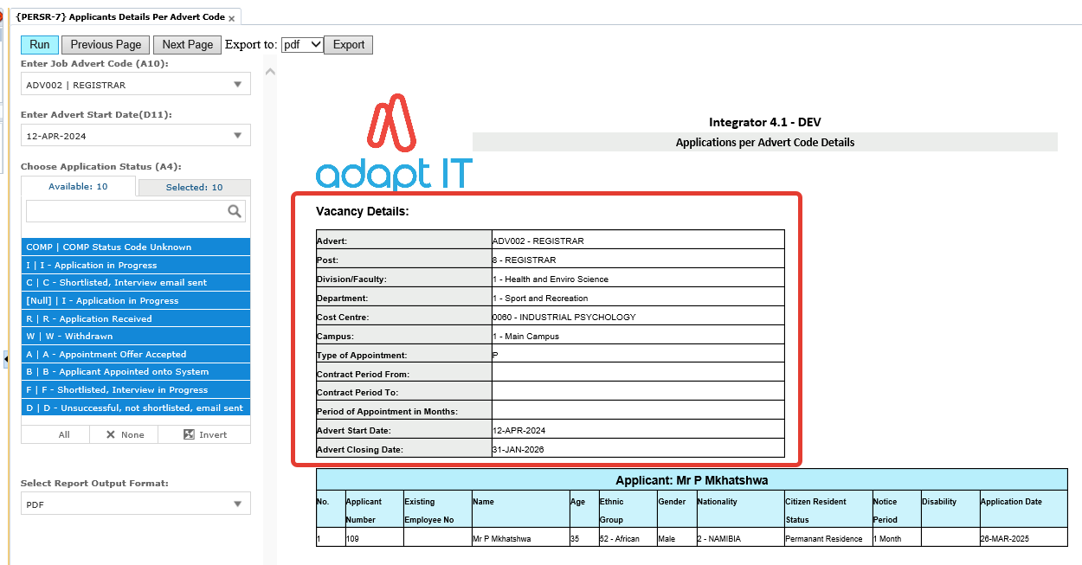
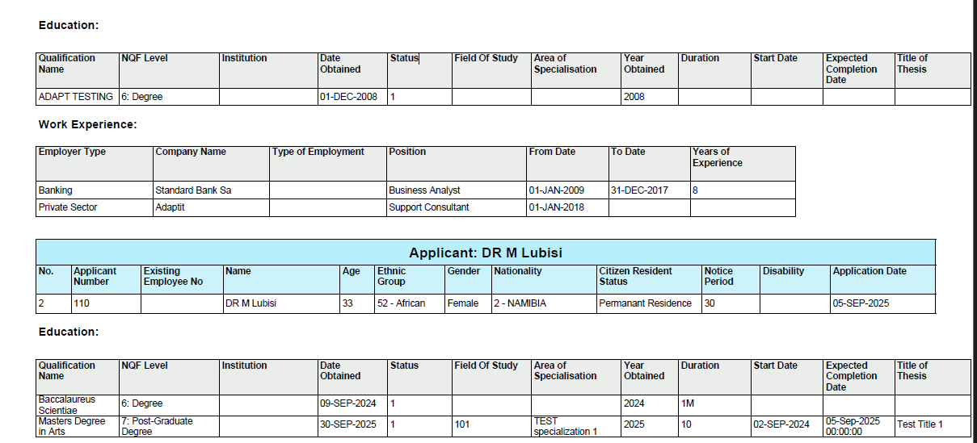
E-Recruitment Enhancements : Phase 1
Notes:
The user must be able to select the advert code from the drop-down, and once the advert code is selected, the advert start date should automatically display; the advert start date should not be selected by the user manually.
The system should display a header with the Advert Details at the top left and list all the applicants.
The report must be exported and viewed in pdf format and Excel.

Slide 26
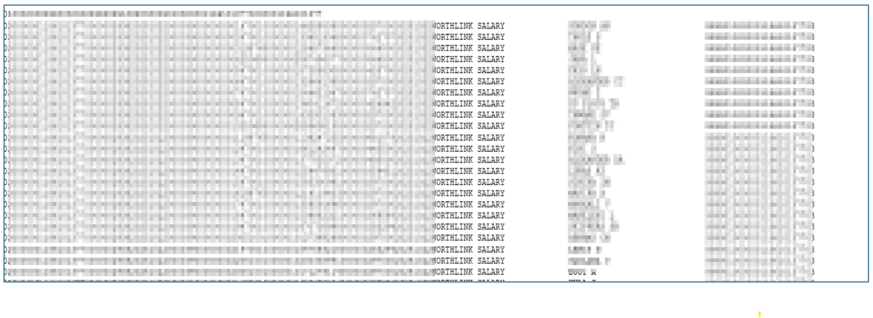
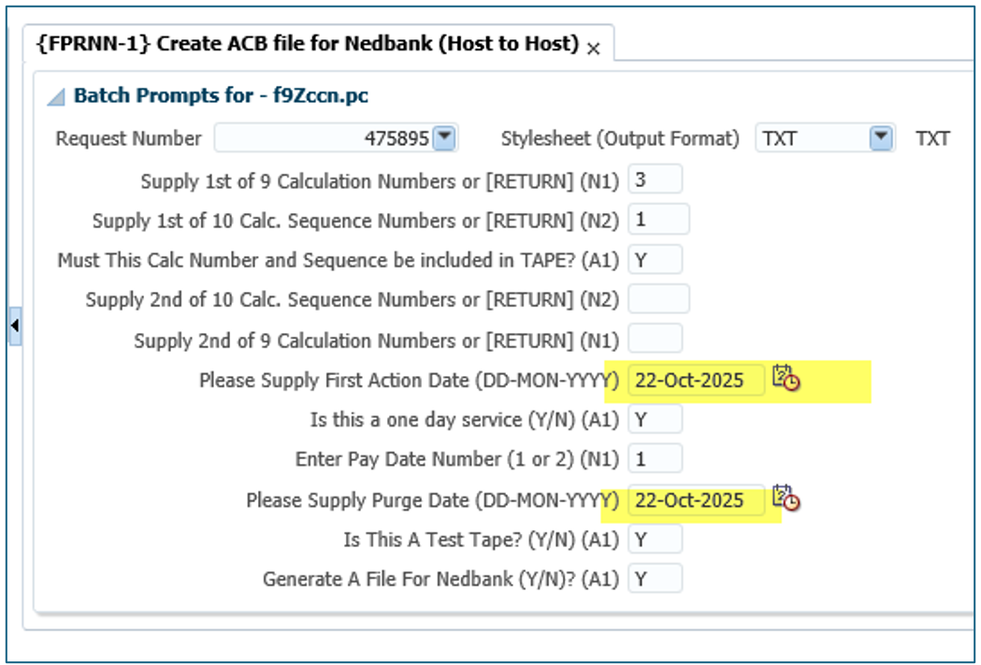
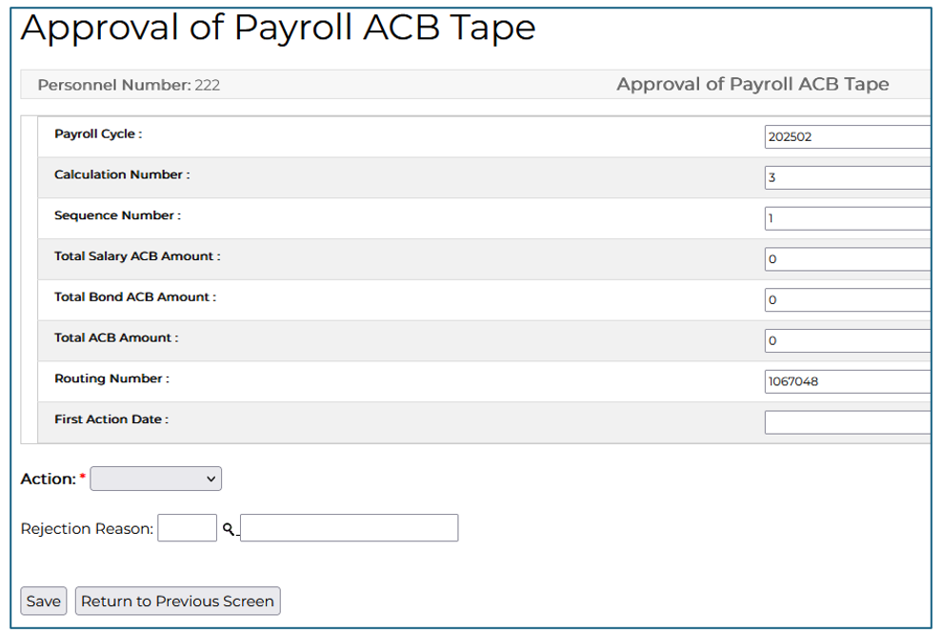
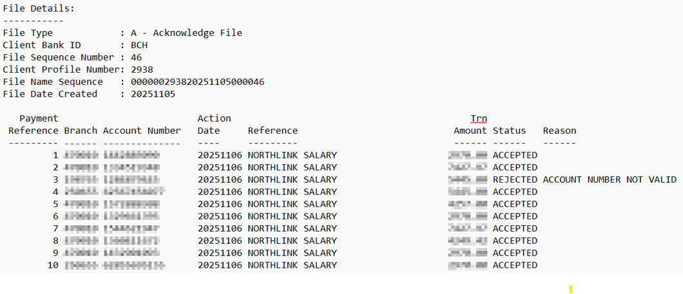
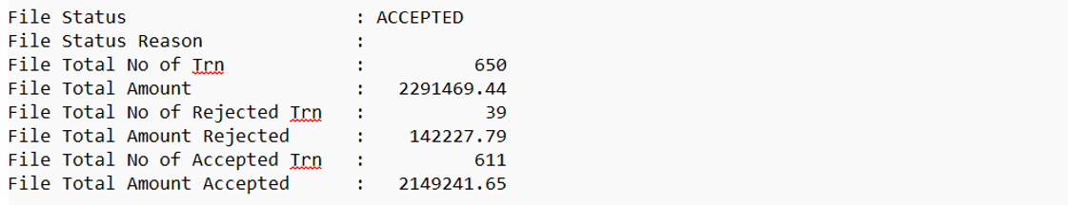
Host to Host for Salaries : Nedbank

Slide 27
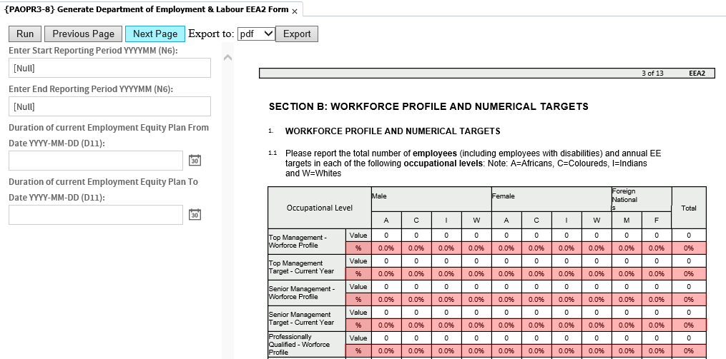
Equity Reporting (EEA2 Form)

Slide 28
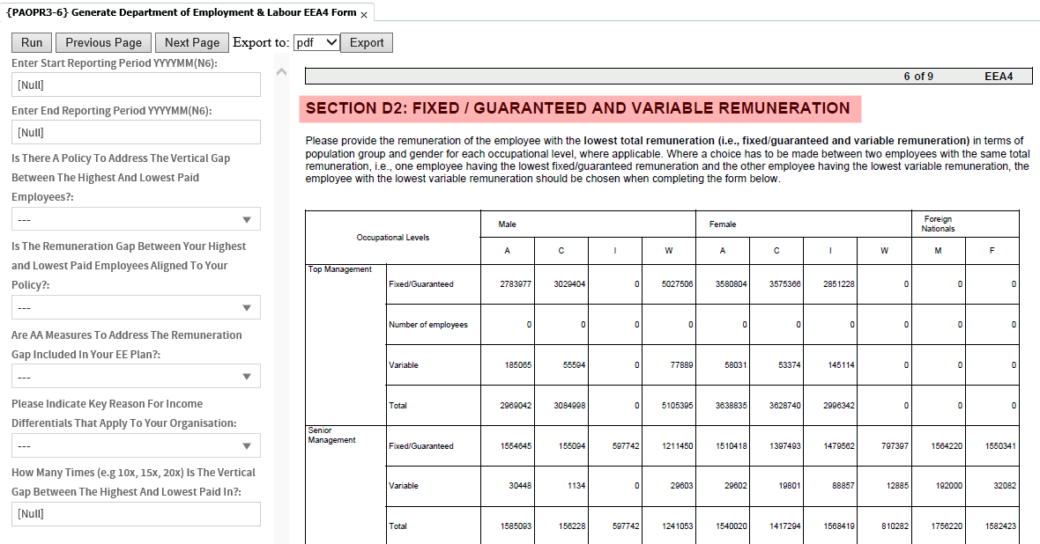
Equity Reporting (EEA4 Form)

Slide 29
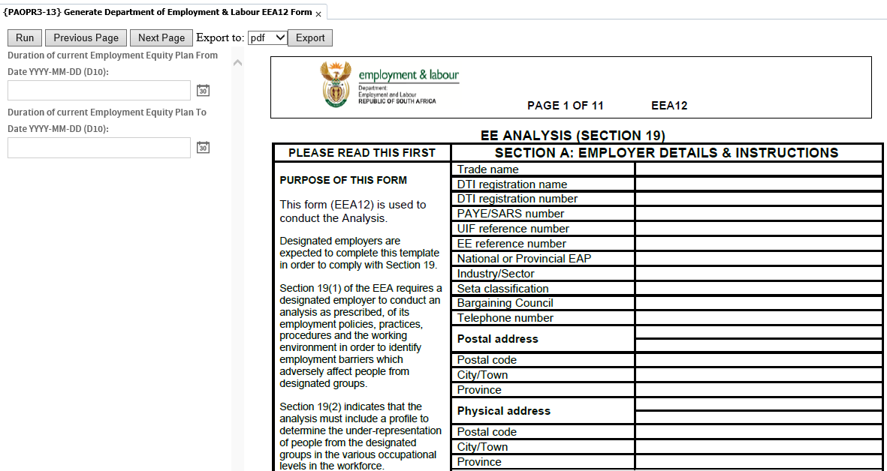
Equity Reporting (EEA12)

Slide 30
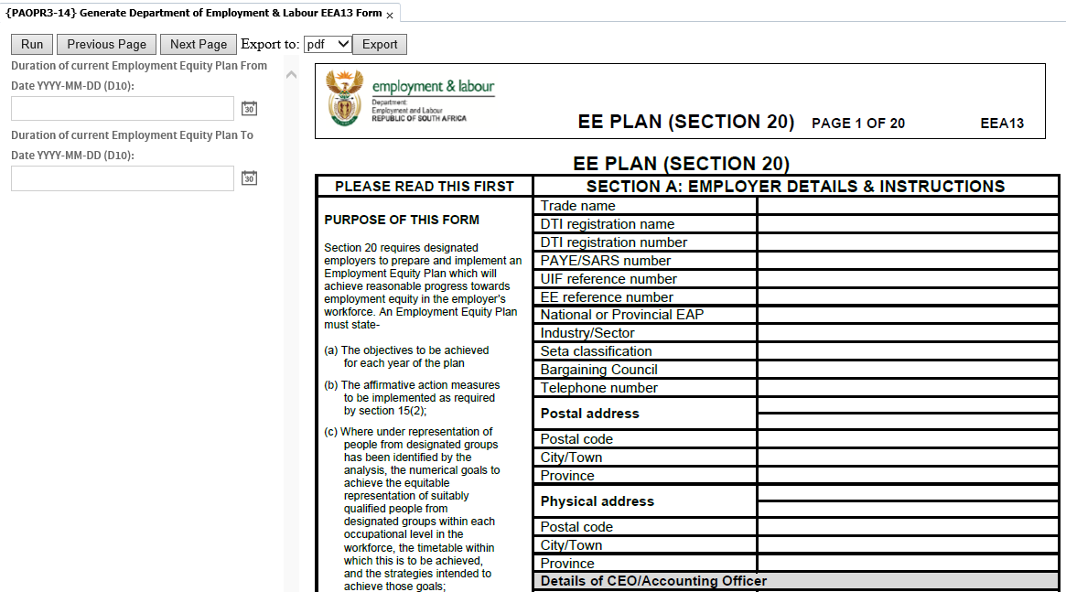
Equity Reporting (EEA13)

Slide 31
HR & Payroll Roadmap

Slide 32
Q1
Q2
Q3
Q4
e-Recruitment Enhancements – Phase 3
20%
Equity Reporting (EEA2,4,12,13 & UI19)
80%
Employee Exit Form
0%
Modernisation: Claims
60%
Dummy Payslip
20%
e-Recruitment Enhancements – Phase 4
0%
iEnabler Staff Payments
20%
SA Statutory Changes: 2026 Budget Speech
0%
e-Recruitment Enhancements – Phase 5
0%
HR & PR Dashboards – Reporting Phase 1
0%
Modernisation: Leave
0%
Online Declaration of Interest Forms
0%
Agentic AI – Phase 1
0%
e-Recruitment Enhancements – Phase 6
0%
Performance Management Enhancements – Phase 1
0%
Study Rebate
0%
Analysis
Not Started
Analysis
Not Started
Not Started
Not Started
Testing
Not Started
Analysis
Not Started
Not Started
Not Started
Development
Not Started
Not Started
Not Started

Slide 33
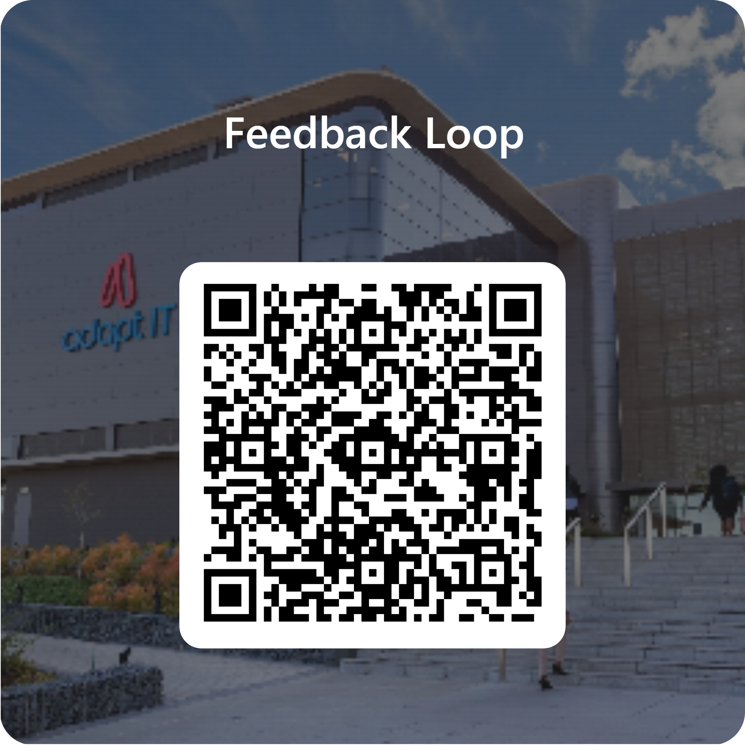
Feedback

