Slide 1





SESSION 44 | ITS USER GROUP CONFERENCE 2026
2026/27 SARS CHANGES AND PAYROLL COMPLIANCE INSIDE ITS
JOHANA CHEMANA & DR QUEEN NTOMBIKAYISE AMBE

Slide 2


SESSION 44 | ITS USER GROUP CONFERENCE 2026
WHY THIS SESSION MATTERS
Payroll compliance is institutional survival
Payroll in South African higher education is no longer:
An administrative process
A transactional back-office function
A technical salary calculation exercise
Payroll is now:
Regulatory compliance
Audit exposure
Financial governance
Institutional reputation management
One payroll error can escalate to:
SARS penalties
Employee litigation
Internal audit findings
Council scrutiny
Media exposure

Slide 3
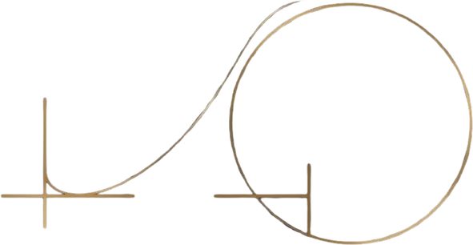
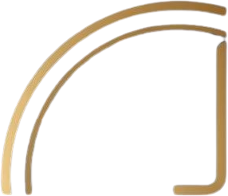
SESSION 44 | ITS USER GROUP CONFERENCE 2026
CONTEXT OF THE 2026 BUDGET
No Dramatic Reforms
Precision & Automation
Audit Defensibility
The 2026 Budget did not introduce sweeping payroll reforms. Instead, it maintained existing frameworks while emphasising institutional accountability and compliance rigour.
Budget expectations reinforced the need for automated payroll processes, accurate calculations, and reduced manual intervention to minimise human error and compliance gaps.
Institutions must demonstrate audit-ready payroll systems with complete trails, statutory reconciliations, and ERP capabilities that support SARS compliance requirements.

Slide 4
SESSION 44 | ITS USER GROUP CONFERENCE 2026
WHY THIS DISCUSSION MATTERS
Higher education payroll environments are uniquely complex.
Each of these interacts with tax legislation.
Manual payroll environments cannot manage this complexity.
Universities experience:
Acting allowances
Retention allowances
Research grants
Travel reimbursements
Backpay settlements
Voluntary severance packages
Retirement transitions
ERP systems must now function as compliance intelligence platforms.

Slide 5


SESSION METHODOLOGY
HOW WE WILL NAVIGATE THIS SESSION
Structured Approach
Interactive Discussion & Engagement
We will systematically examine SARS changes, employee impact, legislative expectations, ERP requirements, ITS capabilities, and future upgrades. This session is designed for active participation and collaborative learning.

Slide 6
Income Tax Act
SESSION 44 | ITS USER GROUP CONFERENCE 2026
Tax Administration Act
LEGISLATIVE LANDSCAPE
Compensation for Occupational Injuries and Diseases Act
The following legislation governs payroll compliance in South Africa.
Skills Development Levies Act
Unemployment Insurance Act
VIEW SOLUTIONS
Payroll systems must simultaneously comply with multiple statutory frameworks.

Slide 7
The Compliance Risk
SARS and internal auditors require complete documentation of all payroll changes, approvals, and calculations. Missing audit trails make it impossible to demonstrate compliance during investigations or disputes.
SESSION 44 | ITS USER GROUP CONFERENCE 2026
MISSING PAYROLL AUDIT TRAILS
Institutional Exposure
Without proper audit trails, universities face qualified audit opinions, council oversight inquiries, potential litigation from employees, and inability to defend tax positions during SARS assessments.
Incomplete or absent audit trails represent one of the most critical compliance failures in university payroll systems, exposing institutions to regulatory penalties and governance failures.
ERP Solution Requirements
ITS must implement comprehensive change logging, approval workflows, calculation audit history, and tamper-proof records. Every payroll transaction should be traceable from input to payment.
VIEW SOLUTIONS

Slide 8
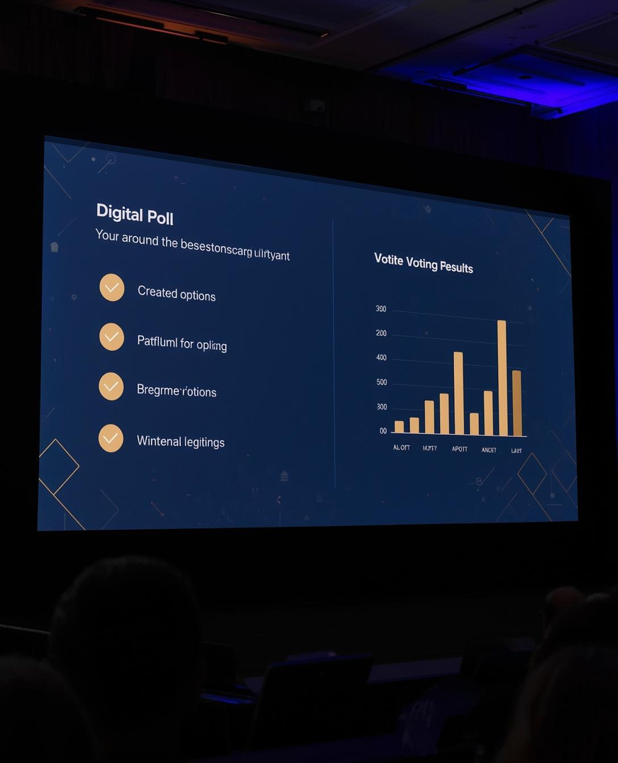
SESSION 44 | ITS USER GROUP CONFERENCE 2026
LIVE POLL
Which payroll area creates the highest institutional risk?
Cast your vote now:
• Retirement lump sums
• Travel allowances
• COIDA reporting
• AA88 deductions
• Backpay settlements

Slide 9

SESSION 44 | ITS USER GROUP CONFERENCE 2026
RETIREMENT LUMP SUM TAXATION FRAMEWORK
Income Tax Act Second Schedule governs taxation of lump sums from pension funds, provident funds, retirement annuities, preservation funds, and divorce assignments. Cumulative lifetime taxation applies.
Withdrawal Tax Table
Cumulative Lifetime Rule

Slide 10




SESSION 44 | ITS USER GROUP CONFERENCE 2026
RETIREMENT LUMP SUM SCENARIOS AND DISCUSSION
University-Specific Case Examples
• Severance packages for early retirement
• Divorce assignments and fund transfers
• Voluntary early retirement scenarios
• Discussion: Could ITS calculate lifetime cumulative lump sums automatically?

Slide 11


SESSION 44 | ITS USER GROUP CONFERENCE 2026
AA88 THIRD PARTY APPOINTMENT COMPLIANCE
Tax Administration Act Requirements
Deduction Obligations & Risk Management
When SARS issues an AA88 letter, employers must deduct specified amounts from employee remuneration. Key risks include staff termination before deductions complete, and manual tracking failures.

Slide 12
COIDA COMPLIANCE
RETURN OF EARNINGS
The Compensation for Occupational Injuries and Diseases Act requires accurate earnings classification. Maximum threshold: R633 168. Misclassification risks include acting allowances, responsibility allowances, overtime, and standby pay.
Earnings Classification
ERP Statutory Requirements

Slide 13

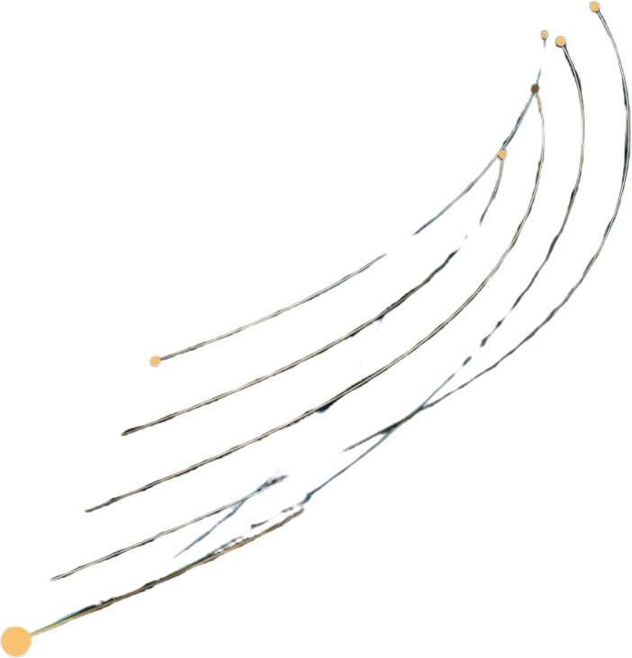
SESSION 44 | ITS USER GROUP CONFERENCE 2026
TRAVEL AND SUBSISTENCE ALLOWANCE RULES
Local Subsistence Rates
Documentation Requirements
Compliance Risk Factors
Income Tax Act Section 8 prescribes allowable rates:
• Meals & Incidentals: R595 per day
• Incidentals Only: R184 per day
Amounts exceeding these rates become taxable income.
Staff must retain proof of travel and accommodation. Missing documentation exposes institutions to SARS audit findings and potential penalties for non-compliance.
Flat rate payments without verification create audit exposure. ERP systems must validate claims against prescribed limits and flag exceptions automatically.

Slide 14

SESSION 44 | ITS USER GROUP CONFERENCE 2026
TRAVEL REIMBURSEMENT RATE AND TAXABLE EXCESS
New SARS rate: R4.95 per kilometre
The 2026/27 SARS prescribed rate is R4.95 per kilometre. When employees receive reimbursement exceeding this rate, the excess becomes taxable income. Example: If reimbursed at R5.50/km for 500km, the taxable excess is (R5.50 - R4.95) × 500 = R275.

Slide 15
SESSION 44 | ITS USER GROUP CONFERENCE 2026
PAYE TAX TABLES AND BRACKET CREEP
The 2026/27 tax year brings updated PAYE brackets. Bracket creep occurs when inflation pushes employees into higher tax brackets without real income gains. ERP systems require effective dated tax tables and simulation testing capabilities to ensure accurate PAYE calculations from 1 March annually.
2026/27 Tax Brackets
ERP Table Requirements

Slide 16
SESSION 44 - ITS USER GROUP CONFERENCE 2026
MEDICAL TAX CREDITS OVERVIEW
Primary Taxpayer Credit
Taxpayer Plus One Dependant
Each Additional Dependant
R376 per month medical tax credit for the primary taxpayer. This credit directly reduces your PAYE liability, not your taxable income.
R752 per month combined credit when claiming for taxpayer and one dependant. Ensures medical scheme contributions receive appropriate tax relief.
R254 per month for each additional dependant beyond the first. ERP systems must accurately track dependant counts for correct credit calculation.

Slide 17
SESSION 44 | ITS USER GROUP CONFERENCE 2026
TAX REBATES FOR 2026/27
Tax rebates directly reduce PAYE liability based on taxpayer age. Accurate application of age-based rebates is essential for compliance and requires automated ERP validation to prevent errors and audit findings.
Primary: R17 820
Secondary: R9 765

Slide 18


PAYROLL STATUTORY DEDUCTIONS
SDL AND UIF CONTRIBUTIONS
Skills Development Levy (SDL)
01
02
UIF Employer Contribution
1% of total payroll contributed by employer to fund skills training and development programmes.
1% employer contribution to the Unemployment Insurance Fund for each employee.
UIF Employee Contribution
03
04
Total UIF Obligation
1% deducted from employee earnings, matched by employer contribution.
Combined 2% UIF contribution ensures employee protection and statutory compliance.

Slide 19


ERP COMPLIANCE ARCHITECTURE
INTEGRATED PAYROLL INTELLIGENCE PLATFORM
System Architecture Overview
Compliance Intelligence Layers
Modern payroll must evolve beyond transaction processing into a compliance intelligence platform. This architecture integrates SARS requirements, ITS Payroll Core, Tax Engine, Compliance Engine, Audit Engine, and Governance Layer into a unified system.

Slide 20


GOVERNANCE INSIGHT
INTERNAL AUDIT QUESTIONS
Can payroll changes be traced?
Are tax directives enforced automatically?
01
02
Every modification to payroll data must have a complete audit trail including user, timestamp, and justification for compliance verification.
SARS directives must be systematically applied without manual intervention to prevent compliance failures and penalties.
Are statutory bases reconciled monthly?
Why These Questions Matter
03
04
Regular reconciliation of PAYE, UIF, SDL, and other statutory deductions ensures accuracy and audit readiness.
Internal auditors increasingly focus on payroll as a high-risk area requiring demonstrable controls and evidence.

Slide 21
GOVERNANCE INSIGHT
INTERNAL AUDIT QUESTIONS - PART 2
Travel Allowance Verification
Data Protection Controls
01
02
Are travel allowances verified against supporting documentation and SARS prescribed rates before processing?
Is payroll data protected against unauthorized manipulation through access controls and audit trails?
Segregation of Duties
Exception Reporting
03
04
Are payroll processing, approval, and reconciliation functions adequately segregated to prevent fraud?
Does the system generate automated exception reports for unusual payroll transactions requiring review?

Slide 22

SESSION 44 | ITS USER GROUP CONFERENCE 2026
LIVE POLL: PAYROLL COMPLIANCE AUTOMATION
How automated is your payroll compliance environment today?
• Fully automated
• Mostly automated
• ERP plus spreadsheets
• Mostly manual
• Manual controls dominate

Slide 23

DISCUSSION PROMPT
ITS MAJOR UPGRADE PRIORITIES
If ITS could introduce one major upgrade, what should it be?
Share your institutional priorities:
• Lifetime lump sum tracking across employment history
• Automated AA88 compliance registers
• Real-time SARS integration and validation
• Enhanced audit trail and governance dashboards
• Predictive compliance risk alerts

Slide 24


SESSION 44 | ITS USER GROUP CONFERENCE 2026
KEY COMPLIANCE TAKEAWAYS
Critical SARS Changes & ERP Requirements
• PAYE tables must be updated by 1 March annually
• Medical tax credits: R376 primary, R752 with dependant
• Travel reimbursement rate: R4.95 per kilometre
• AA88 deductions require automated compliance tracking
• COIDA earnings threshold: R633 168 maximum
• Retirement lump sums follow cumulative taxation rules

Slide 25
SESSION 44 - ITS USER GROUP CONFERENCE 2026
IMPLEMENTATION ROADMAP
Immediate Actions
Short-Term Priorities
Long-Term ERP Goals
Verify 2026/27 PAYE tax tables are loaded and effective dated from 1 March. Confirm medical tax credits and rebates are updated. Audit AA88 compliance registers. Review COIDA earnings classifications against statutory requirements.
Implement travel allowance documentation workflows. Establish monthly statutory reconciliation processes. Configure automated compliance dashboards.
Develop lifetime lump sum tracking functionality. Build integrated audit trail systems. Implement predictive compliance alerts. Establish governance reporting automation.

Slide 26


SESSION 44 | ITS USER GROUP CONFERENCE 2026
PAYROLL COMPLIANCE CHECKLIST
AA88 Deduction Tracking
Retirement Taxation Verification
01
02
Confirm cumulative lump sum calculations align with Second Schedule. Verify tax tables updated annually. Document all fund transfers and divorce assignments.
Maintain active AA88 register. Ensure automated deduction monitoring. Track staff transfers and terminations. Generate compliance reports monthly.
COIDA Earnings Classification
03
04
Travel Allowance Documentation
Review statutory earnings classifications quarterly. Verify acting allowances, overtime, and standby pay categorisation. Reconcile against R633 168 threshold.
Validate R4.95/km reimbursement rate application. Ensure supporting documentation retained. Calculate taxable excess correctly. Review subsistence claims.

Slide 27


SESSION 44 - ITS USER GROUP CONFERENCE 2026
BEST PRACTICES FOR PAYROLL GOVERNANCE
Automation strategies for compliance excellence
Audit preparation and continuous monitoring
Establish automated compliance checkpoints at every payroll cycle. Implement real-time audit trails for all tax calculations. Schedule monthly reconciliation reviews with documented sign-offs. Build exception reporting dashboards for proactive risk identification.

Slide 28
SESSION 44 - ITS USER GROUP CONFERENCE 2026
COMPLIANCE PERFORMANCE METRICS
Key performance indicators measuring payroll accuracy, audit readiness, and regulatory adherence across South African higher education institutions using ITS payroll systems.
Accuracy Rate by Category
Target: 99.5% Compliance

Slide 29
PAYROLL COMPLIANCE FRAMEWORK
RISK MITIGATION STRATEGIES
Preventive Controls
01
02
Detective Controls
Implement automated validation rules, mandatory approval workflows, and system-enforced compliance checks before payroll processing begins.
Deploy real-time monitoring dashboards, exception reporting, and automated reconciliation to identify discrepancies immediately.
Corrective Actions
03
04
Continuous Improvement
Establish rapid response protocols, documented remediation procedures, and SARS communication channels for swift error resolution.
Conduct regular compliance audits, update ERP configurations annually, and implement lessons learned from audit findings.

Slide 30
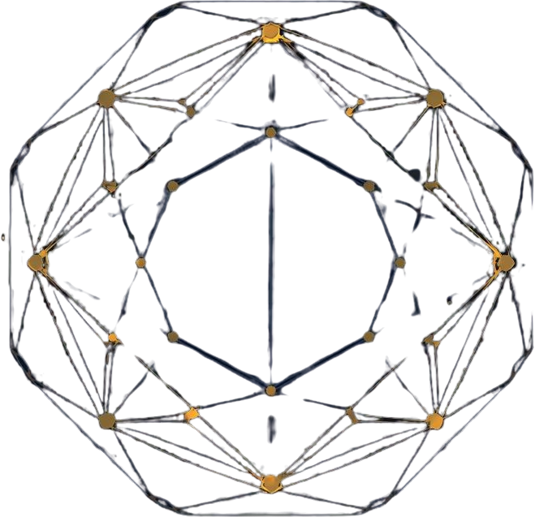


SESSION 44 - ITS USER GROUP CONFERENCE 2026
FUTURE SARS REGULATORY OUTLOOK
Anticipating Changes and Preparing Your Institution
SARS continues to signal increased automation requirements, real-time reporting expectations, and enhanced audit capabilities. Institutions must prepare for digital tax submissions, AI-driven compliance checks, and tighter integration between ERP systems and SARS platforms.

Slide 31
Conduct Compliance Audit
Review your current payroll processes against the 2026/27 SARS requirements. Identify gaps in tax table updates, lump sum calculations, AA88 tracking, and COIDA classifications. Document findings for governance reporting.
SESSION 44 | ITS USER GROUP CONFERENCE 2026
NEXT STEPS FOR YOUR INSTITUTION
Engage ITS Support
Contact your ITS account team to schedule a compliance readiness assessment. Discuss configuration requirements for automated tax directives, audit trails, and statutory earnings classifications within your ERP environment.
Transform your payroll compliance from reactive to proactive. The time to act is now—before the next audit cycle begins.
Implement Automation Priorities
Prioritise automation of high-risk areas identified in this session: retirement lump sum taxation, travel allowance verification, and AA88 deduction monitoring. Build your business case for the ITS upgrade roadmap.
TAKE ACTION TODAY

Slide 32
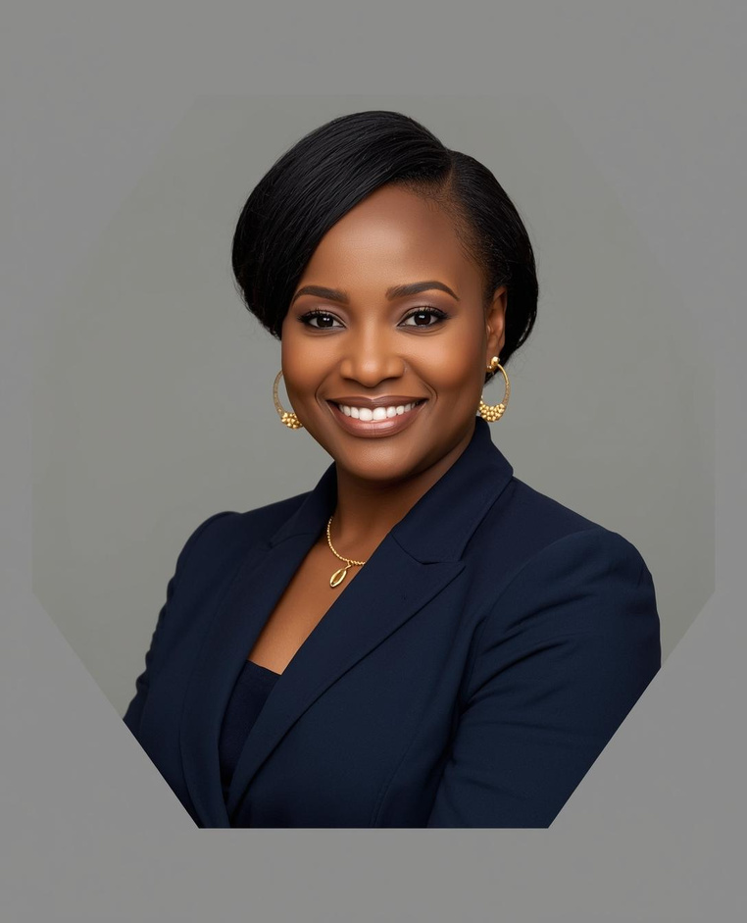
SESSION 44 CONTACT INFORMATION
GET IN TOUCH
Questions? Connect with our facilitators
Johana Chemana | Adapt IT
johana.chemana@adaptit.com
Dr Queen Ntombikayise Ambe | University of the Western Cape
qambe@uwc.ac.za

Slide 33



ITS USER GROUP CONFERENCE 2026 | SESSION 44
THANK YOU

