Slide 1

HR & Payroll Modernisation and Agentic AI POC
Presenter: Brilliant Tleane

Slide 2

DISCLAIMER
This presentation is only a summary of some of Adapt IT’s products, features and their latest developments. Adapt IT only intends for the information to give you an overview, and not a complete and comprehensive statement that necessarily suits your purposes.
Adapt IT reserves the right to change any information contained in this presentation and is not responsible for any loss that results from inaccuracies in the information. You may not distribute or reproduce the information without Adapt IT’s written permission.

Slide 3
TABLE OF CONTENT
Modernization
Agentic AI

Slide 4
Modernisation

Slide 5

Why Modernisation?
The current iEnabler platform:
  Visually outdated and not user-friendly
  Aging technology with potential security vulnerabilities
  Not mobile responsive or scalable
  Fragmented user experience
Strategic Goal: Secure, Mobile, Intelligent HR & Payroll Platform

Slide 6
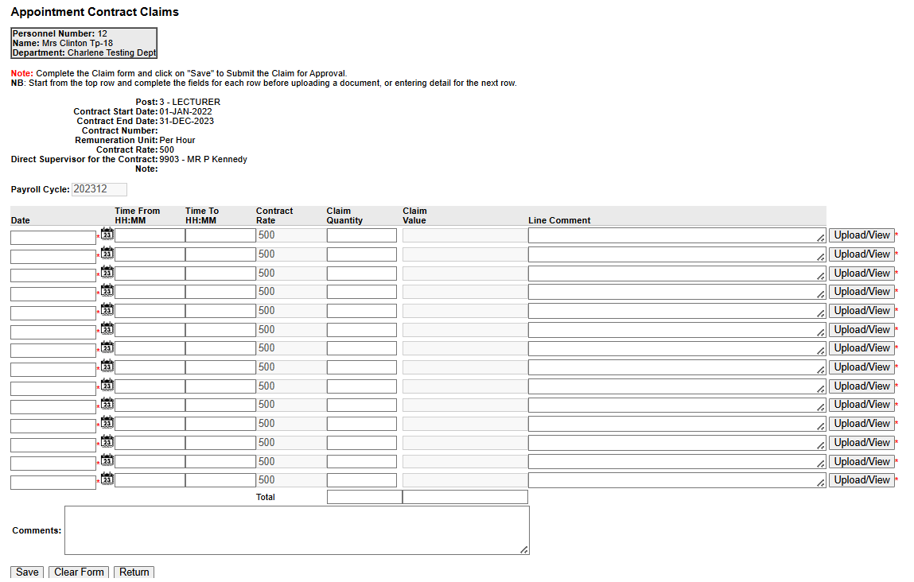
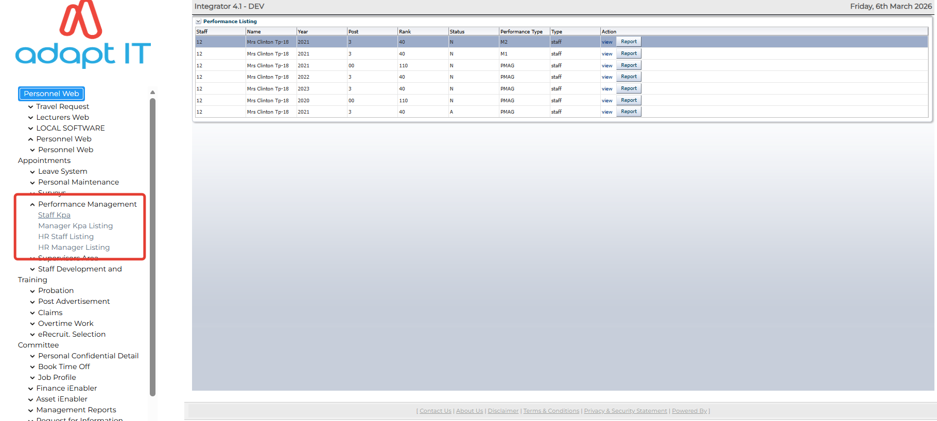
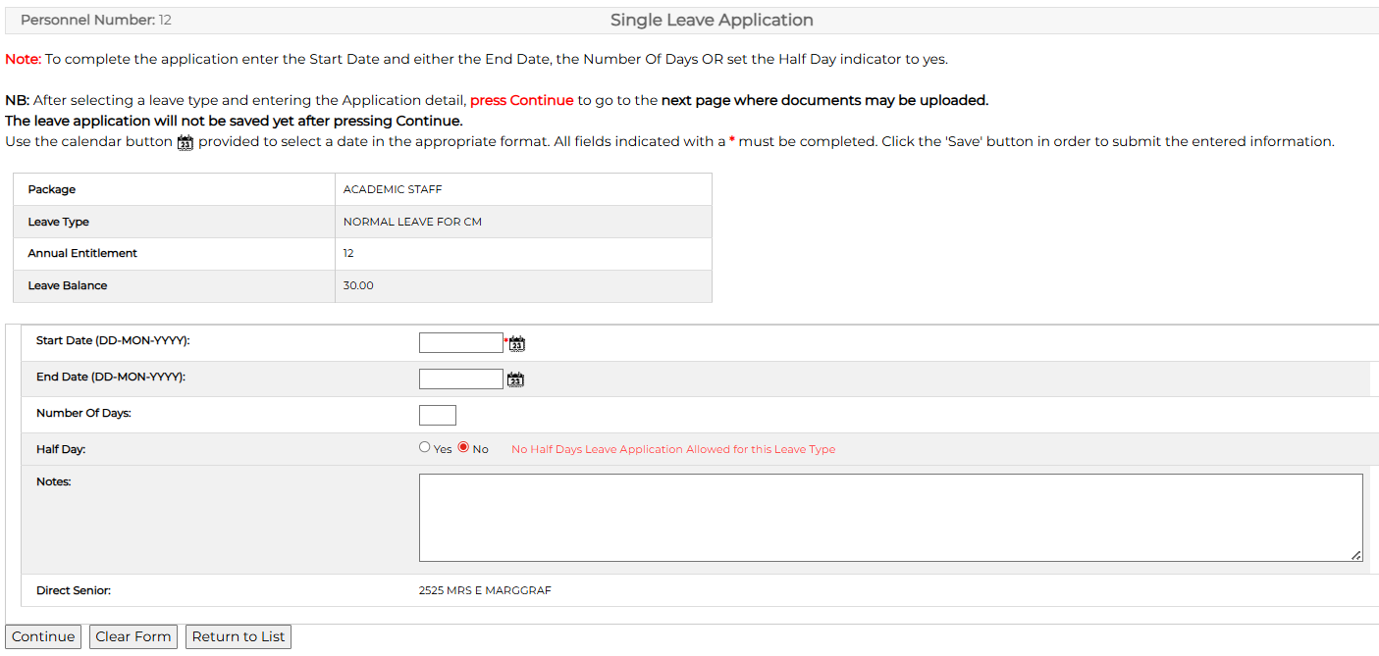
Current 4.1 iEnabler

Slide 7
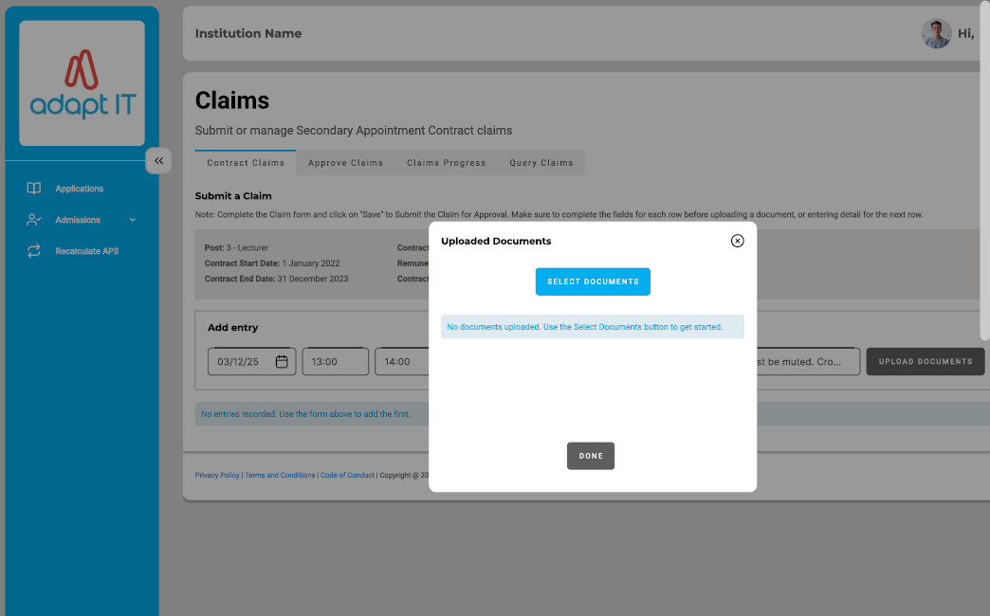
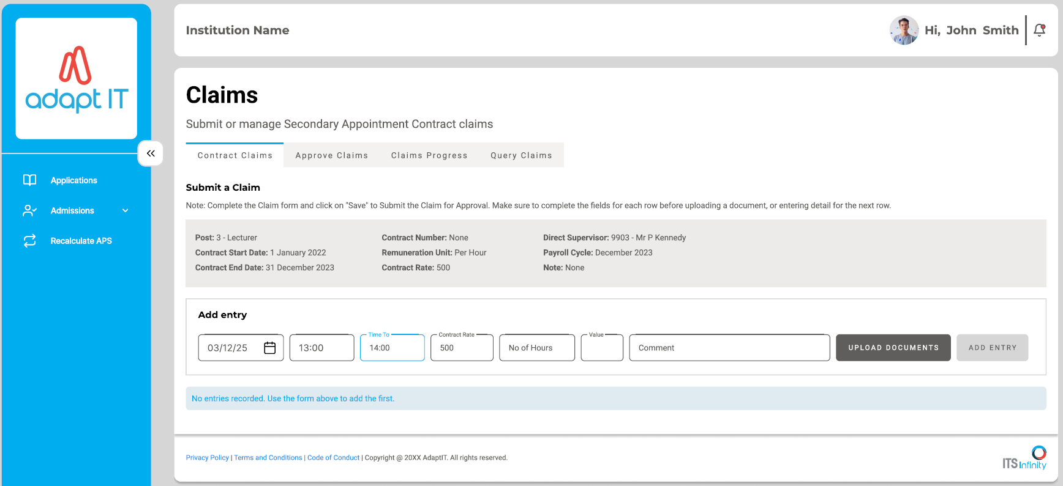
Modernisation

Slide 8
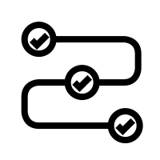


Modernization Roadmap
Performance Management
Leave Management
Claims

Slide 9
Benefits
Adapt IT
Reduced support calls and manual queries from clients.
Easier system maintenance and faster rollout of new HR services.
Platform ready for AI, automation, and future enhancements.
Institutions
Improved workflow (leave, claims and others).
Better compliance, audit trails, and data security.
More efficient HR & PR processes with reduced administrative workload.
Users (Staff)
Modern, mobile-friendly self-service platform.
Faster access to HR & PR services (leave, claims and others).
Improved employee satisfaction

Slide 10
Agentic AI

Slide 11
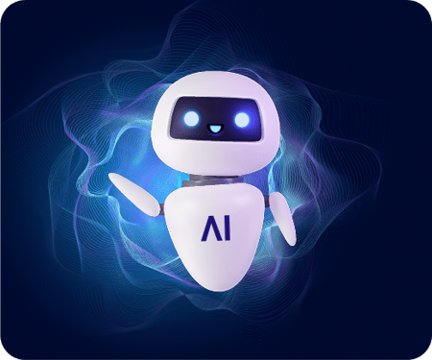
About Agentic AI
DEFINITION
AI systems that can plan, execute multi-step tasks, reason over goals, and take autonomous actions under constraints.
Key Capabilities:
  Autonomous Decision Making
  Understand Natural Language
  Task Automation
  Proactive Assistance
Agentic AI adapts and optimizes towards goals.

Slide 12
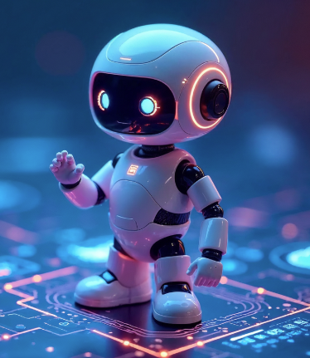
Why Add Agentic AI?
With AI:
  Conversational self-service
  Reduced support dependency
  Improved user experience
  Performs proactive interventions
  Reduce higher training costs

Slide 13
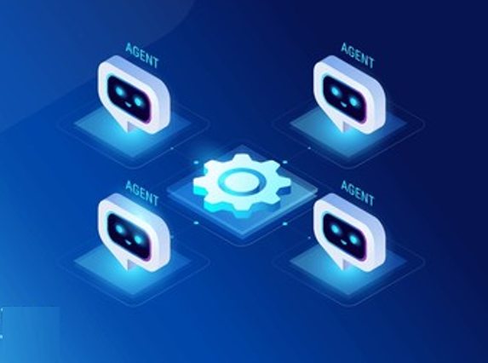
AI Use Cases
Intelligent Navigation
Leave Balance Enquiry
Proactive Leave Reminders
Leave Application Assistance
Overlapping Leave Detection
Duplicate ID Detection

Slide 14
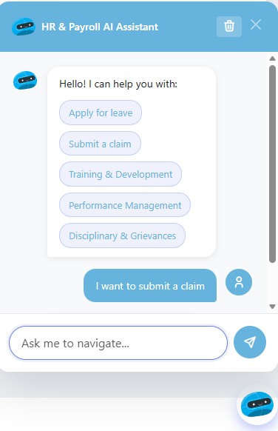
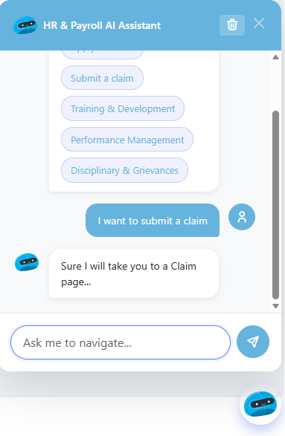
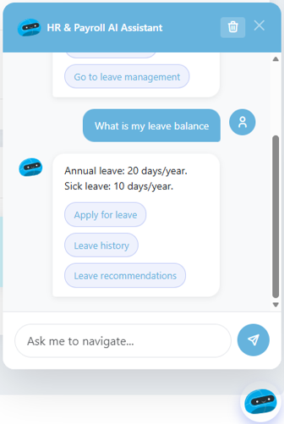
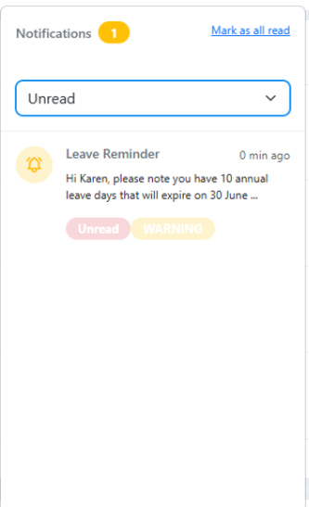
AI POC (Staff)

Slide 15
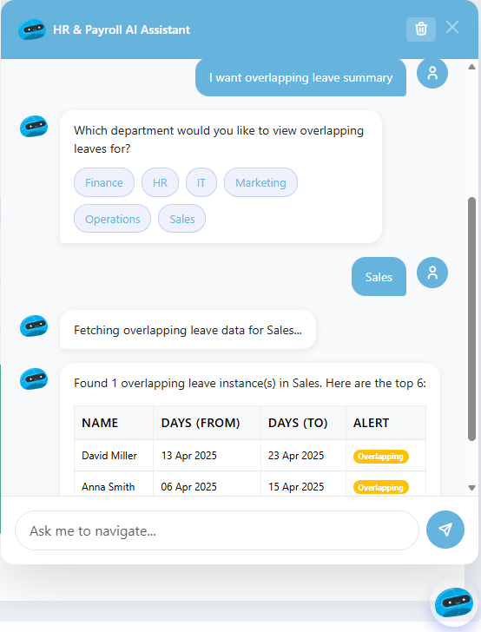
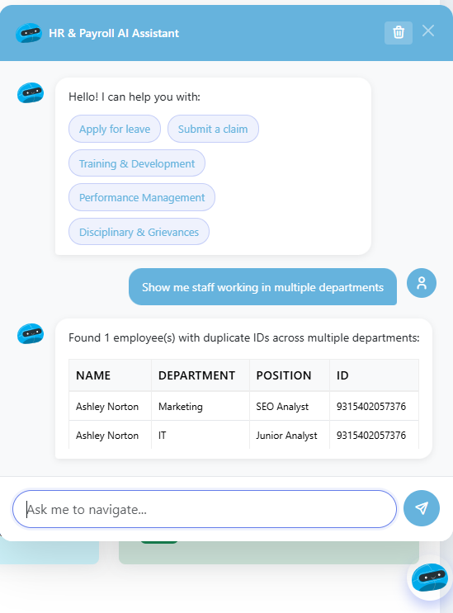
AI POC (Manager)

Slide 16
AI Benefits
Adapt IT
  Enables intelligent platform capabilities.
  Reduces support tickets and operational costs through automated assistance.
  Provides scalable AI solutions that can be deployed across multiple institutions.
Institution
  Reduces administrative workload through automated responses
  Improves operational efficiency and service delivery.
  Enhances decision-making with AI-driven insights and alerts.
Users
  Provides 24/7 conversational assistance for queries
  Simplifies navigation of complex systems and services.
  Enables faster access to info and Improves overall digital experience and satisfaction.

Slide 17
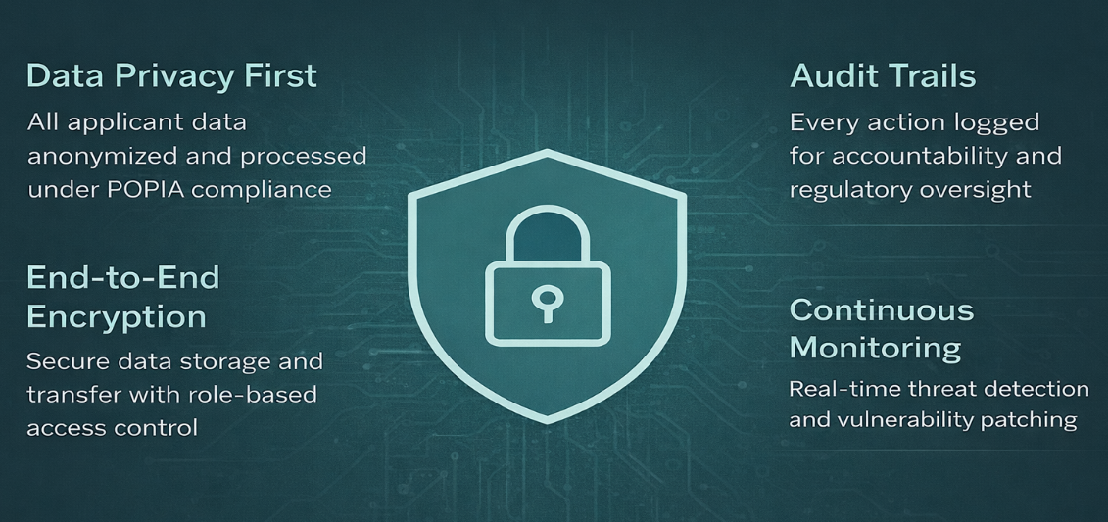
Security and Data Protection

Slide 18
Key Takeways
Modernization is strategic and necessary
  Legacy platform is outdated and inefficient
  Modern HR improves experience and control
  Agentic AI enhances intelligence and automation
  From Legacy System to Intelligent HR Experience !!!

Slide 19
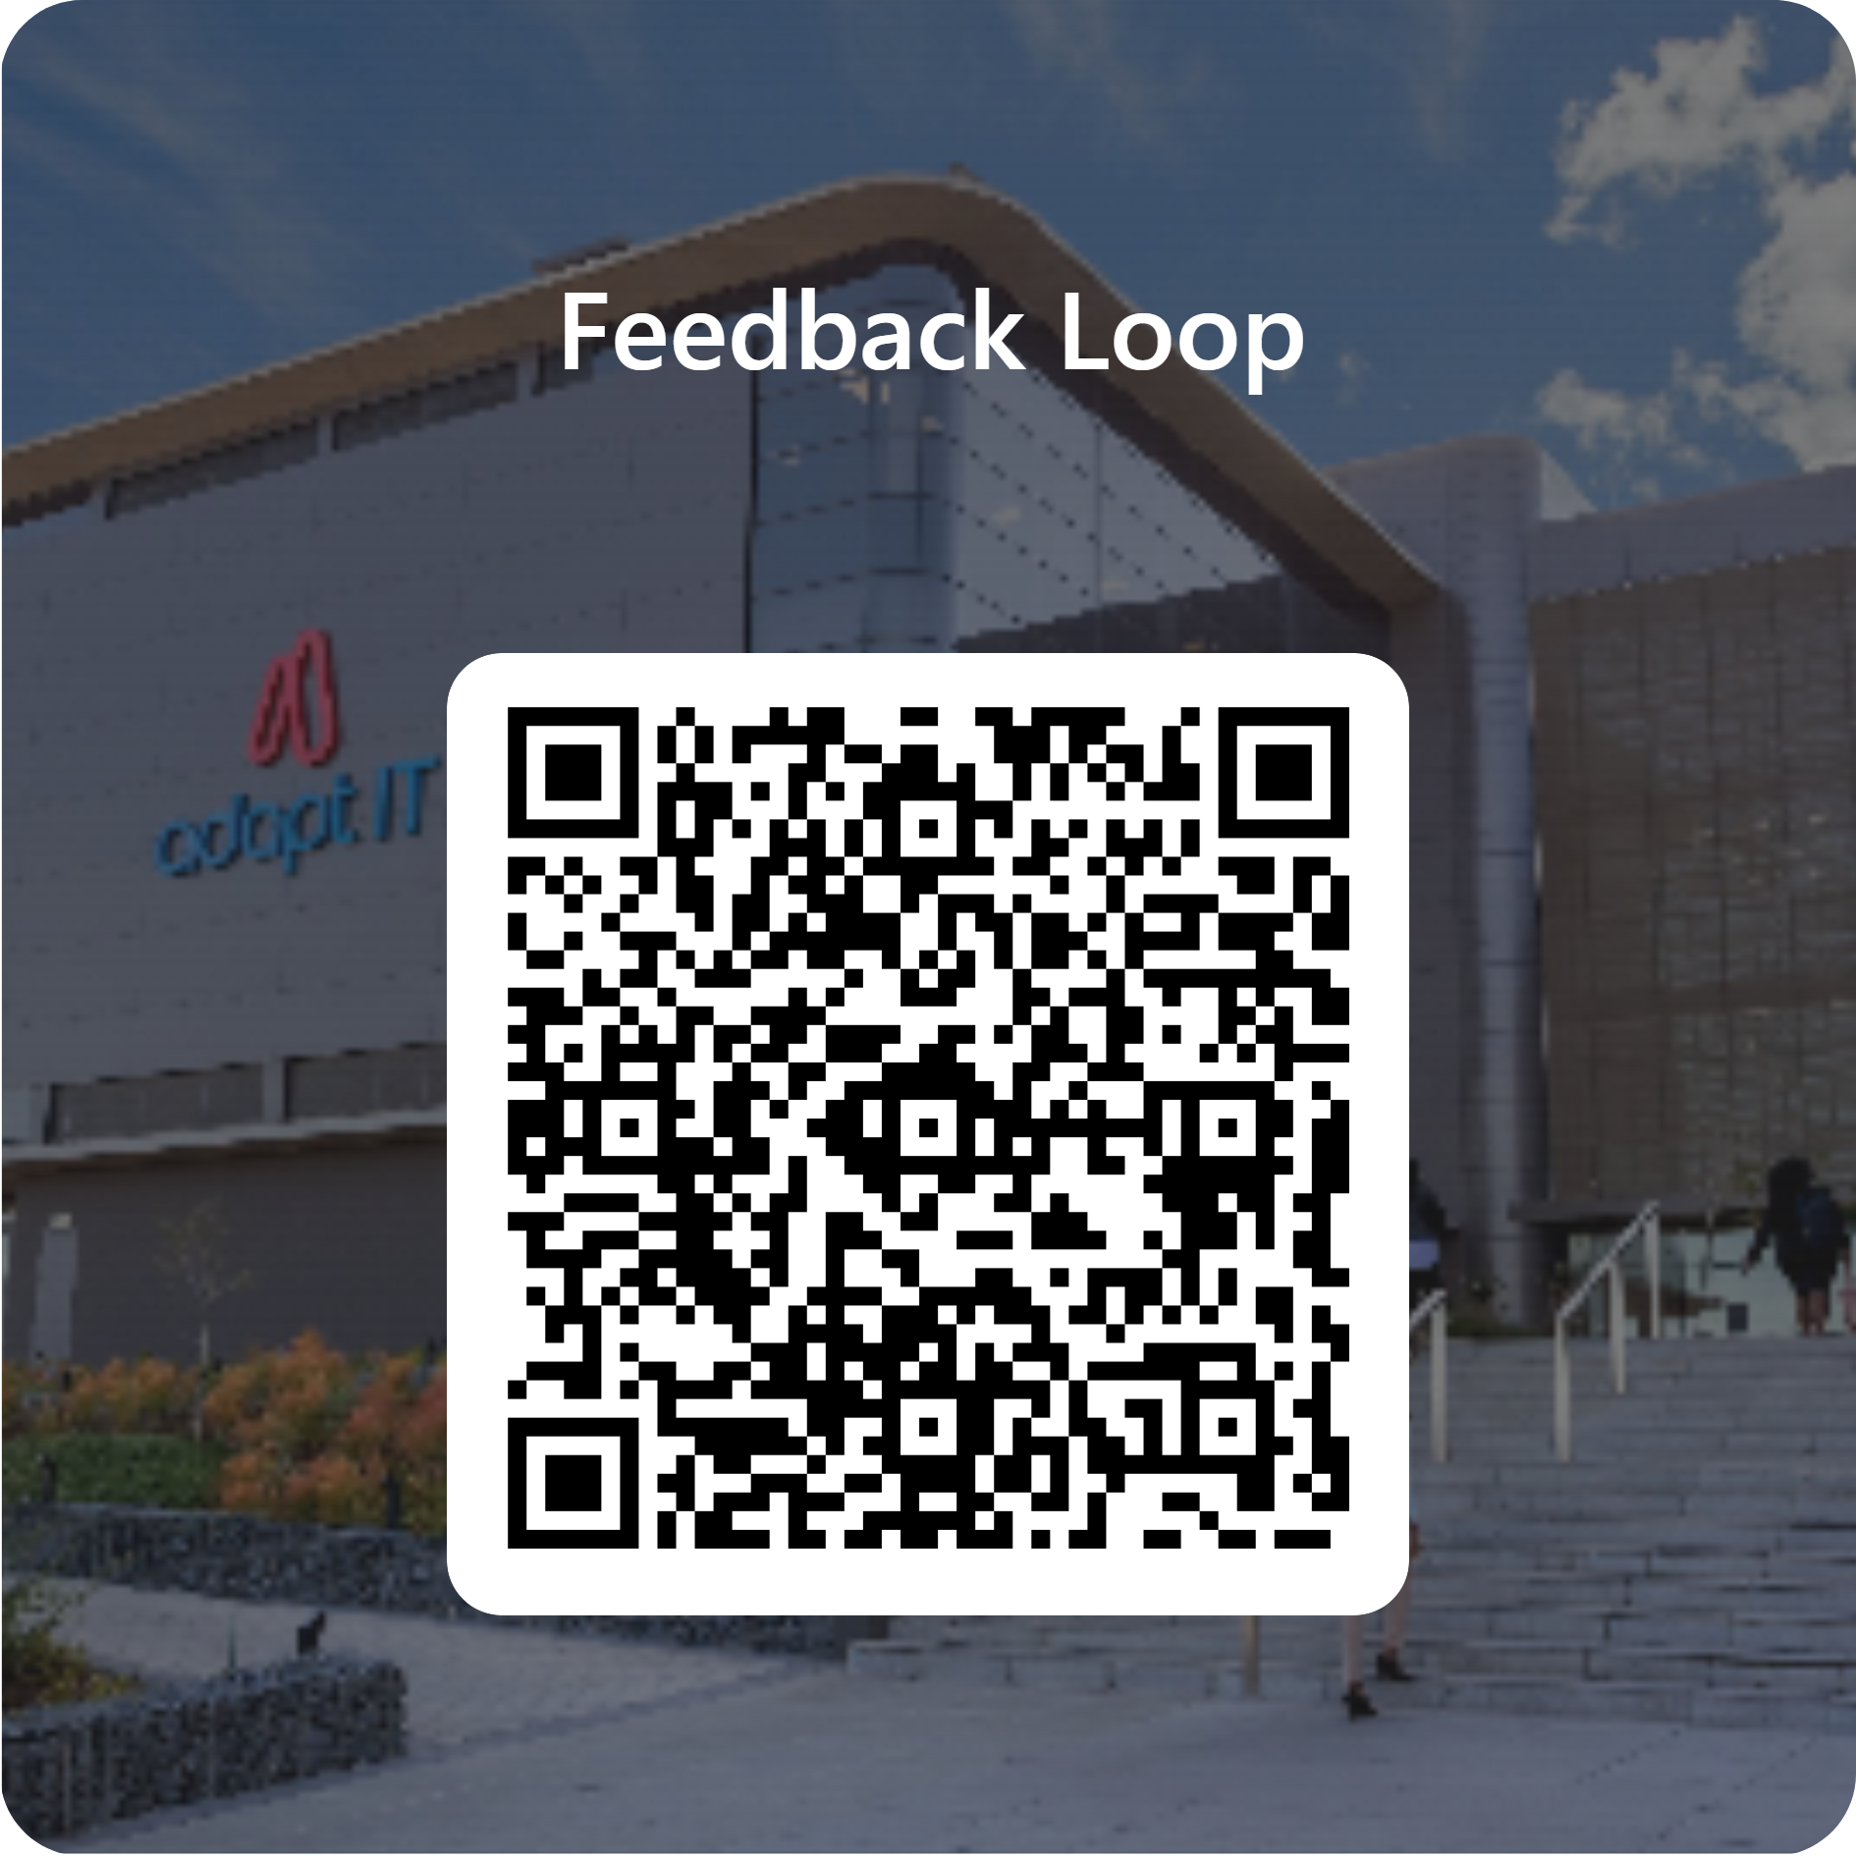
Feedback

