Slide 1


Success Story
Training and Development
UWC Experience
Presenter: | Ganessen Saayman
Powered
by

Slide 2




Background
Challenges With the Legacy System
Impact of These Challenges
Project Objective
The New Course Booking System
Key Improvements
Benefits to Back Offers-HR
Future Enhancements
Explain why a course booking system exists.
Employees use the booking system to apply for internal training
Used by multiple Departments to offer there courses
HR – 1010 (Incl.History)
Registrar – 89
CIECT -264
Reporting
DASHBOARDS
ATR
WSP
Powered
by
Presenter: | Ganessen Saayman

Slide 3



Background
Challenges With the Legacy System
Impact of These Challenges
Project Objective
The New Course Booking System
Key Improvements
Benefits to Back Offers-HR
Future Enhancements
System Access
Intergration
Manual Input of new staff and update of Email Address
No integration with HR System system to link updates on ManageRs for Approvals and Updated staff records
Data/Reporting
Unable to extract error free reporting for WSP/ATR
No histotic view attended course
Overall Poor User Experience
Powered
by
Presenter: | Ganessen Saayman

Slide 4





Background
Challenges With the Legacy System
Impact of These Challenges
Project Objective
The New Course Booking System
Key Improvements
Benefits to Back Offers-HR
Future Enhancements
Increased Manual Administrative Workload
Reduction in new Bookings
Delays in Booking
Frustration among staff and administrators
Inaccurate/ Inconsistent Data/Reporting
Powered
by
Presenter: | Ganessen Saayman

Slide 5
Background
Challenges With the Legacy System
Impact of These Challenges
Project Objective
The New Course Booking System
Key Improvements
Benefits to Back Offers-HR
Future Enhancements
With the implementation of the ITS, we had the opportunity to improve the Course Booking System with the Staff Development and Training Module
Must have a Simple End to End booking process
Must have improved Reports & Oversight. UWC Receive grants for training its staff
Overall, must provide a better User Experience for both Employee and Training providers(Departments)
Must be ingrated, to ensure reduced Manual Administration
Powered
by
Presenter: | Ganessen Saayman

Slide 6
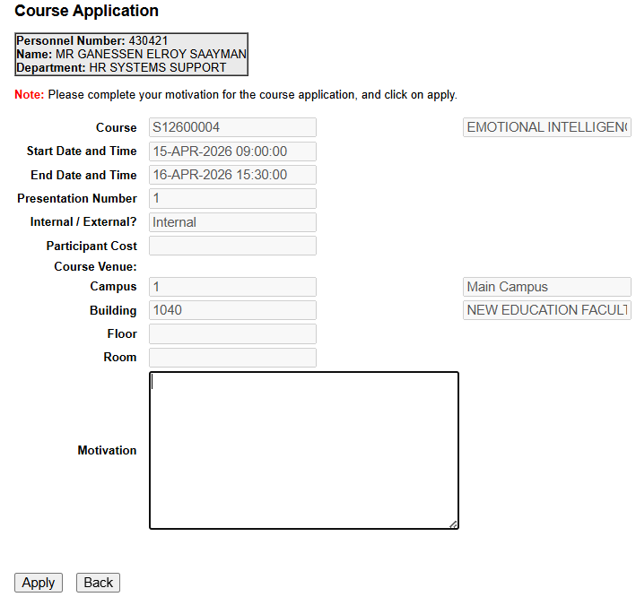
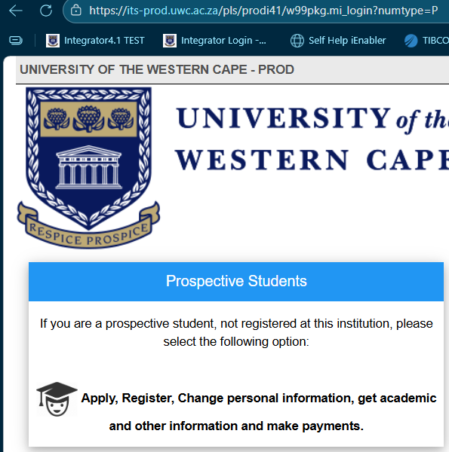
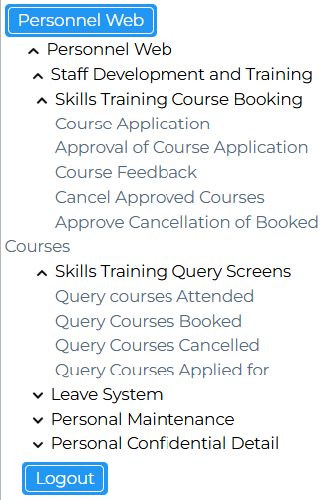
Background
Challenges With the Legacy System
Impact of These Challenges
Project Objective
The New Course Booking System
Key Improvements
Benefits to Back Offers-HR
Future Enhancements
Course Application
iEnabler
Staff One-Stop-Shop to:
Apply for Leave
View Payslips
View PreLim Payslips
View Personal Details
View Tax Certificates
Book training - Staff Development & Training
Coming Soon
Submit Overtime Claims
PDS – Performance Development System
Powered
by
Presenter: | Ganessen Saayman

Slide 7
Background
Challenges With the Legacy System
Impact of These Challenges
Project Objective
The New Course Booking System
Key Improvements
Benefits to Back Offers-HR
Future Enhancements
Course Application
Powered
by
Presenter: | Ganessen Saayman

Slide 8
Background
Challenges With the Legacy System
Impact of These Challenges
Project Objective
The New Course Booking System
Key Improvements
Benefits to Back Offers-HR
Future Enhancements
Course Application
Powered
by
Presenter: | Ganessen Saayman

Slide 9
Background
Challenges With the Legacy System
Impact of These Challenges
Project Objective
The New Course Booking System
Key Improvements
Benefits to Back Offers-HR
Future Enhancements
Course Application
Powered
by
Presenter: | Ganessen Saayman

Slide 10
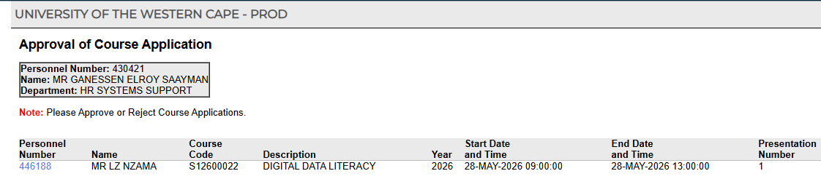
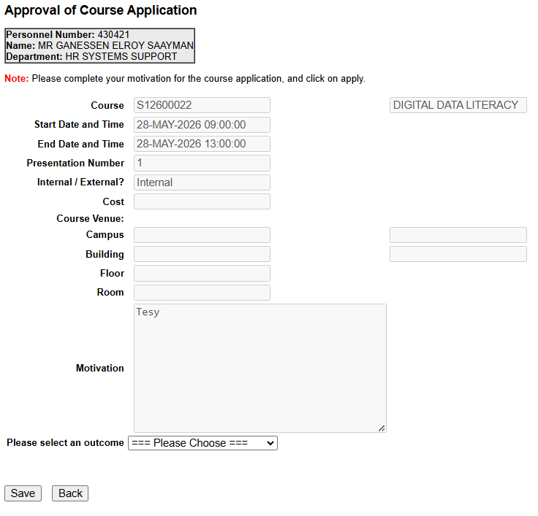
Background
Challenges With the Legacy System
Impact of These Challenges
Project Objective
The New Course Booking System
Key Improvements
Benefits to Back Offers-HR
Future Enhancements
Course Approval
Powered
by
Presenter: | Ganessen Saayman

Slide 11
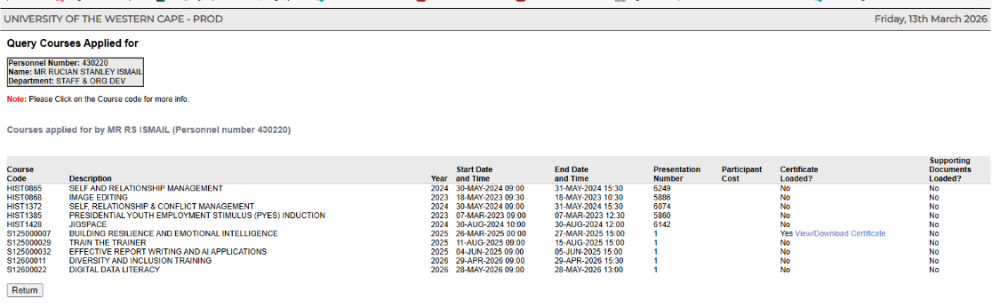
Background
Challenges With the Legacy System
Impact of These Challenges
Project Objective
The New Course Booking System
Key Improvements
Benefits to Back Offers-HR
Future Enhancements
Courses Applied For
Powered
by
Presenter: | Ganessen Saayman

Slide 12
Background
Challenges With the Legacy System
Impact of These Challenges
Project Objective
The New Course Booking System
Key Improvements
Benefits to Back Offers-HR
Future Enhancements
Course Application
… | …
… | …
… | …
Powered
by
Presenter: | Ganessen Saayman

Slide 13
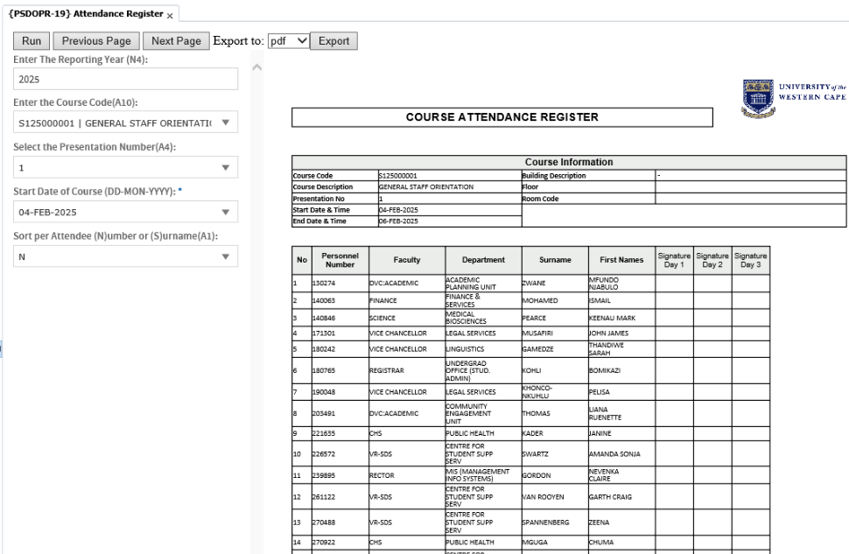
Background
Challenges With the Legacy System
Impact of These Challenges
Project Objective
The New Course Booking System
Key Improvements
Benefits to Back Offers-HR
Future Enhancements
Course Attendance
Powered
by
Presenter: | Ganessen Saayman

Slide 14
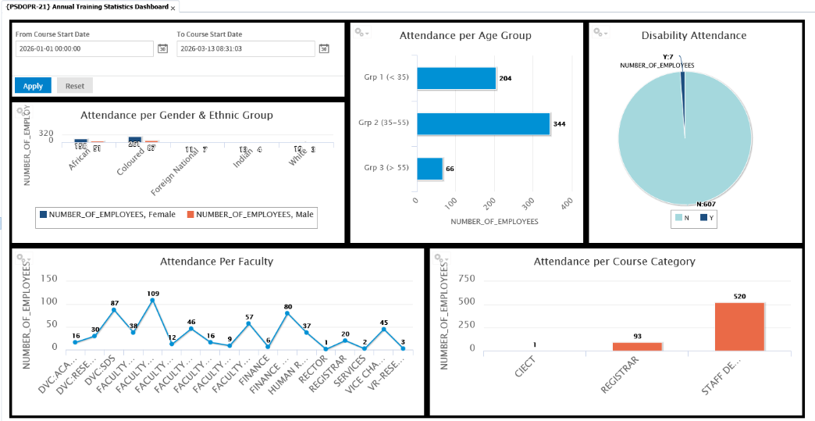
Background
Challenges With the Legacy System
Impact of These Challenges
Project Objective
The New Course Booking System
Key Improvements
Benefits to Back Offers-HR
Future Enhancements
Dashboard
Powered
by
Presenter: | Ganessen Saayman

Slide 15
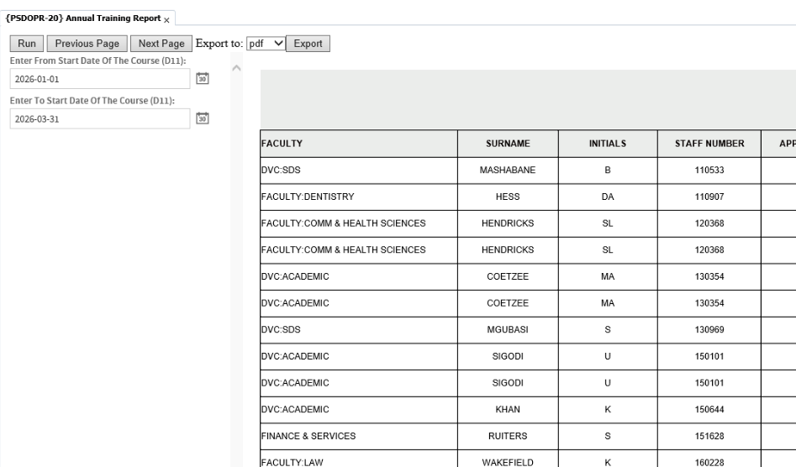
Background
Challenges With the Legacy System
Impact of These Challenges
Project Objective
The New Course Booking System
Key Improvements
Benefits to Back Offers-HR
Future Enhancements
ATR Report
Powered
by
Presenter: | Ganessen Saayman

Slide 16
Background
Challenges With the Legacy System
Impact of These Challenges
Project Objective
The New Course Booking System
Key Improvements
Benefits to Back Offers-HR
Future Enhancements
Better reporting
Staff Historic course data
Integrated Course booking system
Better User Experience
Automated Workflows/ Notifications/ Reminders
Powered
by
Presenter: | Ganessen Saayman

Slide 17
Background
Challenges With the Legacy System
Impact of These Challenges
Project Objective
The New Course Booking System
Key Improvements
Benefits to Back Offers-HR
Future Enhancements
Reduced admin work for Back Office
Better training data and reporting
Easier course registration for staff
Improved training planning
Faster approvals
Powered
by
Presenter: | Ganessen Saayman

Slide 18


Background
Challenges With the Legacy System
Impact of These Challenges
Project Objective
The New Course Booking System
Key Improvements
Benefits to Back Offers-HR
Future Enhancements
Allow staff to add training not on the system
Eg PowerBi
IMPLEMTENTED-Line Manager notifications for staff not attending scheduled training
Push notifications for compulsory training for eg new staff Induction
IMPLEMENTED - Upload certificates of courses attended
​
Powered
by
Presenter: | Ganessen Saayman

Slide 19
The End
Powered
by

