Slide 1

Driving Efficiency & Simplifying Payroll ReconciliationsTitle
Building compliant workplaces
where people thrive!!!
Presenter: Allie de Nysschen

Slide 2

DISCLAIMER
This presentation is only a summary of some of Adapt IT’s products, features and their latest developments. Adapt IT only intends for the information to give you an overview, and not a complete and comprehensive statement that necessarily suits your purposes.
Adapt IT reserves the right to change any information contained in this presentation and is not responsible for any loss that results from inaccuracies in the information. You may not distribute or reproduce the information without Adapt IT’s written permission.

Slide 3
Agenda
Prerequisites for a Successful Payroll Process
Monthly Payroll Process

Slide 4





Determine HR cutoff Date, And Stick to It
Determine Claims Cutoff date, And Stick to it
Prerequisites for Successful Payroll Process
Ensure You have an Audit Approved process in regard to Appointments and changes
Determine upfront What constitutes a Crisis
Ensure the correct people have the correct Access not anybody should be updating Salary Notches

Slide 5


Ensure any changes is done timeously to prevent the possibility of late salaries
Determine Approval processes and Approvers upfront and ensure Approvers are Available
Prerequisites for Successful Payroll Process
Ensure You have The correct Data to validate against as well as Supporting Documentation
Ensure the payroll setup is correct and tested and apply timeously on production
Ensure that the Post Establishment is a holy grail and new post are Approved with budget Approval

Slide 6

Payroll Process
Steps to take into account
Determine fair cutoff dates:
1. Determine the date the ACB file has to be in the bank based on your
pay date and the service that you use from the bank, i.e. Pay Date 25th
or if the date falls on a weekend the last weekday prior to the 25th for
the specific month.
2. You use a one-day service this means the ACB file must hit the bank on
the 24th before the cutoff time to be paid by the 25th
Now determine a fair number of days the payroll Dept requires to perform all relevant Payroll changes and reconcile the payroll let’s say 10 working days.
No manual intervention when Medical Aid rates, dependents change
Bonus Provision & RF on Bonus Provision calculated & posted monthly
General Increases, quick & simple
What If scenarios, quick & simple
Enhanced reporting

Slide 7
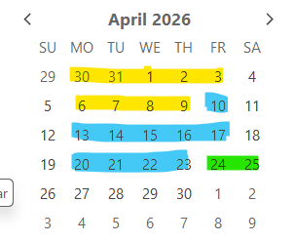
Payroll Process
Steps to take into account
Now determine a fair number of days the HR Dept requires to perform all relevant HR changes and Appointments let’s say 10 working days.
Looking at the Calendar:
Pay Date - 24 April 2026
ACB File hit the bank 23 April 2026
Payroll starts processing on 10 April 2026
HR Starts Processing on 27 March 2026
No manual intervention when Medical Aid rates, dependents change
Bonus Provision & RF on Bonus Provision calculated & posted monthly
General Increases, quick & simple
What If scenarios, quick & simple
Enhanced reporting

Slide 8
Payroll Process
Steps to take into account
Step 2 - Now set Event B Change the start and End date to Block HR from Working. Start Date being System date and End date being > End of April 2026.
No manual intervention when Medical Aid rates, dependents change
Bonus Provision & RF on Bonus Provision calculated & posted monthly
General Increases, quick & simple
What If scenarios, quick & simple
Enhanced reporting

Slide 9
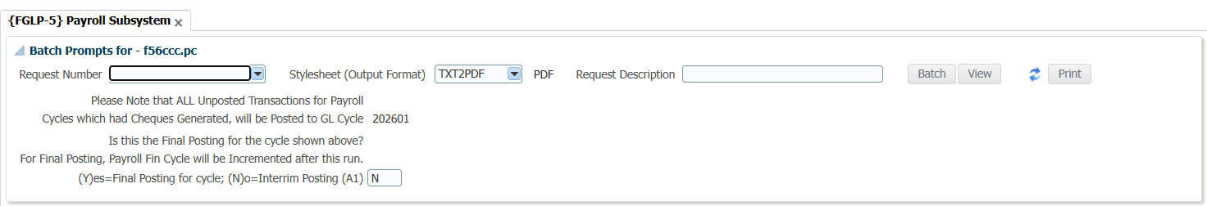
Payroll Process
Steps to take into account
For the purpose of this explanation the financial Year runs from March to February.
Step 1 - Now run {FGLP-5} and run the option as a final Posting – This will now post all Payroll transactions not posted for March 2026 in Payroll cycle 1 and increment the Payroll cycle to 2.
No manual intervention when Medical Aid rates, dependents change
Bonus Provision & RF on Bonus Provision calculated & posted monthly
General Increases, quick & simple
What If scenarios, quick & simple
Enhanced reporting

Slide 10
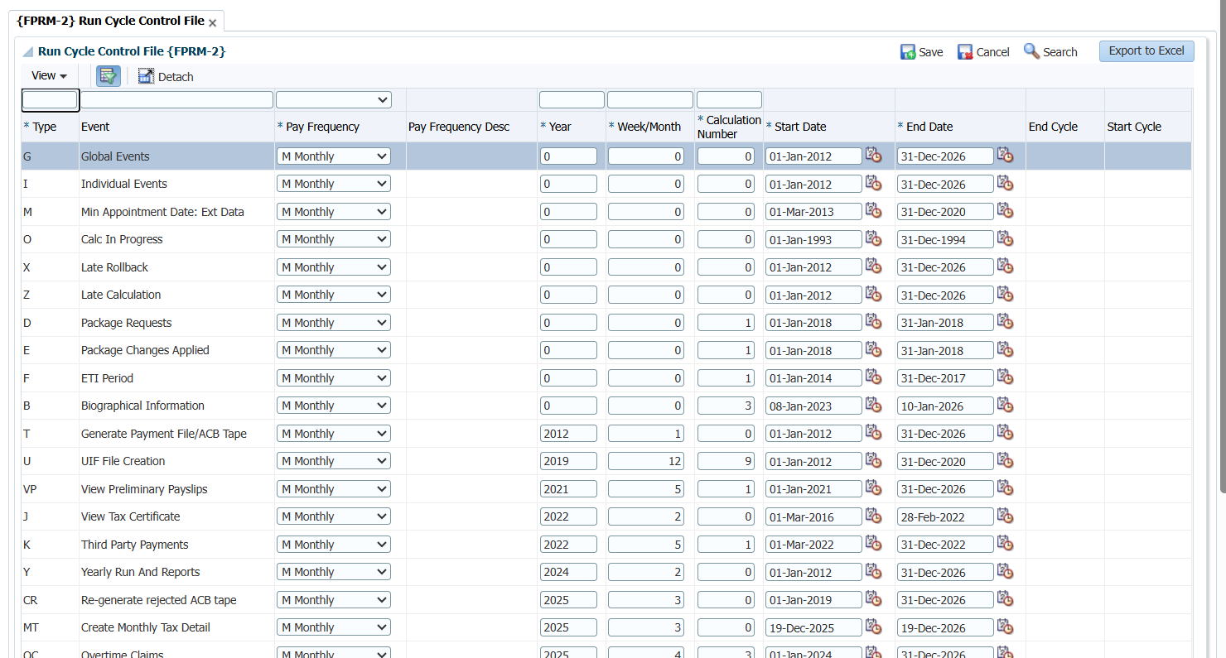
Payroll Process
Steps to take into account
Step 3 - Now setup the Run Cycle control file for April {FPRM-2} Change the cycle for Events A,C,T,O and P to the current Payroll Cycle,
No manual intervention when Medical Aid rates, dependents change
Bonus Provision & RF on Bonus Provision calculated & posted monthly
General Increases, quick & simple
What If scenarios, quick & simple
Enhanced reporting

Slide 11
Payroll Process
Steps to take into account
Step 4 – Now Sort out claims
No manual intervention when Medical Aid rates, dependents change
Bonus Provision & RF on Bonus Provision calculated & posted monthly
General Increases, quick & simple
What If scenarios, quick & simple
Enhanced reporting
FPRIC-1 | Maintain Claims
FPRIC-2 | Generate Fixed Claims
FPRIC-5 | Unapproved / Approved but not final claims
FPRIC-3 | Copy Claims to Payroll
FPRIC-4 | Rollback claims
FPRIC-6 | Report to run to resolve all Approved / Approved but not final claims
FPRICR-1 | List Appointments / Contracts

Slide 12
Payroll Process
Steps to take into account
Step 5 – Now Apply Individual Changes, based on Source documentation received.
No manual intervention when Medical Aid rates, dependents change
Bonus Provision & RF on Bonus Provision calculated & posted monthly
General Increases, quick & simple
What If scenarios, quick & simple
Enhanced reporting
FPRI-1 | Fixed Salary Detail
FPRI-2 | Individual Earnings / Deductions
FPRI-4 | Tax Directives

Slide 13
Payroll Process
Steps to take into account
Step 6 – Now run Payroll Validations to determine if any errors exists in data or Data changes.
No manual intervention when Medical Aid rates, dependents change
Bonus Provision & RF on Bonus Provision calculated & posted monthly
General Increases, quick & simple
What If scenarios, quick & simple
Enhanced reporting

Slide 14
Payroll Process
Steps to take into account
Step 7 – Now run Automatic Notch Increases
No manual intervention when Medical Aid rates, dependents change
Bonus Provision & RF on Bonus Provision calculated & posted monthly
General Increases, quick & simple
What If scenarios, quick & simple
Enhanced reporting

Slide 15
Payroll Process
Steps to take into account
Step 8 – Now run the full Salary Calculation
Please check the Salary Calc report up to the Last Page for errors.
No manual intervention when Medical Aid rates, dependents change
Bonus Provision & RF on Bonus Provision calculated & posted monthly
General Increases, quick & simple
What If scenarios, quick & simple
Enhanced reporting

Slide 16
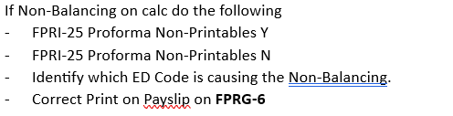
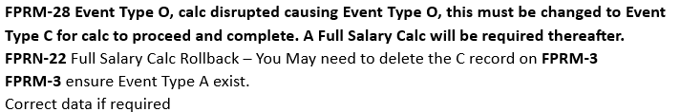
Payroll Process
Steps to take into account
Typical Errors
Check for Non-Balancing or Negative Pay slips.
Full Salary Calculation - View calculations report to ensure there is no Non-Balancing or Negative or
If the calc was disrupted i.e. power failure
No manual intervention when Medical Aid rates, dependents change
Bonus Provision & RF on Bonus Provision calculated & posted monthly
General Increases, quick & simple
What If scenarios, quick & simple
Enhanced reporting

Slide 17
Payroll Process
Steps to take into account
Step 9 – Errors occurred Rollback the Calc
If it is only a few individuals
Do a single Rollback {FPRN-23} for the affected Individual, correct the
data.
Do a single Calculation {FPRN-3} for the person again
If There is quite a lot of Errors
Do a Full Rollback {FPRN-22} for all personnel, correct the
data.
Do a Full Calculation {FPRN-2} for all personnel again
No manual intervention when Medical Aid rates, dependents change
Bonus Provision & RF on Bonus Provision calculated & posted monthly
General Increases, quick & simple
What If scenarios, quick & simple
Enhanced reporting

Slide 18
Payroll Process
Steps to take into account
Full Salary Calculation - View calculations report to ensure there Non-Balancing or Negative or
If the calc was disrupted i.e. power failure
No manual intervention when Medical Aid rates, dependents change
Bonus Provision & RF on Bonus Provision calculated & posted monthly
General Increases, quick & simple
What If scenarios, quick & simple
Enhanced reporting

Slide 19
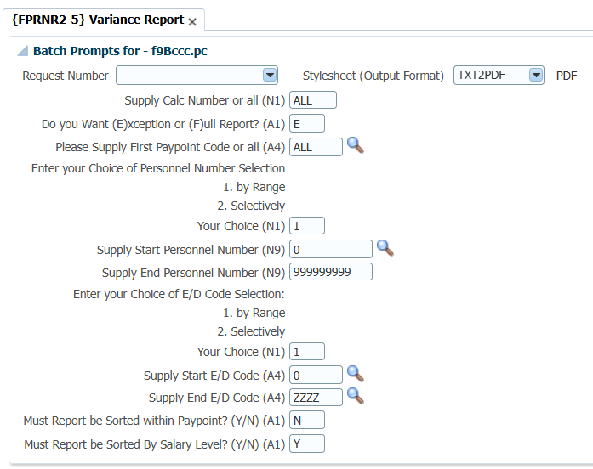
Payroll Process
Steps to take into account
Step 10 – Check the Calc Report for errors again if no errors occurred:
Run the Variance report {FPRNR2-5} Start with a Exception Report only displaying differences from the last Payroll
No manual intervention when Medical Aid rates, dependents change
Bonus Provision & RF on Bonus Provision calculated & posted monthly
General Increases, quick & simple
What If scenarios, quick & simple
Enhanced reporting

Slide 20
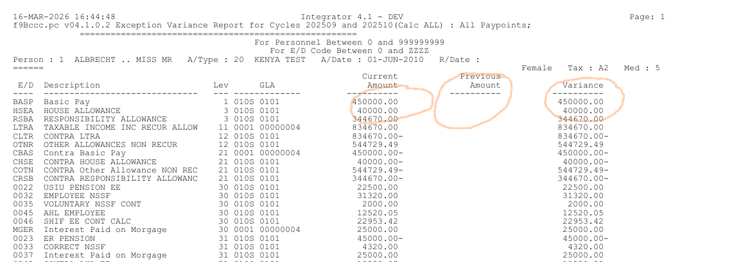
Payroll Process
Steps to take into account
No manual intervention when Medical Aid rates, dependents change
Bonus Provision & RF on Bonus Provision calculated & posted monthly
General Increases, quick & simple
What If scenarios, quick & simple
Enhanced reporting

Slide 21
Payroll Process
Steps to take into account
Step 11 – Run the Detail ED Code report{FPRIR1-6} to ensure the totals of ED Codes paid or deducted are correct.
If you now find errors regarding Earnings or Deductions that was not captured on the payroll or incorrectly captured the payroll needs to be corrected.
Repeat step 9,10 and 11 until the payroll Balance
No manual intervention when Medical Aid rates, dependents change
Bonus Provision & RF on Bonus Provision calculated & posted monthly
General Increases, quick & simple
What If scenarios, quick & simple
Enhanced reporting

Slide 22
Payroll Process
Steps to take into account
Step 12 – The Payroll now Balances now run {FPRN-5} Generate Payments
Step 13 Generate the ACB File. This may or May be not a local software option. Going Forward all ACB Files for different banks will be developed as standard Software, if the Software does not exists as standard software the client requesting the development will carry the development cost.
Step 14 Generate Pay slips {FPRN-8} to print from the back office or personnel may view Pay slips on the iEnabler most of these pay slips differ as a result it may be local software for some clients.
No manual intervention when Medical Aid rates, dependents change
Bonus Provision & RF on Bonus Provision calculated & posted monthly
General Increases, quick & simple
What If scenarios, quick & simple
Enhanced reporting

Slide 23
Payroll Process
Steps to take into account
Step 15 – Run the tax certificate validations {FPRNR2-2} to check that tax validations are clean, if this is run on a monthly basis at the end of the year you should only have one cycle with tax validations if any, else you might sit with a year’s worth of validation errors.
No manual intervention when Medical Aid rates, dependents change
Bonus Provision & RF on Bonus Provision calculated & posted monthly
General Increases, quick & simple
What If scenarios, quick & simple
Enhanced reporting

Slide 24
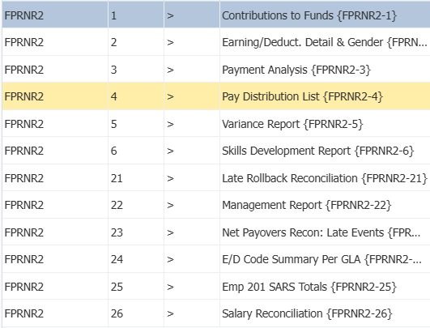
Payroll Process
Steps to take into account
Step 16 – Additional Reports that can be run
No manual intervention when Medical Aid rates, dependents change
Bonus Provision & RF on Bonus Provision calculated & posted monthly
General Increases, quick & simple
What If scenarios, quick & simple
Enhanced reporting

Slide 25
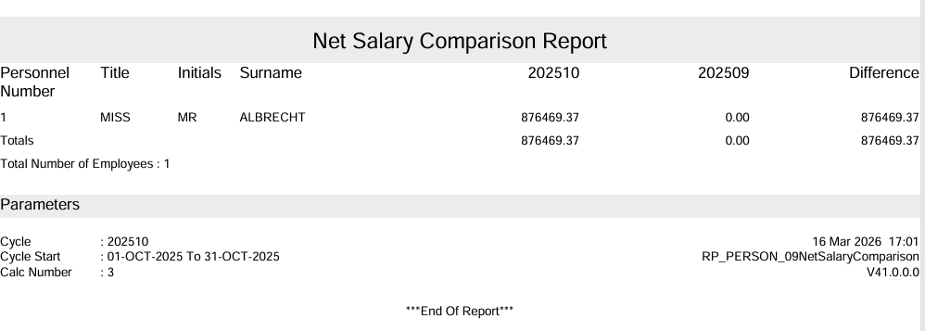
Payroll Process
Steps to take into account
Step 16 – Additional Reports that can be run
FPRNR1-2 Net Pay comparison.
No manual intervention when Medical Aid rates, dependents change
Bonus Provision & RF on Bonus Provision calculated & posted monthly
General Increases, quick & simple
What If scenarios, quick & simple
Enhanced reporting

Slide 26
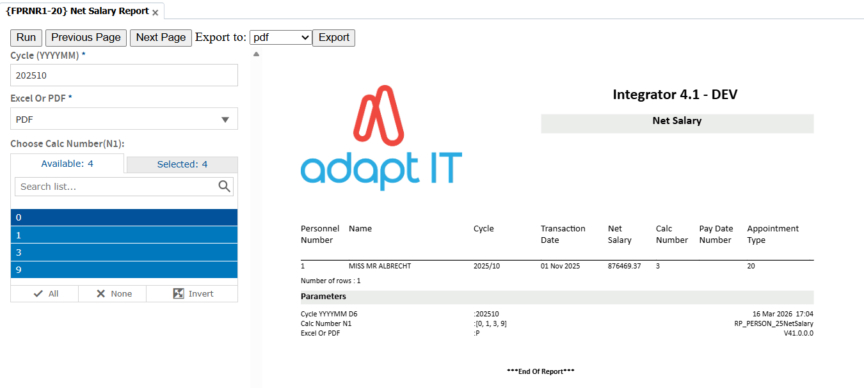
Payroll Process
Steps to take into account
Step 16 – Additional Reports that can be run
FPRNR1-20 Net Pay comparison.
No manual intervention when Medical Aid rates, dependents change
Bonus Provision & RF on Bonus Provision calculated & posted monthly
General Increases, quick & simple
What If scenarios, quick & simple
Enhanced reporting

Slide 27
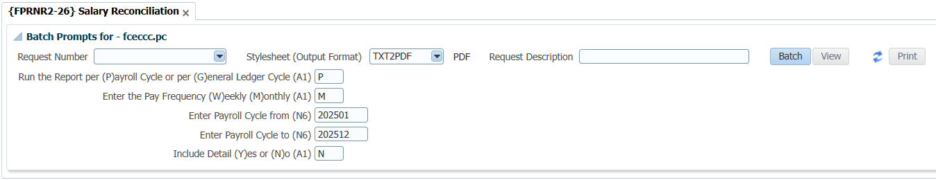
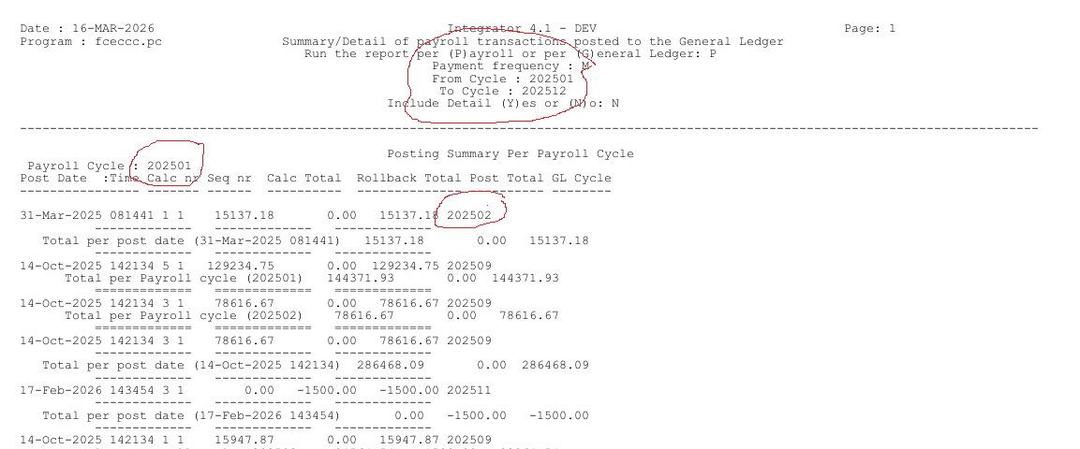
Payroll Process
Steps to take into account
Step 16 – Additional Reports that can be run
No manual intervention when Medical Aid rates, dependents change
Bonus Provision & RF on Bonus Provision calculated & posted monthly
General Increases, quick & simple
What If scenarios, quick & simple
Enhanced reporting

Slide 28
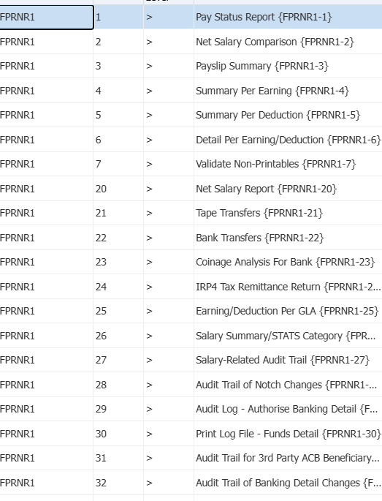
Payroll Process
Steps to take into account
Step 16 – Additional Reports that can be run
No manual intervention when Medical Aid rates, dependents change
Bonus Provision & RF on Bonus Provision calculated & posted monthly
General Increases, quick & simple
What If scenarios, quick & simple
Enhanced reporting

Slide 29
Payroll Process
Steps to take into account
Step 17 – special Reports to prevent Fraught that can be run at any time
No manual intervention when Medical Aid rates, dependents change
Bonus Provision & RF on Bonus Provision calculated & posted monthly
General Increases, quick & simple
What If scenarios, quick & simple
Enhanced reporting

Slide 30
Payroll Process
Steps to take into account
Step 18 – Run {FGLP-5} post payroll transactions – Run as Intermediate to ensure the payroll fin cycle stay 202602.
No manual intervention when Medical Aid rates, dependents change
Bonus Provision & RF on Bonus Provision calculated & posted monthly
General Increases, quick & simple
What If scenarios, quick & simple
Enhanced reporting

Slide 31

Feedback

