Slide 1

Opportunities to Leverage HR & Payroll System Capabilities
Building compliant workplaces where people thrive!!!
Presenter: Allie de Nysschen

Slide 2

DISCLAIMER
This presentation is only a summary of some of Adapt IT’s products, features and their latest developments. Adapt IT only intends for the information to give you an overview, and not a complete and comprehensive statement that necessarily suits your purposes.
Adapt IT reserves the right to change any information contained in this presentation and is not responsible for any loss that results from inaccuracies in the information. You may not distribute or reproduce the information without Adapt IT’s written permission.

Slide 3
Agenda
HR & Payroll Overview
High Level Overview - Functionality

Slide 4

HR & Payroll Overview
It is an integrated system that is rich in functionality and specializes in the Higher education sector.
Statutory requirements i.e. adhering to tax requirements of each country where we have a footprint.
The system is being modernized and enhanced on a regular basis based on customer requests, SIG’S, Statutory requirements. The Roadmap is determined by our system owner,
Where the system does not meet a specific client request that is applicable to the specific client, we do cater for customization.
We have a dedicated support team to ensure that clients are supported timeously to ensure critical processes like payrolls are generated on time, submission of statutory reporting is completed timeously.

Slide 5
HR & Payroll Overview
Walter Sisulu University (WSU) in South Africa is facing an extreme, multi-year crisis where student applications vastly exceed available capacity, resulting in hundreds of thousands of applicants being turned away.
Application vs. Enrollment Data (2024-2026)
2026 Academic Year: Approximately 500,000 applicants were reportedly turned away, with only about 7,000 spaces available.
2025 Academic Year: The university received 380,000 applications for just 7,300,000 first-year spots.
2024 Academic Year: WSU received 304,671 applications, but could only accept 7,322 first-year students.
What is the Natural Result
Private Universities are emerging
Universities are scaling their ability to cater for more students and offerings and the result growing staff compliment and facilities.
Why is a stable HR & PAYROLL system required?
South Africa's 26 public higher education institutions spent R58,5 billion on employee compensation in 2024.
This salary bill, including salaries, wages, and benefits, consistently represents over 60% of total operating expenses.
Why will this trend continue?
In 2025 South African universities receive 30 times more applications than available spaces
The University of Johannesburg (UJ), with 693, 990 applications (all choices) which translates to a headcount of 358, 992 applicants for approximately 10 900 undergraduate spaces.
The University of KwaZulu-Natal (UKZN) received over 290, 600 individual applications for approximately 8 600 first-year places

Slide 6

HR & Payroll Overview
43%
Ghana
Southern Africa
48%
Kenya/ Rwanda
West Africa
5%
0%
Namibia
4%
0%
Eswatini
East Africa
Botswana
Lesotho
University
TVET Colleges
South Africa

Slide 7
HR & Payroll
No manual intervention when Medical Aid rates, dependents change
Bonus Provision & RF on Bonus Provision calculated & posted monthly
General Increases, quick & simple
What If scenarios, quick & simple
Enhanced reporting

Slide 8
High Level Overview

Slide 9

Security
Available Options
No manual intervention when Medical Aid rates, dependents change
Bonus Provision & RF on Bonus Provision calculated & posted monthly
General Increases, quick & simple
What If scenarios, quick & simple
Enhanced reporting
Access per options – No Access/View/Update {USERS}
Additional Access control via Access/Restrictions per Dept/Faculty –{PAMT-1}
Approval Positions per Dept/Faculty for a Post/specific personnel number {GCS-10}
Promotions - Post Changes will retract Access and require new access application

Slide 10
Security
Available Options
No manual intervention when Medical Aid rates, dependents change
Bonus Provision & RF on Bonus Provision calculated & posted monthly
General Increases, quick & simple
What If scenarios, quick & simple
Enhanced reporting
Access can be Requested via the iEnabler in the case of promotions or changes to Job specifications with relevant approvals.
Access per sub system and User ID {Users}
Access per personnel type on the Payroll system (Top Management/Other Salaried Personnel/ Wage Personnel) {FPRM-6}
Oracle DB is one of the most secure databases available and has multiple levels of security and passwords

Slide 11
Security
Available Options
No manual intervention when Medical Aid rates, dependents change
Bonus Provision & RF on Bonus Provision calculated & posted monthly
General Increases, quick & simple
What If scenarios, quick & simple
Enhanced reporting
Password protection – standard software will force user passwords to include Upper case/Lower Case Characters, numbers, special Characters and password length.
On the Ienabler we cater for the standard login Password as well as an additional Password for Confidential Information
Keep Log Files on Critical data as well as Dynamic Log files {PAOPR2-25}

Slide 12

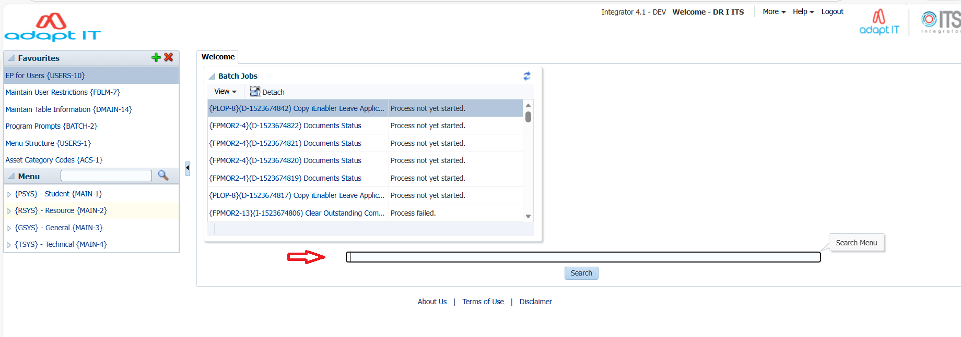
Menu Options
How do I find an Option
No manual intervention when Medical Aid rates, dependents change
Bonus Provision & RF on Bonus Provision calculated & posted monthly
General Increases, quick & simple
What If scenarios, quick & simple
Enhanced reporting

Slide 13
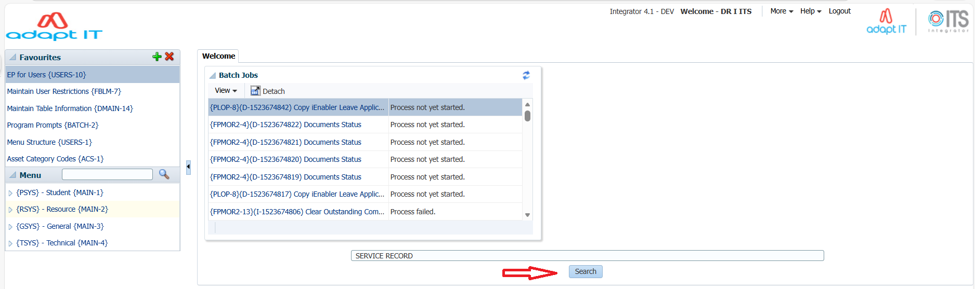
Menu Options
How do I find an Option
No manual intervention when Medical Aid rates, dependents change
Bonus Provision & RF on Bonus Provision calculated & posted monthly
General Increases, quick & simple
What If scenarios, quick & simple
Enhanced reporting

Slide 14
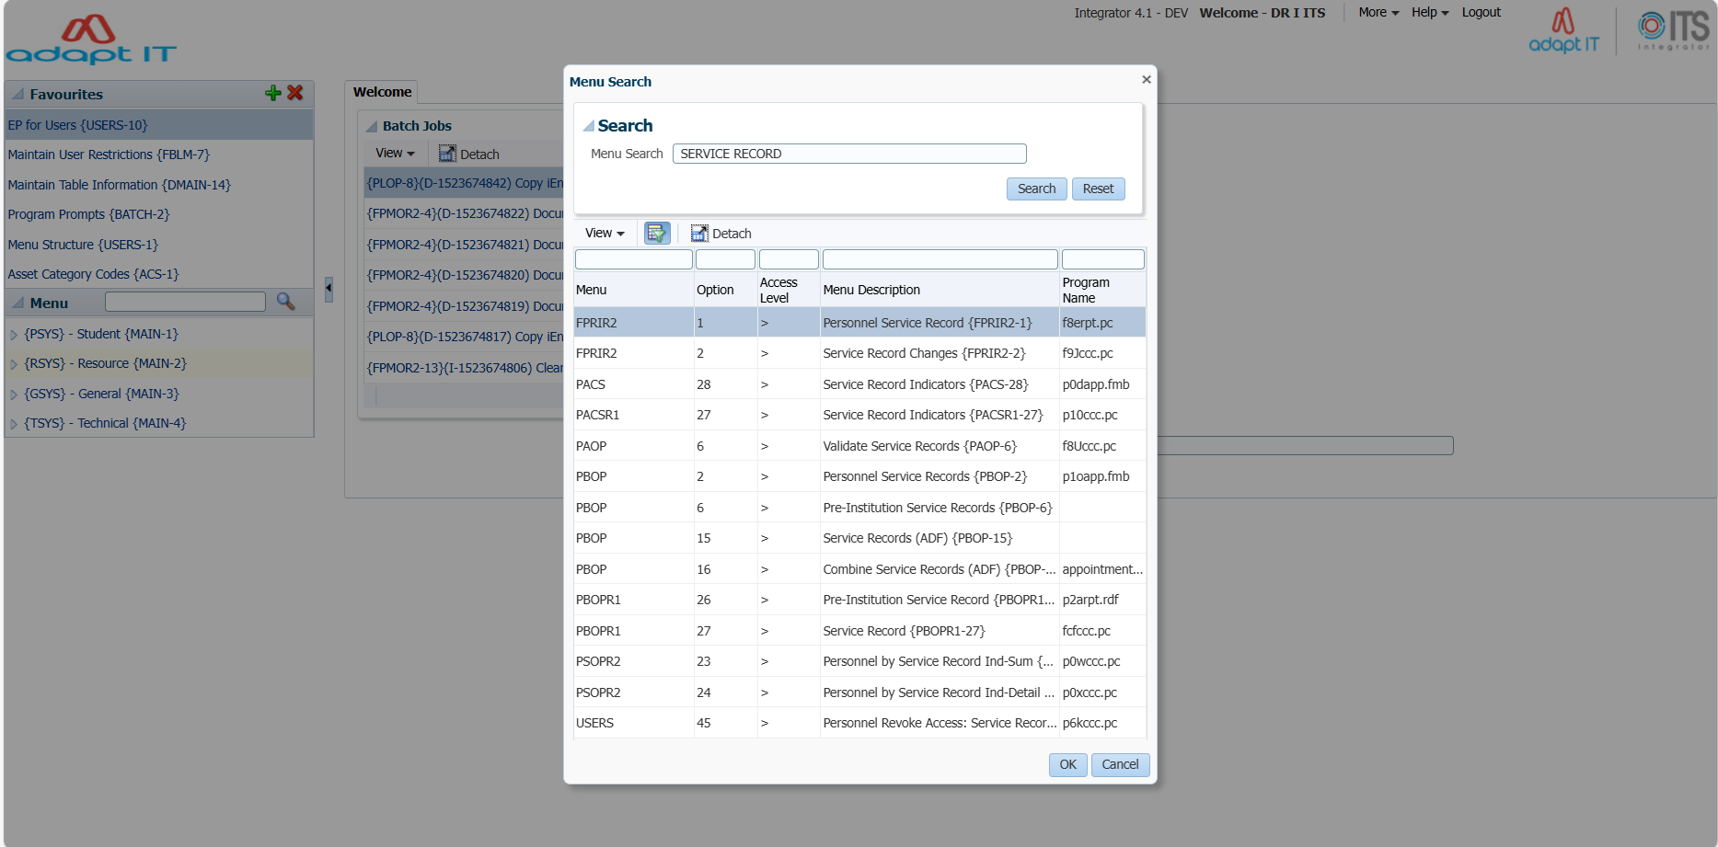
Menu Options
How do I find an Option
No manual intervention when Medical Aid rates, dependents change
Bonus Provision & RF on Bonus Provision calculated & posted monthly
General Increases, quick & simple
What If scenarios, quick & simple
Enhanced reporting

Slide 15
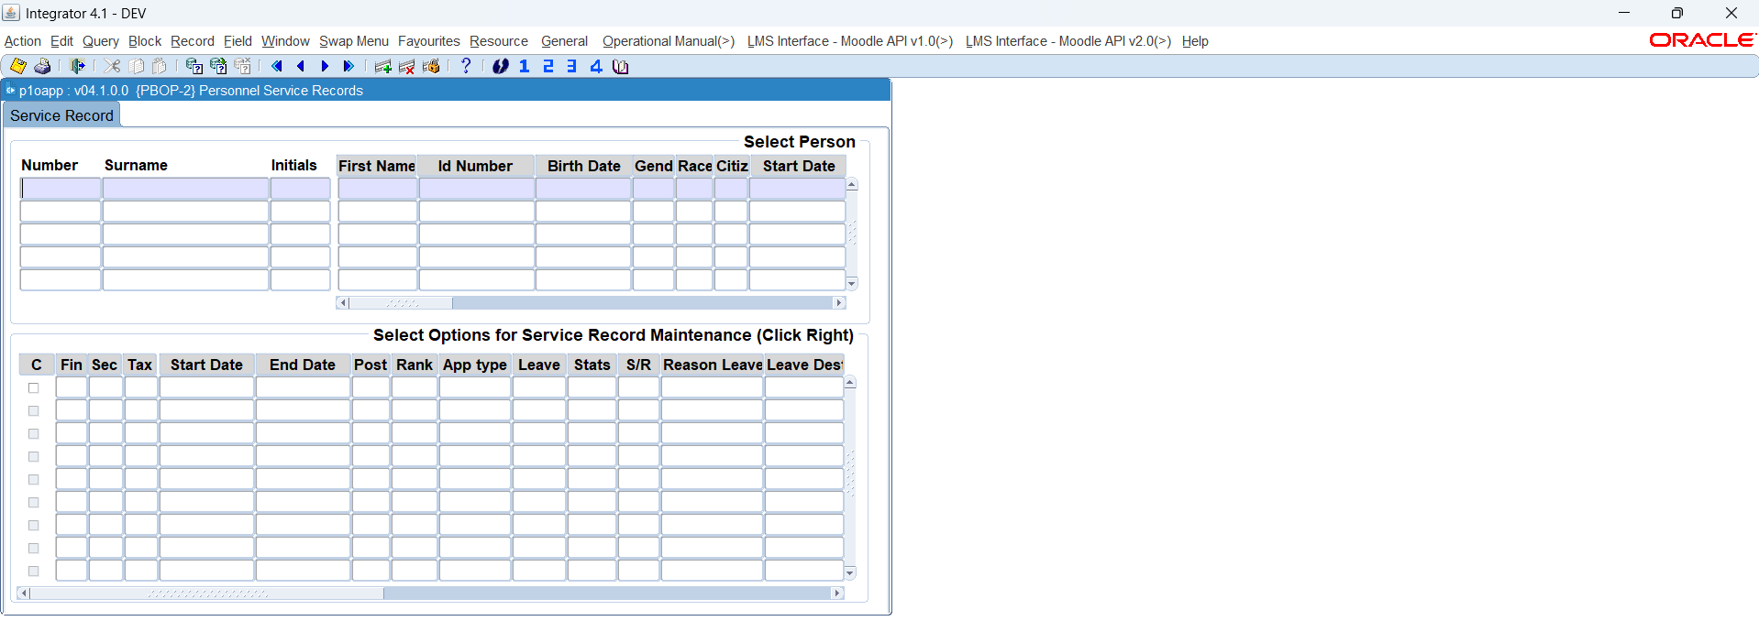
Menu Options
How do I find an Option
No manual intervention when Medical Aid rates, dependents change
Bonus Provision & RF on Bonus Provision calculated & posted monthly
General Increases, quick & simple
What If scenarios, quick & simple
Enhanced reporting

Slide 16

HR – Appointment Module
Available Options
No manual intervention when Medical Aid rates, dependents change
Bonus Provision & RF on Bonus Provision calculated & posted monthly
General Increases, quick & simple
What If scenarios, quick & simple
Enhanced reporting
Permanent Employee Appointment process – Back office system – {PBOP}
Temporary Employee Appointment process – Back Office system –{PAOP}
Secondary contract – Back office {PAOP}
Secondary contract – iEnabler – WEB Appointments

Slide 17
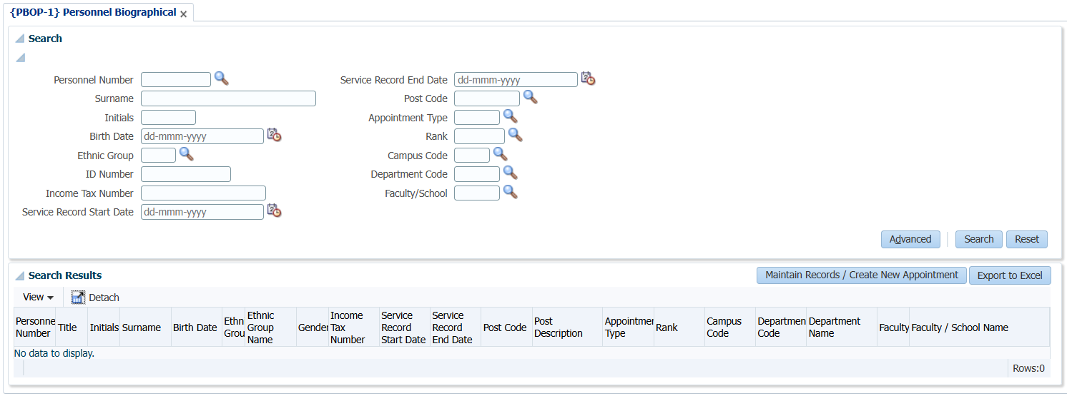
HR – Appointment Module
Available Options
No manual intervention when Medical Aid rates, dependents change
Bonus Provision & RF on Bonus Provision calculated & posted monthly
General Increases, quick & simple
What If scenarios, quick & simple
Enhanced reporting

Slide 18
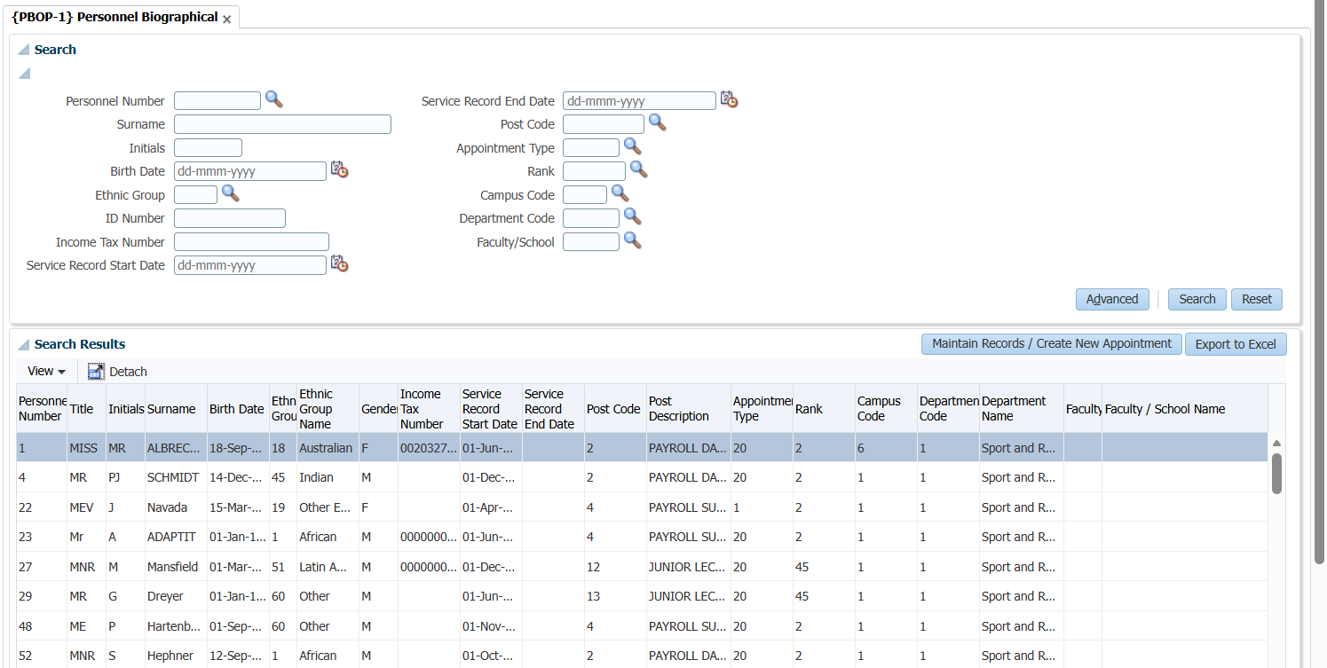
HR – Appointment Module
Available Options
No manual intervention when Medical Aid rates, dependents change
Bonus Provision & RF on Bonus Provision calculated & posted monthly
General Increases, quick & simple
What If scenarios, quick & simple
Enhanced reporting

Slide 19
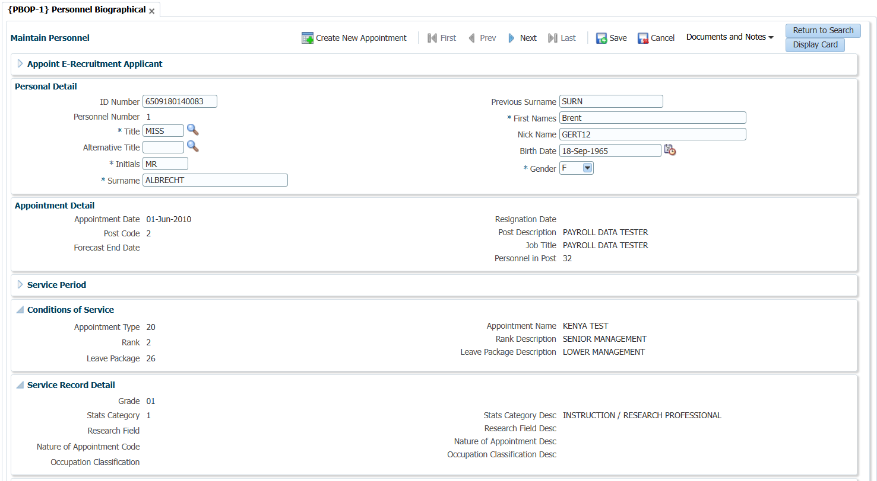
HR – Appointment Module
Available Options
No manual intervention when Medical Aid rates, dependents change
Bonus Provision & RF on Bonus Provision calculated & posted monthly
General Increases, quick & simple
What If scenarios, quick & simple
Enhanced reporting

Slide 20
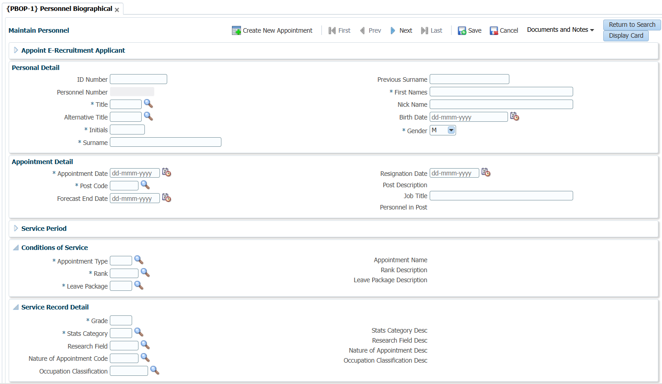
HR – Appointment Module
Available Options
No manual intervention when Medical Aid rates, dependents change
Bonus Provision & RF on Bonus Provision calculated & posted monthly
General Increases, quick & simple
What If scenarios, quick & simple
Enhanced reporting

Slide 21
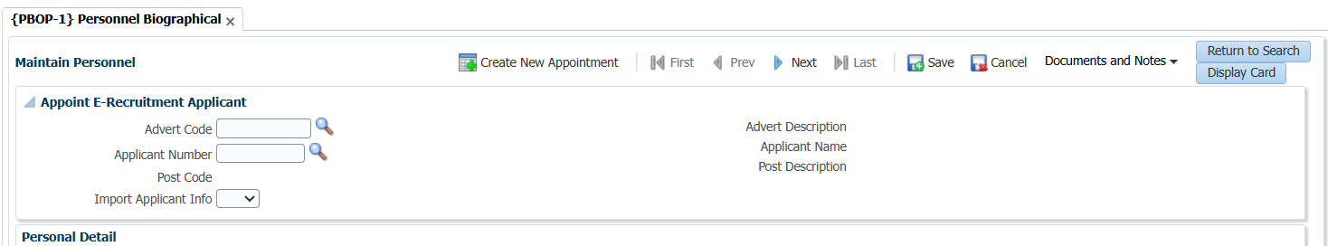
HR – Appointment Module
Available Options
No manual intervention when Medical Aid rates, dependents change
Bonus Provision & RF on Bonus Provision calculated & posted monthly
General Increases, quick & simple
What If scenarios, quick & simple
Enhanced reporting

Slide 22
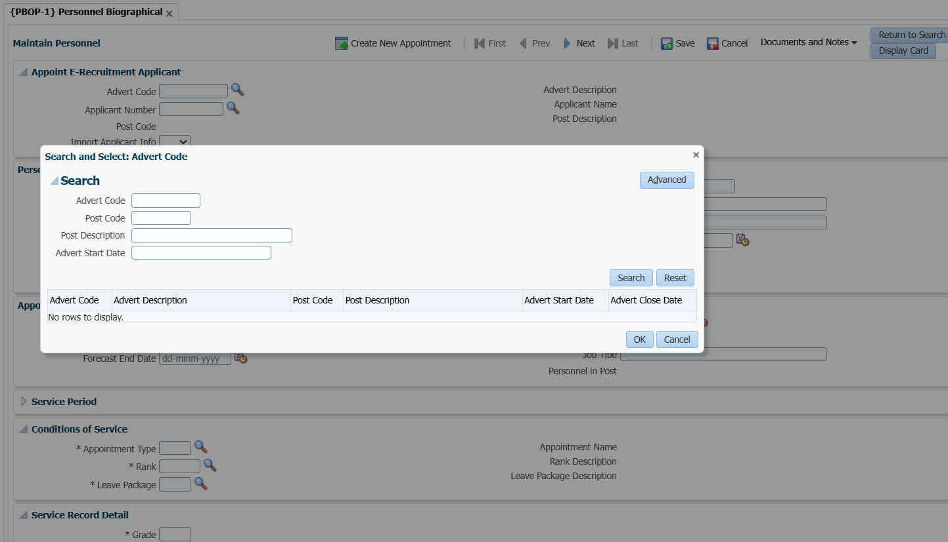
HR – Appointment Module
Available Options
No manual intervention when Medical Aid rates, dependents change
Bonus Provision & RF on Bonus Provision calculated & posted monthly
General Increases, quick & simple
What If scenarios, quick & simple
Enhanced reporting

Slide 23
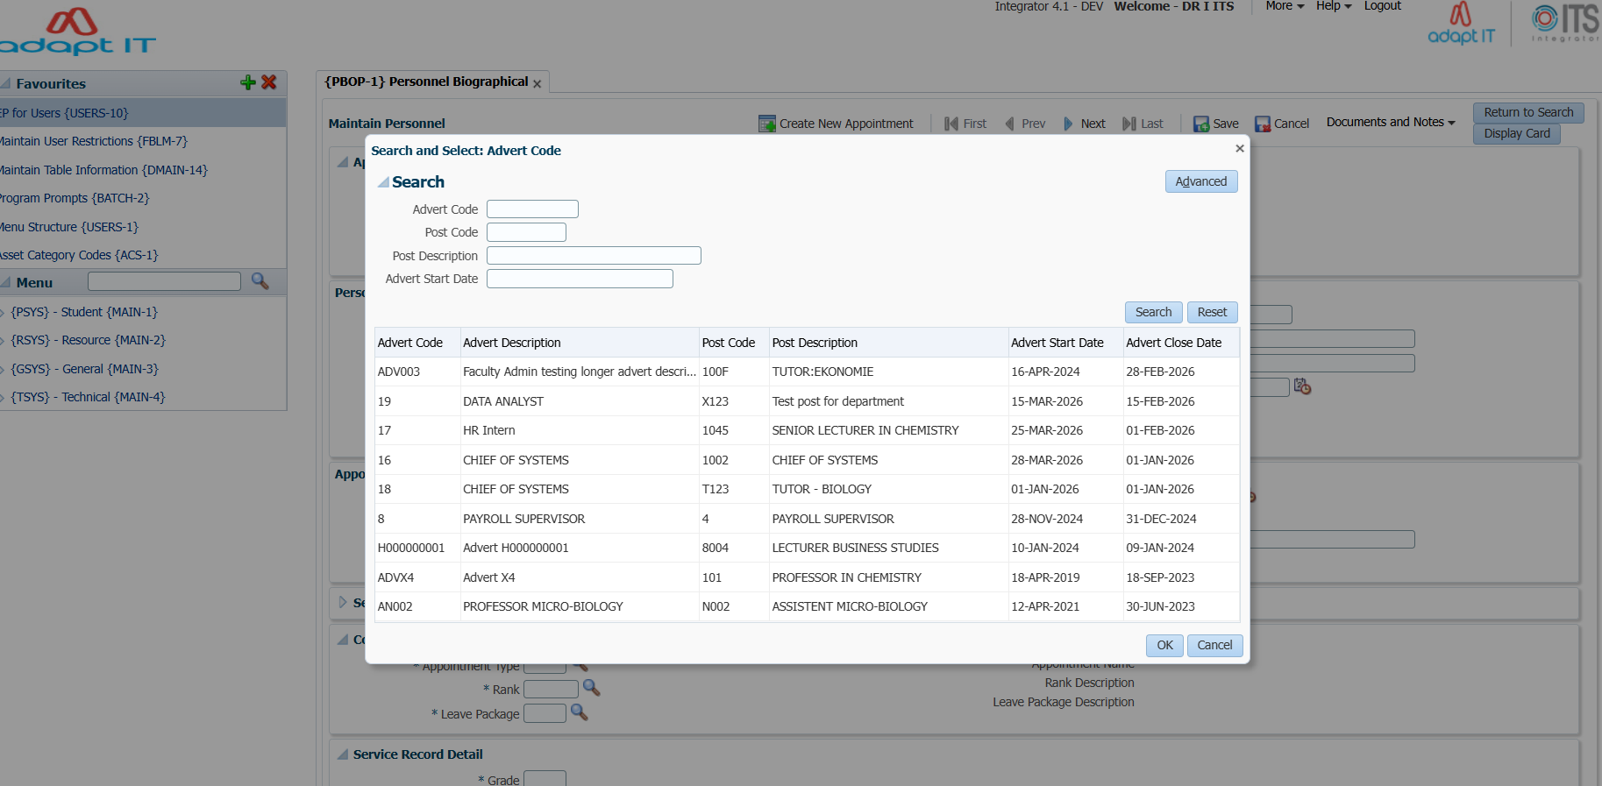
HR – Appointment Module
Available Options
No manual intervention when Medical Aid rates, dependents change
Bonus Provision & RF on Bonus Provision calculated & posted monthly
General Increases, quick & simple
What If scenarios, quick & simple
Enhanced reporting

Slide 24
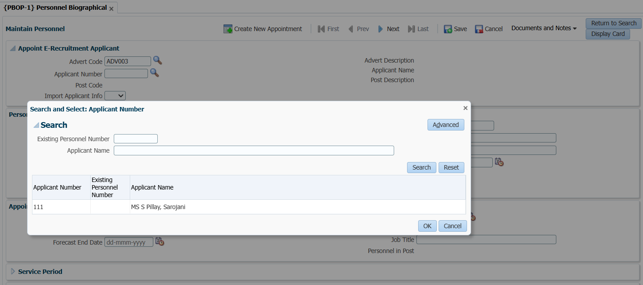
HR – Appointment Module
No manual intervention when Medical Aid rates, dependents change
Bonus Provision & RF on Bonus Provision calculated & posted monthly
General Increases, quick & simple
What If scenarios, quick & simple
Enhanced reporting
Available Options

Slide 25

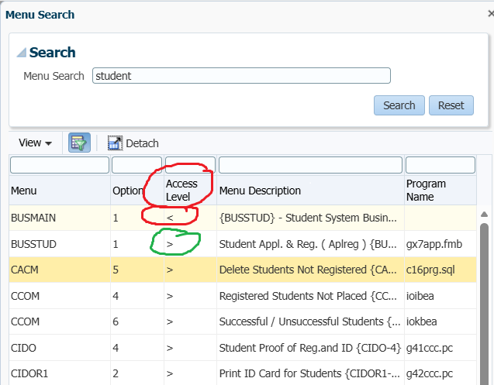
Access Control
Access
No manual intervention when Medical Aid rates, dependents change
Bonus Provision & RF on Bonus Provision calculated & posted monthly
General Increases, quick & simple
What If scenarios, quick & simple
Enhanced reporting

Slide 26

HR – Appointment Module
Value Proposition
No manual intervention when Medical Aid rates, dependents change
Bonus Provision & RF on Bonus Provision calculated & posted monthly
General Increases, quick & simple
What If scenarios, quick & simple
Enhanced reporting
Keep Biographical detail {PBOP-1}
Keep complete Service record history {PBOP-2}
Maintain Post Establishment {PPEO-1}
Maintain User defined code structures that supports consistency {PACS/PACS2}
Use Appointment types to group Benefits for personnel{PACS}

Slide 27

HR – Appointment Module
Value Proposition
No manual intervention when Medical Aid rates, dependents change
Bonus Provision & RF on Bonus Provision calculated & posted monthly
General Increases, quick & simple
What If scenarios, quick & simple
Enhanced reporting
Cater for grades and Ranks {PACS}
Relevant Reporting {PBOPR1/PBOPR2/PBOPR3}
Keep one Personnel number per person
Validate for duplicate ID Numbers
Integrated system

Slide 28

HR – Leave Module
Back Office
Multiple leave types – User Defined {PLCS-2}
Leave Packages User Defined {PLCS-1/PLCS-3}
6 different leave calculation methods {PLCS-3}
Fixed Credit as well as variable Credits based on years of service {PLOP}
Back office Leave application {PLOP}
No manual intervention when Medical Aid rates, dependents change
Bonus Provision & RF on Bonus Provision calculated & posted monthly
General Increases, quick & simple
What If scenarios, quick & simple
Enhanced reporting

Slide 29
HR – Leave Module
Back Office
No manual intervention when Medical Aid rates, dependents change
Bonus Provision & RF on Bonus Provision calculated & posted monthly
General Increases, quick & simple
What If scenarios, quick & simple
Enhanced reporting
Individual or Bulk Leave Manipulation {PLOP}
Multiple Reporting Options {PLOPR1/PLOPR2}
Setup Multiple Approval processes based on leave type/Rank/Appointment type
Caters for leave based on Working Days/Calendar Days
Relevant Reporting

Slide 30
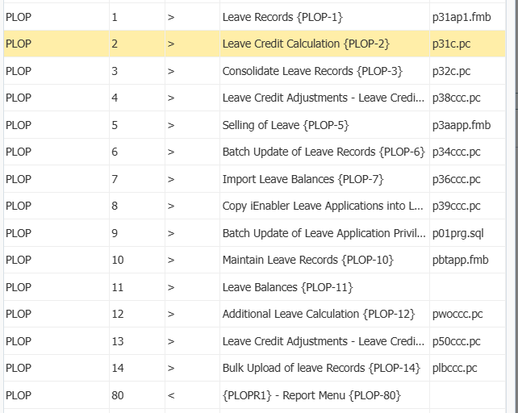
HR – Leave Module
Back Office
No manual intervention when Medical Aid rates, dependents change
Bonus Provision & RF on Bonus Provision calculated & posted monthly
General Increases, quick & simple
What If scenarios, quick & simple
Enhanced reporting

Slide 31
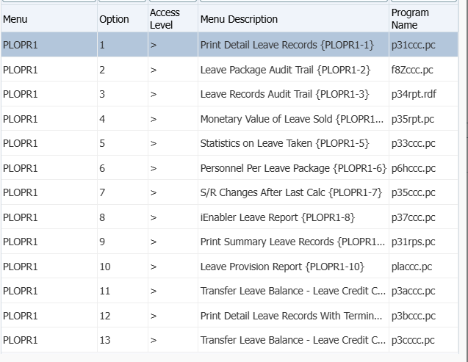
HR – Leave Module
Back Office
No manual intervention when Medical Aid rates, dependents change
Bonus Provision & RF on Bonus Provision calculated & posted monthly
General Increases, quick & simple
What If scenarios, quick & simple
Enhanced reporting

Slide 32
HR – Leave Module
iEnabler
No manual intervention when Medical Aid rates, dependents change
Bonus Provision & RF on Bonus Provision calculated & posted monthly
General Increases, quick & simple
What If scenarios, quick & simple
Enhanced reporting
Single/Multiple/Calendar leave application
Indicate who can apply for leave on your behalf
Leave Approval is User defined for levels of Approval as well as the process per leave type/rank/Appointment type
Cancel Leave

Slide 33
HR – Leave Module
No manual intervention when Medical Aid rates, dependents change
Bonus Provision & RF on Bonus Provision calculated & posted monthly
General Increases, quick & simple
What If scenarios, quick & simple
Enhanced reporting
iEnabler
Track your Leave Approval progress
Auto Approve or Auto Reject and Time Out

Slide 34
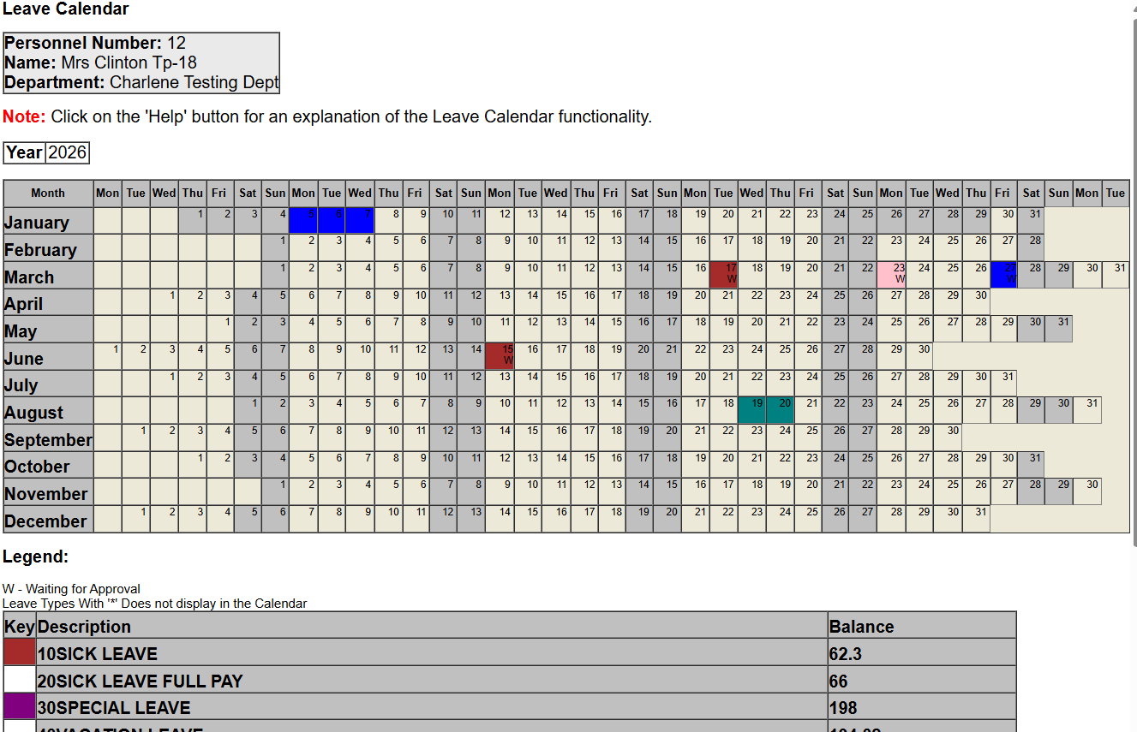
HR – Leave Module
No manual intervention when Medical Aid rates, dependents change
Bonus Provision & RF on Bonus Provision calculated & posted monthly
General Increases, quick & simple
What If scenarios, quick & simple
Enhanced reporting
iEnabler

Slide 35
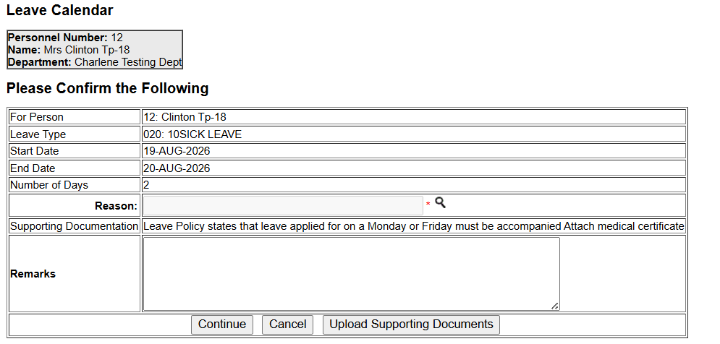
HR – Leave Module
No manual intervention when Medical Aid rates, dependents change
Bonus Provision & RF on Bonus Provision calculated & posted monthly
General Increases, quick & simple
What If scenarios, quick & simple
Enhanced reporting
iEnabler

Slide 36

HR – Additional Personal details and Maintenance
Back Office
No manual intervention when Medical Aid rates, dependents change
Bonus Provision & RF on Bonus Provision calculated & posted monthly
General Increases, quick & simple
What If scenarios, quick & simple
Enhanced reporting
Qualification details {PBOP-8}
Work permit details {PBOP-23}
Letter Generation{PLETC/PLETO}
Fund detail {PAOP-4/5}
Dependent detail {PBOP-}
Academic Membership {PBOP-7}

Slide 37
HR – Additional Personal details and Maintenance
Back Office
No manual intervention when Medical Aid rates, dependents change
Bonus Provision & RF on Bonus Provision calculated & posted monthly
General Increases, quick & simple
What If scenarios, quick & simple
Enhanced reporting
Publications {PBOP-5}
Personal Health {PBOP-29}
Disabilities {PBOP-24}
Bank Detail {PBOP-13}
Personal Detail {PBOP-1}
Notch detail {FPRI-1}

Slide 38
HR – Additional Personal details and Maintenance
Back Office
No manual intervention when Medical Aid rates, dependents change
Bonus Provision & RF on Bonus Provision calculated & posted monthly
General Increases, quick & simple
What If scenarios, quick & simple
Enhanced reporting
Service Record {PBOP-2}
Code structures {PACS/PACS2}
SOD{System Operational definitions} {GCS2-11}

Slide 39
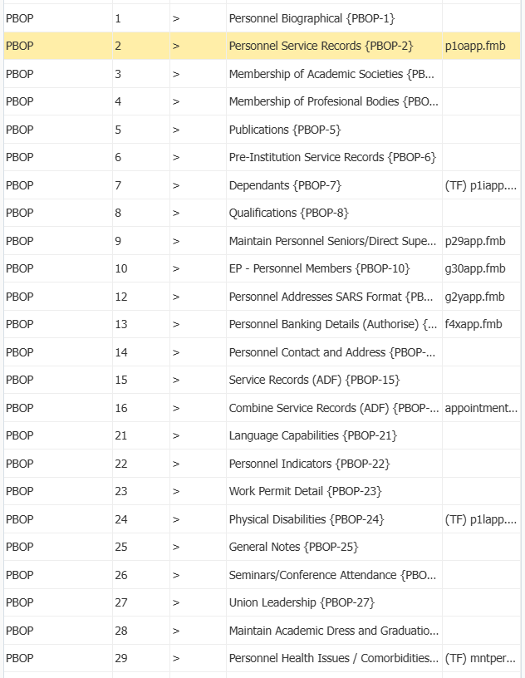
HR – Additional Personal details and Maintenance
Back Office
No manual intervention when Medical Aid rates, dependents change
Bonus Provision & RF on Bonus Provision calculated & posted monthly
General Increases, quick & simple
What If scenarios, quick & simple
Enhanced reporting

Slide 40
HR – Additional Personal details and Maintenance
iEnabler
Depending on setup options are View only/ Fully Updateable or Only Some fields are Updateable or will not display.
Options:
Personal Detail/Address Communication Detail/Pension Provident Detail/Qualification detail/Fund detail/Service record/Academic Society Membership/ Professional Body Membership/ Publications/ Dependents/ Language Capabilities/ Work Permit Detail/ Seminar Conferences Attended/ Union Leadership/ Hemis Program Allocation / Heath Issues /Alternative Title
No manual intervention when Medical Aid rates, dependents change
Bonus Provision & RF on Bonus Provision calculated & posted monthly
General Increases, quick & simple
What If scenarios, quick & simple
Enhanced reporting

Slide 41

HR – Probation
Value Proposition
No manual intervention when Medical Aid rates, dependents change
Bonus Provision & RF on Bonus Provision calculated & posted monthly
General Increases, quick & simple
What If scenarios, quick & simple
Enhanced reporting
User defined Notifications
User defined Assessment questions - Personal member and Management
Outcome Notification
Extensions
Automatically kicks off Assessment processes
Setup Assessment processes/questionnaires based on multiple basis such as Appointment type

Slide 42

HR – Automated Notification
Value Proposition
No manual intervention when Medical Aid rates, dependents change
Bonus Provision & RF on Bonus Provision calculated & posted monthly
General Increases, quick & simple
What If scenarios, quick & simple
Enhanced reporting
User defined Notifications for Appointments/Resignations/Work Permit
Email Notifications
SMS Notifications

Slide 43

HR – Integration with 3rd Parties
Available Interfaces
No manual intervention when Medical Aid rates, dependents change
Bonus Provision & RF on Bonus Provision calculated & posted monthly
General Increases, quick & simple
What If scenarios, quick & simple
Enhanced reporting
SIGNIFY – Performance Management system - API
REMCHANNEL –Salary survey and Benchmark system
ORANGE NOW – Document Storage system - API
Old Mutual Conflict of Interest
HR Smart

Slide 44

HR – HEMIS
Value Proposition
No manual intervention when Medical Aid rates, dependents change
Bonus Provision & RF on Bonus Provision calculated & posted monthly
General Increases, quick & simple
What If scenarios, quick & simple
Enhanced reporting
Standard HEMIS validations like VALPAC
Standard HEMIS submission process.
HEMIS is integrated into HR data in Back Office/iEnabler
Generate three files and extracts data from Personal and student systems: (PROF - Profile, SFTE – FTE Data,PDRS – Post docs)

Slide 45

HR – SURVEYS
Value Proposition
No manual intervention when Medical Aid rates, dependents change
Bonus Provision & RF on Bonus Provision calculated & posted monthly
General Increases, quick & simple
What If scenarios, quick & simple
Enhanced reporting
User defined Surveys
Personnel Apply on the iEnabler

Slide 46

HR – Job Profiles/E-recruitment
Value Proposition
No manual intervention when Medical Aid rates, dependents change
Bonus Provision & RF on Bonus Provision calculated & posted monthly
General Increases, quick & simple
What If scenarios, quick & simple
Enhanced reporting
Full Job Profile system
E-Recruitment system

Slide 47

HR – Industrial Relations/Incident system
Value Proposition
No manual intervention when Medical Aid rates, dependents change
Bonus Provision & RF on Bonus Provision calculated & posted monthly
General Increases, quick & simple
What If scenarios, quick & simple
Enhanced reporting
Industrial Relations (Grievance) system - Phase 1 completed
Incident Management system

Slide 48

HR – Reporting
Value Proposition
No manual intervention when Medical Aid rates, dependents change
Bonus Provision & RF on Bonus Provision calculated & posted monthly
General Increases, quick & simple
What If scenarios, quick & simple
Enhanced reporting
Statistical Information
Standard reports
Jasper Reporting
ADF Excel extracts
Statutory Reporting – EEA2, EEA3,EEA12,EEA1,EEA19

Slide 49

Payroll
Value Proposition
No manual intervention when Medical Aid rates, dependents change
Bonus Provision & RF on Bonus Provision calculated & posted monthly
General Increases, quick & simple
What If scenarios, quick & simple
Enhanced reporting
Monthly and Fortnightly Payrolls
9 calculation number
99 sequences
Allow rollbacks and Late rollbacks
Statutory tax calculations and reporting
Salary + Benefits calculations
Total Guaranteed Package calculations
Manual or Host to Host Salary Payments

Slide 50
Payroll
Value Proposition
No manual intervention when Medical Aid rates, dependents change
Bonus Provision & RF on Bonus Provision calculated & posted monthly
General Increases, quick & simple
What If scenarios, quick & simple
Enhanced reporting
30 Calculation methods
Integrated system
3rd party Payments
Salary Scales and Ranks
Various controls built into the system i.e.
Various Audit Trails
Pension reform and medical aid Calculations
Validation control

Slide 52
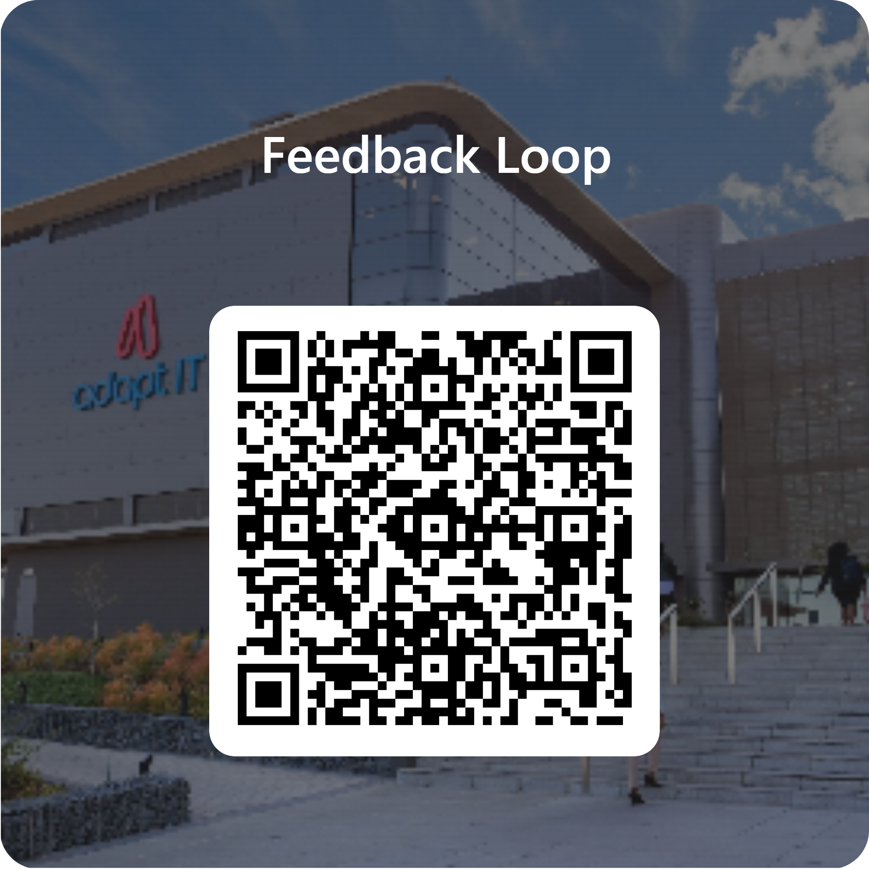
Feedback

