Slide 1
ITS & Blackboard integration

Slide 2
Overview
Integration Goals
Change Management
Process Flow
ITS Menus used
Menu details and options
Configuration pushed to Blackboard
Lecturer Impact
Marks download report examples
Snags

Slide 3
Integration Goals
Reduce the time spent by academics/faculty uploading into iEnabler
Increase the accuracy of marks captured on iEnabler
Promote the use of Blackboard as a primary source of marks and other student interaction
Automate the course and user management on Blackboard by automating
User creation
Course creation
User enrollment
Continue to embrace the freedom of lecturers by using calculation columns
Collection of marks from Blackboard into iEnabler

Slide 4
Change Management: Testing of Integration and Training of Academic Staff
Alongside the development, Training of Academic staff was needed. Although the finalise product was not done
Process happened almost concurrently by starting with small pilot of 4 academics that assisted with testing (One Faculty)
Cohort of Academics across all Faculties (60 modules were selected)
Training at the beginning of the academic year – whilst finalization of the integration was still ongoing

Slide 5
ITS Menu Options
Menu Option | Action | Result
GCS2-11 | System Operational Definitions | Blackboard API configuration
GCS2-18 | Blackboard API Configuration | Set Default Year and CourseKey Configuration
SACADO-10 | Maintain subject on academic structure. | Creates a Request for the creation of Course record on Blackboard.
SACADO-13) | Link a personnel member as a lecturer. | Creates a request for the creation of the Primary Lecture as user on Blackboard.
SCODE-10] | Maintain mark type codes | Types of assessments/tests to be transferred to Blackboard
SSTUD3-7 | Assessment Criteria | Assessment Criteria configuration & assessment types to create.
SSTLMS-12,13,14 | Buld data extract into csv | Used for initial Blackboard bulk uploads
BATCH-9 | Background processes | Process intervals
SREGAR-1 | Register a student for a subject. | The Subject Registration of a student for a LMS Subject will create a request for the Student to be created as a ‘Student’ user and an ‘Enrolment’ on Blackboard.

Slide 6
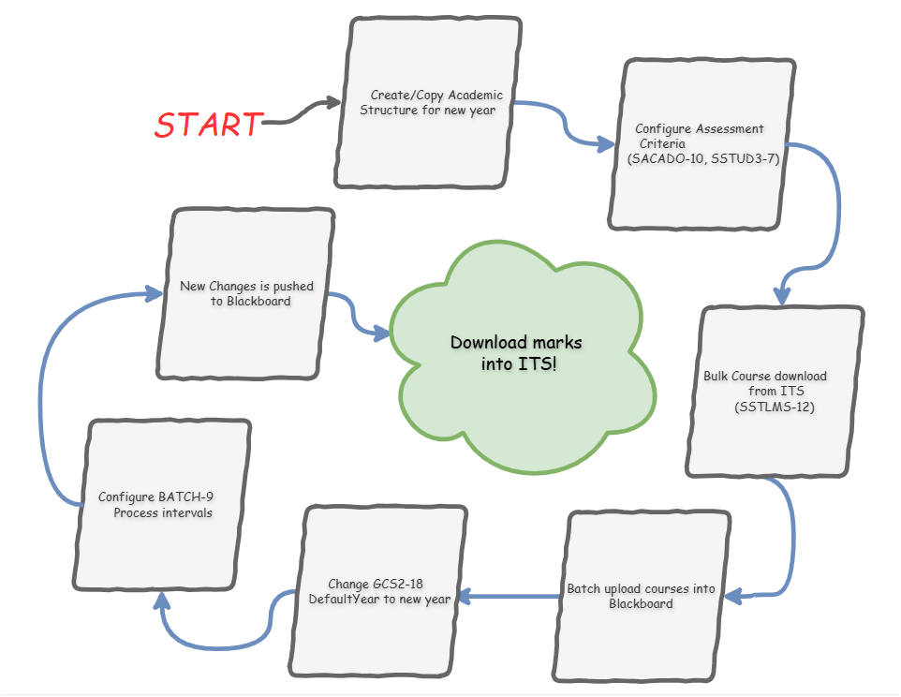

Slide 7
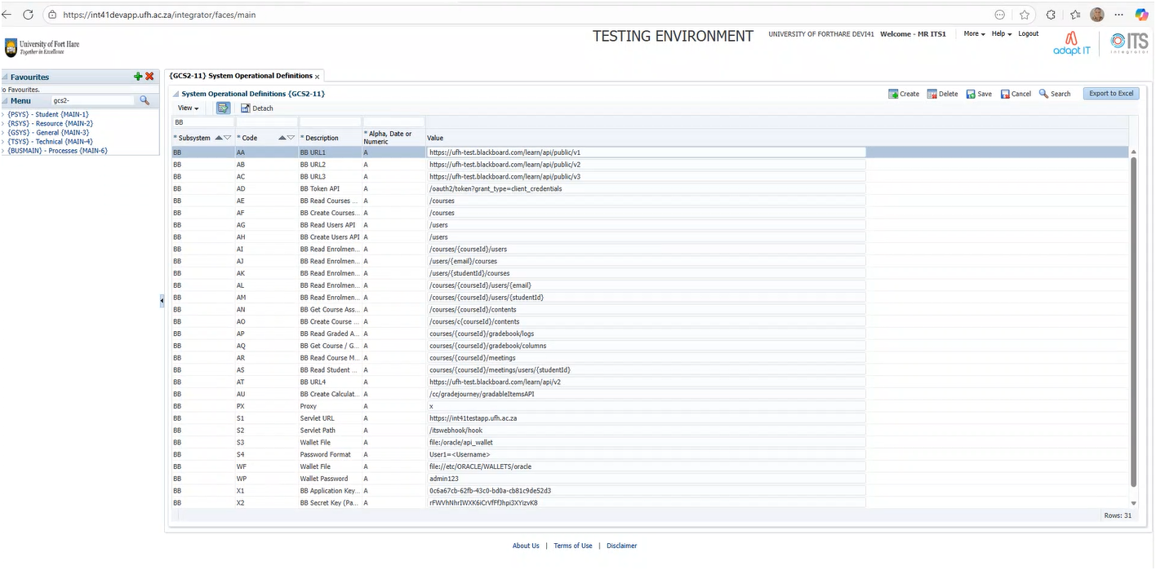
GCS2-11

Slide 8
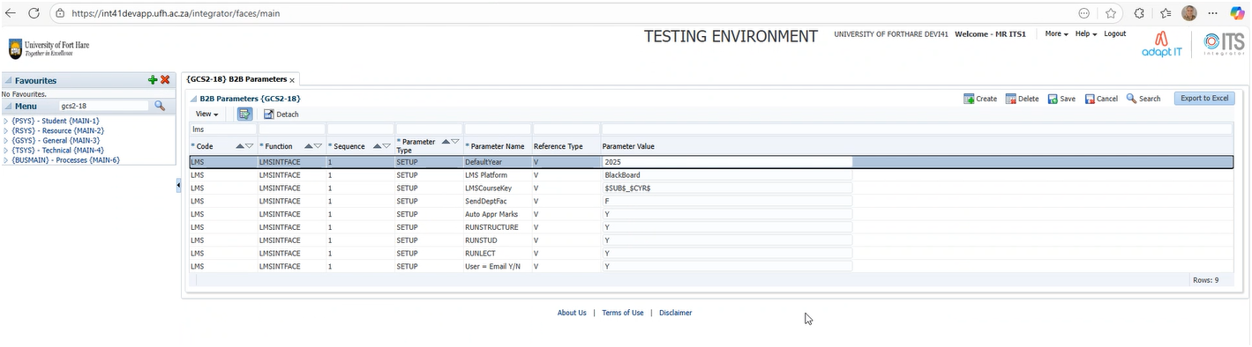
GCS2-18 (Course Key)

Slide 9
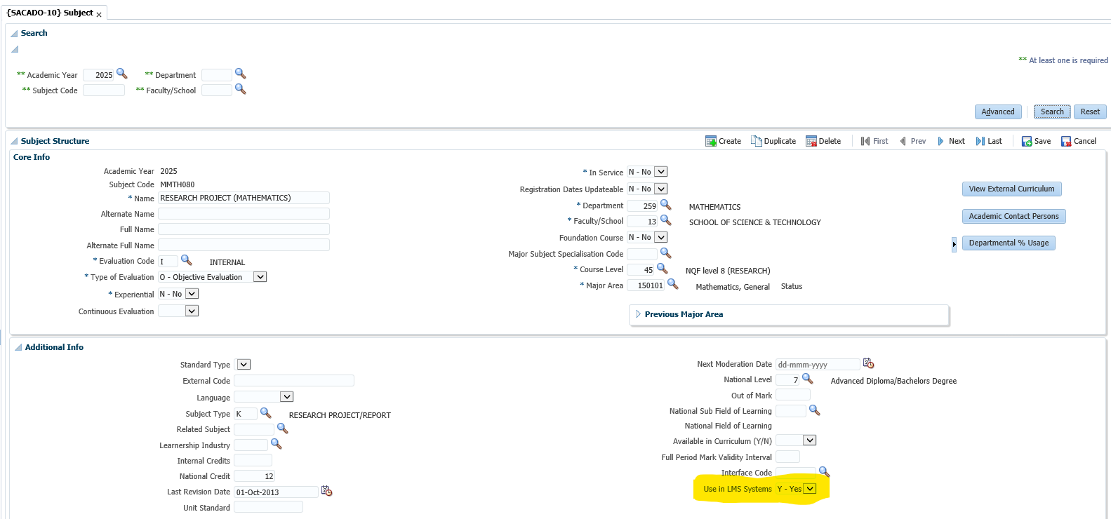
SACADO-10

Slide 10
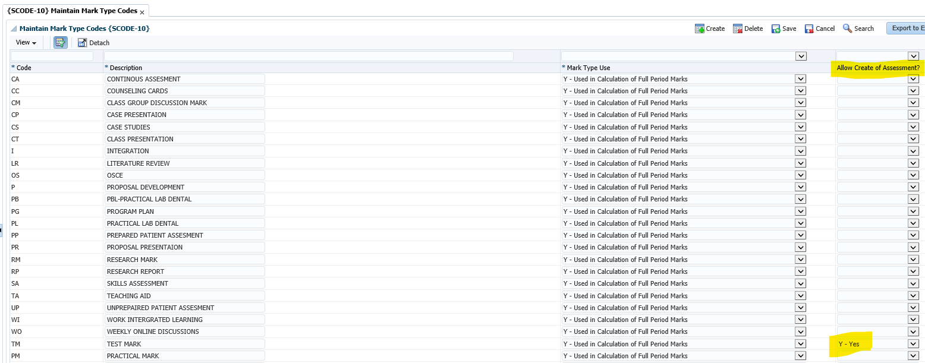
SCODE-10

Slide 11
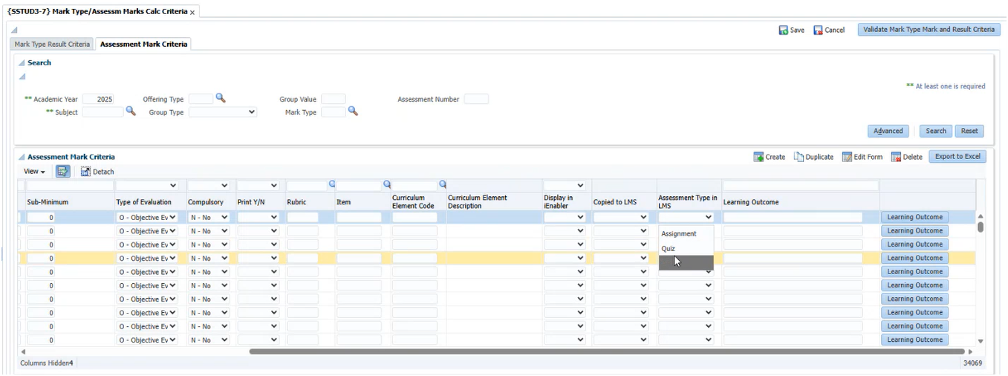
SSTUD3-7

Slide 12
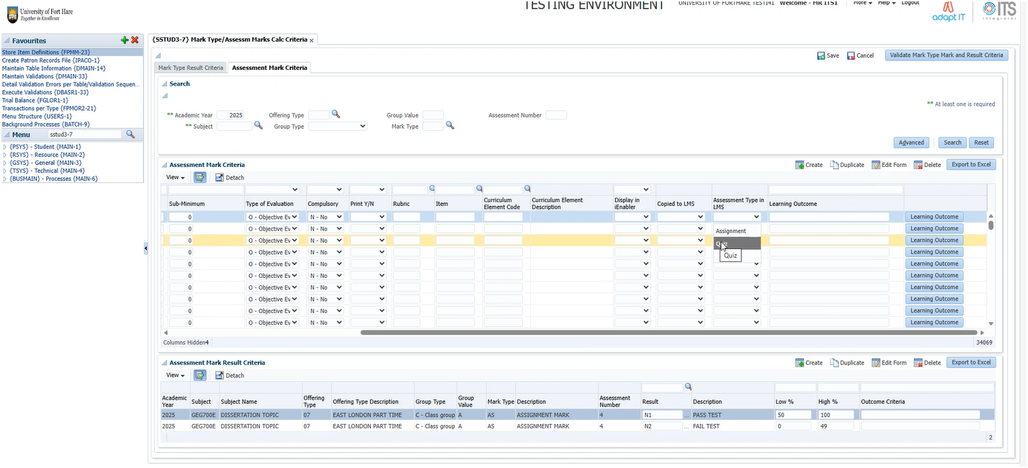
SSTUD3-7

Slide 13
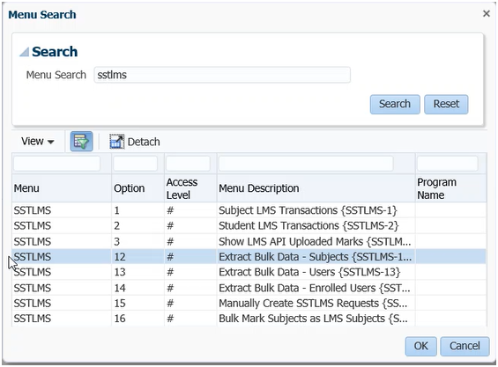
Bulk Download of Courses
12 – Bulk upload of course before registration
13,14 – Only if API turned on after registration start

Slide 14
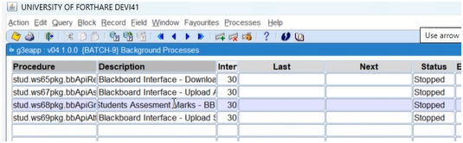
Batch9 – Process intervals
stud.ws65pkg -- Run account create and enroll on Blackboard
stud.ws67pkg -- Upload assessment criteria to Blackboard from SSTUD3-7
stud.ws68pkg -- Process to draw marks from calculation columns and apply in ITS.

Slide 15
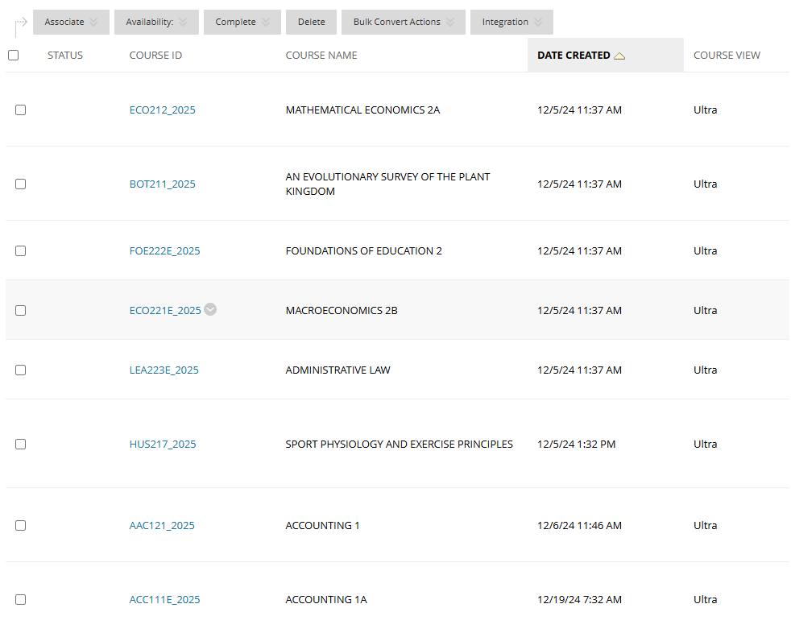
Blackboard – Courses Created

Slide 16
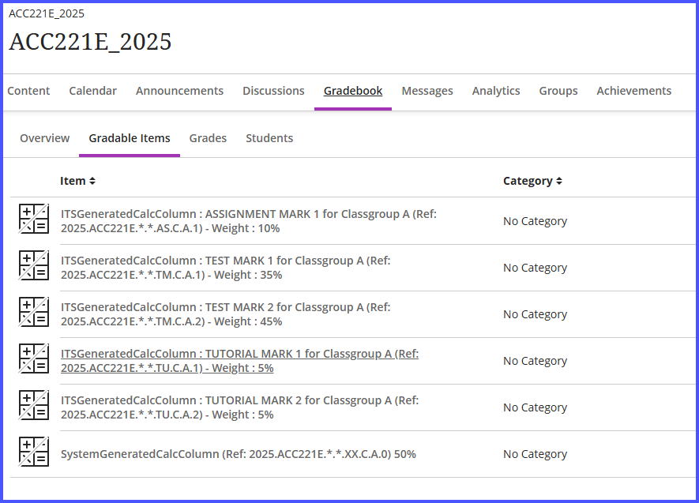
Blackboard – Created Calculation Columns

Slide 17
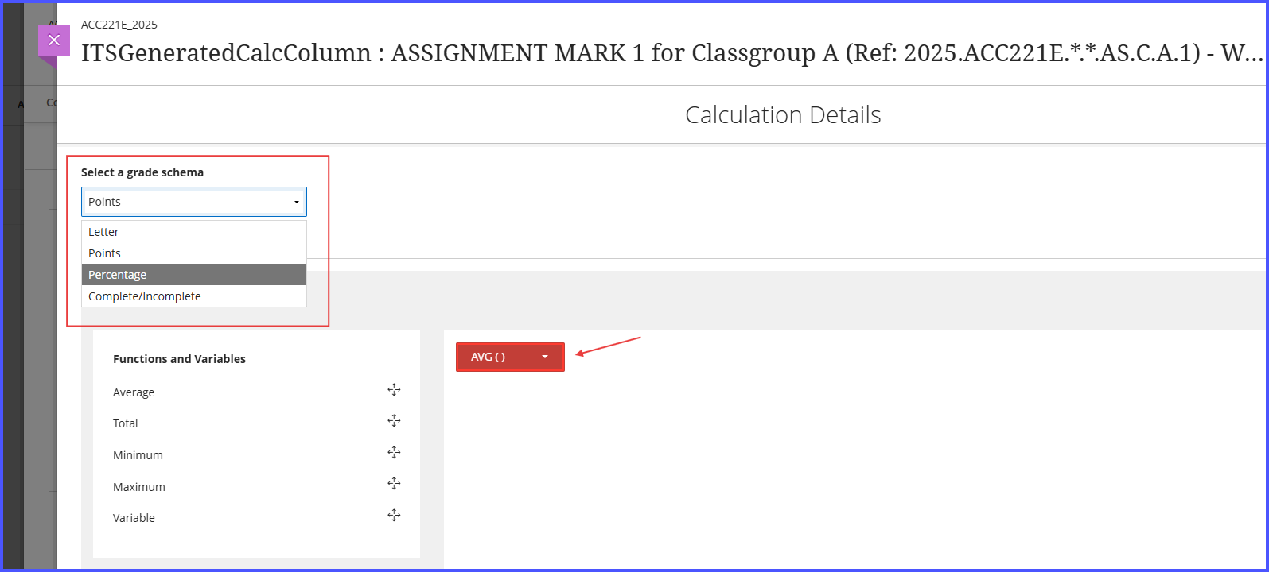
Calculation Column

Slide 18
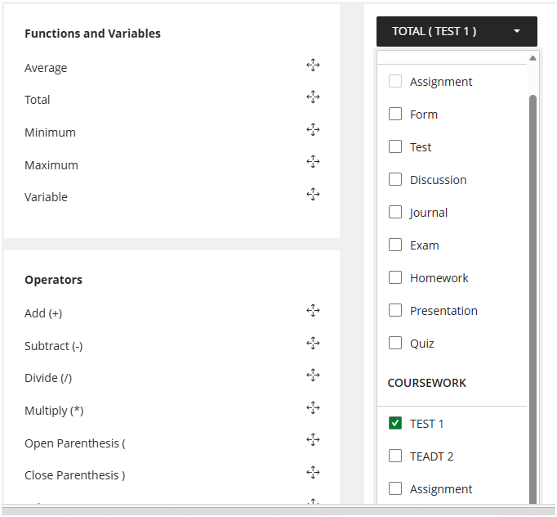
Calculation Column Linking

Slide 19
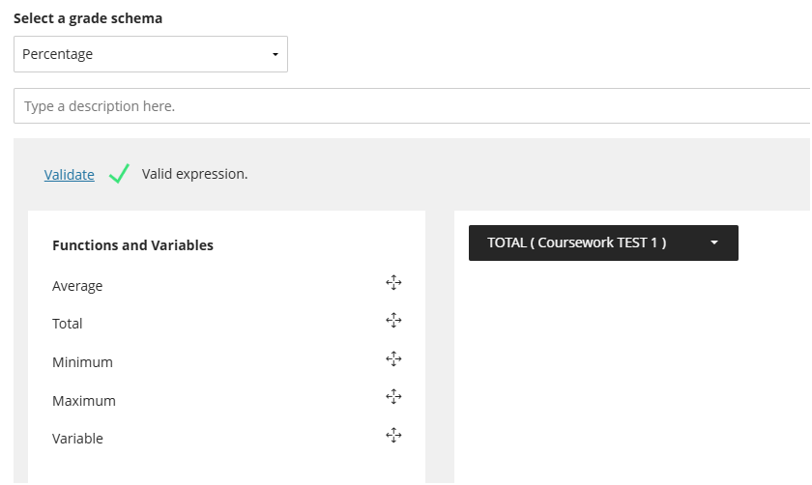
Calculation Column Config

Slide 20
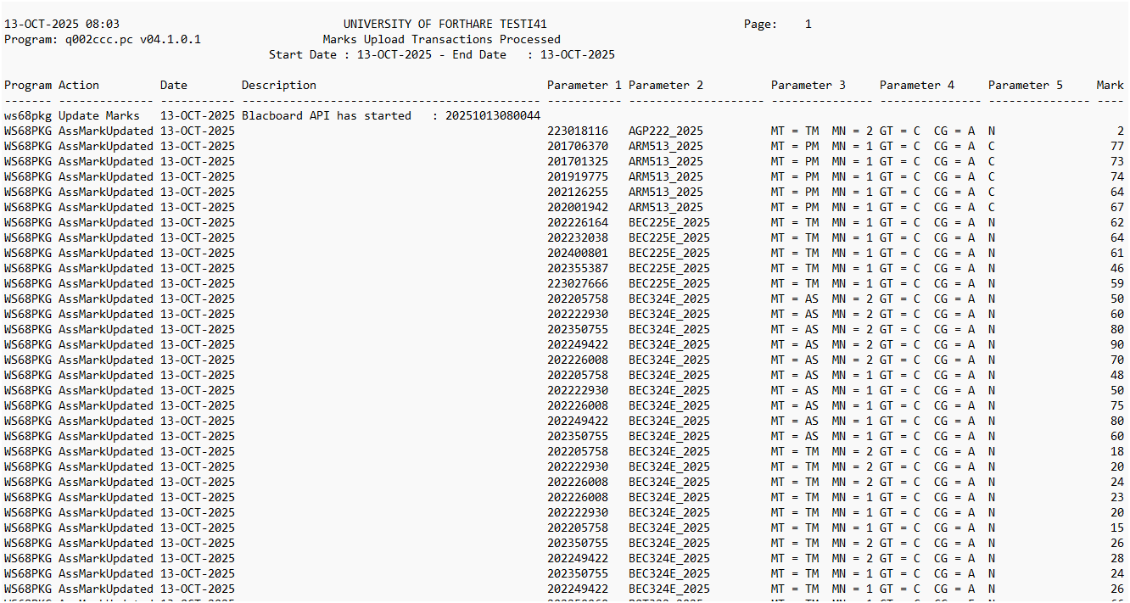
SSTLMS-3

Slide 21
Snag List
Complete & Accurate Academic Structure
Marking of subject (SACADO-10) for LMS can be done in bulk, but risk applying unnecessary subjects in Blackboard.
Assessment Criteria
Assessment types and weights must be accurate to ensure the appropriate calculation columns is created in Blackboard.
Student Creation and Enrollment
Student account creation and Enrollment works well, but require the subjects to be available during process for enrollment.
Lecturer enrollment
Only enrolls Primary Lecturer from ITS.
Inability to apply Student course unenrollment changes
Student de-registration from courses not applied on Blackboard
Lockdown of Assessments & Calculation Columns
Unable to lock Assessments & Calculation Columns for changes after academic cycles closed.

Slide 22
QUESTIONS

