Slide 1

Server Patch updates & Application Security information
ITSUG 2026 – Session 60

Slide 2
TABLE OF CONTENT
01 The Threat Landscape
Why patching is not optional
02 Vulnerability Identification
OpenVAS, Lynis, Oracle CPU advisories
03 Risk Classification
CVSS scoring & exploitability ratings
04 Exposure & Access Tiers
Internet-facing vs internal vs air-gapped
05 The Patching Playbook
Linux OS to Oracle DB to WebLogic - test before prod
06 The 40-Day Patch Cycle
Process, rollback, sign-off & lessons learned

Slide 3
01 The Threat Landscape

Slide 4
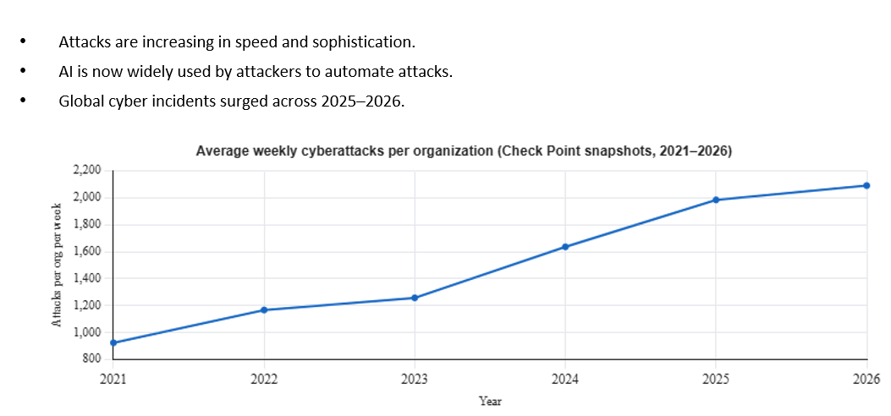
Cyber Security Attacks

Slide 5
The World Changed
48,000+
15 days
60%
€4.5M
CVEs published in 2025
Average attacker dwell time
Breaches via unpatched vulnerabilities
Average breach cost
That’s 131 per day
Before detection in unpatched systems
A patch a day keeps the hacker away
Patching suddenly sounds affordable

Slide 6
Why Oracle & Linux Are Prime Targets
Oracle Ecosystem
Linux Stack
› Oracle DB holds your crown jewels — payroll, financials, customer data
› Kernel vulnerabilities can escalate any user to root instantly
› WebLogic has a long history of critical RCE (Remote Code Execution) CVEs
› OpenSSL, glibc, sudo — critical libraries updated constantly
› Oracle CPU patches quarterly — but attackers don't wait 90 days
› RPM/APT package managers make patching easy
› Serialization exploits in WebLogic are actively weaponized
› Log4Shell taught us: transitive dependencies bite hardest
› Unpatched Oracle DB = open safe with a 'please don't steal' sign

Slide 7
02 Vulnerability Identification

Slide 8
Your Vulnerability Hunting Toolkit
Rapid7 / Qualys
Linux
Oracle CPU Advisories
Oracle
Vulnerability Scanner
Vendor Bulletins
Identifies CVEs across OS, services, and exposed ports. Essential first line.
Quarterly Critical Patch Updates. Every CVSS score, affected component, and patch availability from Oracle.
NIST NVD / CVE Database
Intel
Continuous Protection
VMDR
Threat Intelligence
Vulnerability Risk Management
The authoritative CVE registry. Look up any vulnerability — CVSS base score, vector, public exploits, references.
Provides endpoint security, threat intelligence, and cyberattack response services

Slide 9
03 Risk Classification

Slide 10
CVSS: Putting a Number on Your Nightmares
CRITICAL
HIGH
MEDIUM
LOW / INFO
9.0–10.0
7.0–8.9
4.0–6.9
0.1–3.9
Patch within 24–72 hours. No debate.
Patch within 7 days. Escalate immediately.
Patch in next cycle (40 days).
Best-effort. Track and schedule.
CVSS v3 Vector Components (what drives the score):
AV: Attack Vector: Network / Adjacent / Local / Physical
UI: User Interaction: None = automated exploit possible
AC: Attack Complexity: Low = trivial exploit, High = complex
S/C/I/A: Scope / Confidentiality / Integrity / Availability impact
PR: Privileges Required: None = anyone can attack, High = insider needed

Slide 11
Exploitability: From "Theoretical" to "Please Call Your Manager"
🔴 WEAPONIZED
Exploit code is publicly available AND actively used in the wild.
Examples: Log4Shell (CVE-2021-44228), WebLogic RCE (CVE-2020-14882), EternalBlue
Act Now
🟠 POC AVAILABLE
Proof-of-concept exploit published. Skilled attackers can weaponize within days. Treat as critical regardless of CVSS base score.
Examples: CVE-2023-21839 Oracle WebLogic, Dirty Pipe (CVE-2022-0847) Linux kernel
Urgent
🟡 THEORETICAL
Vulnerability confirmed and documented, but no public exploit yet. Window of opportunity — patch before someone publishes a PoC.
Examples: Most Oracle CPU quarterly patches fall here initially
High Priority
🟢 UNPROVEN
Vendor advisory issued, low exploitability assessed. Fit into your standard 40-day cycle. Don't ignore — PoC status changes.
Examples: Minor privilege escalations, local-only attacks, requires authenticated access
Scheduled

Slide 12
04 Exposure & Access Tiers

Slide 13
Who Can Actually Reach Your Systems?
🌐
🏢
🔒
🛡️
Tier 1
Tier 2
Tier 3
Tier 4
MAXIMUM
HIGH
MEDIUM
MANAGED
Public-facing web servers, APIs, WebLogic DMZ instances. Reachable by anyone on earth.
Systems accessible within corporate network. Still at risk from lateral movement after initial breach.
Isolated subnets with strict ACLs. Requires VPN + jump host. Limited attack surface.
Physically isolated networks. Patching via offline media. Rare vulnerabilities matter most.
SLA:
Critical: 24h
High: 72h
Medium: 7 days
SLA:
Critical: 72h
High: 7 days
Medium: 40 days
SLA:
Critical: 7 days
High: 40 days
Medium: Next cycle
SLA:
Critical: 14 days
All others: Scheduled
WebLogic OHS, Oracle REST Data Services, public load balancers
Internal Oracle DB servers, internal WebLogic app clusters, dev/QA
Production Oracle DB tier, batch processing servers, financial systems
SCADA, classified systems, offline Oracle Data Guard standby

Slide 14
05 The Patching Playbook

Slide 15
Linux Patching: The Right Order Matters
Step 1 — Snapshot / Backup
VM snapshot or bare-metal backup BEFORE anything.
Step 2 — Patch TEST Environment
Apply patches to test first. 48h observation window.
Step 3 — Validate & Sign Off
App team confirms stable. DBA confirms Oracle connects.
Change management approval + CAB sign-off
Step 4 — Patch Non-Production
Apply to dev/staging/UAT. Repeat validation.
Step 5 — Patch Production (Rolling)
Maintenance window: notify → patch → verify
Step 6 — Post-Patch Verification
Check all services and confirm vulnerabilities have been addressed.

Slide 16
06 The 40-Day Patch Cycle

Slide 17
The 40-Day Standard Patch Cycle
Days 1-5: Assess
Scan systems, download advisories, create vulnerability register.
Days 6-10: Prioritise
CVSS scoring, exposure tier mapping, risk sign-off.
Days 11-20: Test Environment
Patch DEV/TEST, regression testing, UAT sign-off.
Days 21-30: Non-Production
Patch SIT /Pre-Prod, extended soak period, approvals.
Days 31-38: Production
Prod patch, maintenance windows, monitoring.
Day 39: Report
Patch completion report + metrics.
Day 40: Lessons Learned
Review what broke, what worked, next cycle planning.
Ongoing: Continuous Monitoring
Emergency patches bypass standard cycle — activate Emergency Change Process.

Slide 18
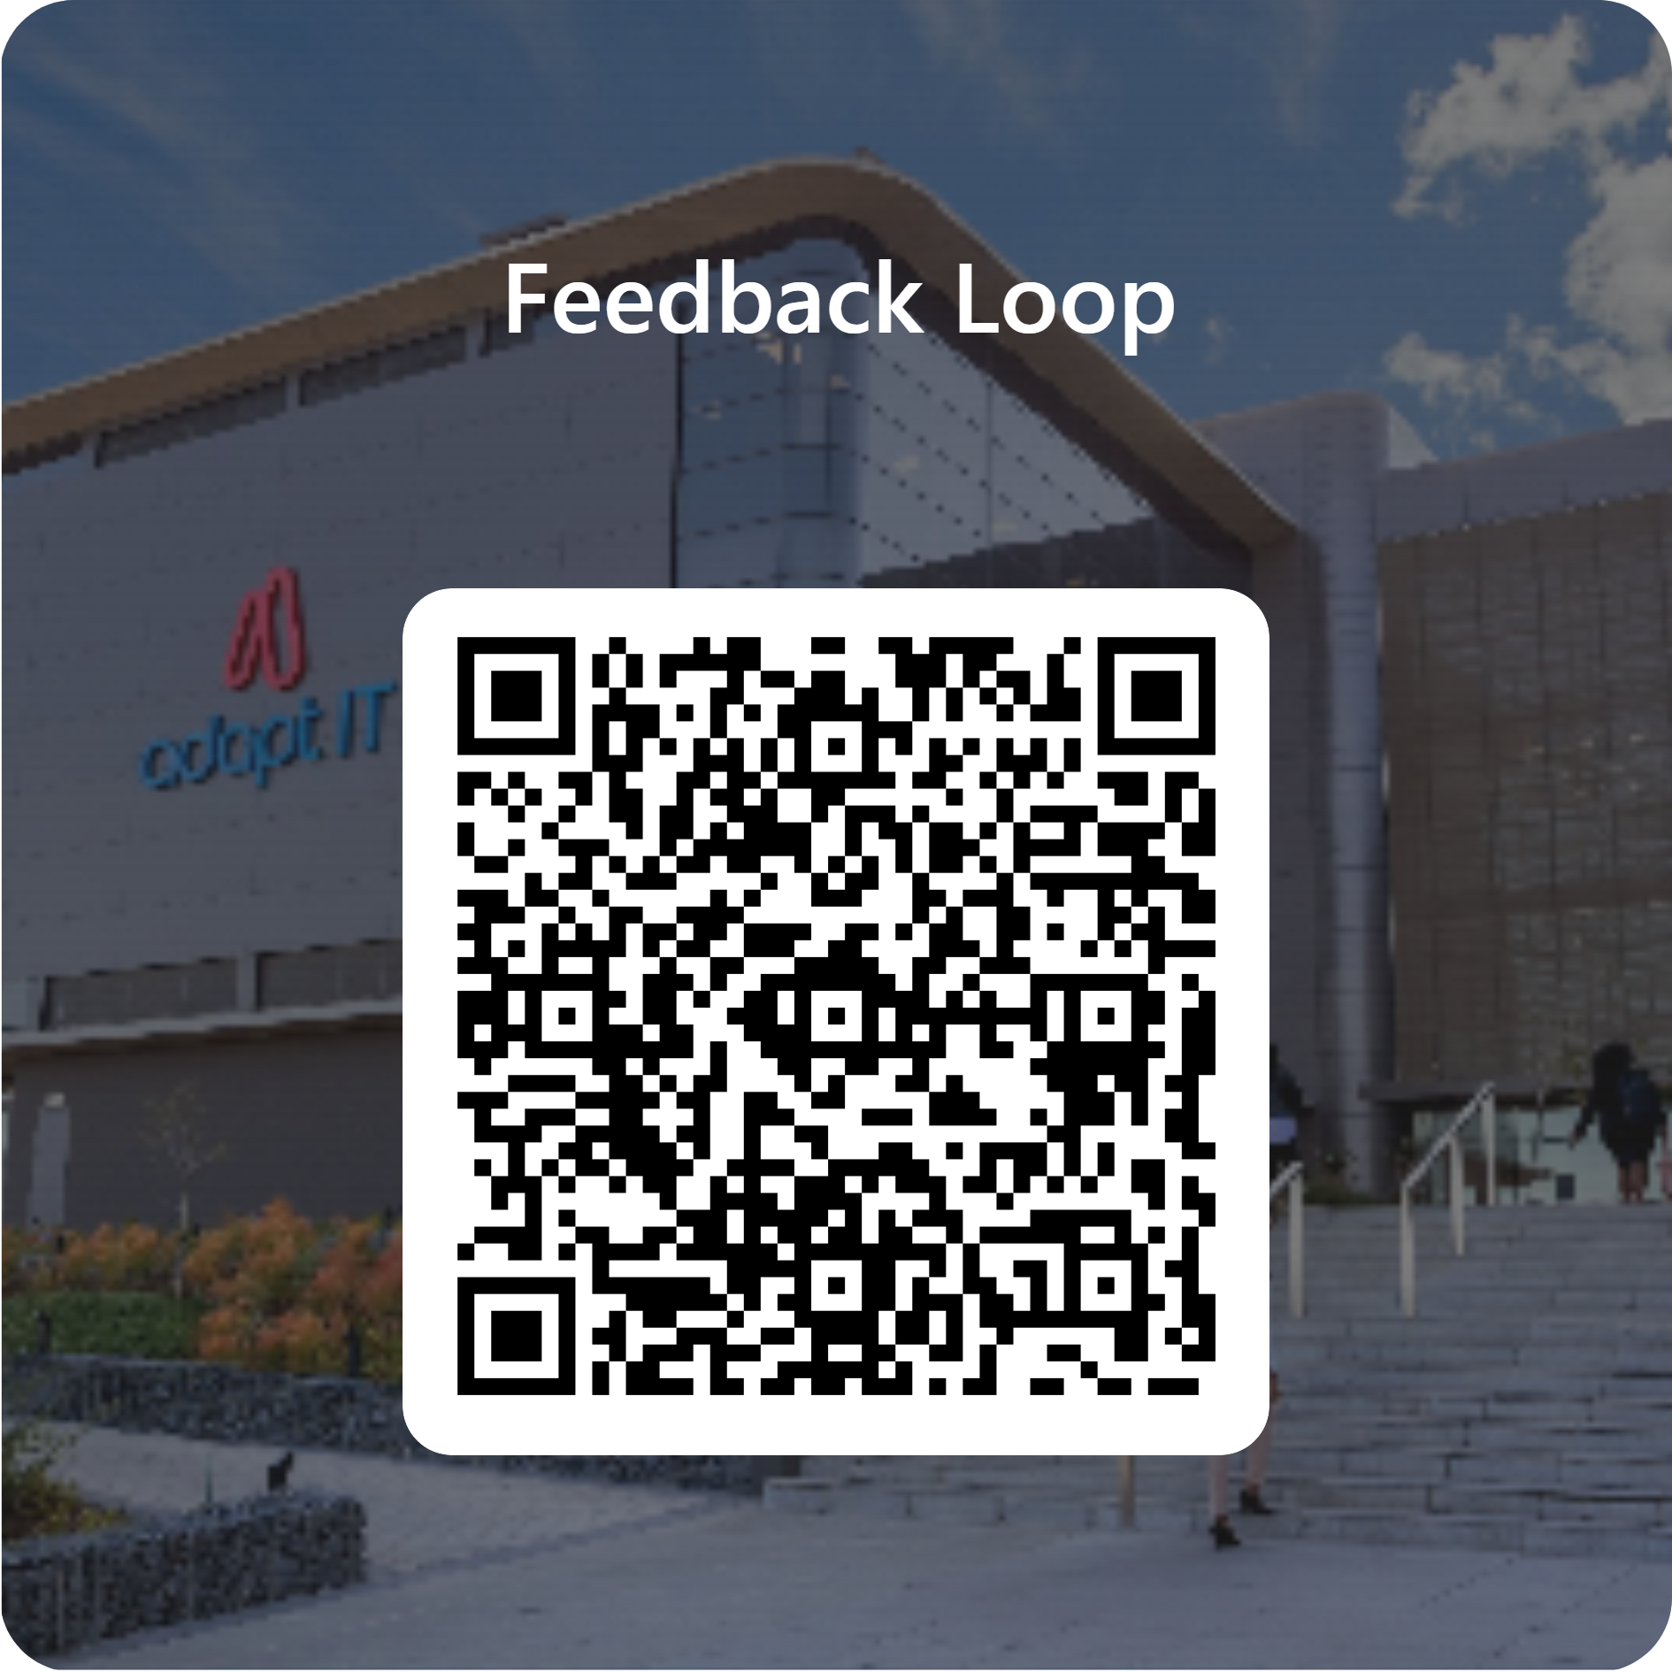
Feedback

