Slide 1

Introducing Single Sign-On for ITS Integrator
Powered by SAML 2.0 & Active Directory Federation Services (ADFS)
Session 71

Slide 2
Today’s Agenda
01
What is SAML SSO?
02
Why It Matters
03
Prerequisites
04
How It Works on ITS Integrator
05
Cost Considerations
06
Implementation Roadmap
07
Q&A

Slide 3
What is SAML Single Sign-On?

Slide 4
How SAML SSO Works
Login Flow:
The Plain-English Version
SAML SSO (Security Assertion Markup Language) lets your staff and students log in once using their existing Windows / Active Directory credentials and gain seamless access to ITS Integrator.
Think of it as a universal key: one credential opens all the right doors.
ADFS = Identity Provider (IDP)
ITS Integrator = Service Provider (SP)
1. User opens ITS Integrator
2. Redirected to ADFS login page
3. User enters Windows credentials once
4. ADFS validates and issues SAML token
5. ITS Integrator grants access

Slide 5
Why SSO Matters for Your Institution
Strategic benefits for higher education

Slide 6
Key Benefits of SAML SSO
Enhanced Security
Improved Productivity
Compliance Ready
Centralised authentication eliminates weak, reused passwords. Credentials never leave your Active Directory environment.
Staff and students log in once and move freely across systems — no more repeated logins or password resets.
Supports POPIA, GDPR and institutional audit requirements with centralised access control and audit trails.
Reduced IT Burden
Better Student Experience
Seamless Integration
Fewer helpdesk password tickets. User provisioning managed centrally through Active Directory.
Students use existing campus credentials to access ITS Integrator portals — reducing friction and improving satisfaction.
Leverages your existing Microsoft ADFS infrastructure. No new identity provider platform required.

Slide 7
Prerequisites
What your institution will need before we begin

Slide 8
Prerequisites — What You’ll Need
Technical Requirements
Organisational Requirements
✓ Microsoft Active Directory (ADFS 2.0 or later)
✓ Institutional commitment from IT management
✓ Windows Server with IIS and SSL certificate
✓ Designated IT administrator with ADFS access
✓ Oracle WebLogic Server (ITS Integrator platform)
✓ Active Directory accounts matching ITS Integrator users
✓ Network connectivity between ADFS and ITS Integrator
✓ Valid SSL/TLS certificate (self-signed for testing)
✓ Change management plan for staff and students
✓ ADFS federation metadata XML file
✓ Test environment before production rollout

Slide 9
How It Works on ITS Integrator
Active Directory
ADFS (IDP)
WebLogic (SP)
ITS Integrator
User identities stored centrally
Validates identity, issues SAML token
Receives SAML assertion from ADFS
Full access granted to user
Key Configuration Steps
1. ADFS Setup
2. Metadata Exchange
3. WebLogic SP Config
4. Trust Establishment
5. Test & Validate
Install ADFS, create Federation Service, configure SSL certificate on Windows Server
Export ADFS federation metadata XML; clean tags unsupported by WebLogic
Configure SAML 2.0 Identity Asserter, AD provider and SP settings in WLS console
Import ITS Integrator SP metadata into ADFS as Relying Party Trust
Test SP-initiated and IDP-initiated SSO flows before production cutover

Slide 10
Cost Considerations & Roadmap
Investment overview and implementation timeline

Slide 11
Cost Considerations
Microsoft ADFS
Typically Included
Included with Windows Server 2012 R2+. If your institution already runs Windows Server, there is no additional licensing cost for ADFS itself.
SSL Certificate
Low / Already Owned
A self-signed certificate works for testing. Production may use your existing SSL cert or require a new one (typically $50-$300/year).
ITS Integrator Config
Professional Services
Our team handles the WebLogic and SAML configuration. This is scoped as a professional services engagement with pricing upon assessment.
Infrastructure
Depends on Environment
If ADFS is not yet deployed, Windows Server licensing and IIS setup may be required. Most institutions already have this in place.

Slide 12
Implementation Roadmap
Phase 1
Phase 2
Phase 3
Phase 4
Phase 5
Discovery & Scoping
ADFS Setup
ITS Integration
Testing & UAT
Go-Live
Wk 1-2
Wk 2-3
Wk 3-4
Wk 4-5
Wk 5-6
› Assess ADFS/AD infrastructure
› Configure ADFS federation service
› Configure WebLogic SAML Asserter
› SP-initiated SSO testing
› Production cutover
› Define user mapping strategy
› Set up SSL and IIS
› Establish IDP-SP trust
› IDP-initiated SSO testing
› Staff communication
› Agree on test environment
› Export and validate ADFS metadata
› Import metadata and URIs
› Pilot group UAT
› Monitoring & hypercare
Indicative timeline: 5-6 weeks from engagement to production. Timelines vary based on institutional readiness.

Slide 13
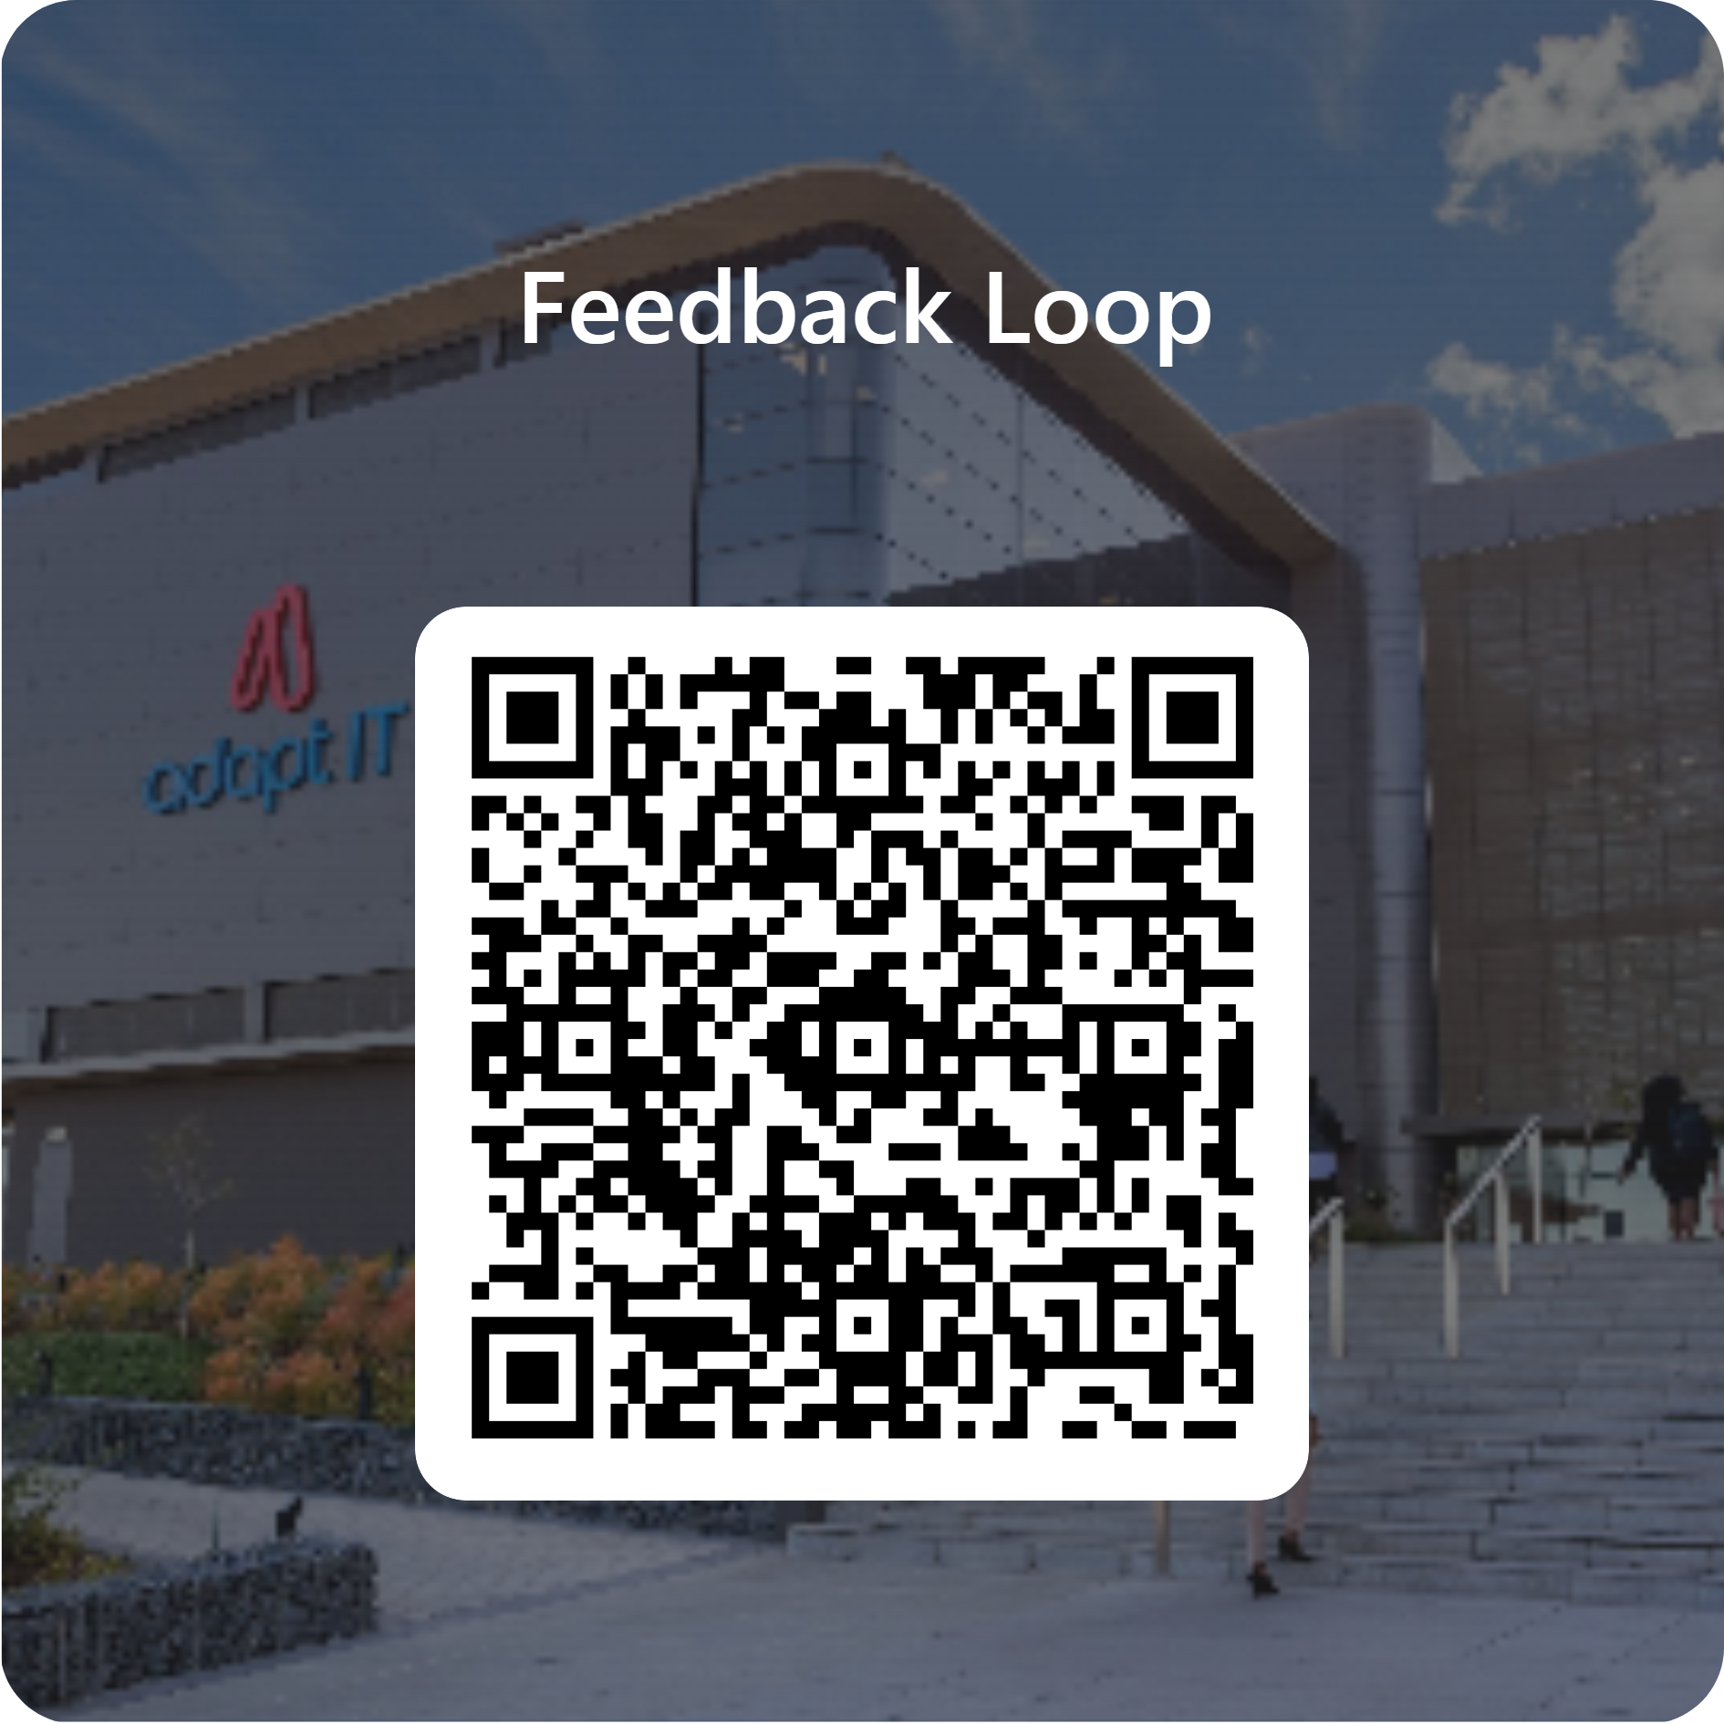
Feedback

