Slide 1

Securing the Future of ITS Integrator
Moving from Browser-Based Applets to Java Web Start
ITSUG 2026 – Session 72

Slide 2

DISCLAIMER
This presentation is only a summary of some of Adapt IT’s products, features and their latest developments. Adapt IT only intends for the information to give you an overview, and not a complete and comprehensive statement that necessarily suits your purposes.
Adapt IT reserves the right to change any information contained in this presentation and is not responsible for any loss that results from inaccuracies in the information. You may not distribute or reproduce the information without Adapt IT’s written permission.

Slide 3
TABLE OF CONTENT
Introduction
Why the Change is Necessary
Current Architecture (Java Applets)
Technology Architecture Evolution
What is Java Web Start?
Oracle Forms 12c & Java Web Start
Security Architecture Improvements
Technology Compatibility
Testing & Validation
Impact on Institutions
System Requirements
Risks and Considerations
Jasper Reports Compatibility
Implementation Approach
Technology Roadmap
Preparing for the Transition
Support
Conclusion

Slide 4
Presentation Synopsis
With Build 88 released in 2024, Adapt IT introduced support for Oracle Java Web Start (JWS) as part of the ITS Integrator modernisation programme. Many institutions have already adopted JWS, while others are in the process of transitioning from legacy browser-based Java Applets. This session highlights how the move delivers a safer, faster, and future-ready ITS Integrator with minimal disruption, and why now is the right time for institutions to make the transition.

Slide 5
Introduction
Modern web technologies are evolving rapidly, and legacy browser plugins are being phased out across the industry. Java Applets, once widely used to run enterprise applications within browsers, are no longer supported by modern browsers due to security vulnerabilities.
To ensure the continued security, reliability, and sustainability of the ITS Integrator platform, Adapt IT introduced Oracle Java Web Start as part of ITS Integrator Build 88 (2024) to modernise the platform and remove dependency on browser-based Java Applets.

Slide 6
Presentation Overview
This session will cover:
Why Java Applets are being retired
Limitations of the current browser-based approach
What Java Web Start is and how it works
Security and technology improvements
Impact on institutions and users
Implementation considerations
Adapt IT’s rollout plan

Slide 7
Why the Change Is Necessary
Modern browsers have permanently removed support for Java Applets due to security vulnerabilities and architectural limitations.
Institutions have been able to temporarily continue using Oracle Forms through Microsoft Edge Internet Explorer compatibility mode, but this approach is no longer sustainable.
The industry is moving toward plugin-free browser architectures, requiring modern alternatives.

Slide 8
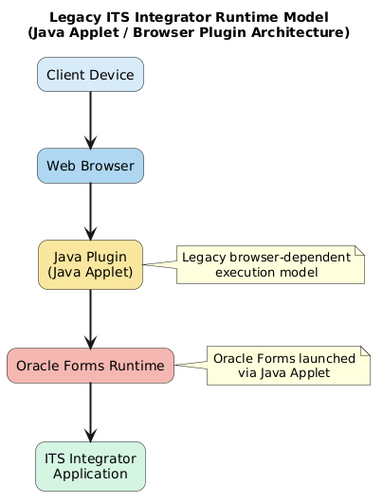
Old Architecture (Java Applets)
Challenges
Dependence on legacy browser plugins
Increasing security risks
Limited compatibility with modern browsers
Difficult to maintain in enterprise environments
Legacy ITS Integrator architecture relied on browser-embedded Java Applets to launch Oracle Forms.

Slide 9
Technology Architecture Evolution
The ITS Integrator is transitioning from browser-embedded Java execution to desktop-based Java application launch using Java Web Start.
Java Web Start launches Oracle Forms outside the browser, eliminating legacy plugin dependencies.
Key Improvements
Browser independence
Reduced security exposure
Improved stability and performance

Slide 10
What is Java Web Start?
Oracle Forms 12c & Java Web Start
Java Web Start is natively supported in Oracle Forms 12c, making it the recommended approach for modern Oracle Forms environments.
Key Advantages
  Native Oracle Forms support
  Eliminates browser plugin dependency
  Compatible with modern browsers
  Aligns with Oracle’s recommended architecture
  Supports long-term platform sustainability
Java Web Start is a technology that enables Java applications to be downloaded and executed directly on the client machine.
Instead of running inside the browser, the application launches through a JNLP configuration file, allowing Java applications to run securely through the Java Runtime Environment (JRE).
This eliminates the need for browser plugins.

Slide 11
Security Architecture Improvements & Technology Compatibility
The transition to Java Web Start significantly improves the security posture of the ITS Integrator platform.
Security Enhancements
Removal of browser-based Java plugins
Execution within controlled Java Runtime Environment
Signed JAR files with trusted certificates
Reduced browser attack surface
Improved compliance with enterprise security standards
This approach creates a more secure and controlled application runtime environment.
Moving to Java Web Start ensures the platform remains compatible with modern technologies.
Benefits
Compatibility with Chromium-based browsers
Alignment with Oracle Forms 12c architecture
Improved platform stability
Support for future technology upgrades
Reduced reliance on legacy technologies

Slide 12
Testing & Validation
Adapt IT conducted extensive testing to ensure stable execution of Oracle Forms applications through Java Web Start.
Tested Java Runtime Versions
  Java 8 Update 381
  Java 8 Update 351
  Java 8 Update 261
Testing Results
  Stable application launch through JWS
  Consistent runtime behaviour across environments
  Reliable Oracle Forms execution

Slide 13
Impact on Your Institution
For most institutions, the impact will be minimal. Some institutions are already operating successfully on Java Web Start, while others are currently planning or executing their transition.
What Will Change
Oracle Forms will launch using Java Web Start
Users will no longer rely on Edge IE compatibility mode
Applications will launch from the desktop environment
Users typically adjust quickly to the new launch process.

Slide 14
System Requirements
To use Java Web Start successfully, client machines must have:
Java Runtime Environment (JRE) 1.8 installed
Correct Java security settings configured
Recommended Configuration
Deploy both 32-bit and 64-bit JRE
Configure Java settings through IT policies or group policy deployment

Slide 15
Risks & Considerations
Environment Consistency
Java Web Start and Edge IE Mode cannot operate simultaneously in the same environment.
Institutions must transition the environment fully to Java Web Start.
Reversion Scenario
Should an institution need to revert to Edge IE mode, the application can be redeployed with approximately two hours of downtime.

Slide 16
Jasper Reports Consideration
Institutions using JasperReports 8 embedded reports must also consider browser compatibility.
Key point:
Edge IE Mode cannot reliably render embedded Jasper reports.
Moving to modern browsers and Java Web Start ensures continued compatibility.

Slide 17
Implementation Approach
Implementation Plan
Adapt IT will support institutions through the transition with:
Detailed technical documentation
Configuration guidelines
Recommended implementation practices
Support from Adapt IT deployment engineers
This approach ensures a smooth and controlled migration.
Implementation Timeline
The transition will be introduced as part of:
ITS Integrator Build 88
Implementation Timeline:
Build 88 (2024) introduced Java Web Start support in ITS Integrator
Several institutions have already transitioned to JWS
Additional institutions are currently migrating from Java Applets
Adapt IT continues to support institutions as they complete the transition

Slide 18
Technology Roadmap
The transition to Java Web Start is part of a broader strategy to modernise the ITS Integrator platform.
Strategic Direction
Elimination of legacy browser dependencies
Improved platform security
Adoption of modern enterprise technologies
Enhanced reporting capabilities
Long-term system sustainability
This roadmap ensures ITS Integrator remains a future-ready enterprise platform.

Slide 19
Preparing for the Transition
Institutions that have not yet transitioned should prepare by:
Reviewing the transition documentation
Verifying Java installations on client machines
Planning internal IT rollout strategies
Communicating changes to end users
Early preparation will ensure a smooth migration.

Slide 20
Support
Adapt IT will provide ongoing support throughout the transition.
Support Channels
Adapt IT Deployment Team
Adapt IT Technical Support
Institutions will receive technical guidance and assistance throughout the implementation process.

Slide 21
Why This Matters for Higher Education Institutions
Higher education institutions rely on stable, secure, and sustainable technology platforms to support critical academic and administrative operations. The transition from Java Applets to Java Web Start ensures that the ITS Integrator platform continues to operate reliably in modern technology environments.

Slide 22
Why This Matters for Higher Education Institutions
Strategic Benefits for Institutions
Improved Security
Eliminates legacy browser plugins that introduce security vulnerabilities.
Technology Sustainability
Ensures compatibility with modern browsers and evolving enterprise environments.
Operational Stability
Reduces reliance on browser-specific configurations such as IE compatibility mode.
Future Readiness
Positions institutions to adopt upcoming platform improvements and reporting technologies.
Reduced IT Complexity
Simplifies deployment and runtime management for institutional IT teams.

Slide 23
Conclusion
The transition from Java Applets to Java Web Start represents an important milestone in the evolution of the ITS Integrator platform.
Key Outcomes
Improved security
Compatibility with modern technologies
Reduced reliance on legacy browsers
Greater platform stability
This change ensures ITS Integrator remains secure, reliable, and ready for the future.

Slide 24
Questions & Discussion

Slide 25
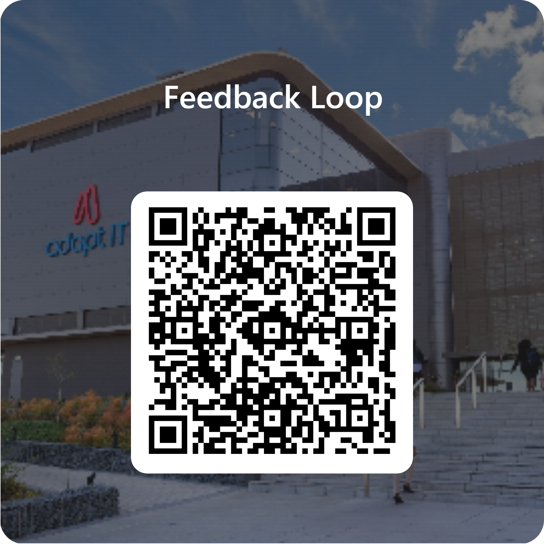
Feedback

