Slide 1

DETERMINANTS INFLUENCING FIRST-YEAR STUDENTS’ ACADEMIC PROGRAMME CHOICES IN SOUTH AFRICAN UNIVERSITIES.
Presenter: Ms Felicity Mathye

Slide 2
Introduction
Study choice is a critical decision for first-year students.
Quality education is central to Sustainable Development Goal 4 (SDG 4) (United Nations, 2023).
SDG 4 aims to "ensure inclusive and equitable quality education and promote lifelong learning opportunities for all" by 2030.
Higher education drives economic growth, innovation, and social mobility (World Bank, 2022; UNESCO, 2023).
Study choice is shaped by aspirations, identity, and structural constraints.
Parental influence remains significant in educational decision-making.
The study investigates parental influence within a South African context.

Slide 3
Aim / Objective of the Study
To understand push factors influencing students’ course selection.
To examine reasons behind course switching among first-year students.
To evaluate the influence of parental guidance on study choices.
To explore how sociocultural and personal factors shape decisions.

Slide 4
Literature Review
Institutional reputation and employability influence student choice (Altbach & de Wit, 2021; OECD, 2024).
Socioeconomic background and social capital shape access and decisions (Haltia et al., 2022).
Parental involvement positively correlates with motivation and achievement (Wilder, 2023; Paun, 2024).
Supportive parenting enhances autonomy; controlling styles reduce motivation (Vermote et al., 2023).
Digital platforms increasingly mediate educational decision-making (UNESCO, 2025; Marginson, 2024).

Slide 5
Methodology
Mixed-method approach (qualitative and quantitative).
Purposive sampling of first-year students (Faculties of Management & Law, Humanities).
Data collected via online questionnaire (student email system).
Sample size: 205 respondents.
Analysis: Descriptive statistics (percentages) and interpretative qualitative analysis.

Slide 6
Demographic Overview
Predominantly aged 18–24 (99%).
Female majority (55.1%).
98.5% Black/African students.
Majority from Limpopo (67.3%).
Moderate parental influence most common response.
High willingness to change study choice.

Slide 7
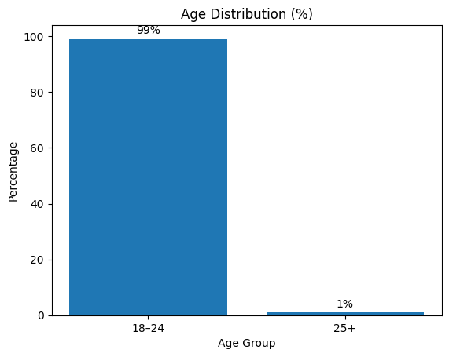
Age Distribution

Slide 8
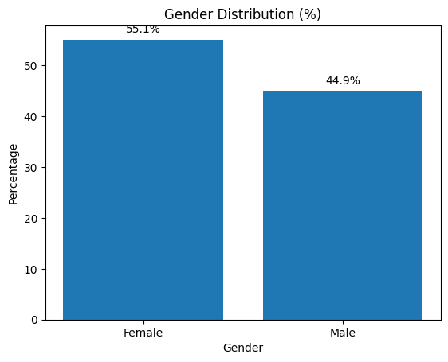
Gender Distribution

Slide 9
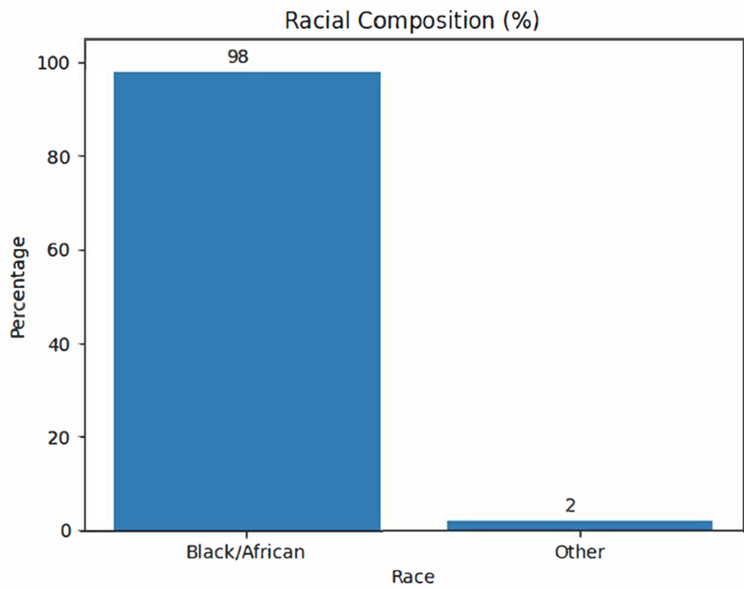
Racial Composition

Slide 10
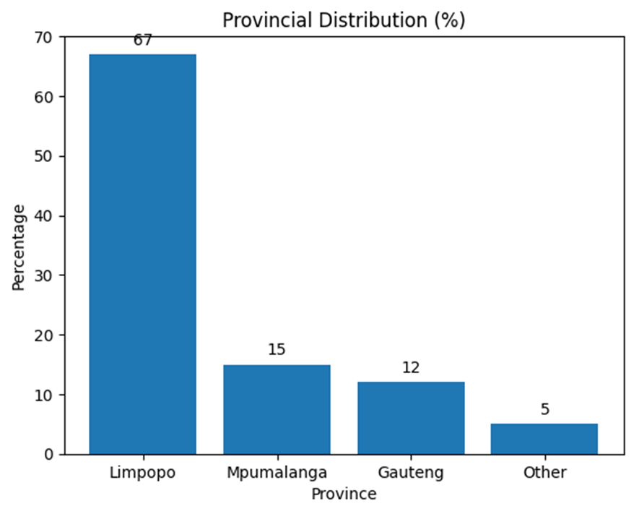
Provincial Distribution

Slide 11
Results
Majority aged 18–24; predominantly Black/African students.
Most respondents reported moderate parental influence ('Somewhat’).
Supportive parental guidance enhances confidence and alignment.
High willingness to change study choice reflects evolving academic identity.
Institutional preference influenced by affordability, proximity, and reputation.

Slide 12
Practical Implications for Student Administrators
Using ERP (Enterprise Resource Planning) tools to strengthen mentoring and advising
Improve career guidance and parental involvement (communication tools - keeping parents and guardians informed and involved in students’ academic journeys)
Identify and address socioeconomic challenges (Utilise ERP systems to monitor financial aid, registration trends, and student support needs, enabling administrators to intervene early and improve student access, retention, and success.)
Support informed and autonomous study choices
Design effective orientation programmes that minimise unnecessary course-switching

Slide 13
Originality / Contribution
Provides context-specific evidence from a South African regional institution.
Highlights interplay between parental influence and student autonomy.
Contributes to policy development and student support strategies.
Leverages ERP data for student success
Offers insights for curriculum planning and institutional communication (enabling institutions to better align academic programmes with student expectations and career pathways)
Aligns student support strategies with digital transformation in higher education, demonstrating how ERP systems can drive institutional progress

Slide 14
Conclusion
Parental influence plays a notable role in study choice.
Promote student autonomy in decision-making.
Encourage joint parent-student career counselling sessions.
Provide structured institutional career support.
Use ERP data to strengthen academic advising.
Digital systems enable early student support interventions.
Data-driven orientation can reduce course-switching.
ERP innovation improves student decision-making and success.

Slide 15
“Take-home message”
Combining informed parental support, empowered student autonomy, and data-driven ERP systems enables universities to guide students toward better study choices, stronger academic success, and improved institutional outcomes in the digital era.

Slide 16
References
Altbach, P. G., & de Wit, H. (2021). The global landscape of higher education: Competition, cooperation and challenges. International Higher Education, 106, 3–5.
Callender, C., & Melis, G. (2022). The privilege of choice: How prospective college students’ financial concerns influence their choice of higher education institution and subject of study in England. The Journal of Higher Education, 93(3), 477–501.
Haltia, N., Isopahkala-Bouret, U., & Jauhiainen, A. (2022). The vocational route to higher education in Finland: Students’ backgrounds, choices and study experiences. European Educational Research Journal, 21(3), 541–558.
Marongwe, N., & Mutesasira, G. (2024). Harnessing parental involvement and educational equity for sustainable development in South African schools. Interdisciplinary Journal of Sociality Studies, 4, 1–15.
OECD. (2024). Education at a Glance 2024: OECD Indicators. OECD Publishing.
UNESCO. (2025). Global Education Monitoring Report 2025: Pathways to Higher Education – Equity, Access and Success. Paris: UNESCO.
Vermote, B., Soenens, B., Vansteenkiste, M., Coenye, J., Verschueren, K., & Beyers, W. (2023). The role of parental involvement and authentic inner compass in study choice processes. Journal of Adolescence, 95(8), 1749–1763.
World Bank. (2022). World Development Report 2022: The Role of Education in Economic Transformation. Washington, DC: World Bank.

Slide 17
THANK YOU

