Slide 1

Accelerating Institutional Growth Through Digital Innovation
Matshele Molaoli: Instructional Designer

Slide 2

DISCLAIMER
This presentation is only a summary of some of Adapt IT’s products, features and their latest developments. Adapt IT only intends for the information to give you an overview, and not a complete and comprehensive statement that necessarily suits your purposes.
Adapt IT reserves the right to change any information contained in this presentation and is not responsible for any loss that results from inaccuracies in the information. You may not distribute or reproduce the information without Adapt IT’s written permission.

Slide 3
TABLE OF CONTENT
What Is Instructional Design
The Confluence of Design Methodologies
Core Design Principles
Adapt IT Academy Learning Hub
Scaling Learning Through AI-Powered Videos
BIWA Business Case: Design As the Differentiator
The Adapt IT Academy: Hassle Premium
Designing The Future of Learning

Slide 4
Instructional design is not about delivering information; it’s about designing experiences that transform learners into confident, capable contributors.” — ITD World
Notes:
Today, I’ll show how we can anchor ERP transformation in human-centered learning experiences, through the Adapt IT Academy and our Learning by Design approach to ensure adoption, engagement, and long-term impact.
Institutions are under pressure to modernise and remain competitive in the digital era.
ERP systems provide the backbone for integration, efficiency, and transparency.
Yet, technology alone does not guarantee progress, adoption depends on people.
Instructional Design ensures ERP innovation is accessible, engaging, and sustainable.
Focus point: Tools like Synthesia enable scalable, personalised learning experiences that keep pace with ERP evolution.
Learning by Design transforms ERP rollouts into cultural shifts that drive long-term institutional growth.

Slide 5
What Is Instructional Design?
Aligns content, delivery, and learner needs for maximum impact.
A systematic approach to creating effective, engaging learning experiences.
Moves beyond “training” to design transformative learning journeys.

Slide 6
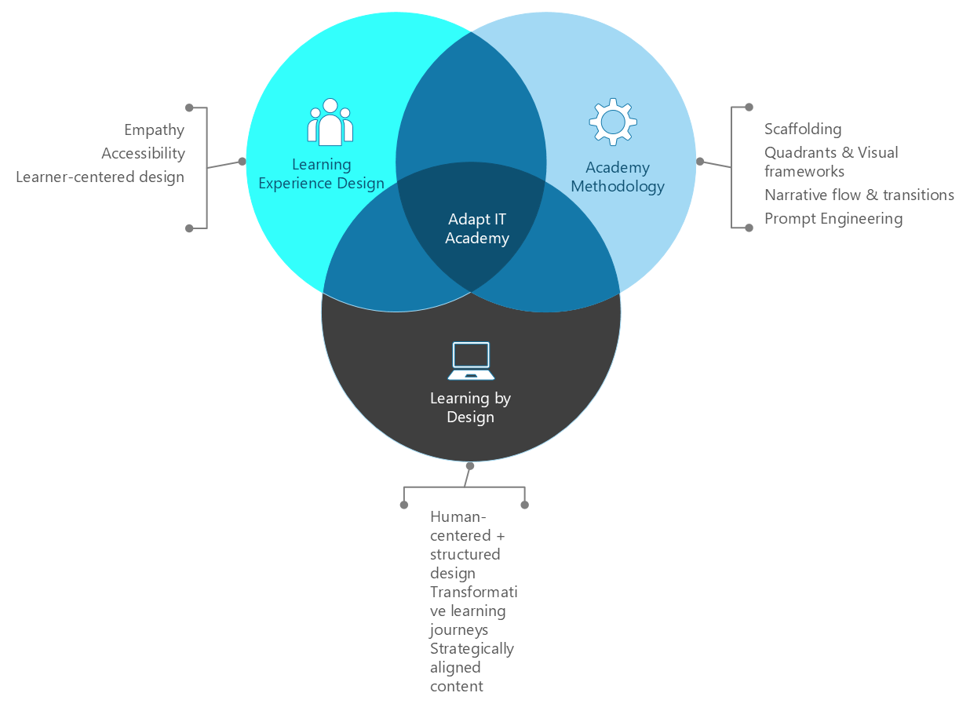
The Confluence of Design Methodologies

Slide 7
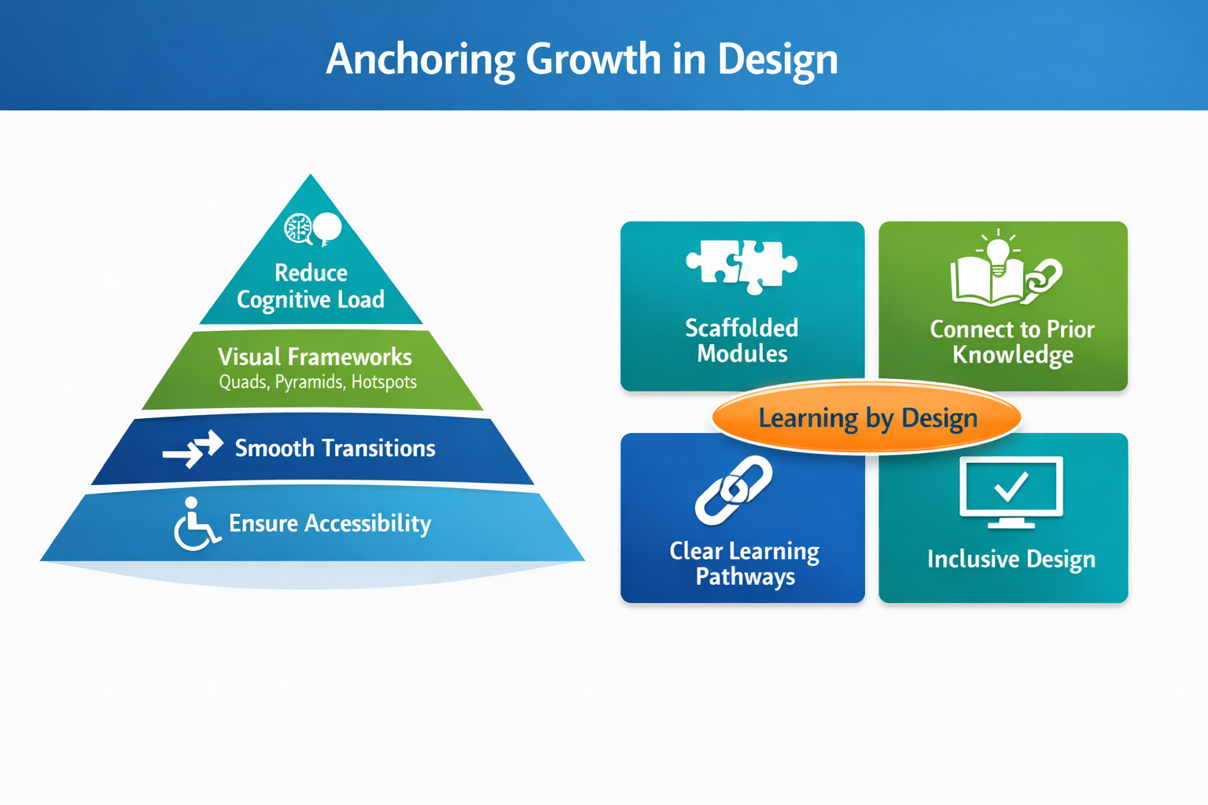
Core Design Principles
Break complex systems into digestible, learner-friendly chunks
Use plain language, progressive disclosure, and visual cues to guide attention
Minimise unnecessary information to reduce overwhelm and increase retention
Design for clarity, not just completeness
Help learners “see” relationships, hierarchies, and workflows
Use colour coding and consistent iconography to reinforce meaning
Connect new concepts to prior knowledge using narrative flow
Use transitional cues (“Now that you’ve seen X, let’s explore Y”) to guide progression
Avoid abrupt shifts, learners need continuity to build mental models
Design modules like stories: each section builds on the last
Use alt text, captions, keyboard navigation, and screen reader compatibility
Choose fonts, contrast, and layouts that support readability and focus
Accessibility isn’t a feature, it’s foundational to inclusive learning

Slide 8
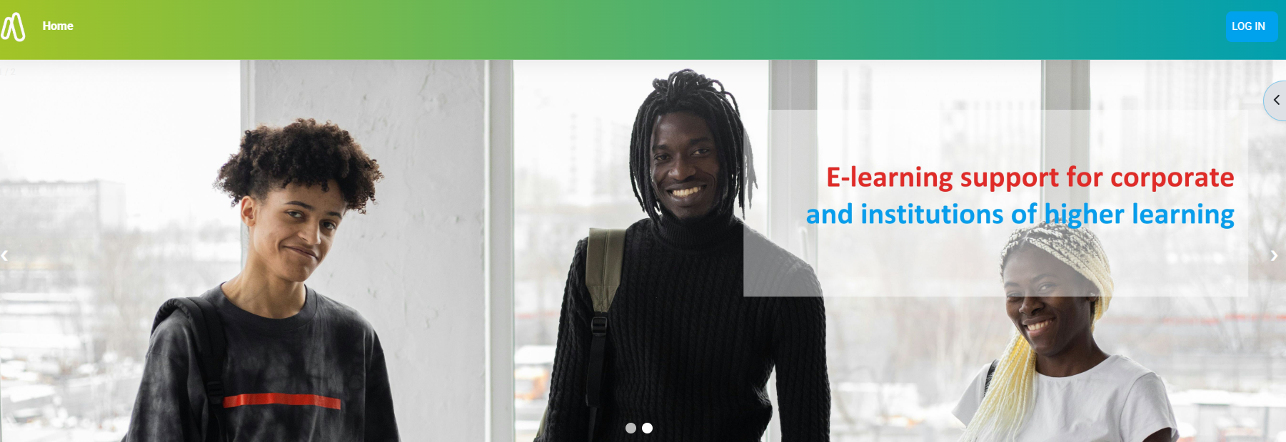

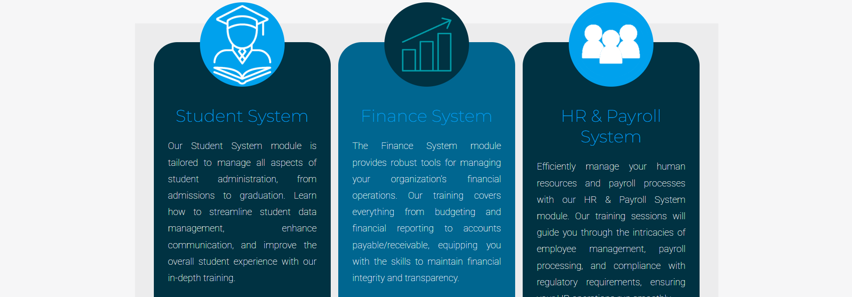
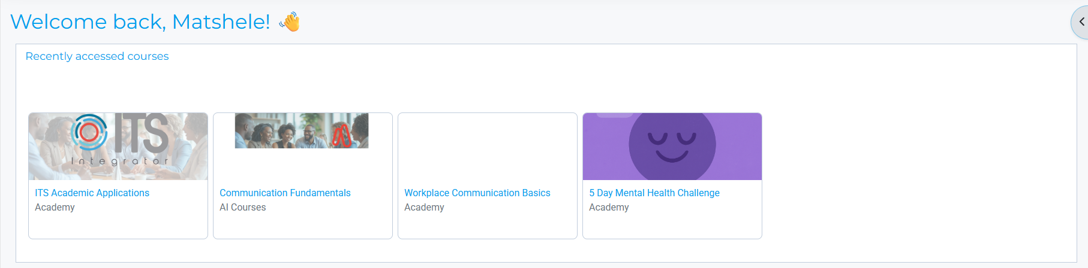
Adapt IT Academy Learning Hub

Slide 9
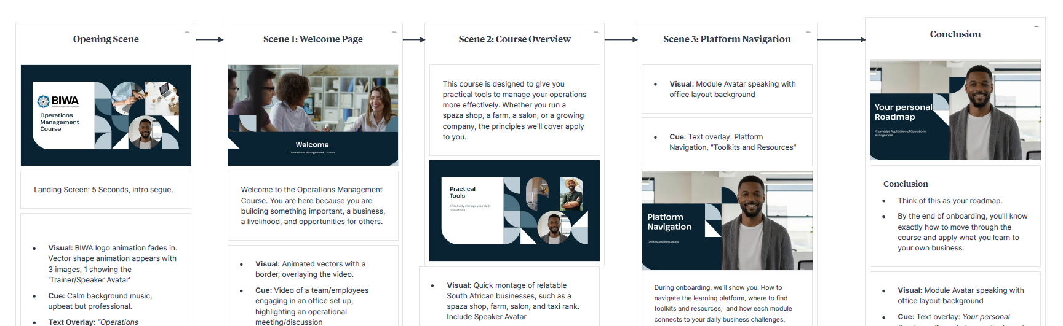
Scaling Learning Through AI-Powered Videos

Slide 10
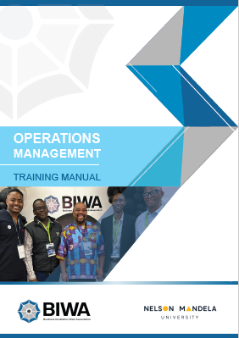
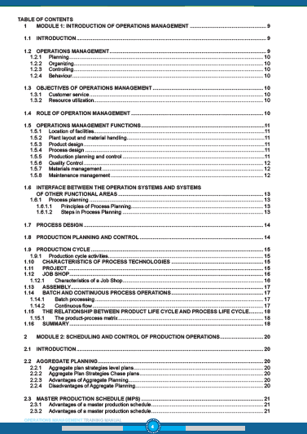
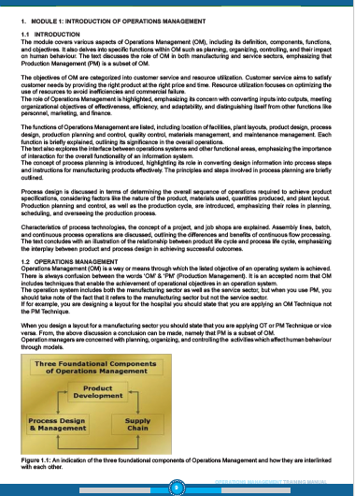
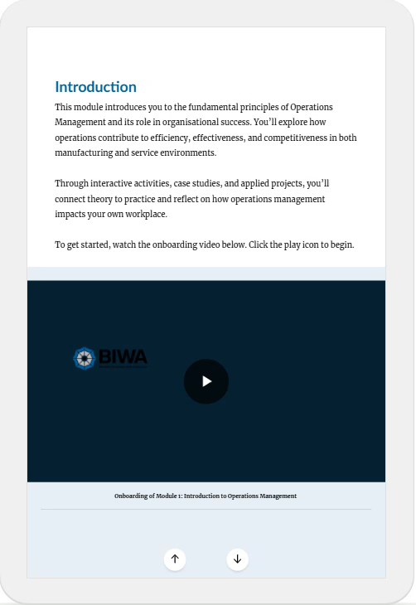
BIWA Business Case: Design As the Differentiator
Raw Content
Content Applicability, Objectives, Outcomes, Content Flow, Clear Pathways for Learning, Competency
SCORM Package: Course/Module

Slide 11
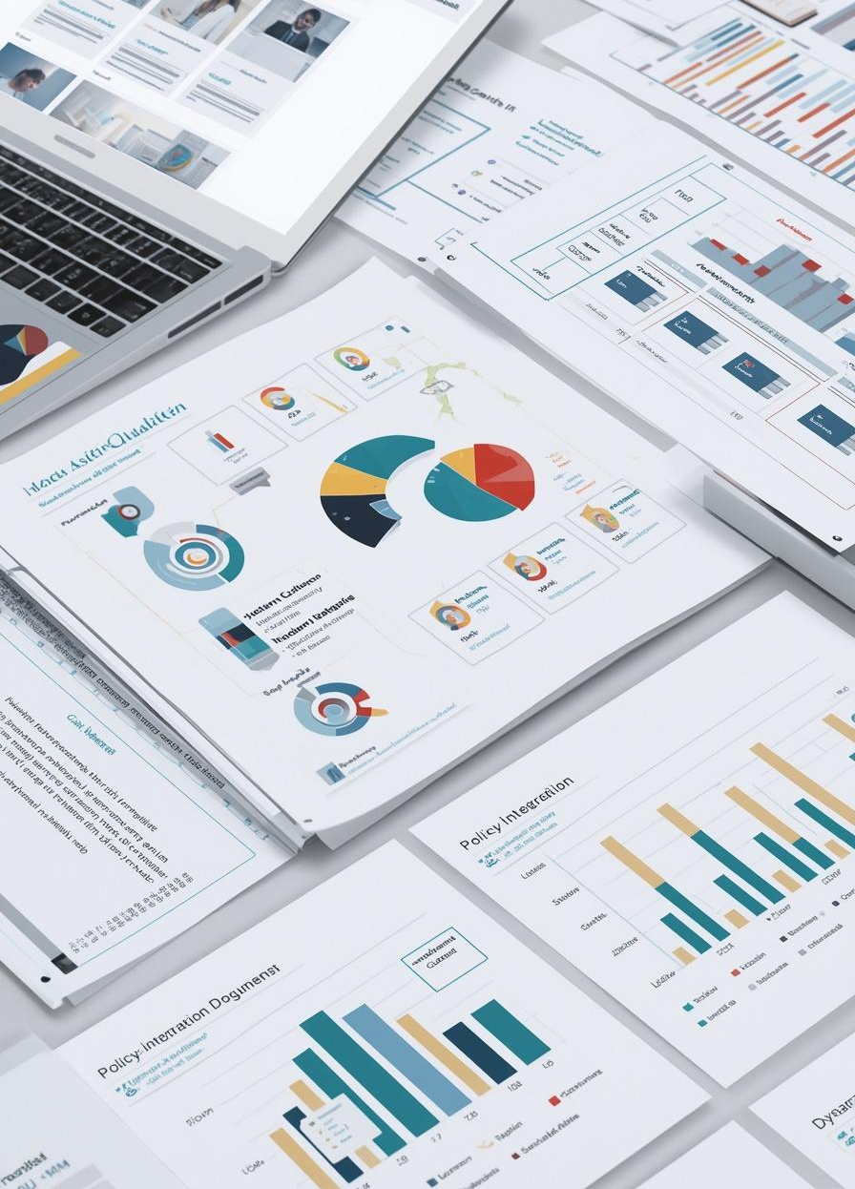
The Adapt IT Academy: Hassle Premium
We remove friction from digital learning: Our instructional design eliminates overwhelm, confusion, and resistance, the biggest hassles in tech adoption.
We transform complexity into clarity: Dense ERP workflows, modules, and compliance content become intuitive, scaffolded learning journeys.
We save time, energy, and support costs: Learners onboard faster, ask fewer questions, and engage more deeply, because the design does the heavy lifting.
We deliver emotional relief: Our content feels calm, clear, and empowering. That’s the premium: not just knowledge, but confidence.
We use premium tools to deliver premium relief. Our AI Powered development tools allow us to scale this clarity across institutions, with consistency, personalisation, and elegance.

Slide 12


Designing The Future of Learning
Design → Empower → Transform.

Slide 13
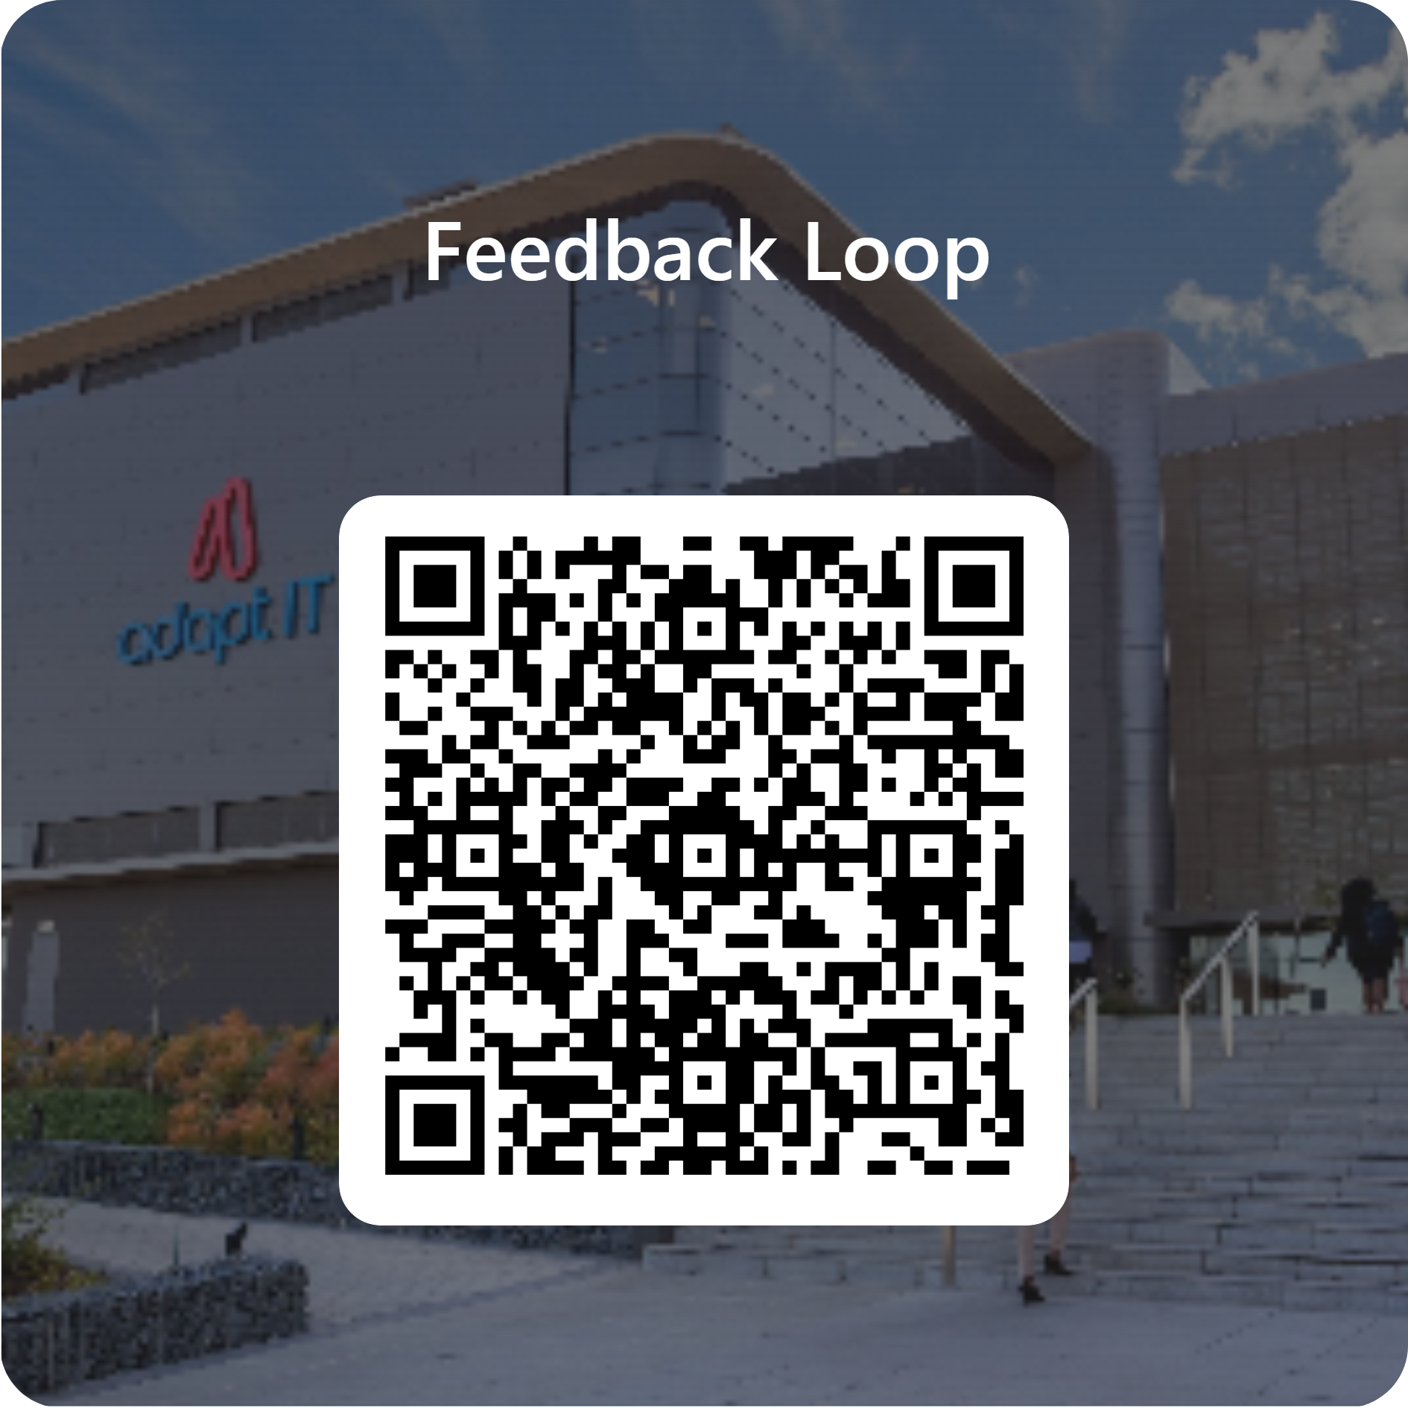
Feedback

