Slide 1

Student enhancements
Modernising WIL: From Compliance to Value
Learner Profiler / PACE Integration: Unlocking Learner Potential Through Integration
Digitisation of Proof of Registration Signatures
Session 79
Presenter: Linda Putu & Desiree Makofane

Slide 2

DISCLAIMER
This presentation is only a summary of some of Adapt IT’s products, features and their latest developments. Adapt IT only intends for the information to give you an overview, and not a complete and comprehensive statement that necessarily suits your purposes.
Adapt IT reserves the right to change any information contained in this presentation and is not responsible for any loss that results from inaccuracies in the information. You may not distribute or reproduce the information without Adapt IT’s written permission.

Slide 3
TABLE OF CONTENT
Modernising WIL: From Compliance to Value
Learner Profiler / PACE Integration: Unlocking Learner Potential Through Integration
Digitisation of Proof of Registration Signatures

Slide 4
Work Integrated Learning (WIL)

Slide 5
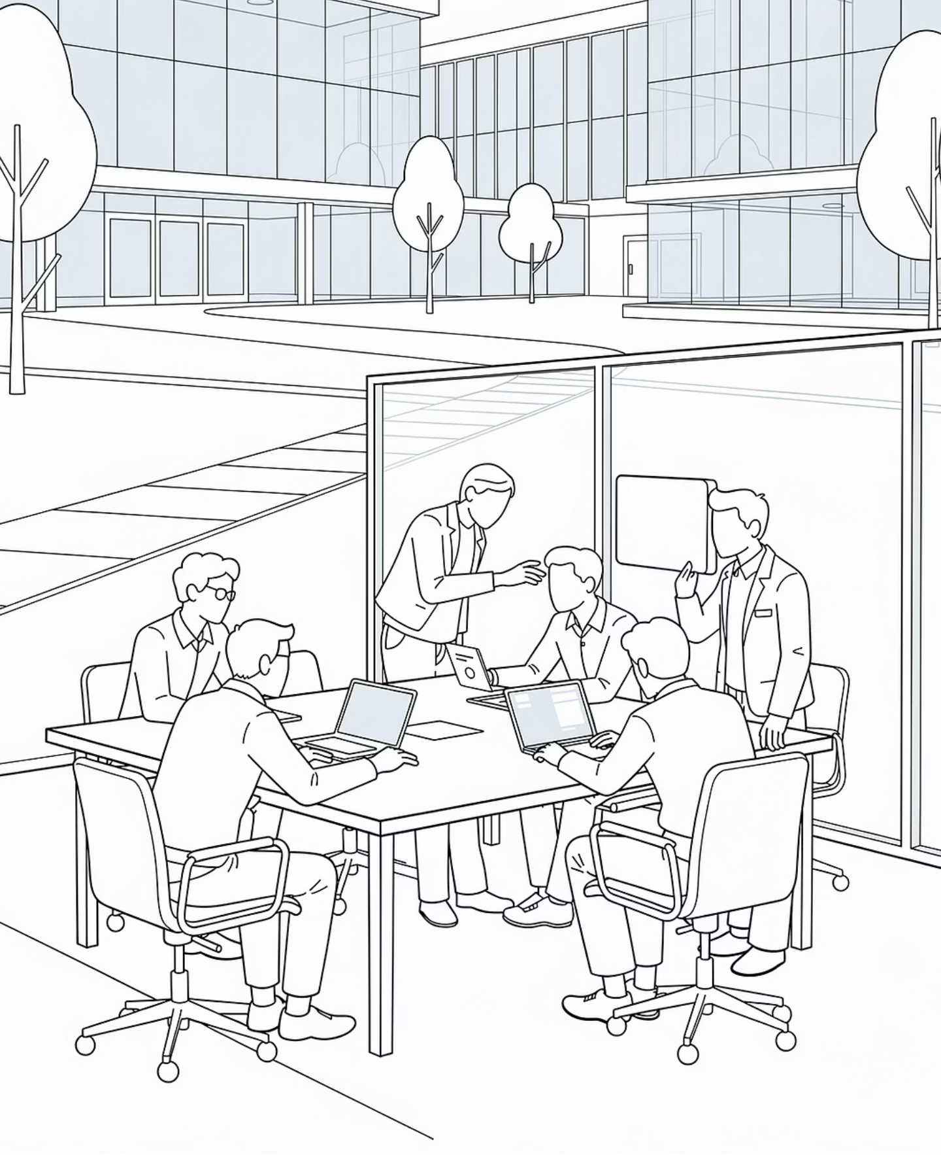
Work Integrated Learning (WIL) Capability Now Available
ITS is proud to announce that the Work Integrated Learning (WIL) Graduation Integration has been successfully developed and is now ready for deployment across TVET client institutions. This marks a significant milestone in the ITS Student System's ability to support the complete qualification journey.
NEW CAPABILITY
ITS STUDENT SYSTEM

Slide 6




What WIL Graduation Integration Delivers
This enhancement empowers TVET institutions to manage the complete pathway from academic completion to qualification award within a single integrated system — eliminating manual gaps and fragmented processes.
Academic + Workplace Integration
POE Submission Management
Seamlessly link academic completion records with workplace learning outcomes in one unified platform.
Enable students to upload and manage their Portfolio of Evidence directly through the ITS system.
Evaluation & Approval Tracking
Automatic Graduation Records
Route departmental reviews and approvals through a structured, trackable workflow process.
Graduation records are generated automatically once all WIL requirements have been fully satisfied.

Slide 7
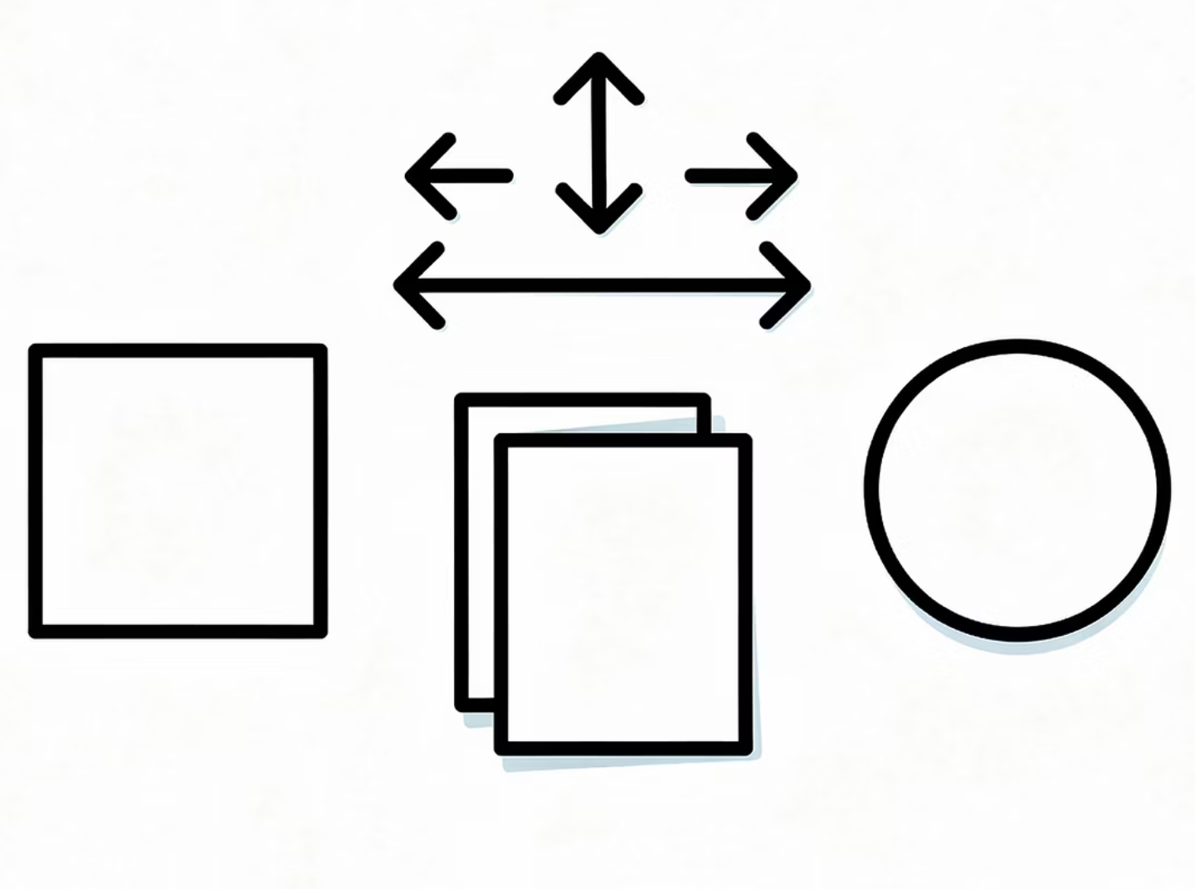
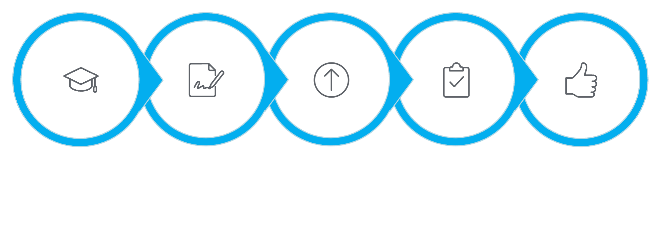





Current WIL Process Supported in ITS
The ITS Student System already supports a structured, end-to-end WIL graduation workflow. Each step is tracked within the system to ensure consistent evaluation before a final qualification is awarded.
Qualify
Request
Upload POE
Review
Approve
This structured workflow ensures that workplace learning is formally evaluated and recorded before a student's graduation record is processed — bringing consistency and accountability to the qualification award process.

Slide 8
Next Phase: Enhancing the WIL Lifecycle
While the core WIL Graduation functionality is live and available, ITS is continuing to invest in a fuller WIL management lifecycle — extending system support from initial placement through to final graduation.
What's Coming Next
Planned Enhancements
The next development phase will introduce additional business processes to support placement management and real-time monitoring of students throughout their practical period.
Interview & Placement Management — structured allocation workflows
Timesheet Submissions — workplace hour tracking and monitoring
Reporting Dashboards — institutional oversight via Jasper Reports

Slide 9
Interview Management Process
ENHANCEMENT 1
A new Interview Management Process will be introduced immediately after a student submits their WIL Service Request. This ensures that placement allocation is preceded by a formal, system-tracked interview stage — bringing structure and accountability to the process.
Schedule Placement Interviews
Manage Interview Outcomes
Institutions can schedule and manage interviews with prospective workplace partners, all tracked within the ITS system.
Record and store interview results, enabling departments to make informed placement decisions based on documented outcomes.
Automated Email Notifications
Workplace Placement Allocation
Approval routing is handled through automated email notifications, reducing manual follow-up and accelerating the process.
Upon a successful interview, students are formally allocated to a workplace placement — ensuring a structured path to WIL registration.

Slide 10


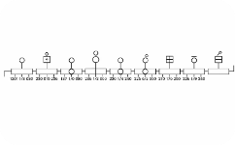
WIL Registration & Placement Capture
ENHANCEMENT 2
Following successful interviews and formal placement allocation, institutions will be able to register students for Work Integrated Learning within the ITS system — creating an official, traceable record of every placement.
Formal WIL Registration
Placement Information Capture
WIL Period Tracking
Students are officially registered for WIL within the system following confirmed placement — ensuring compliance with institutional and DHET requirements.
The system tracks WIL start and completion dates, giving institutions full visibility of each student's practical learning timeline.
Employer details, placement dates, and workplace contact information are captured and linked directly to the student's profile.

Slide 11

Student Timesheet Submission & Monitoring
ENHANCEMENT 3
To support ongoing oversight of student workplace activity, ITS will introduce a Timesheet Submission process within the system. This gives both students and institutions a structured mechanism to record, review, and validate workplace hours throughout the WIL period.
For Students
For Institutions
Submit timesheets directly through the ITS system
Record daily or weekly workplace hours completed
Track cumulative progress toward the required WIL duration
Review all submitted timesheets in one place
Approve submissions or request corrections from students
Maintain a complete, auditable record of workplace participation
Timesheet monitoring provides institutions with the evidence trail needed to validate workplace learning hours ahead of POE submission and final graduation processing.

Slide 12
WIL Status Reporting via Jasper Reports
ENHANCEMENT 4
To support institutional oversight at every stage of the WIL journey, ITS will introduce Jasper Reports for comprehensive WIL tracking. Administrators will have real-time visibility into student progress across all stages of the WIL lifecycle.
Placement Pipeline
Interview Outcomes
View students currently awaiting placement allocation and interview scheduling.
Track results of all placement interviews across departments and cohorts.
WIL Registration Status
Timesheet Progress
Monitor which students are formally registered and actively placed in workplaces.
Track hour submissions and identify students who may be falling behind on reporting.
POE Submission Status
Graduation Readiness
View outstanding and submitted POEs, including evaluation and approval status.
Identify students who have met all requirements and are cleared for graduation processing.

Slide 13

The Complete WIL Lifecycle in ITS
With all enhancements in place, the ITS Student System will provide end-to-end management of Work Integrated Learning — from initial student request through to final qualification award — within a single, integrated platform.
WIL Request
Student submits WIL Service Request to begin the process
Interview Process
Placement interviews scheduled, conducted, and outcomes recorded
Placement Allocation
Student formally allocated and registered for workplace learning
Timesheet Monitoring
Ongoing workplace hours captured, reviewed, and approved
POE Submission
Portfolio of Evidence submitted, reviewed, and approved
Graduation Processing
All requirements met — qualification record automatically generated
Key Outcome: Institutions can now manage both academic learning and workplace experience within a single integrated system — reducing manual effort, improving compliance, and supporting every student on their path to qualification.

Slide 14
Learner Profile & PACE Integration

Slide 15

Learner Profile & PACE Integration
Enhancing student insights from the application stage — platform capability update for institutional product managers and implementation teams.
DEVELOPMENT COMPLETE · TESTING IN PROGRESS

Slide 16




Enhancing Student Insights from Application Stage
CHAPTER 1 — LEARNER PROFILE & PACE
The Learner Profile & PACE Integration capability has been developed and is currently in system testing. It enables institutions to build a richer picture of each learner from the moment they apply — not just once they enrol.
External Assessment Data
360° Learner Profile
Capture learner capability scores from third-party assessment platforms at the point of application.
Aggregate assessment results into a holistic learner profile that travels with the student through their journey.
Programme Suitability Analysis
Data-Driven Student Support
Enable academic staff to evaluate whether a student's profile aligns with programme requirements before registration.
Equip support teams with early insight to design targeted interventions and reduce misaligned enrolments.

Slide 17

Integration with External Assessment Platforms
The solution supports two distinct integration interfaces for retrieving learner capability data from third-party assessment systems. Institutions will activate only one interface depending on their assessment platform of choice.
LearnerProfiler Interface
PACE / GoStudy Interface
Used by institutions running the LearnerProfiler assessment platform.
Used by institutions running the GoStudy assessment platform.
stud.izkpkg.getLearnerProfiles
stud.izypkg.getGoStudyInfo
Also executed through the same {BATCH-9} scheduled batch process, with a configurable start date parameter.
Data is retrieved via a scheduled batch process executed through {BATCH-9}.
Both interfaces share the same batch execution mechanism. Only one should be active per institution.

Slide 18
Assessment Data Processing & Validation
The integration extracts learner assessment information from third-party systems and validates the data before loading it into ITS. Key differences exist between the two interfaces in how historical data is managed.
PACE Interface — Extraction Behaviour
LearnerProfiler API — Extraction Behaviour
Extracts all available assessment records for the institution
No period restrictions applied during extraction
Responsibility lies with the third-party system to filter historical records
Requires a start date parameter to scope the extraction window
Prevents unnecessary extraction of historical assessment records
Institutions may update this start date annually to control data volume
Configuration for the extraction start date is maintained in: {GCS2-18} DEVAOA / ExtractFrom

Slide 19




Student Matching Logic
Once assessment data is received from the third-party system, the platform applies a structured matching process to link each assessment record to the correct student. The logic follows a two-step lookup with a defined fallback.
Check Enrolments
Check Applications
Apply Fallback
This structured fallback logic ensures data integrity is maintained even when no direct student match can be established — preventing processing errors while retaining the assessment record for future reconciliation.

Slide 20

Student Access via iEnabler Portal
Students can access their learner profile resources and external assessment tools directly through the iEnabler self-service portal. Institutions configure a web link that is surfaced to the student within the portal interface.
Configuration Reference
Use Cases for the LOGINURL
Portal configuration is maintained in:
Redirect students to external assessment platforms for self-assessment
Provide access to learner profiling tools and results
Launch integrated assessment portals from within iEnabler
{GS2-18} PACE / ATTR / ENV
The LOGINURL parameter defines the link displayed to the student.
This approach keeps the student experience seamless and centralised without requiring separate logins to external systems.

Slide 21
Reporting & Analytics — Jasper Domain Views
Learner profile data is exposed through Jasper Domain Views, enabling institutional reporting teams to build custom reports on assessment outcomes, student capabilities, and programme suitability insights.
1
2
PACE / GoStudy Reporting Domain
LearnerProfiler Reporting Domain
DM_STUDPERSINFO_12PACELearnerProfileInfo
DM_STUDPERSINFO_11LearnerProfilerInfo
Supports reporting on GoStudy assessment outcomes and learner profile indicators for students processed through the PACE interface.
Supports reporting on LearnerProfiler assessment data for institutions using the alternative interface.
📊 Assessment Outcomes
🎯 Capability Indicators
📋 Programme Suitability
Report on individual and cohort-level assessment scores.
Surface student capability dimensions for academic review.
Identify alignment between learner profiles and programme requirements.

Slide 22
Current Status — Testing in Progress
The Learner Profile & PACE Integration capability has completed development and has entered the system testing phase. The following testing activities are currently underway before the capability is made available for client activation.
01
02
Data Extraction Validation
Interface Integration Testing
Verifying that assessment records are correctly extracted from third-party systems via both the PACE and LearnerProfiler interfaces.
End-to-end testing of both batch integration interfaces, including scheduled execution via {BATCH-9}.
03
04
Student Matching Logic Verification
Jasper Reporting Validation
Confirming that enrolment lookups, application record matching, and fallback logic all function correctly across a range of student scenarios.
Testing domain view accuracy and report output against expected learner profile data for both reporting domains.
Following successful completion of testing, the capability will be made available for client activation and configuration.

Slide 23

Strategic Value — Supporting Student Success
The Learner Profile capability is more than a technical integration — it represents a strategic shift toward personalised, data-driven student journeys from the very first point of contact.
Early Student Insight
Better Programme Alignment
Understand learner strengths, gaps, and capabilities before registration, enabling proactive engagement at the application stage.
Match student capability profiles to programme requirements, reducing the risk of misaligned enrolments and improving first-year outcomes.
Improved Student Retention
Equip student support teams with the data they need to design targeted interventions — earlier and more effectively than ever before.

Slide 24
Digital Signature

Slide 25




Exploring Adobe Digital Signature Integration
DIGITAL SIGNATURES
As part of our broader modernisation journey, we are currently engaging with Adobe to explore the integration of industry-standard digital signature capability into the platform. Discussions are ongoing as we evaluate the most suitable approach for our client base.
Digitally Sign Documents
Document Authenticity & Integrity
Enable institutions and students to sign institutional and academic documents electronically, eliminating paper-based approval workflows.
Ensure every signed document is tamper-evident and verifiable, meeting institutional compliance and audit requirements.
Secure Audit Trail
Fully Digital Workflows
Maintain a complete, time-stamped audit trail for all approvals — supporting governance and regulatory obligations.
Support end-to-end digital processes across both academic and administrative functions — from student agreements to staff approvals.
As is often the case when engaging large service providers, the evaluation process has taken longer than initially anticipated. We will communicate progress as discussions advance.

Slide 26
ITS-Native Digital Signature — Alternative Solution
In parallel with the Adobe engagement, we are exploring the development of an ITS-native digital signature capability — a platform-owned solution that avoids dependency on external licensing and delivers the same core functionality at no additional cost to institutions.
Why an ITS-Native Solution?
Planned Capability
No dependency on external vendor licensing models
No additional cost for institutions
Full integration within the modernised platform architecture
Long-term maintainability and roadmap control
Digital signing of institutional and student documents
Secure approval workflows within the platform
Designed to meet the same compliance and integrity standards as third-party solutions
This capability is planned for delivery as part of the Modernisation Programme, with a target release of Q3 2026.

Slide 27



Work Integrated Learning — Upcoming Enhancements
Development of the Work Integrated Learning (WIL) capability continues, with a focus on supporting the full placement lifecycle — from employer engagement through to evidence submission and portfolio tracking.
Interview Workflows
Timesheet Submissions
POE Tracking
Structured interview scheduling and outcome recording between students and prospective placement employers.
Digital timesheet capture for students on placement, enabling supervisors to review and approve hours electronically.
Portfolio of Evidence (POE) tracking to support the collection, review, and sign-off of student workplace evidence.
These enhancements will strengthen employer engagement and provide institutions with a more complete view of the student placement experience — from initial matching through to competency verification.

Slide 28
Current Enhancements & Development Focus
We are progressing several key platform enhancements aimed at strengthening student lifecycle management and institutional digital workflows across three strategic areas.
🎓 PACE & Learner Profile
🏢 Work Integrated Learning
✍️ Digital Signatures
Integration developed and in testing. Retrieves third-party assessment data to build comprehensive learner profiles.
Continued WIL enhancements including interview workflows, timesheet submissions, and POE tracking.
Exploring Adobe integration and an ITS-native solution aligned to the Modernisation Programme — target Q3 2026.
Together, these developments strengthen the platform's ability to support data-driven decision making, digital workflows, and improved student success outcomes.

Slide 29


Platform Roadmap Summary
These three capability streams represent the current development focus of the platform — each contributing to a more connected, data-informed, and digitally-enabled institutional environment.
1
Now — In Testing
Learner Profile & PACE IntegrationDevelopment complete. System testing underway ahead of client activation.
2
Ongoing
WIL EnhancementsContinued development of interview workflows, timesheet submissions, and POE tracking capabilities.
3
Under Evaluation
Adobe Digital SignaturesEngagement with Adobe in progress. ITS-native alternative under parallel development.
4
Q3 2026 Target
ITS-Native Digital SignaturesPlatform-owned signing capability planned for release as part of the Modernisation Programme.
For questions on activation timelines or configuration readiness, please contact your ITS implementation consultant.

Slide 30
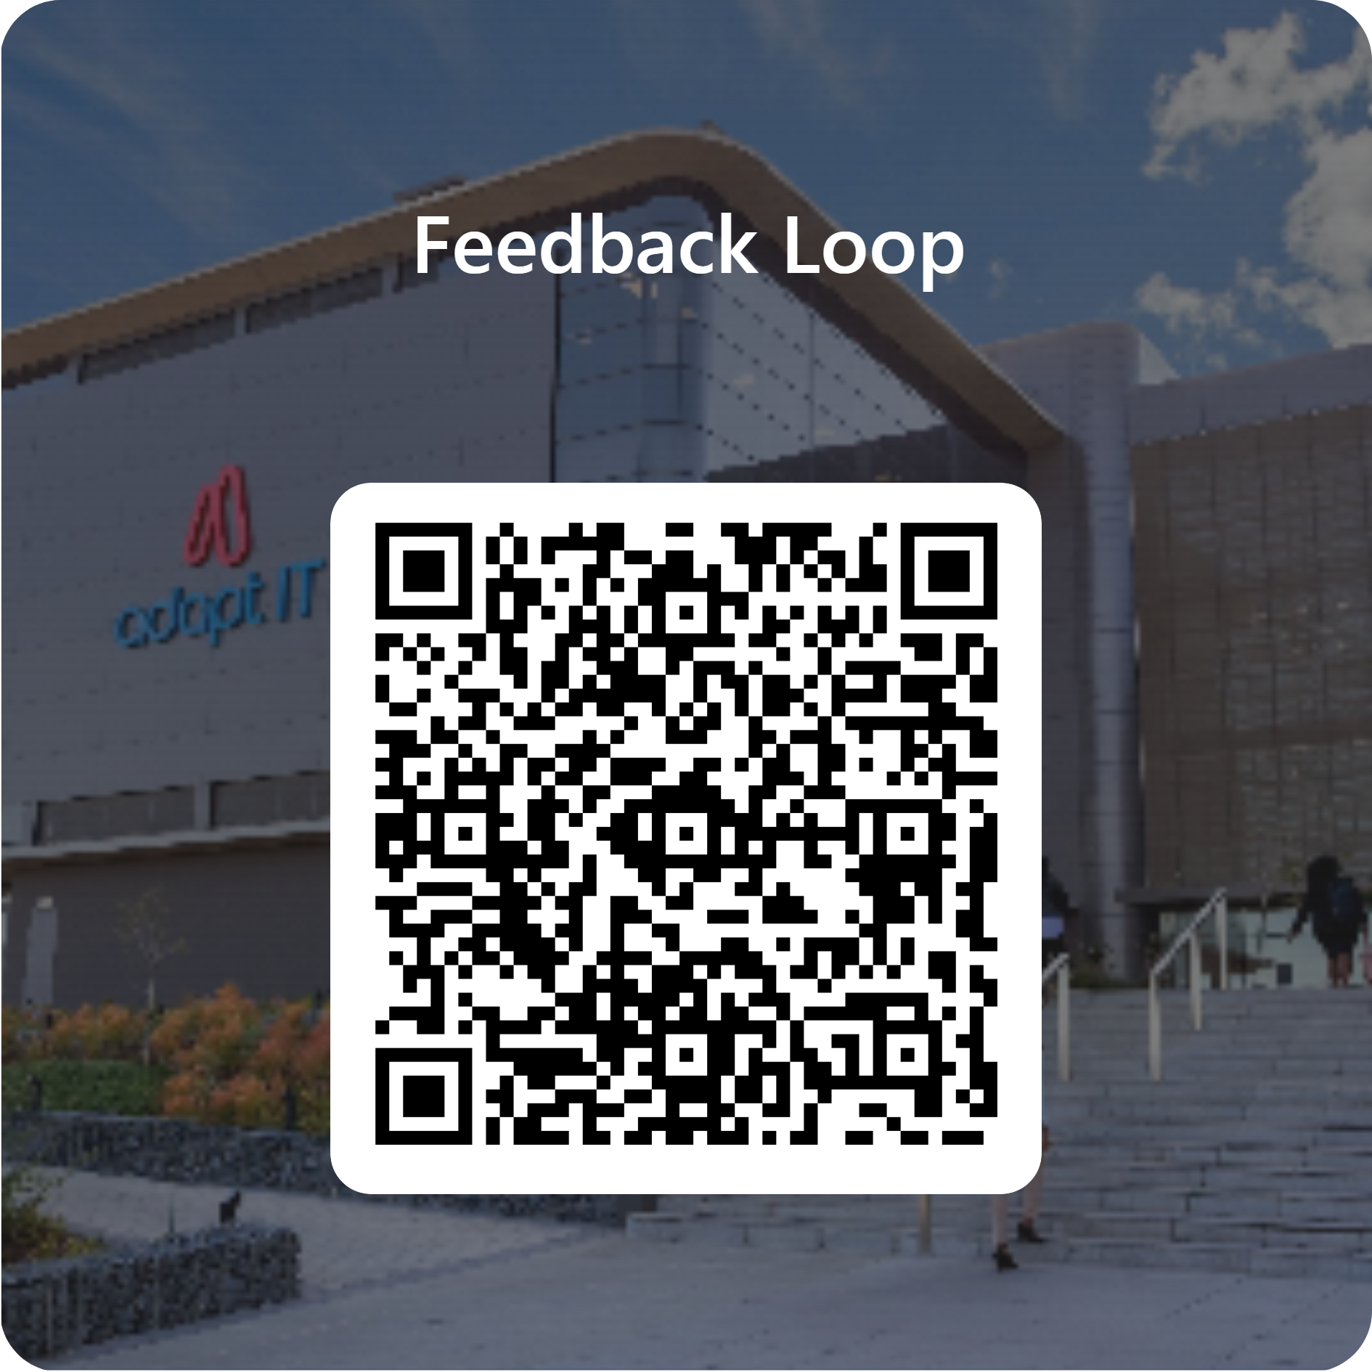
Feedback

