Slide 1
Unlocking the strategic Value of the HRIS in TVET’s
Presenter: Johana Chemana

Slide 2
DISCLAIMER
This presentation is only a summary of some of Adapt IT’s products, features and their latest developments. Adapt IT only intends for the information to give you an overview, and not a complete and comprehensive statement that necessarily suits your purposes.
Adapt IT reserves the right to change any information contained in this presentation and is not responsible for any loss that results from inaccuracies in the information. You may not distribute or reproduce the information without Adapt IT’s written permission.

Slide 3
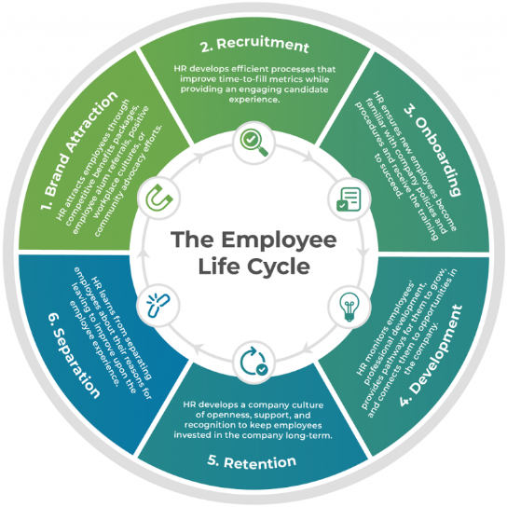
HRIS Ecosystem

Slide 4
What we’ll explore:
The strategic role of HR & Payroll in the TVET Colleges
Operation and Compliance Challenges in the sector
The Role of ITS Intergrator
How HR & Payroll unlocks Institutional value
Future Digital Transformation Opportunities

Slide 5

“Human resources are the most valuable asset of any institution, because without people there can be no progress.”
— Peter Drucker

Slide 6
The Role of the TVET Colleges
Skills development
Workforce preparation
Economic growth
Reducing Unemployment
Supporting national development priorities

Slide 7
From Administrative functions to Strategic Partner
Traditional HR | Strategic HR
Personnel Record Maintenance | Talent strategy
Processing Payroll | Workforce analytics
Handling process manually | Digital HR System
Notes:
HR was previously viewed as merely an administrative support role, but things are changing HR is now more of the strategic partner
Personnel Records Maintenance: Includes Leave Application forms, Recruitment processes, Staff Development
Processing Payroll: This role does not just end on paying salaries, the system enables admins to report to statutory such as SARS and DOL and you can use the data to draw strat that will inform the institution on compliance
Manual processes: Improve the pace of digitalising processes that currently handled manually can help free up HR staff and allow them to focus on strategic initiatives

Slide 8
The Employee Life Cycle in the TVET colleges
Attraction
Recruiting
Onboarding
Engagement
Development
Retention
Exit Advocacy
Notes:
1. Attraction
Attraction involves building the institution’s reputation and employer brand to attract qualified candidates to apply for job opportunities.
2. Recruiting
Recruiting is the process of identifying, evaluating, and selecting suitable candidates to fill vacant positions within the institution.
3. Onboarding
Onboarding is the structured process of integrating new employees into the institution by providing orientation, training, and access to systems and policies.
4. Engagement
Engagement refers to the level of employee motivation, commitment, and involvement in their work and the institution’s goals.
5. Development
Development focuses on improving employees’ skills, knowledge, and competencies through training, education, and career growth opportunities.
6. Retention
Retention involves strategies and policies designed to keep skilled and valuable employees within the institution for long-term organizational stability.
7. Exit Advocacy
Exit advocacy refers to managing employee departures professionally while maintaining positive relationships so former employees remain advocates of the institution.

Slide 9
Compliance Engine for Institution’s of Higher Learning
Statutory Compliance Automation: Automatically calculates and validates payroll obligations such as PAYE, UIF, SDL, and other regulatory deductions in line with legislation.
Common TVET’s limitations:
  Fragmented data across HR, payroll, and finance
  Manual, paper-heavy processes for HR/Payroll Administrators and employees
  Siloed systems between core HR, finance, learning management, and Employee relations
  Delayed reporting is hindering strategic workforce planning and budgeting
Risks: compliance penalties, reputational risk, misaligned compensation, and inefficient use of time that could support strategic initiatives

Slide 10
The importance of adopting a strategic approach
 | Key Institutions outcomes
 | Optimised headcount planning for Academic staff, administrative staff, and student assistants
 | Improved staff engagement and retention
 | Data-driven budgeting for programs and student services
 | Real-time visibility into labour costs, benefits utilisation, and compliance
 | Strategic questions to ask
 | Do payroll and HR data inform enrollment management, salary budgeting, and workforce planning?
 | Can workflows be automated to free time for academic staff and admin?
 | Do we have real-time data for labour costs per department, program, and do we know the funding source?

Slide 11
The values of the ITS Integrator to your Institution
  End-to-End eRecruitment with Integration to import data to the personnel system, i.e. Bio, Qualifications, Work Permits, document storage, etc.
Seamless integrations with ERP, finance, payroll, Leave, global benefits, administration, and enhanced Staff development
Automations across tax calculation, Appointments and Resignation, Increase Letters etc.
Self-service portals for employees, managers, and administrators
Automated workflows from Leave, Claims, Job Descriptions, and Employee Relations and many other functions
Unified HR & Payroll tailored to Academic Staff, Admins, and Student Assistance

Slide 12

Focus Area 1: Increase efficiency in the tertiary institution's context
Payroll runs for different employee categories
Streamlined workflows for onboarding and offboarding of different workstreams
Data accuracy and reporting
Centralised data – One true source of data
Reduced time spent on employee error corrections
Build in validations to track duplicate employees, banking details
Fast payroll run with the facility to view the impact of the appointment, promotions and resignations on finance
Automated posting to General Ledger

Slide 13
Focus Area 2: Employee experience and satisfaction
Employee Self-Service
Outcomes
View and Update Biographical, qualifications, information, etc
Streamlined workflows on the iEnabler
Access to Personal Confidential Information, Payslips, Tax Certificates and Letters
Enable access to JD
Track workflow process statuses
Boost morale among staff and improve engagement
Improved retention of critical staff
Better experience for HR and Payroll administrators
Efficient and allows staff to focus more on strategic initiatives

Slide 14
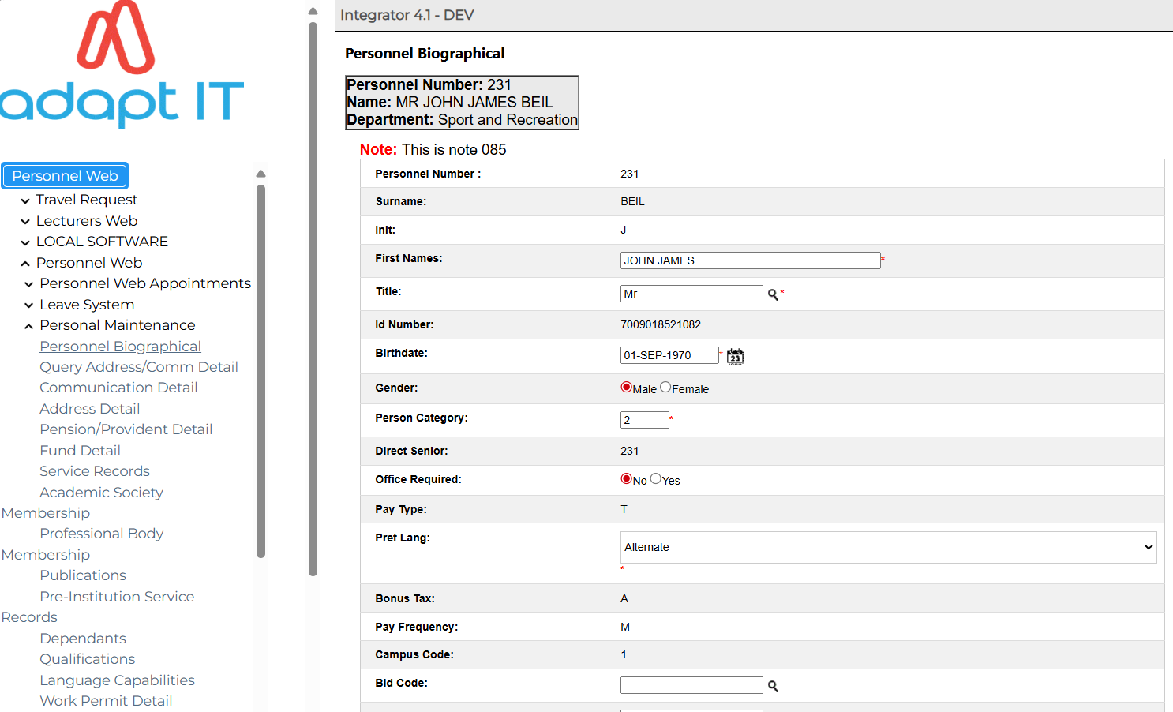
Personal Maintenance

Slide 15
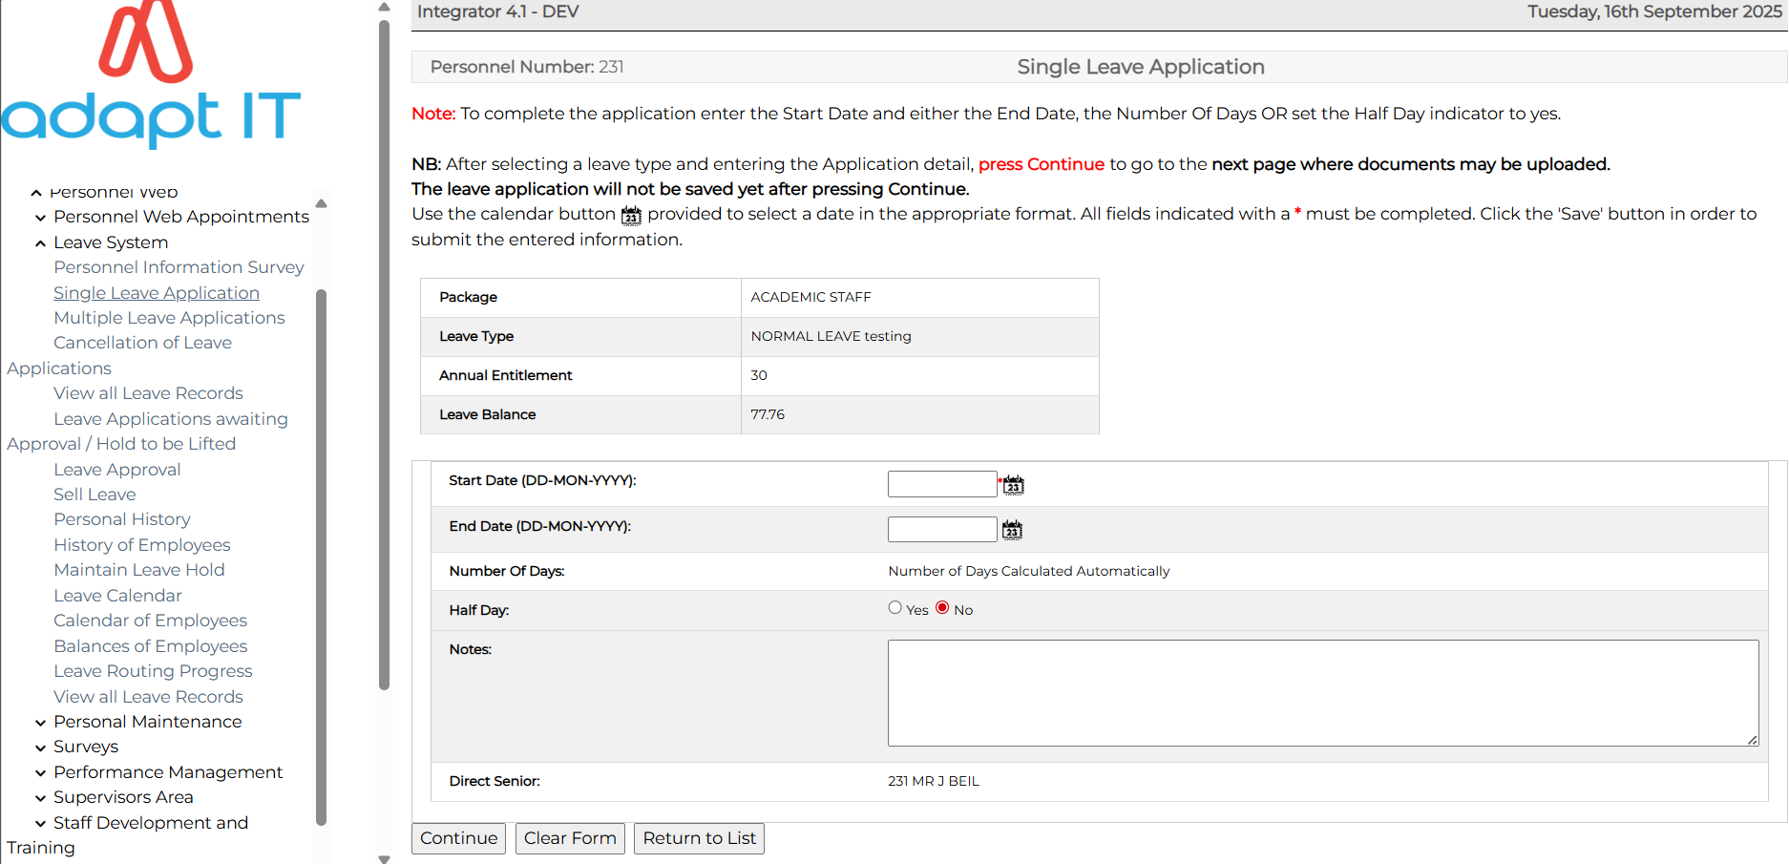
iEnabler Leave

Slide 16
Focus Area 3: Informed data-driven decision making
Capabilities:
Headcounts, compensation, and labour cost forecasting for operational costs
Workforce organisational readiness
Operational alignment, recruiting, onboarding, and PMS
Measurements and Key Performance Areas
Leverage analytical capabilities through Jaspersoft
Outcome:
Compensation planning efficiency
Enhanced recruiting effectiveness
Better workforce planning
Monitoring representation for diversity, equity and inclusion
Notes:
Data literacy: HR professionals and payroll staff capable of interpreting analytics outputs.
Change management: Stakeholder buy-in, training, and clear governance for analytics initiatives.
Culture of experimentation: Willingness to test hypotheses with controlled experiments (A/B tests, pilots)

Slide 17
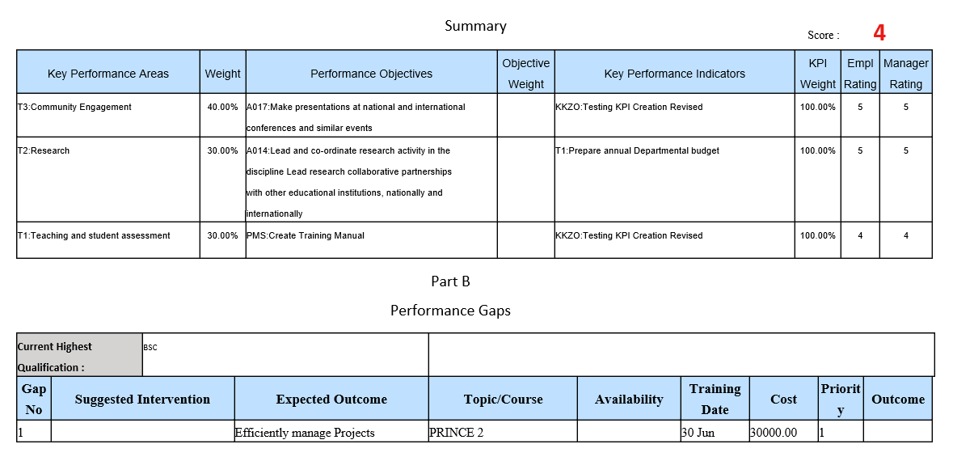
Performance Review Report

Slide 18
Focus Area 4: Better Leadership Decisions for the College
Integrated data model:
Connected payroll, benefits, performance, and administration data
Leaders gain:
Clear visibility into total compensation and workload distribution
Evidence-based budgeting and staffing for programs
Alignment of HR initiatives with academics and strategic goals
Outcomes:
Efficient and more informed decisions across departments and admin units with
competitive talent strategy and staff acquisition

Slide 19
Benefits of ITS Integrator in TVET’s
Compliance and Confidence
Timeous updates to tax rules, benefits, privacy and tailored institution payroll policies
Unified data model
single source of truth across HR, Payroll, Finance
Smart analytics
Proforma payslips and what-if scenarios
Flexible Automation and workflows
Applications and approval streamlined processes from recruiting to offboarding, including compensation workflows
Security and Governance
Role-based access, audit trails, and well-defined menu-driven functions

Slide 20
Challenges and mitigations for TVET’s
Complex Payroll for different funding sources
Data quality across departments and multiple systems
Leverage the salary budget module to allocate funds to the correctly defined funding bodies
Data cleansing sprints, analyse the cost of using a duplicate system and the efficiency of maintaining a single source of data
Change Management
Regulatory and Privacy concerns
Identify campus champions and roll out tailored role-based training
Strong access controls, role-based access and audit trail

Slide 21
Best Practices for TVET’s success
Provide Comprehensive Users Training:
- Offer thorough ITS training to all users to ensure they are proficient in using the system for various tasks, maximising its utilisation and enabling employees to manage their own information.
Implement Regular Data Audits:
- Conduct routine data clean-ups and audits to ensure the accuracy and integrity of employee records, performance evaluations, and payroll information, preventing errors and improving decision-making.
Automate Processes:
- Leverage the system's automation capabilities for repetitive tasks like scheduling, streamlining claim processes, and onboarding/offboarding to reduce administrative burden and enhance efficiency.

