Slide 1

Leveraging Build-In Moodle Learning Analytics to Improve Student Success: Agentic AI Student Tracking & Early Alerts
Presenter: Lebato Tswaledi

Slide 2

DISCLAIMER
This presentation is only a summary of some of Adapt IT’s products, features and their latest developments. Adapt IT only intends for the information to give you an overview, and not a complete and comprehensive statement that necessarily suits your purposes.
Adapt IT reserves the right to change any information contained in this presentation and is not responsible for any loss that results from inaccuracies in the information. You may not distribute or reproduce the information without Adapt IT’s written permission.

Slide 3
TABLE OF CONTENT
How can we Improve Student success? Bigger Picture
Where we want to be? A Compressive Student Tracking framework
A look into the Built-in Moodle Learning Analytics Models
Their Benefits
Introducing: Agentic AI Driven Early Alerts
Early Alerts features
Integrated Framework
A look into the features in full context
Where are we now?

Slide 4
How can we Improve Student success? A Bigger Picture
Academic progress
Financial status
Socio-economical factors
Lifestyle
Health
Student Tracking Data points

Slide 5
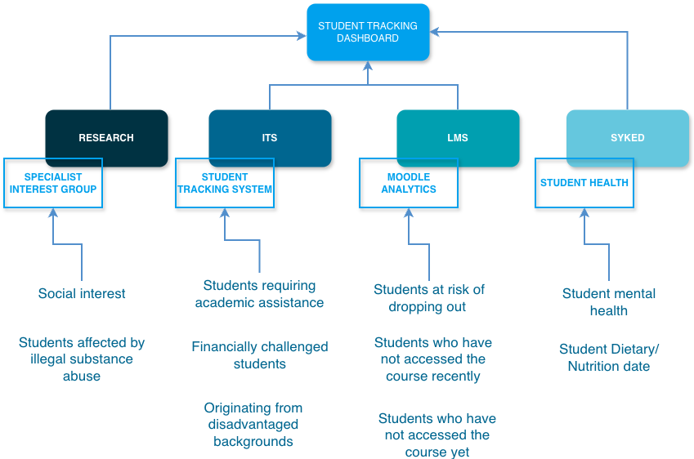
Where we want to be? A Compressive Student Tracking framework

Slide 6
Built-in Moodle Learning Analytics Models
Analytics framework that detects students learning patterns on the LMS then suggest interventions for Lecturers
Students at Risk of Dropping out
Students who have not accessed the course recently
Students who have not accessed the course yet
Indicators
Course Access: Start date & End date
Course Participation: Activities and Forums
Assessments Results: Quiz & Assignment
Time since last access
Any access since the beginning of the course
Any course access
Notes:
Students at Risk of Dropping Out
Indicators:
Course access: start date and end date
Course participation: Activity access, forum posts
Assessments results: quiz marks assignment marks
Students who have not accessed the course recently or yet
Indicators:
Time since last access
Access since beginning of the course

Slide 7
Benefits
Identifies at-risk students early
timely interventions
Data-Driven Decision Making
Improved Student Retention

Slide 8
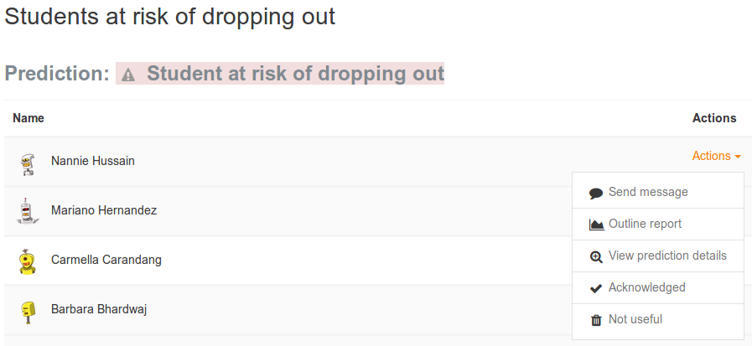
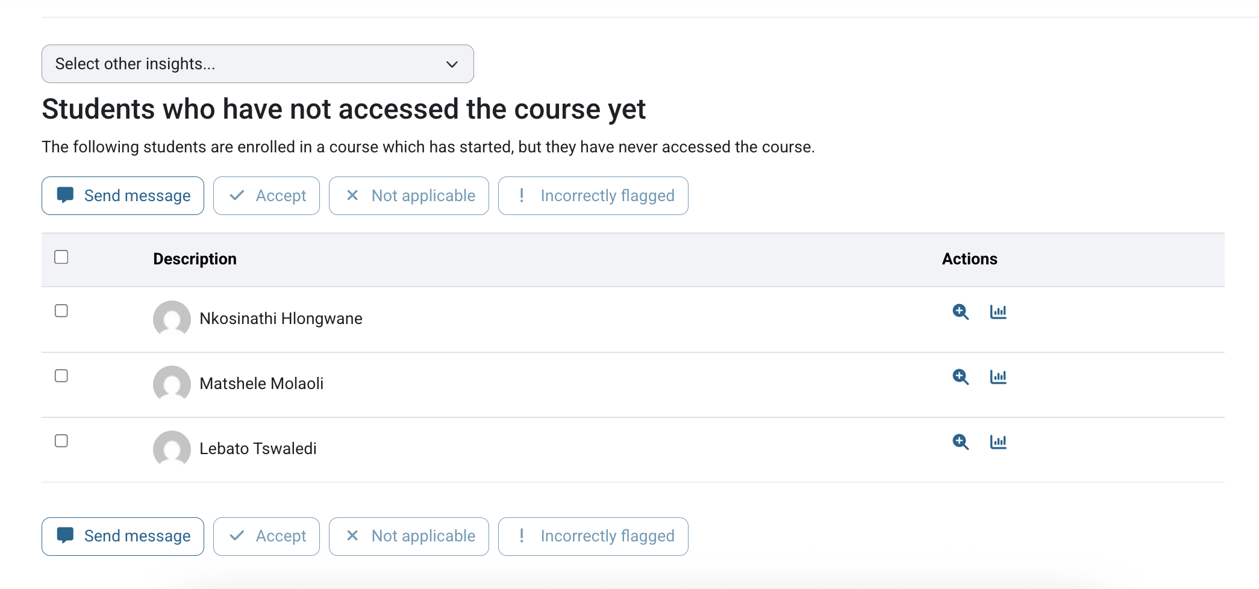
Learning Analytics Models in context
Predictions & Insights as is in the LMS

Slide 9
Introducing: Agentic AI Driven Early Alerts

Slide 10
Features: Leverage Built-in Models to improve Insights
Integrate agentic AI
Interactive dashboard
Track interventions impact
Student’s personalised dashboard
Student study assistant bot
Real-time suggested interventions

Slide 11
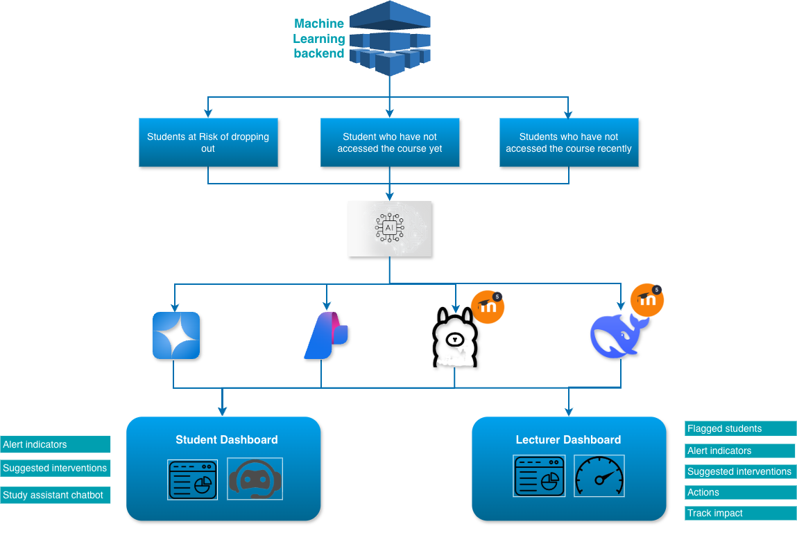
Integrated Framework
Built-in Models
Enhanced Early Alerts
Open AI
Azure AI
Ollama
DeepSeek

Slide 12
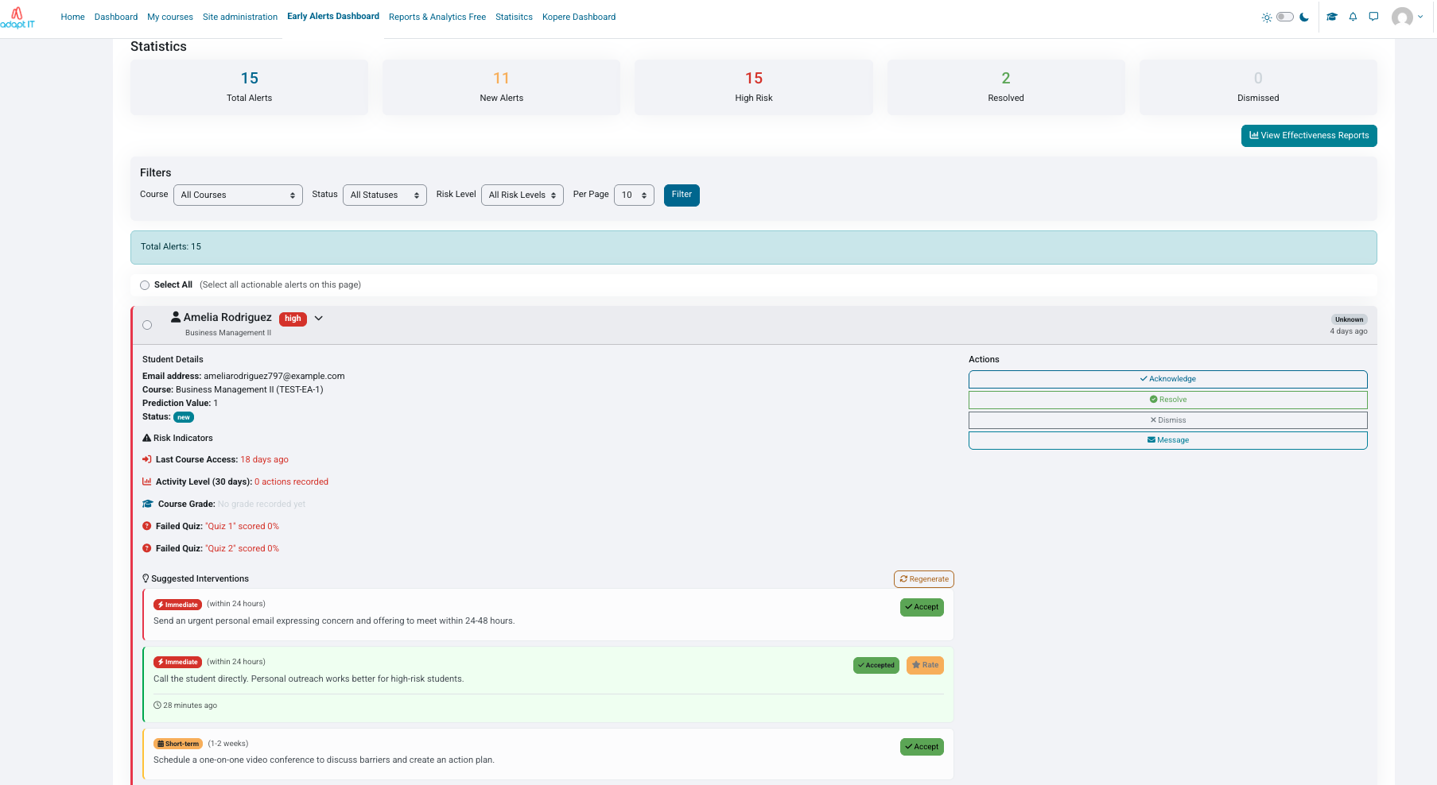
Lecturer’s Dashboard
High-level statistics
High-level statistics
Interactive filters
Bulk selection & Actions
Risk Indicators
Real-time Interventions

Slide 13
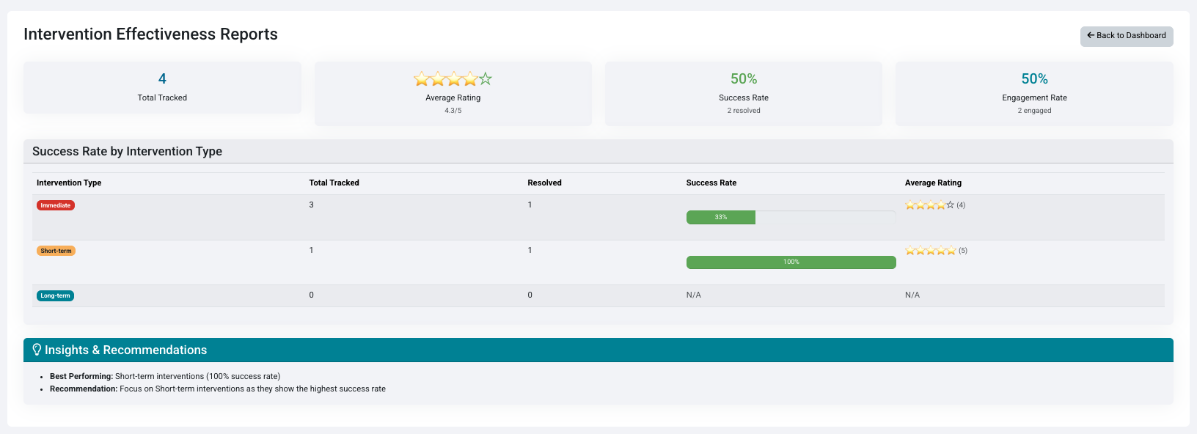
Interventions impact Dashboard

Slide 14
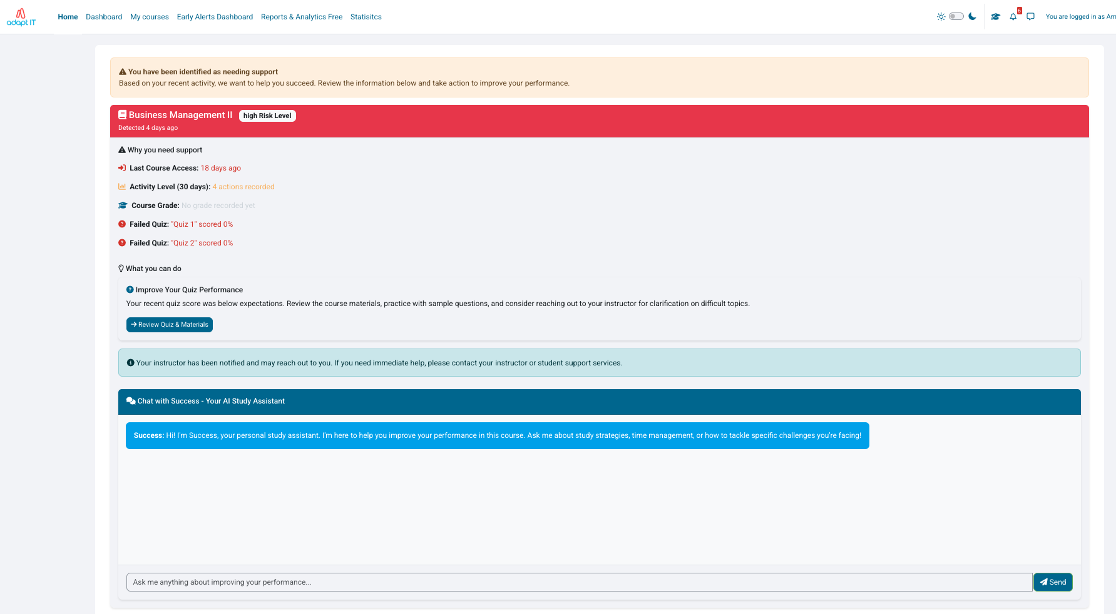
Student Dashboard

Slide 15




Where are we now?
Agentic AI Committee forums
Multiple tracking agents across systems
Present POC’s
Gather client input
Consolidate and Analyse
Plan
Development
Implementation
We are here!

Slide 16
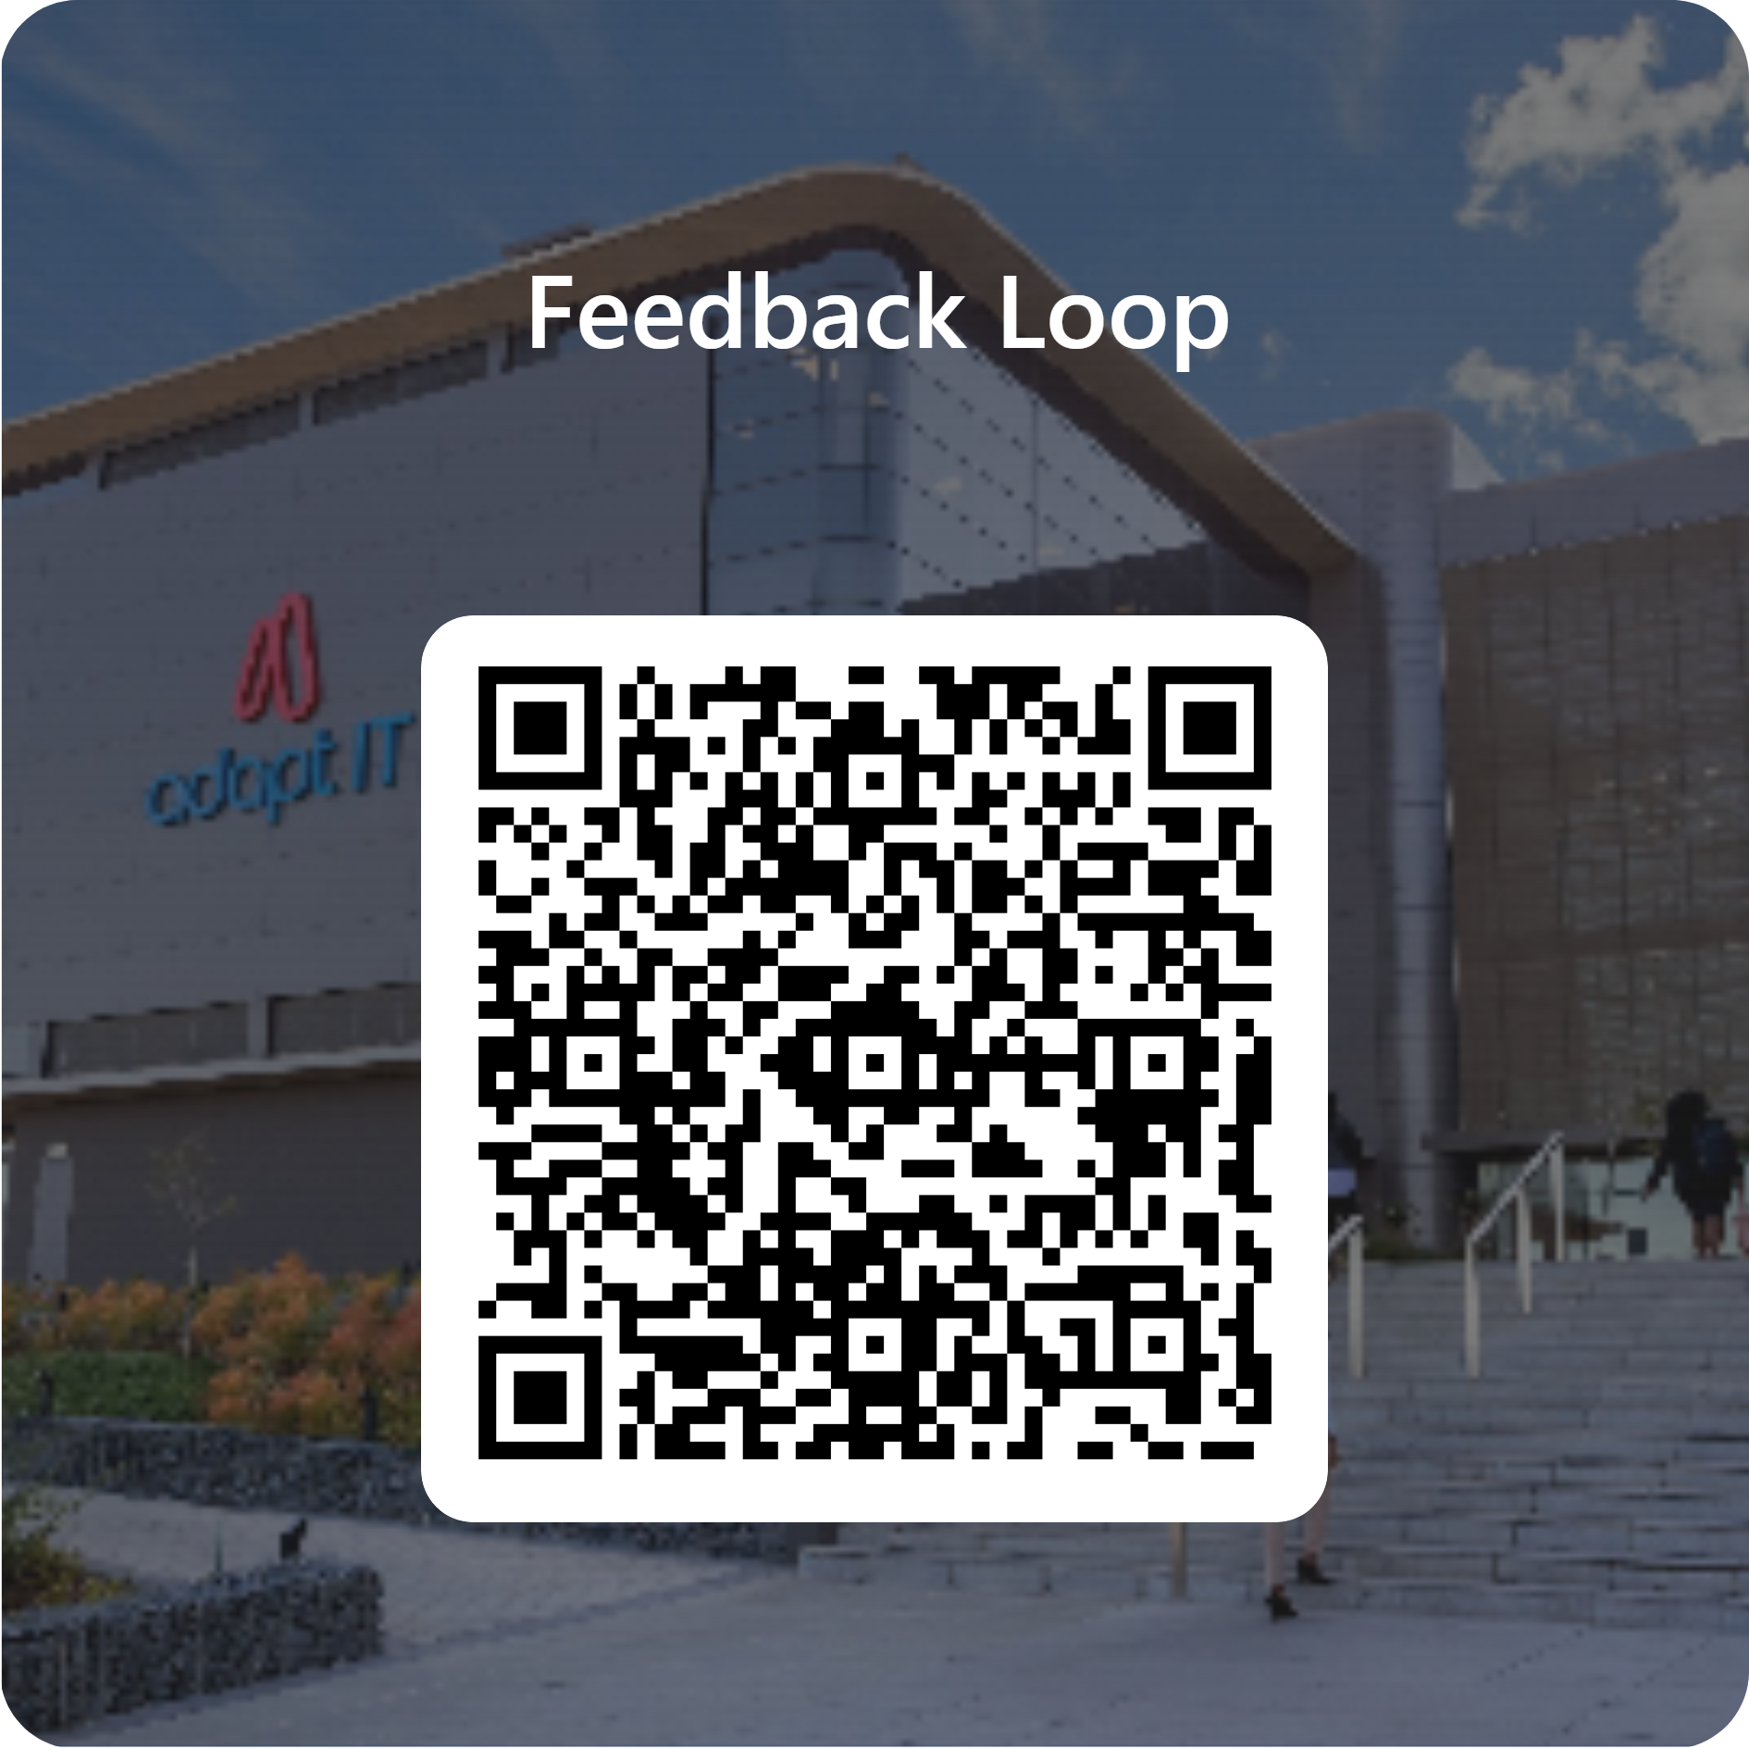
Feedback

